Slide 1

The EcoSystem Indicator Partnership shifts from ESIP 1.0 to ESIP 2.0
April 17, 2015
Notes:
Rest of session: Estuarine Water Quality and Anthropogenic Nitrogen
Much of ESIP’s work is based on using indicators to look at pressures and responses of estuarine waters.

Slide 2









Author list:
Christine M. Tilburg (GOMC)
James S. Latimer (EPA)
Robin Anderson (Fisheries and Oceans Canada)
Adria Elskus (USGS/U Maine)
Jeff Hyland (NOAA)
David Page (Bowdoin)
Marilyn ten Brink (EPA)
Paul Stacey (New Hampshire Fish and Game)
Shannon Sterling (Dalhousie University)
Notes:
Who are all these people? To understand that we have to do a quick cliff notes version of ESIP

Slide 3
What/Who is ESIP?
We should try to figure out how the Gulf of Maine/Bay of Fundy is doing.
ESIP
GOMC

Slide 4
What/Who is ESIP?
We should set up a Steering Committee to figure this out.
ESIP Steering Committee
ESIP

Slide 5
Who is ESIP – Steering Committee
Jawed Hameedi (NOAA)
Jim Latimer (EPA)
Abe Miller-Rushing (DOI)
Heather Breeze (DFO)
Matt Liebman (EPA)
Kathryn Parlee (Environment Canada)
Marilyn ten Brink (EPA)
Peter Wells (Dalhousie)
Adria Elskus (USGS/U Maine)
ESIP Steering Committee

Slide 6
ESIP Community
Climate Change
Directional Committee
Aquatic Habitats
Coastal Development
Eutrophication
ESIP Steering Committee
Contaminants
Aquaculture
Fisheries

Slide 7

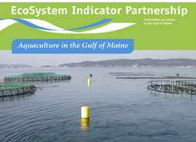
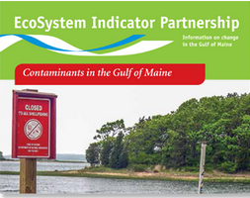
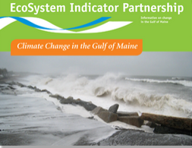

Products from Subcommittees
Aquaculture
Aquatic Habitats
Contaminants
Climate Change
Eutrophication

Slide 8
Products from Subcommittees
Eutrophication
Notes:
Much of the session is about water quality and eutrophication. Point out that we have a fact sheet on this and are also working on two projects to increase our understanding (one is the EPA-ORD project and one is the Gulf of Maine Initiative with ECW).
Mention that we’re starting to use watershed portraits to describe how the indicators and Indicator Reporting Tool can be used to develop a better understanding of things.

Slide 9
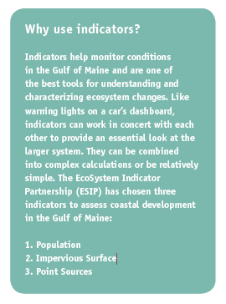
Coastal Development

Slide 10
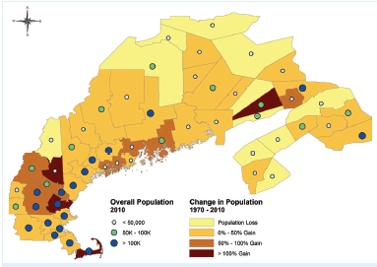
Coastal Development
Indicator 1: Population density
Notes:
Population change for each county from 1970 to 2010 is represented by county color gradient (browns to yellows). Overall population in each county is 2010 is prepresented by blue markers. US information from www.census.gov and Canadian from www.statcan.gc.ca.

Slide 11
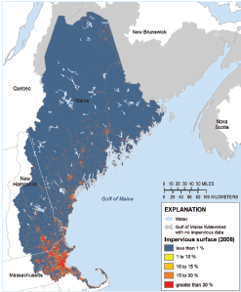
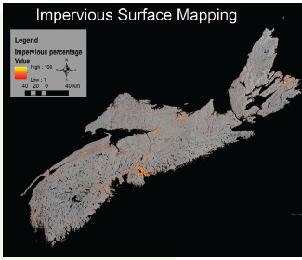
Coastal
Development
Indicator 2: Impervious Surface
Gap addressed: Canadian impervious surface
Notes:
Figure 2: While most of the landmass draining into the GOM has less than 1% imperviousness, many urban areas not only exceed 10% imperviousness but have imperviousness greater than 30%.

Slide 12
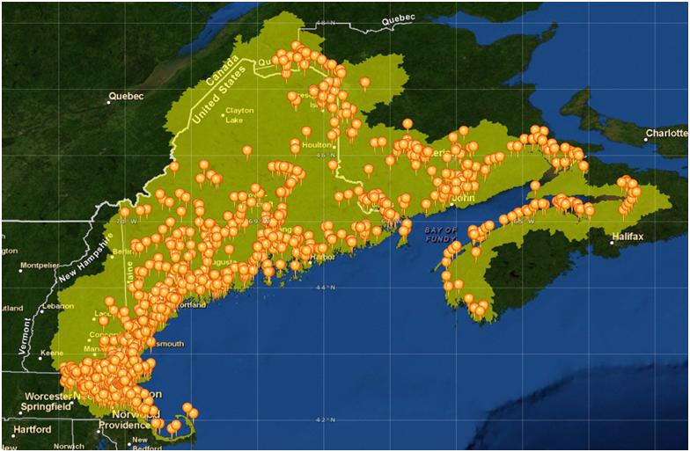
Coastal Development
Indicator 3: Point sources
Notes:
NPRI from Canada + NPDES for US.

Slide 13

ESIP 2.0
So, we’re done, right?
Directional Committee
Notes:
What are we missing from ESIP 1.0 that the service type indicators will help broaden our understanding of.

Slide 14
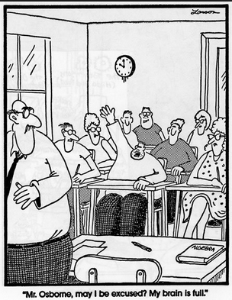
Directional Committee
Robin Anderson (DFO)
John Brazner (Nova Scotia)
David Page (Bowdoin)
Hilary Neckles (USGS)
Jawed Hameedi (NOAA)
Jeff Hyland (NOAA)
Jim Latimer (EPA)
Shannon Sterling (Dalhousie)
Paul Stacey (Great Bay NERR)

Slide 15
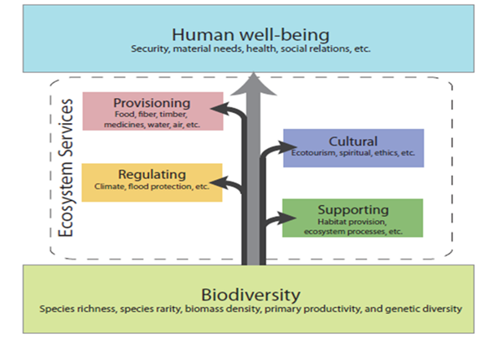
ESIP
2.0

Slide 16
ESIP
2.0

Slide 17
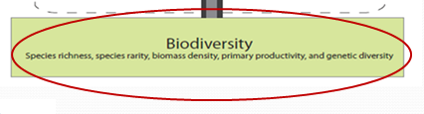
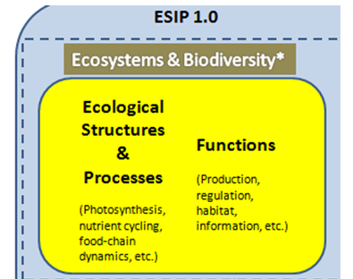
ESIP
1.0
Notes:
Expanded

Slide 18
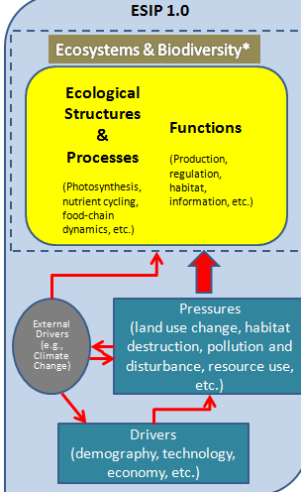
ESIP
1.0
Notes:
Expanded

Slide 19
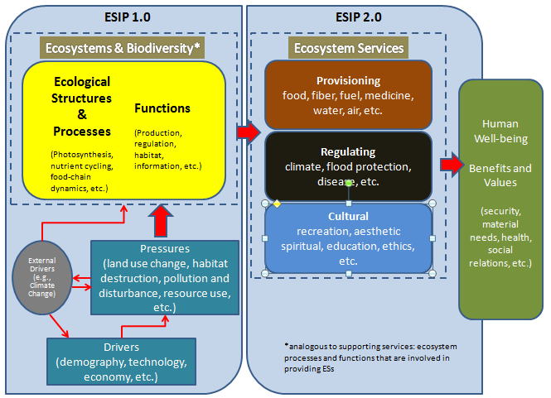
ESIP
1.0 + 2.0
Notes:
Reference: modified from Hattam, C., et al. (2015), Böhnke-Henrichs, et al.(2013) and Kumar, P., Ed. (2010).

Slide 20
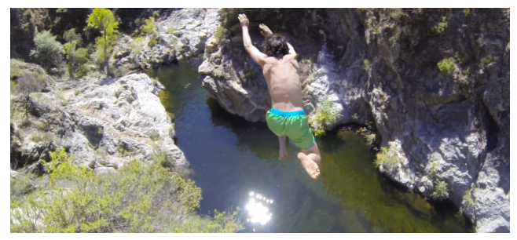
How are we getting this info to people?
ESIP 2.0 commences
Webtools available and improved
Smart phone app

Slide 21
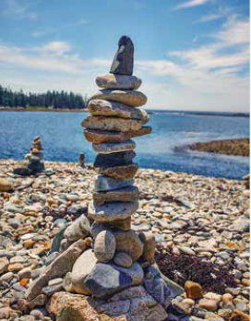
Questions?
Christine: ctilburg@securespeed.us
Fact sheets and folders available
www.gulfofmaine.org/esip

