Slide 1




Climate Change Adaptation for Atlantic Canada
An initiative of the
Atlantic Provinces
Notes:
I would like to talk to you today about the Climate Change Adaptation Strategy for Atlantic Canada and the Atlantic Regional Adaptation Collaborative on behalf of the Atlantic Provinces.
Adapting to Climate Change is very important in Atlantic Canada as we have some of the most vulnerable communities in Canada due to the fact that many of our communities are located along waterways, and the ocean. For example, 60% of New Brunswick’s population lives within 50 km of the coast.
The Atlantic Canadian Provinces share many common interest when it comes to adapting to climate change and because of those interest the Council of Atlantic Environment Ministers worked together to create an Atlantic Strategy for address climate change and to prepare an Atlantic Regional Adaptation Collaborative proposal submission to Natural Resources Canada.
IPCC has indicated that global GHG emissions have increased by 70% between 1970 and 2004
Canada’s GHG emissions in 2006 were 718 megatonnes (3% of the global emissions)
Atlantic Canada’s GHG emission in 2007 were 51.9 megatonnes (8% of Canada’s emissions)
New Brunswick’s GHG emission in 2007 were 18.7 megatonnes (3% of Canada’s emissions)
What this shows is that even thought Atlantic Canada and New Brunswick’s GHG emissions were low and we are small contributor to the Canada and the worlds emission, Atlantic Canada is greatly impacted by the changing climate.

Slide 2
Climate Change Adaptation
Background
An issue of National and Regional Concern:
In 2004-2005 the Canadian Council of Ministers of Environment identified climate change as a national issue
The Council of Federation (COF) also indentified the issue of climate change during their meetings between 2006 and 2008.
At the Council of Atlantic Environment Ministers Meeting in January 2008, the Ministers agreed to develop an Adaptation Strategy for Atlantic Canada and to host an Atlantic wide workshop on adaptation.
In May 2008, the Province of New Brunswick and Natural Resources Canada co-hosted an Atlantic Canadian Adaptation workshop in Saint John, New Brunswick.
Notes:
In 2004-2005 the Canadian Council of Ministers of Environment identified that climate change was a national issue.
In 2006, 2007 and 2008 at the Council of the Federation (COF) meetings the Premiers discussed climate change and agreed more work was needed on the issue. For example, climate change was a major point of discussion at the 2007 COF summer meeting in Moncton. For example, the Premiers adopted a document called “Climate Change: Leading Practices b Provincial and Territorial Governments in Canada” which highlighted need for action on adaptation at the provincial level such as vulnerability assessments.
The Council of Atlantic Environment Ministers has identified climate change, and especially climate change adaptation, as a key environmental issue for Atlantic Canada.
In January 2008, the Council of Atlantic Environment Ministers agreed to develop an Adaptation Strategy for Atlantic Canada and to host an Atlantic wide workshop on adaptation to assist in the development of the strategy.

Slide 3
Climate Change Adaptation
Background
In April 08, Natural Resources Canada (NRCan) announced the national Regional Adaptation Collaborative Program to address adaptation.
The results of the May 2008 workshop formed the basis of the Climate Change Adaptation Strategy for Atlantic Canada
In June 2008 the Council of Atlantic Environment Ministers adopted the Climate Change Adaptation Strategy for Atlantic Canada
A component of the Adaptation Strategy was to submit a single Atlantic Regional Adaptation Collaborative proposal to Natural Resources Canada in response to the federal funding program.
Notes:
In April 2008 Natural Resources Canada announced a National funding program on Regional Adaptation Collaboratives
The Climate Change Adaptation workshop in Saint John, NB included speakers, and representatives from across Atlantic Canada, nationally and internationally. The participants included representatives from the four Atlantic Departments of Environment, several other provincial departments, academia, non-profits, for profits, planners, engineers and municipal representatives. The discussions and outcomes formed the basis for an Atlantic wide initiative.
In June 2008 the Council of Atlantic Environment Ministers adopted a Climate Change Adaptation Strategy for Atlantic Canada which included a component to agree to submit a single Atlantic Regional Adaptation Collaborative proposal to Natural Resources Canada.

Slide 4
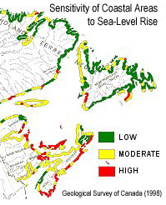
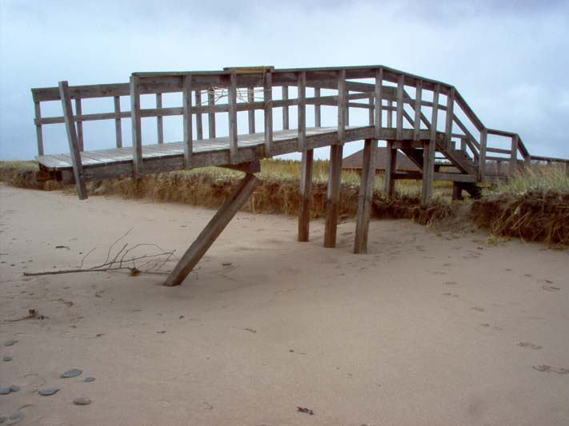
Climate Change Adaptation
Background
Key Climate Change Adaptation Issues for Atlantic Canada include:
Sea-level rise
Coastal flooding
Coastal erosion
Inland flooding
Salt water intrusion
Negative impacts upon infrastructure
Val Comeau, NB
(2007)
Notes:
In the global and national picture, Atlantic Canada is considered a small emitter of GHG’s however, Atlantic Canada is severely impact by the results of a changing climate. For example, New Brunswick produces just 3% of Canada’s greenhouse gas emissions, while Canada produces 2% of global emissions meaning that we are a very minor emitter. However, New Brunswick is severely impacted. Extreme weather events have become 5 x more common. Our relative sea-level has risen and is expected to rise an additional 1-2 metres by 2100.
Quick Facts
Coastal
Major coastal storm surge events in NB, NS and PEI in January 2000, October 2000
IPCC has indicated that coastal erosion globally has risen .17m (17 cm) in the 20th century. It is expected to increase in the future. The predicted range for NB is between 30 cm to 1 metre by 2100 (this number includes subsidence, thermal expansion of the ocean and melting of the glaciers).
Between 1991 and 2008 there have been 26 Atlantic tropical cyclones making landfall in Atlantic Canada
Inland Water
Inland water flooding events: (NB – Spring 2005, Fall 2005, Spring 2008)
Hurricane Juan impacted Atlantic Canada in 2003
White Juan (snow storm February 2004)
Low water advisory in parts of NB in 2007 (drought conditions)
The Federal and Provincial Governments have identified that Atlantic Canada has several common climate change issues, most of the issues in Atlantic Canada are related to water, such as: sea-level rise, coastal flooding, coastal erosion, salt water intrusion aquifers, flooding along inland water courses and impacts on our infrastructure.
Atlantic Canada is already seeing the sever impacts from a changing climate. These trends are expected to increase well into the future.

Slide 5
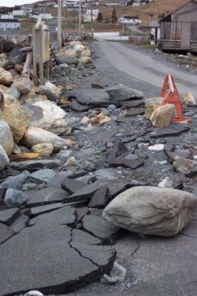
The Climate Change Adaptation Strategy for Atlantic Canada
Purpose
Framework for comprehensive, integrated and long-term planning for climate adaptation in the Atlantic region
Goals
Enhance resilience and adaptive capacity.
Integrate climate change adaptation measures.
Promote meaningful regional collaboration, co-ordination and sharing of good practices.
Ferry Land, NL
Notes:
The Climate Change Adaptation Strategy for Atlantic Canada created by the four Atlantic Provinces is an agreement to work together to address the common climate change issues.
Purpose
The Climate Change Adaptation Strategy for Atlantic Canada provides the framework for comprehensive, integrated and long-term planning for climate change adaptation in the Atlantic region.
Supports and integrates sustainable development principles of securing social, environmental and economic health.
Goals
To enhance the resilience (our ability to recover from impacts) and adaptive capacity of Atlantic Canada to climate change;
To integrate adaptation measures into existing and new development activities (ex. Avoidance); and
To promote meaningful regional collaboration, co-ordination and sharing of good practices on adaptation.

Slide 6
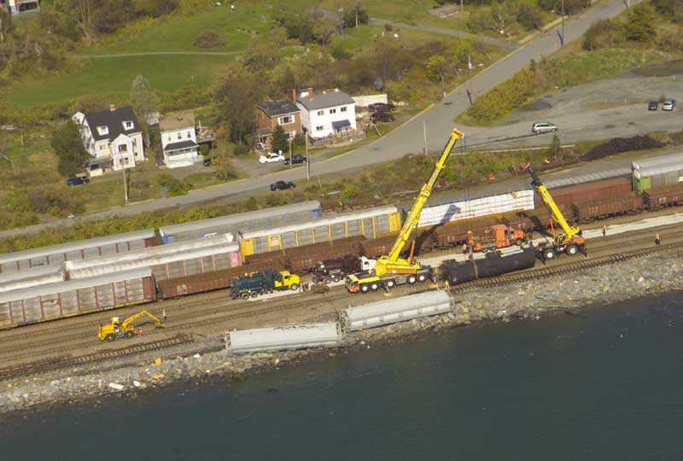
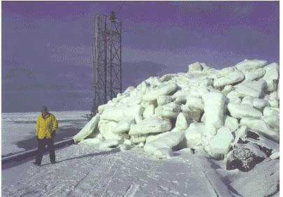
The Climate Change Adaptation Strategy for Atlantic Canada
3 Key Result Areas
Identifying Climate Risks in Atlantic Canada
Climate Proofing Decisions.
Regional Collaboration on areas of common issues and interest.
Priority Sectors
Focus on coastal areas, inland waters and related infrastructure.
Water common element - linkages to other sectors.
Halifax, NS
(2003)
Aboiteau, NB
(2000)
Notes:
Three key result areas were identified under the Adaptation Strategy.
Key Result Area 1 – Identifying Climate Risks (and vulnerabilities): We need to identify the present and future risks and information gaps regarding those risks.
Key Result Area 2 – Climate Proofing Decisions
Key Result Area 3 - Regional Collaboration
The RAC proposal is part of the larger Climate Change Adaptation Strategy for Atlantic Canada.
Coastal areas, inland waters and related infrastructure were chosen as the three priority areas for Atlantic Canada, because those are the areas most impacted in Atlantic Canada as well they are the most threatened. The majority of Atlantic Canada’s population lives in community located either along the coast or along a river or watercourse. The population of Atlantic Canada depend upon the infrastructure located within these communities such as wharves, roads, raillines, etc.
The RAC proposal provides us with the funds from NRCan to begin to launch our Climate Change Strategy for Atlantic Canada particularly with respect to the engagement of communities and professional organizations to understand and deliver adaptation solutions.

Slide 7
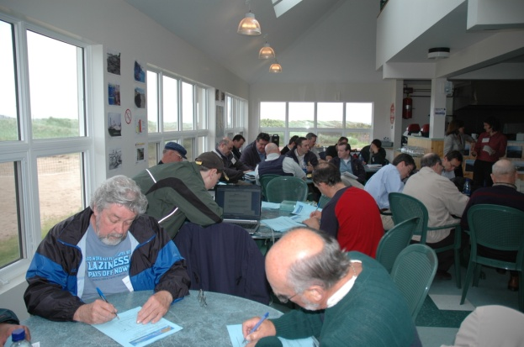
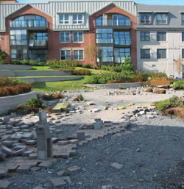
Regional Adaptation Collaborative Program
Elements of the Federal Regional Adaptation Collaborative Program:
Natural Resources Canada - Regional Adaptation Collaborative (RAC) Funding Program
Program to encourage focused collaboration amongst regional decision-makers (government and non-government).
Objective of facilitating the integration of climate change considerations into decision-making.
Overall program funding is $33 million between 2009 and 2013.
A total of 6 RACs will be funded across Canada
A total of $3.3 million of Federal funding per RAC
Cap-Pele, NB
(2007)
Charlottetown, PE
(2000)
Notes:
RAC What is it?
A federal program focused on collaboration amongst regional decision-makers (government and non-government) with the objective of facilitating the integration of climate change considerations into decision-making.
Important Parameters
six “Regional Adaptation Collaboratives” (RACs) will be created across Canada.
Funding from this program can be used to pay for activities (eg. stakeholder consultations, risk assessments, tailoring of tools, applied research) to support adaptation decisions, however, funding can not be used to implement adaptation decisions (eg. funding can not be used for physical works, such as to strengthen a bridge, move a road etc).
$3.3 million funding from NRCan for each RAC.
Atlantic Canada will provide 50% matching funding in cash and in-kind.

Slide 8
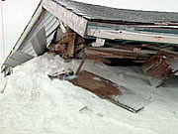
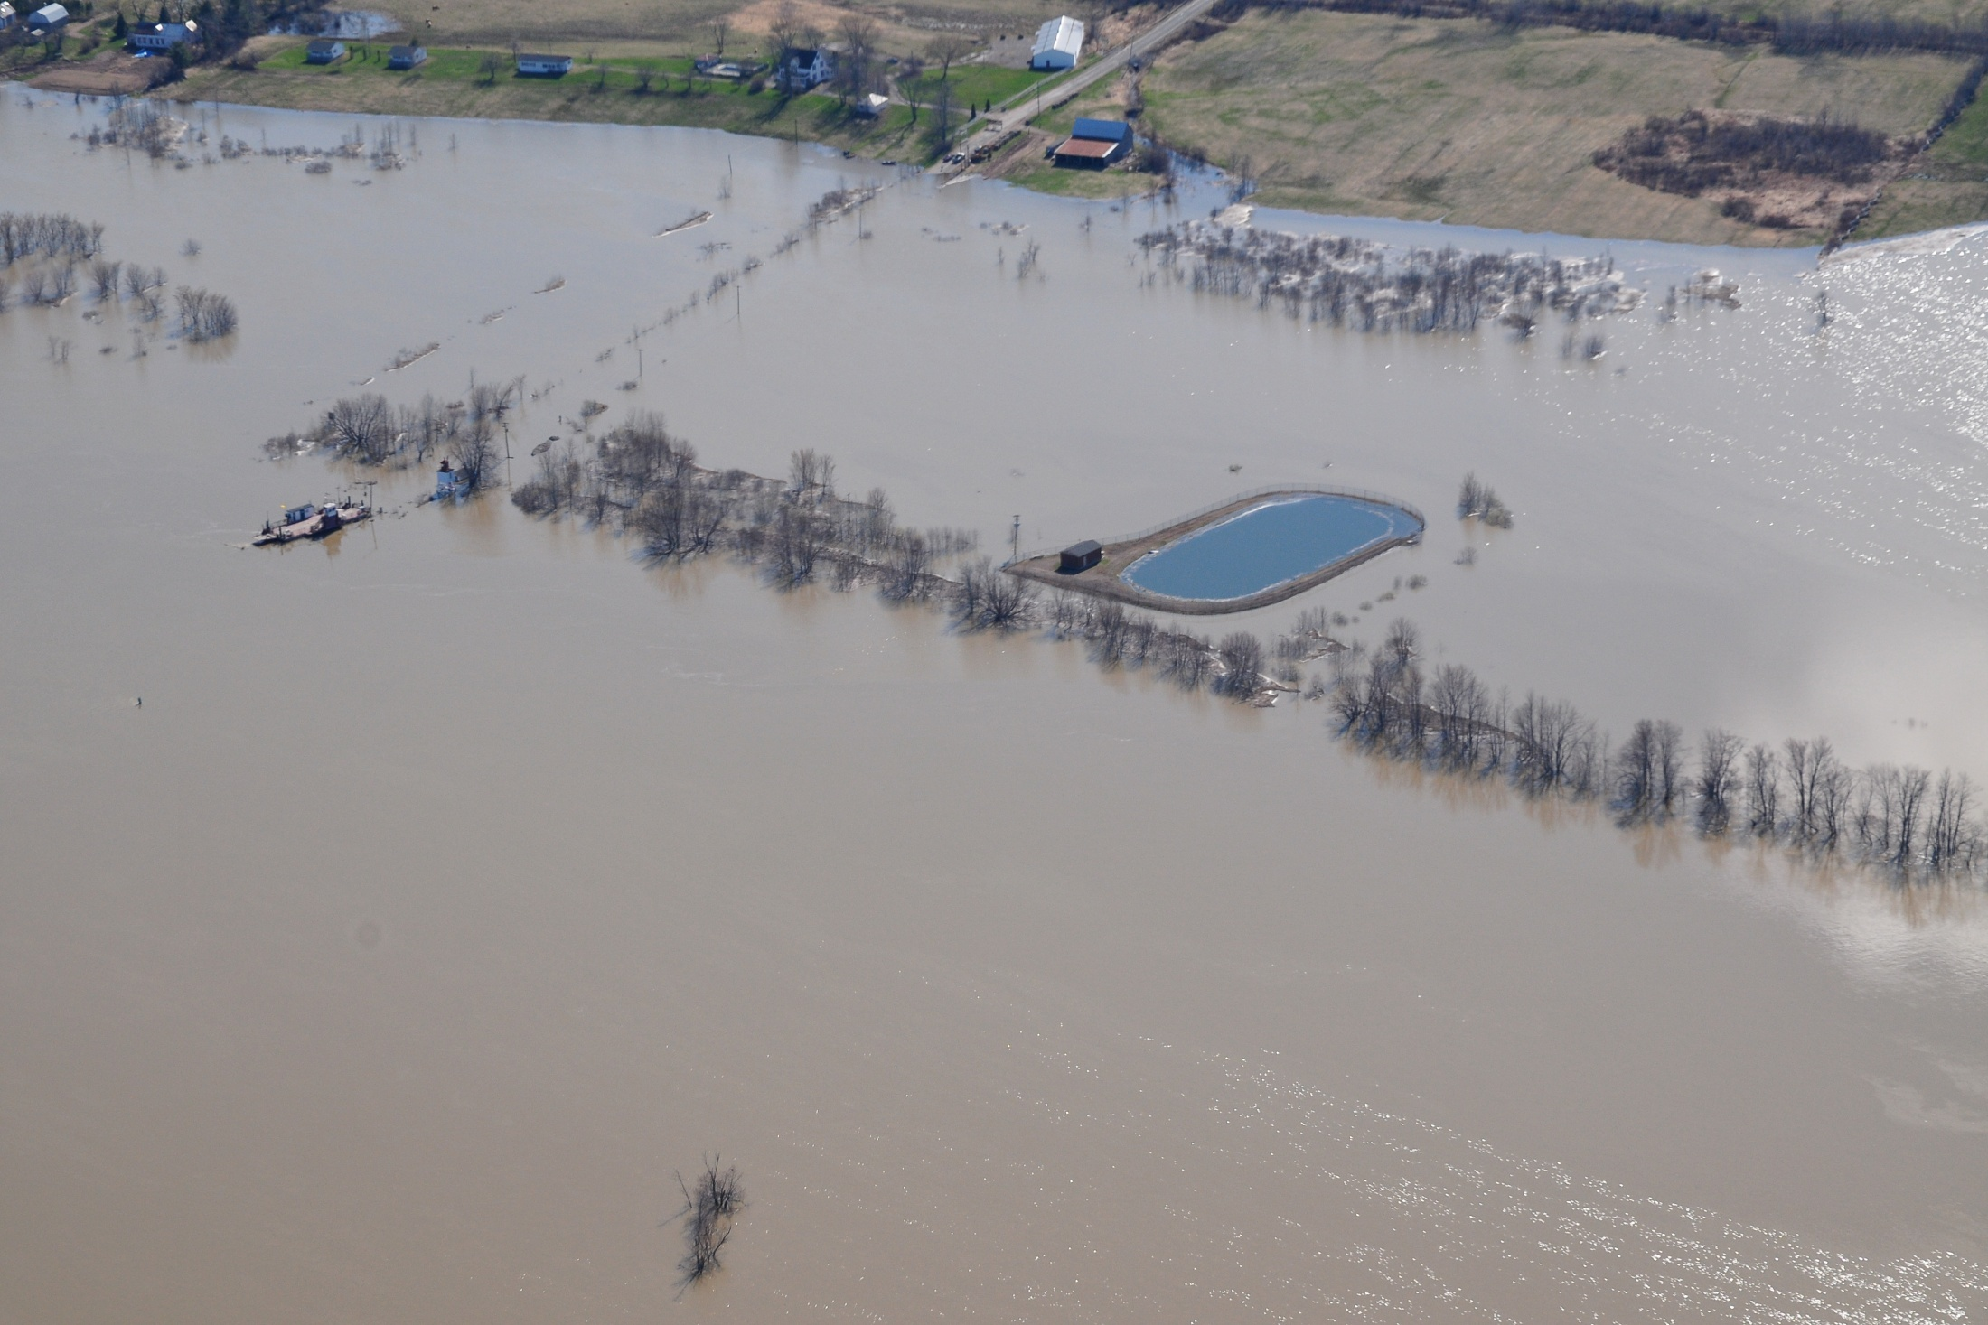
Atlantic Regional Adaptation Collaborative
In the fall of 2008 the four Atlantic Environment Ministers submitted a letter of interest (LOI) to NRCan in response to a call for LOI’s
Atlantic Provinces and it’s Partners submitted a full proposal in August 2009 which was officially accepted by NRCan in September 2009.
Presently preparing to sign a Contribution Agreement with NRCan
Expect projects to begin early 2010 and be completed by December 2012.
Gagetown, NB
(2008)
Maximville, PE
(2000)
Notes:
In the fall of 2008 the four Atlantic Ministers of Environment submitted a Letter of Interest to Natural Resources Canada in response to the NRCan call for Letters of Interest related to the Regional Adaptation Collaborative funding program.
In the winter of 2009, Natural Resources Canada formally asked the Atlantic Provinces to prepare a detailed proposal.
In late summer of 2009, we submitted a detailed proposal to Natural Resources Canada outlining projects in Atlantic Canada to begin in early 2010 and be completed by December 2012.
On September 10, 2009 the Atlantic RAC was accepted for funding consideration by NRCan.
The next steps are to sign a Contribution Agreement with Natural Resources Canada to begin accessing federal funding. We expect this to take place in December 2009.

Slide 9
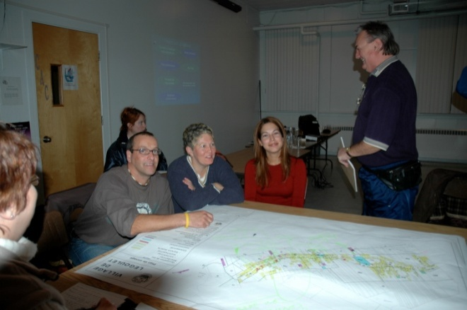
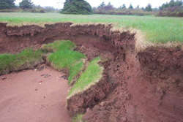
Atlantic Regional Adaptation Collaborative
Twenty five plus projects proposed for Atlantic Canada
Will work with over 50 communities of a variety of sizes throughout Atlantic Canada
A total budget of $8.2 million
Le Goulet, NB
(2007)
Union Corner Provincial Park, PE
Notes:
Total value of the present Atlantic RAC proposal is $8.2 million in cash and in-kind. ($3.3 million in cash from NRCan and over $2.2 million in cash and over $2.5 million in-kind from Atlantic Canada partners).
Over 100 non-profit and for profit partners throughout Atlantic Canada.
25 plus projects are proposed for Atlantic Canada which include a diverse size and type of communities spread among coastal and inland communities. The communities range is size from some of our largest such as Halifax Regional Municipality, NS with a population of 372,680 people to some of our smallest such as the Village of Le Goulet, NB with a population of less than 1,000 people.
The issues in the communities range from a single adaptation issue to those with multiple issues and in need of making major decisions in the near future. This is a true collaboration unlike any other proposed RAC across Canada.

Slide 10
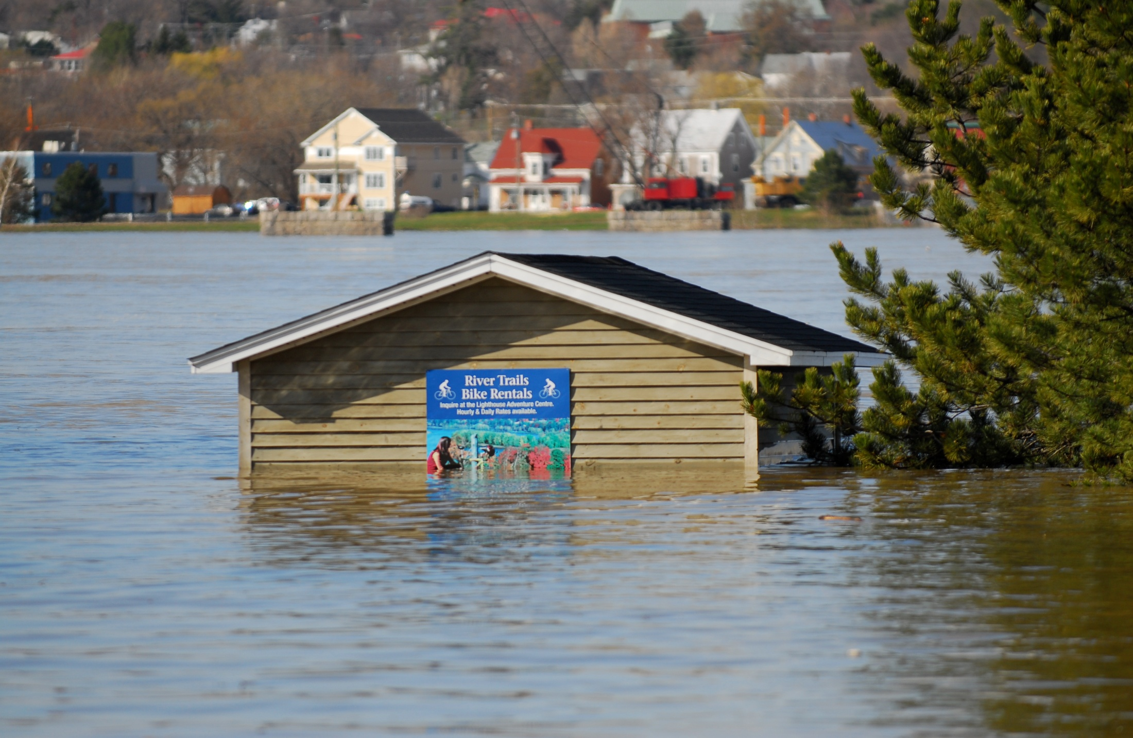
Atlantic Regional Adaptation Collaborative
Primary Partners include:
  Nova Scotia Department of Environment
  New Brunswick Department of Environment
  Prince Edward Island Department of Environment, Energy and Forestry
  Newfoundland and Labrador Department of Environment and Conservation
  Atlantic Planners Institute
  The four Atlantic Engineering Associations
  The Atlantic Municipal Associations/Unions
  Council of Atlantic Premiers Secretariat
  Natural Resources Canada
  Environment Canada
Fredericton, NB
(2008)
Notes:
This is a unique collaboration in Canada with four provincial jurisdictions, the federal government, professional associations, municipalities, academia, non-profit organizations and for profit organizations all partnering and working together in a common approach to addressing the issues of adapting to a changing climate.
No other Regional Adaptation Collaborative in Canada has this many partners/stakeholders as the Atlantic RAC. We have over 100 partners/stakeholders invovled. This is a very ambitious initiative in Atlantic Canada to address pressing concerns and issues.
This is a list of the key or primary partners, who also consist of the Steering Committee for the RAC and include:
the four Atlantic Departments of Environment
the Atlantic Planners Institute;
the four Atlantic Engineering Associations;
the Atlantic Municipal Associations or Unions;
the Council of Atlantic Premiers Secretariat;
Natural Resources Canada; and
Environment Canada

Slide 11
Atlantic Regional Adaptation Collaborative
Examples of projects:
  Dykeland Risk and Vulnerability Assessment Project - (Amherst, NS and Sackville, NB) will determine potential impacts of a changing climate on infrastructure and land uses.
  Sea-Level Rise and Erosion Risk and Vulnerability Assessments – (Le Goulet, NB; City of Summerside, PE; Minas Basin, NS; Stephenville Crossing, NL). Will determine the impact of present and future sea-level rise on the existing built environment.
  Groundwater Quality and Quantity Assessment – three of the Atlantic Provinces will test a salt water intrusion model in the Town of Richibucto, NB, City of Summerside, PE, Minas Basin, NS to determine the impact of salt water intrusion on municipal aquifers. Will assist the communities in finding a sustainable source of potable water.
Notes:
The projects in Atlantic Canada focus on three key areas:
coastal communities,
(2) inland communities and
(3) related infrastructure within those two types of communities.
The projects were built as collaboratives focusing on common adaptation issues in Atlantic Canada. For example, the Dykeland Risks and Vulnerability Assessment Project is a collaborative between NB and NS in the Dykelands area. (the dykes are presently protecting the communities of Sackville, NB and Amherst, NS as well as the trans-Canada highway and the CN railline. The study is important due to the potential socio-economic impact on NS if the highway and railline are flooded and not operational).
All of the Atlantic Provinces are faced with increased sea-level rise and the issues related to storm surges and coastal flooding and coastal erosion. (Le Goulet – presently at sea-level, has issues with coastal erosion, and coastal flooding)
Groundwater Quality and Quantity is presently an issue and will continue to be so in years to come throughout Atlantic Canada. (the project will identify the salt water wedge location in relation to the potable water aquafer both as it exists today and where it may be in the future. This will assist the community indentifying the best location to drill a well for potable water. This information may lead to the need to think about a Regional Water Supply).

Slide 12
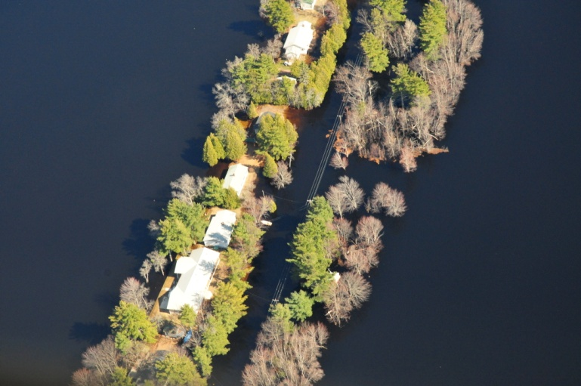
Atlantic Regional Adaptation Collaborative
Examples of projects continued:
  Inland Flooding Risk and Vulnerability Assessment – (Town of Rothesay, NB; Town of Stratford, PE; Bay Roberts, NL; Halifax Regional Municipality, NS). Projects will examine how changes in precipitation and flooding will impact infrastructure and land uses.
Princess Point, NB
(2008)
Notes:
Each of the four Atlantic Provinces presently experience flooding along water ways from extreme precipitation events and spring run-off. These projects will assess the risks and vulnerabilities, propose adaptation solutions along with policy outcomes and new design standards for infrastructure.
The Atlantic RAC projects outlined in the last two slides will include an evaluation and analysis of the potential impacts upon infrastructure found in the communities, for example, impacts upon roads, culverts, bridges, raillines, municipal water and waste water systems, electrical transmission-lines, etc.
The projects will use tools such as LIDAR, modeling downscaled climate data, analyzing orthophotos and airphotos, zoning maps, etc. The results will be an evaluation of the potential impacts both today and 50 years into the future. With this information, we can put forwards adaptation solutions such as potential changes to land use planning, infrastructure design and placement.

Slide 13
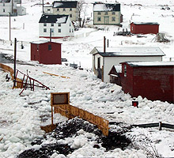
Atlantic Regional Adaptation Collaborative
The deliverables include:
  Model by-laws on adaptation for municipalities
  Proposed changes to municipal land use plans
  Recommended adaptation options both structural and policy
Newfoundland
Notes:
Some of the deliverables or outcomes from the project will include:
Recommended changes to provincial legislation and policy allowing it to incorporate adaptation planning and management.
The development of model by-laws for municipalities and planning authorities
Proposed changes to municipal land use plans in those communities directly involved in the projects.

Slide 14
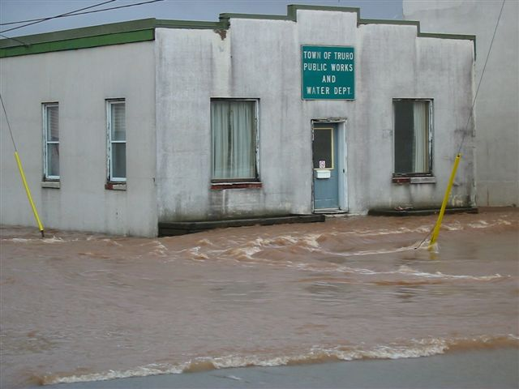
Atlantic Regional Adaptation Collaborative
The deliverables include:
  Recommended changes to infrastructure design standards
  Recommended changes to municipal emergency management plans
  An Atlantic climate change adaptation tool kit
  Build the capacity of professional engineers, planners and municipal officials by supporting learning experiences on adaptation
Truro, NS
(2003)
Notes:
The projects will result in proposed or recommended changes to the design and placement of infrastructure for example, the size of culverts, or the location of a sewage station.
Some communities will use the information from the study to make changes to their emergency management plans.
One of the key deliverables will be a tool kit which can be used by any community in Atlantic Canada
The tool kit will include such items as the model by-law, a development officers development checklist for evaluating projects.
We will build the capacity of our professional engineers, land use planners and municipal officials by assisting in the hosting of annual general meetings on the theme of adaptation to climate change.

Slide 15
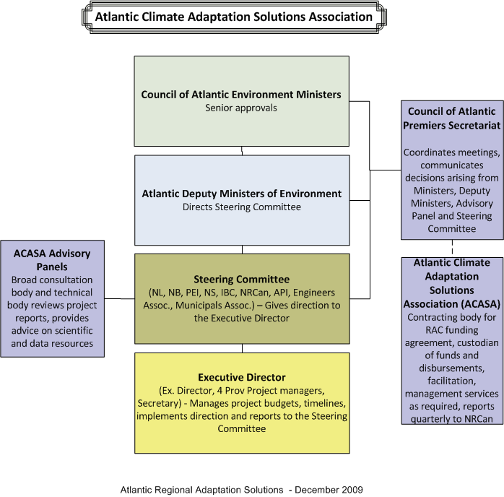
Atlantic RAC Governance
Notes:
The Governance Structure includes the establishment of an incorporated non-profit organization called the Atlantic Climate Adaptations Solutions Association.
The proposed governance structure for the Atlantic Regional Adaptation Collaborative includes oversight by the four Provincial Departments of Environment
A multi-stakeholder Steering Committee will provide direction and leadership on the Atlantic projects, ensuring they are meeting the deliverables and outcomes.
An Executive Director will be responsible for the management of the projects and will report to the Steering Committee.
Four provincial project managers will be hired and will report to the Executive Director.
The Role of the Provincial Project Managers is to manage the day to day activities of the projects taking place in each province.
The ACASA Advisory Panel consists of many stakeholders, for-profit groups, non-profit groups, industry and other interested organizations or agencies. Key scientific partners include Environment Canada, scientists and experts in certain relevant fields. Environment Canada is playing a big role by providing scientific support and in-kind support to the Atlantic RAC. However, their role has limited as there was a limit on in-kind and cash support by federal departments other than NRCan placed on the RAC. This is due to the Treasury Board of Canada conditions.
The Council of Atlantic Premiers Secretariat will manage the financial aspects of the overall project.

Slide 16
Other climate change adaptation projects:
  Insurance Bureau of Canada:
  Water and Waste Water Infrastructure Vulnerability Assessment Tool
Canadian Institute of Planners:
  Mainstreaming Climate Change Tools in the Professional Planning Community: Developing Community Climate Change Adaptation Plans in Atlantic Canada
  The North Shore MicMac District Council Inc.
    Climate Change Risk and Vulnerability Assessments on First Nations Communities
Notes:
Other climate change adaptation projects taking place in Atlantic Canada include:
The Insurance Bureau of Canada with funding from Natural Resources Canada will develop a water and waste water infrastructure vulnerability assessment tool. The tool will be tested in 15-20 communities in Atlantic Canada of a variety of sizes and types. The intent is to assist communities in determining how their existing systems are vulnerable to climate change. The project will begin in 2010 and be completed before March 2013.
The Canadian Institute of Planners are developing adaptation plans with four municipalities in Atlantic Canada, one in each of the four Atlantic Provinces . Two planners are assigned to a communities to work with the members of the community to develop an adaptation plan. The project was funded by Natural Resources Canada and began in the fall of 2009 and will be completed by September 2010. (difference between RAC and this project is that this project is less science based, this project is more based on the impressions of the residents, this project will create an action plan for the community)
The North Shore MicMac District Council Inc. with funding from the Federal Department of Indian and North Affairs has begun a risk and vulnerabilities assessment of nine First Nations communities in north-eastern New Brunswick. The intent is to map and model potential climate change impacts on the communities. The project is underway and is expected to be completed by 2013.

Slide 17
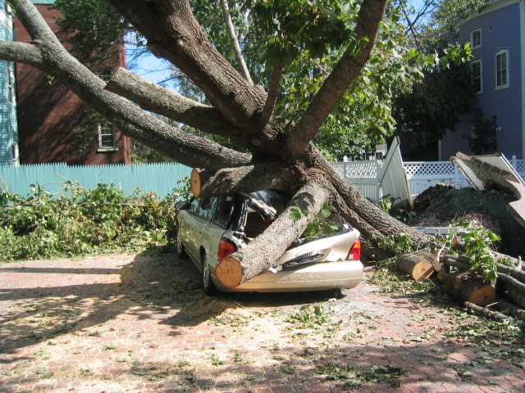
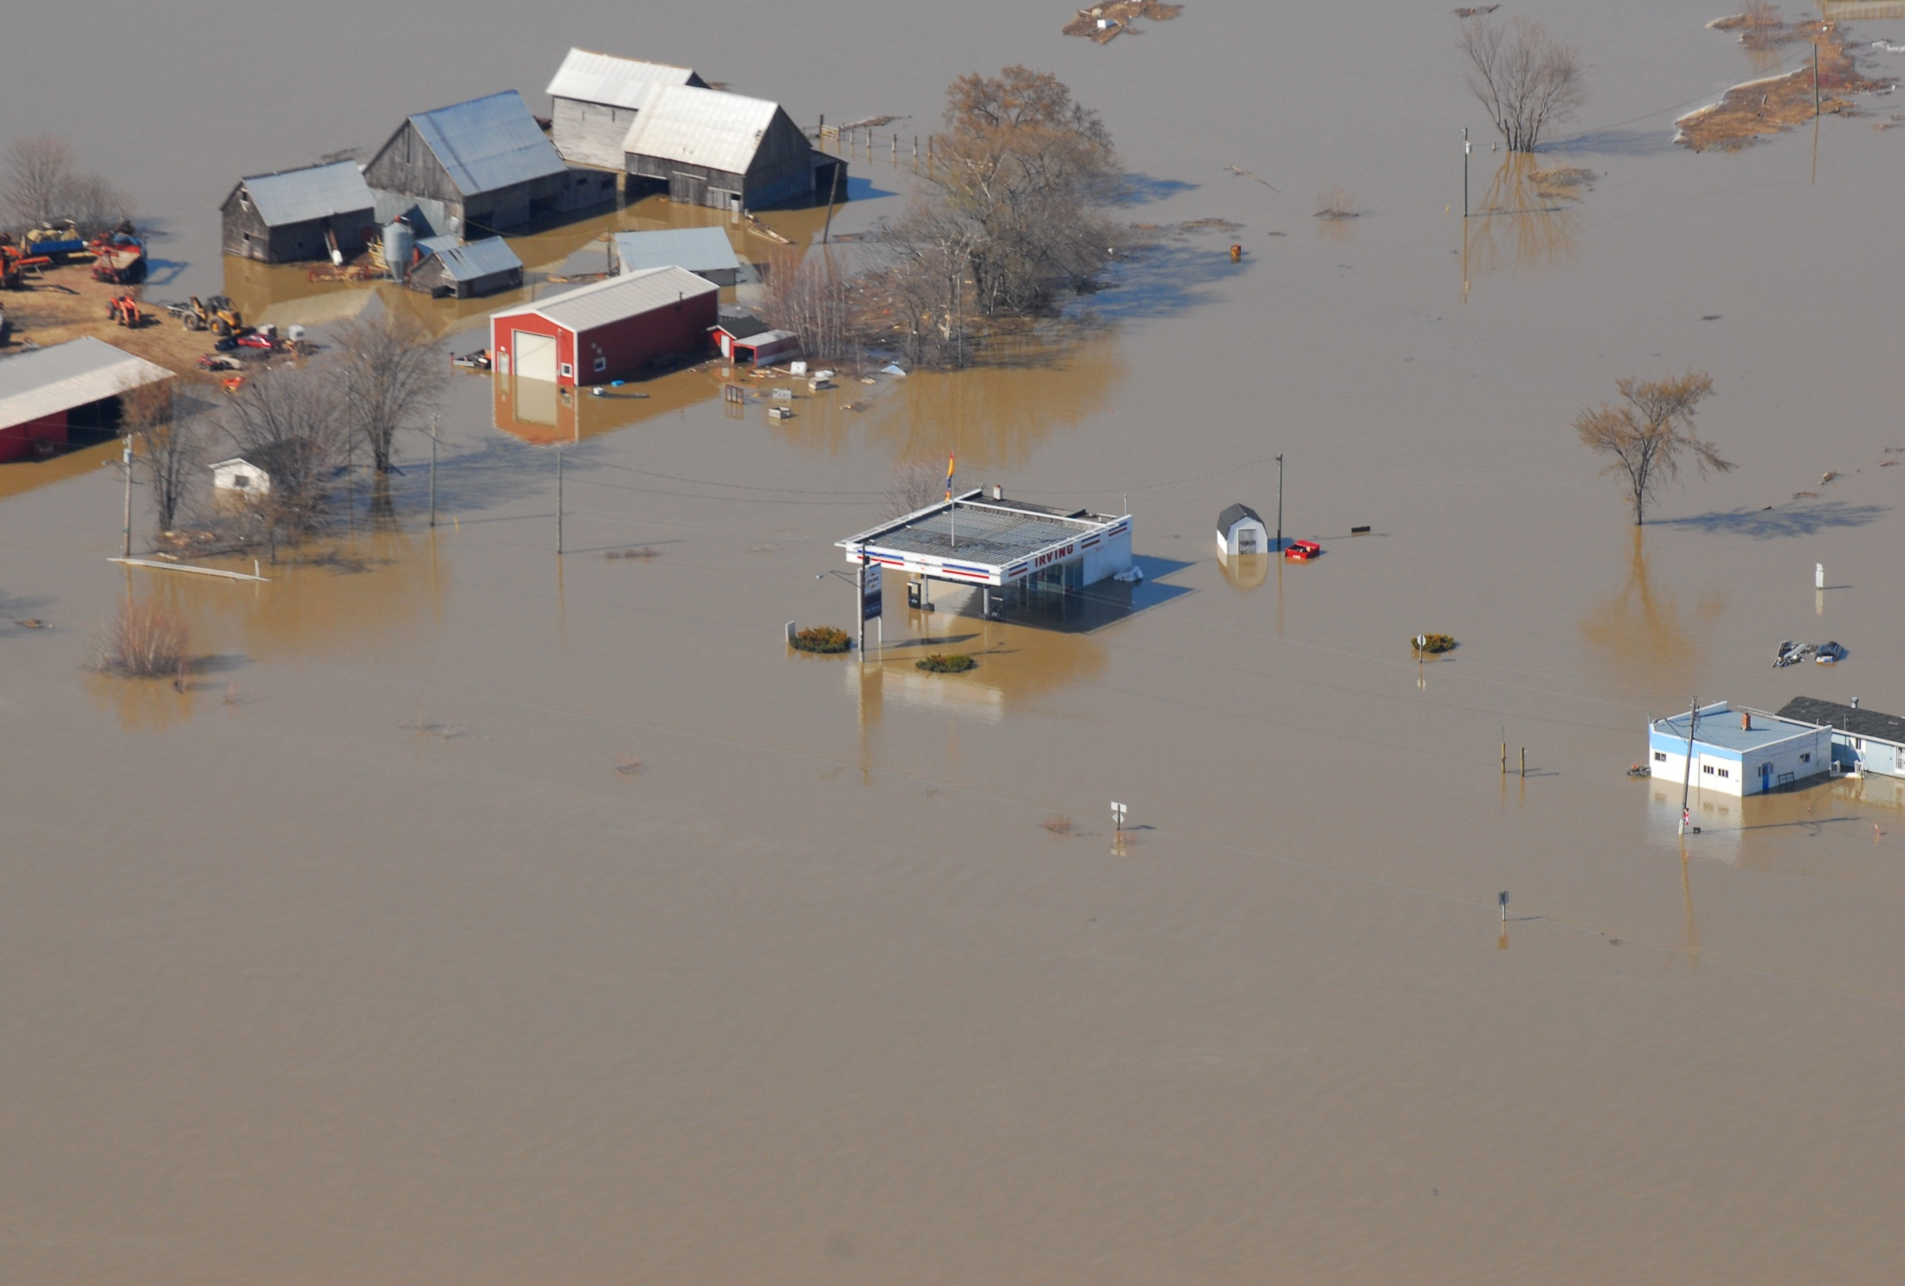
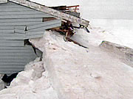
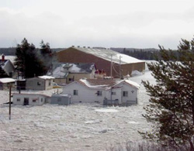
Thank You/Merci
Nova Scotia
(2003)
New Brunswick
(2008)
Prince Edward Island
(2000)
Newfoundland and Labrador
Notes:
Thank you for your time and I will be happy to answer your questions.
New Brunswick Department of Environment Climate Change website (measuring our emissions)
http://logixml.ghgregistries.ca/New%20Brunswick%20Dashboard%20Solo/

