Slide 1
ESIP – 2009 Review and 2010 Look Ahead
Council Meeting
December 2009

Slide 2
Finding, Getting and Using Data
How can you find information? ESIP Monitoring Map
How can you get data? ESIP Webpage and Indicator Reporting Tool
How can you use data? ESIP Indicator Reporting Tool

Slide 3
Is anyone using it?

Slide 4
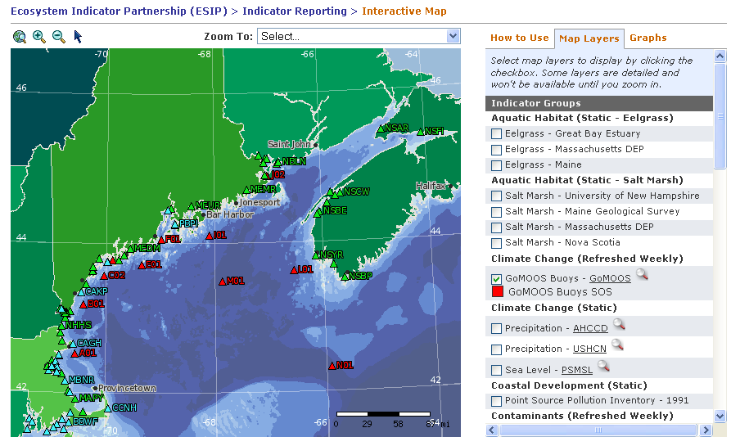
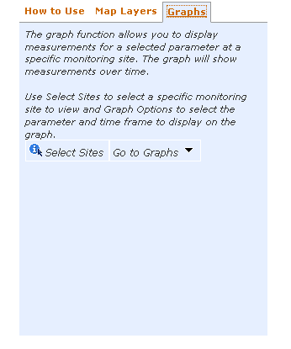
ESIP Indicator Reporting Tool
Notes:
Indicator Reporting Tool was funded by GeoConnections and released March 2008. Currently the tool is under revision based on user comments. At the present time, you can search for parameters from three databases. These data are pulled weekly as an automatic update and then aggregated behind the interface. You can also use the “tell us what you think” and “create pdf.”

Slide 5
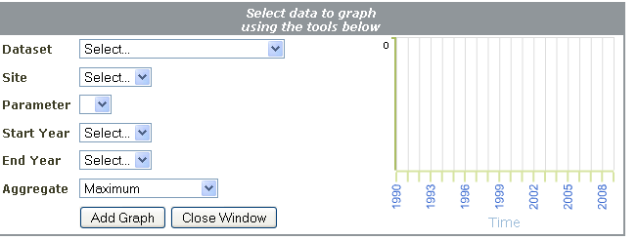
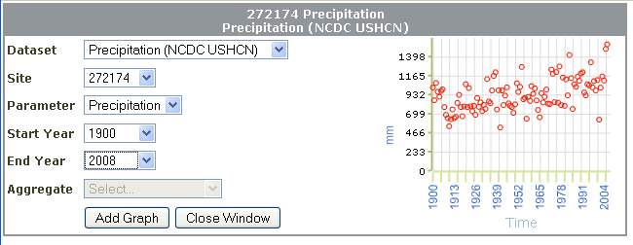
ESIP Indicator Reporting Tool

Slide 6
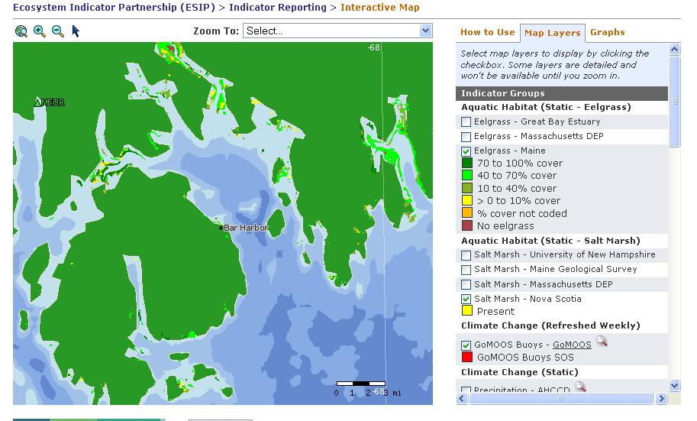
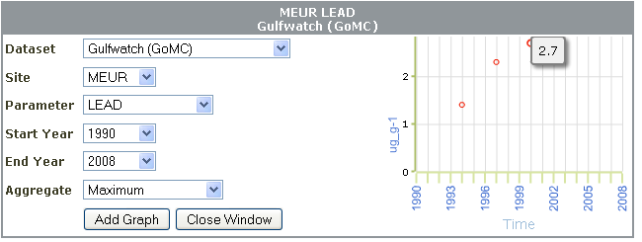
ESIP Indicator Reporting Tool

Slide 7
ESIP Indicator Reporting Tool

Slide 8
Current datasets in the Tool:
NERACOOS Buoys
Environment Canada precipitation
US Precipitation
SAV layers (Mass, Maine, New Hampshire)
Salt March Layers (Mass, Maine, NH, Nova Scotia)
Gulfwatch and Mussel Watch
Sea level

Slide 9
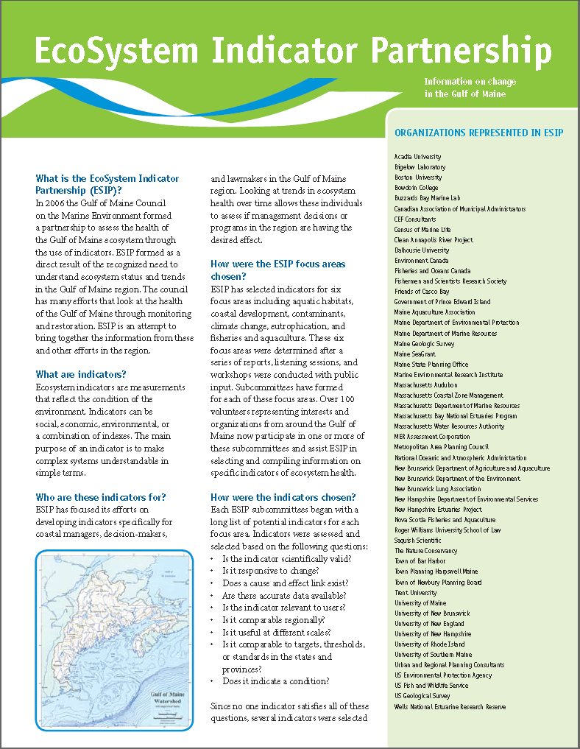
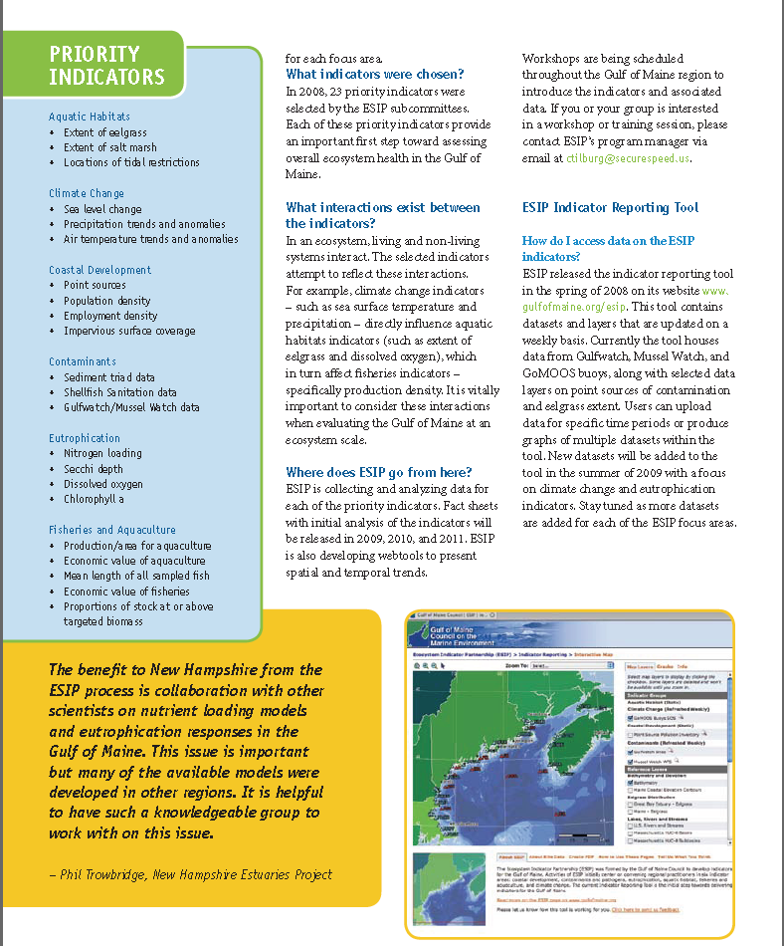
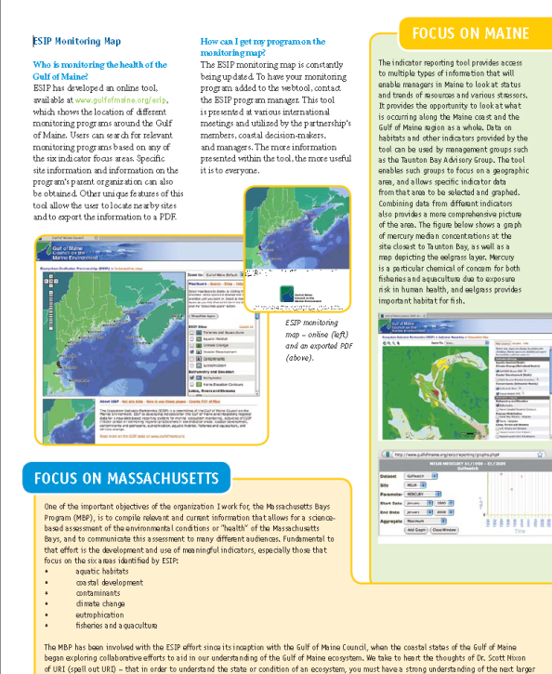

ESIP Fact Sheet – Release June 2009

Slide 10
How we need your help!
Locating individuals to assist in restarting the Fisheries Subcommittee.
Locating an individual to help with watershed delineation for the Coastal Development subcommittee.
Getting the word out about these innovative and useful ESIP tools!
Obtaining funding to spotlight the usefulness of ESIP's indicators for weighing specific issues/decisions in the member States and Provinces.

