Slide 1




Climate Change Adaptation for Atlantic Canada
An initiative of the
Atlantic Provinces
Notes:
I would like to talk to you today about the Climate Change Adaptation Strategy for Atlantic Canada and the Atlantic Regional Adaptation Collaborative on behalf of the Atlantic Provinces.
Adapting to Climate Change is very important in Atlantic Canada as we have some of the most vulnerable communities in Canada due to the face that many of our communities being located along waterways, and the ocean.
The Atlantic Canadian Provinces share many common interest when it comes to adapting to climate change and because of those interest the Council of Atlantic Environment Ministers worked together to create an Atlantic Strategy for address climate change and to prepare an Atlantic Regional Adaptation Collaborative proposal submission to Natural Resources Canada.

Slide 2
Climate Change Adaptation
Background
An issue of National and Regional Concern:
In 2004-2005 the Canadian Council of Ministers of Environment identified climate change as a national issue
At the Council of Federation meeting in 2008 the Premiers agreed further work was needed on climate change.
In May 2008, the Province of New Brunswick and Natural Resources Canada hosted an Atlantic Canadian Adaptation workshop in Saint John, New Brunswick to develop an Atlantic wide adaptation strategy. .
Notes:
In 2004-2005 the Canadian Council of Ministers of Environment identified that climate change was a national issue.
In 2006, the issue was raised among Premiers when the Council of the Federation (COF) met.
Climate change was subsequently highlighted in the COF meeting of August 2007
At the COF 2008 meeting in Vancouver. Premiers agreed that further collaborative work is needed.
The Council of Atlantic Environment Ministers has identified climate change, and especially climate change adaptation, as a key environmental issue for Atlantic Canada.
In April 08, Natural Resources Canada (NRCan) announced a Regional Adaptation Collaborative Program to address adaptation.

Slide 3
Climate Change Adaptation
Background
The May 2008 workshop formed the basis of the Climate Change Adaptation Strategy for Atlantic Canada.
June 2008 - Council of Atlantic Environment Ministers adopts the Climate Change Adaptation Strategy for Atlantic Canada
Adaptation Strategy submits a single Atlantic Regional Adaptation Collaborative proposal to Natural Resources Canada in response to the federal funding program.
Notes:
The Climate Change Adaptation workshop in Saint John, NB included speakers, and representatives from across Atlantic Canada, nationally and internationally. The participants included representatives from the four Atlantic Departments of Environment, several other provincial departments, academia, non-profits, for profits, planners, engineers and municipal representatives. The discussions and outcomes formed the basis for an Atlantic wide initiative.
The Atlantic Environment Ministers agreed Atlantic Canada should work together to submit a single proposal to the Natural Resources Canada Regional Adaptation Collaborative funding program.
In June 2008 the Council of Atlantic Environment Ministers adopted a Climate Change Adaptation Strategy for Atlantic Canada which included a component to agree to submit a single Atlantic Regional Adaptation Collaborative proposal to Natural Resources Canada.

Slide 4
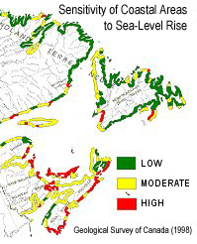
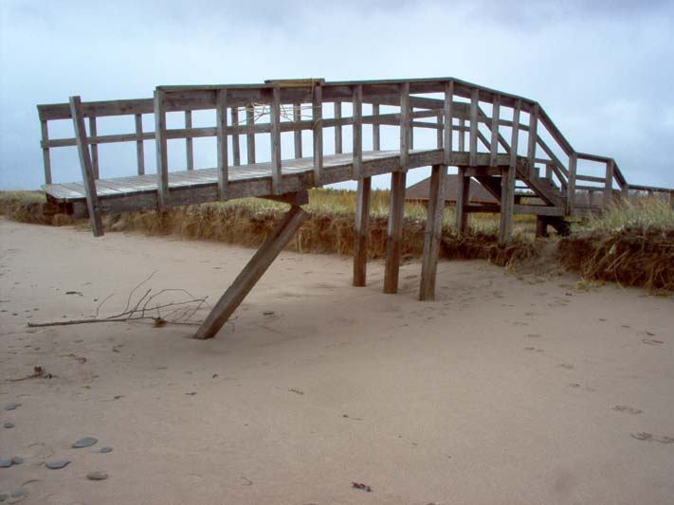
Climate Change Adaptation
Background
Key Climate Change Adaptation Issues for Atlantic Canada include:
Sea-level rise
Coastal flooding
Coastal erosion
Inland flooding
Salt water intrusion
Negative impacts upon infrastructure
Val Comeau, NB
Notes:
The Federal and Provincial Governments identified that Atlantic Canada has several common climate change issues, the majority of being related to water.
Sea-level rise, coastal flooding, coastal erosion, salt water intrusion of aquifers, flooding along inland watercourses, and impacts on our infrastructure are areas of prime concern.

Slide 5
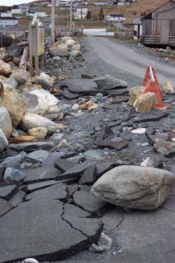
The Climate Change Adaptation Strategy for Atlantic Canada
Purpose
Framework for comprehensive, integrated and long-term planning for climate adaptation in the Atlantic region
Goals
Enhance resilience and adaptive capacity.
Integrate climate change adaptation measures.
Promote regional collaboration, co-ordination, and sharing of best management practices.
Ferry Land, NL
Notes:
The Climate Change Adaptation Strategy for Atlantic Canada created by the four Atlantic Provinces is an agreement to work together to address the common climate change issues.
Purpose
The Climate Change Adaptation Strategy for Atlantic Canada provides the framework for comprehensive, integrated and long-term planning for climate change adaptation in the Atlantic region.
Supports and integrates sustainable development principles of securing social, environmental and economic health.
Goals
Enhance the resilience (our ability to recover from impacts) and adaptive capacity of Atlantic Canada to climate change;
Integrate adaptation measures into existing and new development activities (ex. avoidance); and
Promote regional collaboration, co-ordination, and sharing of best adaptation practices.

Slide 6
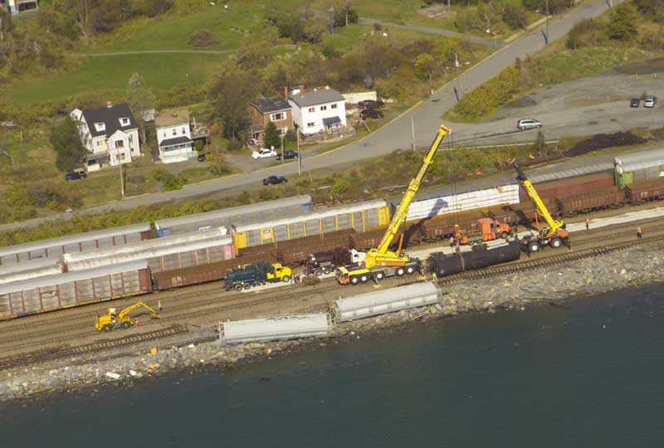
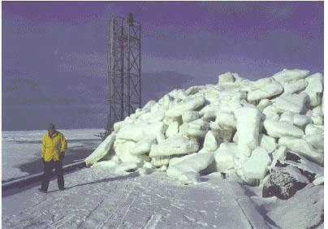
The Climate Change Adaptation Strategy for Atlantic Canada
3 Key Result Areas
Identifying Climate Risks in Atlantic Canada
Climate Proofing Decisions.
Regional Collaboration on areas of common issues and interest.
Priority Sectors
Focus on coastal areas, inland waters and related infrastructure.
Water is the common element - linkages to other sectors.
Halifax, NS
Aboiteau, NB
Notes:
Three key result areas were identified by the Adaptation Strategy.
Key Result Area 1 – Identifying Climate Change Risks (and vulnerabilities): Need to identify the present and future risks and information gaps regarding those risks.
Key Result Area 2 – Climate Proofing Decisions
Key Result Area 3 - Regional Collaboration
The RAC proposal is part of the larger Climate Change Adaptation Strategy for Atlantic Canada.
The RAC proposal provides us with the funds from NRCan to begin to launch our Climate Change Strategy for Atlantic Canada particularly with respect to the engagement of communities and professional organizations to understand and deliver adaptation solutions.

Slide 7
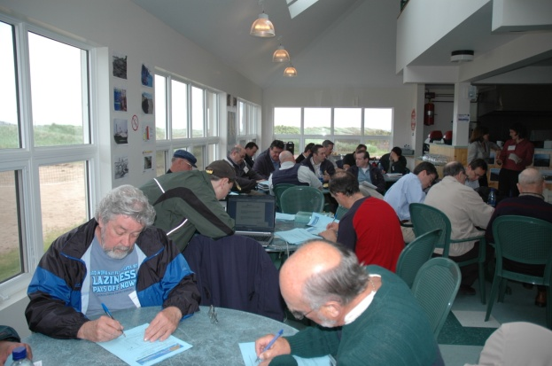
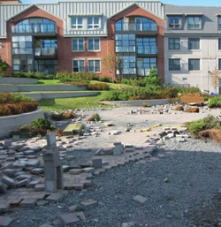
Regional Adaptation Collaborative
Elements of the National Regional Adaptation Collaborative Program:
Natural Resources Canada - Regional Adaptation Collaborative (RAC) Funding Program.
Program to encourage collaboration amongst regional decision-makers (government and non-government).
Objective = Facilitate the integration of climate change considerations into decision-making.
Overall program funding is $33 million between 2009 and 2013.
A total of 6 RAC projects will be funded across Canada
A total of $3.3 million of Federal funding per RAC
Cap-Pele, NB
Charlottetown, PE
Notes:
RAC What is it?
A federal program focused on collaboration amongst regional decision-makers (government and non-government) with the objective of facilitating the integration of climate change considerations into decision-making.
Important Parameters
six “Regional Adaptation Collaboratives” (RACs) will be created across Canada.
Funding from this program can be used to pay for activities (eg. stakeholder consultations, risk assessments, tailoring of tools, applied research) to support adaptation decisions, however, funding can not be used to implement adaptation decisions (eg. funding can not be used for physical works, such as to strengthen a bridge, move a road etc).
$3.3 million funding from NRCan for each RAC.
Atlantic Canada will provide 50% matching funding in cash and in-kind.

Slide 8
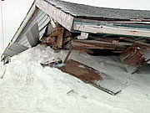
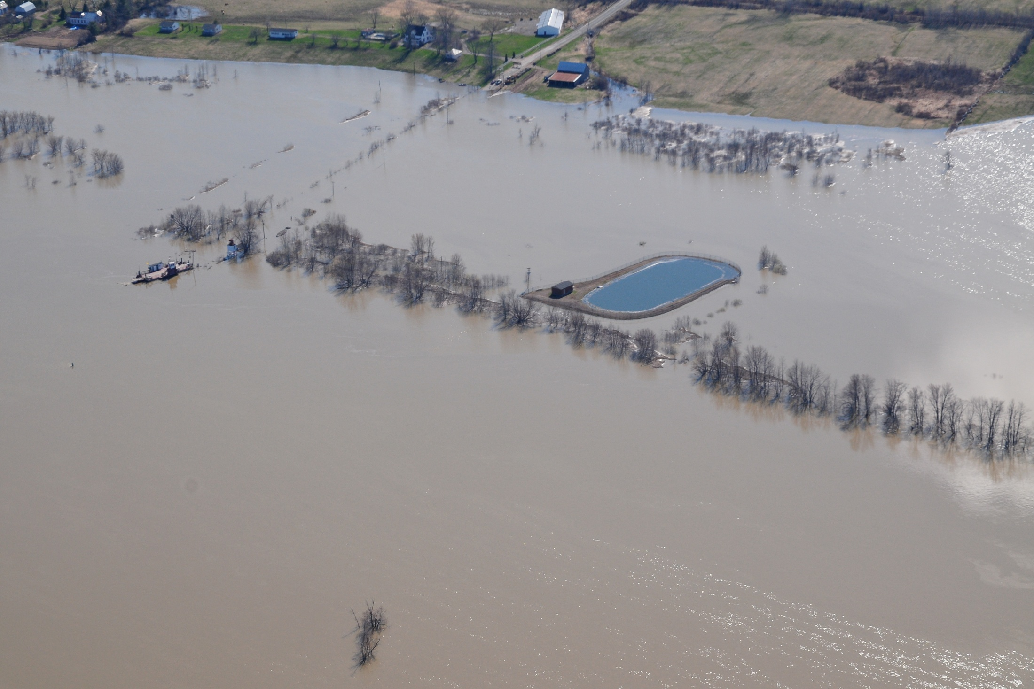
Atlantic Regional Adaptation Collaborative
August 2009 - Atlantic Provinces and it’s Partners submit a full proposal in that is accepted by Natural Resources Canada.
Presently preparing to sign a Contribution Agreement with NRCan
Projects to begin 2010 and be completed by December 2012.
Gagetown, NB
Maximville, PE
Notes:
In the fall of 2008 the four Atlantic Ministers of Environment submitted a Letter of Interest to Natural Resources Canada in response to the NRCan call for Letters of Interest related to the Regional Adaptation Collaborative funding program.
In the winter of 2009, Natural Resources Canada formally asked the Atlantic Provinces to prepare a detailed proposal.
In late summer of 2009, we submitted a detailed proposal to Natural Resources Canada outlining projects in Atlantic Canada to begin in early 2010 and be completed by December 2012.
On September 10, 2009 the Atlantic RAC was accepted for funding consideration by NRCan.
The next steps are to sign a Contribution Agreement with Natural Resources Canada to begin accessing federal funding. We expect this to take place in December 2009.

Slide 9
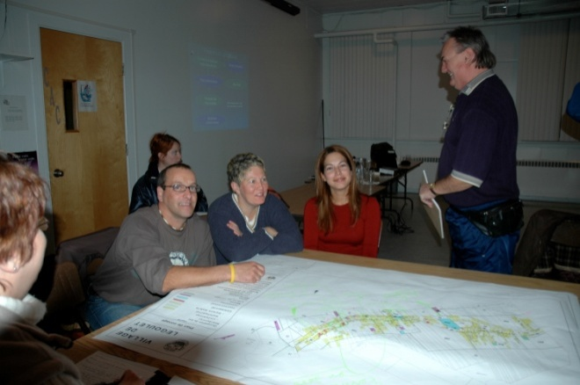
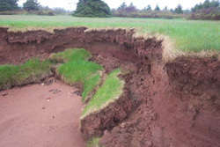
Atlantic Regional Adaptation Collaborative
Twenty five plus projects proposed for Atlantic Canada
50 + communities with a variety of issues within Atlantic Canada
Total budget = $8.2 million
Le Goulet, NB
Union Corner Provincial Park, PE
Notes:
Total value of the present Atlantic RAC proposal is $8.2 million in cash and in-kind. ($3.3 million in cash from NRCan and over $2.2 million in cash and over $2.5 million in-kind from Atlantic Canada partners).
Over 100 non-profit and for profit partners throughout Atlantic Canada.
25 plus projects are proposed for Atlantic Canada which include a diverse size and type of communities spread among coastal and inland communities. The communities range is size from some of our largest such as Halifax Regional Municipality, NS with a population of 372,680 people to some of our smallest such as the Village of Le Goulet, NB with a population of less than 1,000 people.
The issues in the communities range from a single adaptation issue to those with multiple issues and in need of making major decisions in the near future. This is a true collaboration unlike any other proposed RAC across Canada.

Slide 10
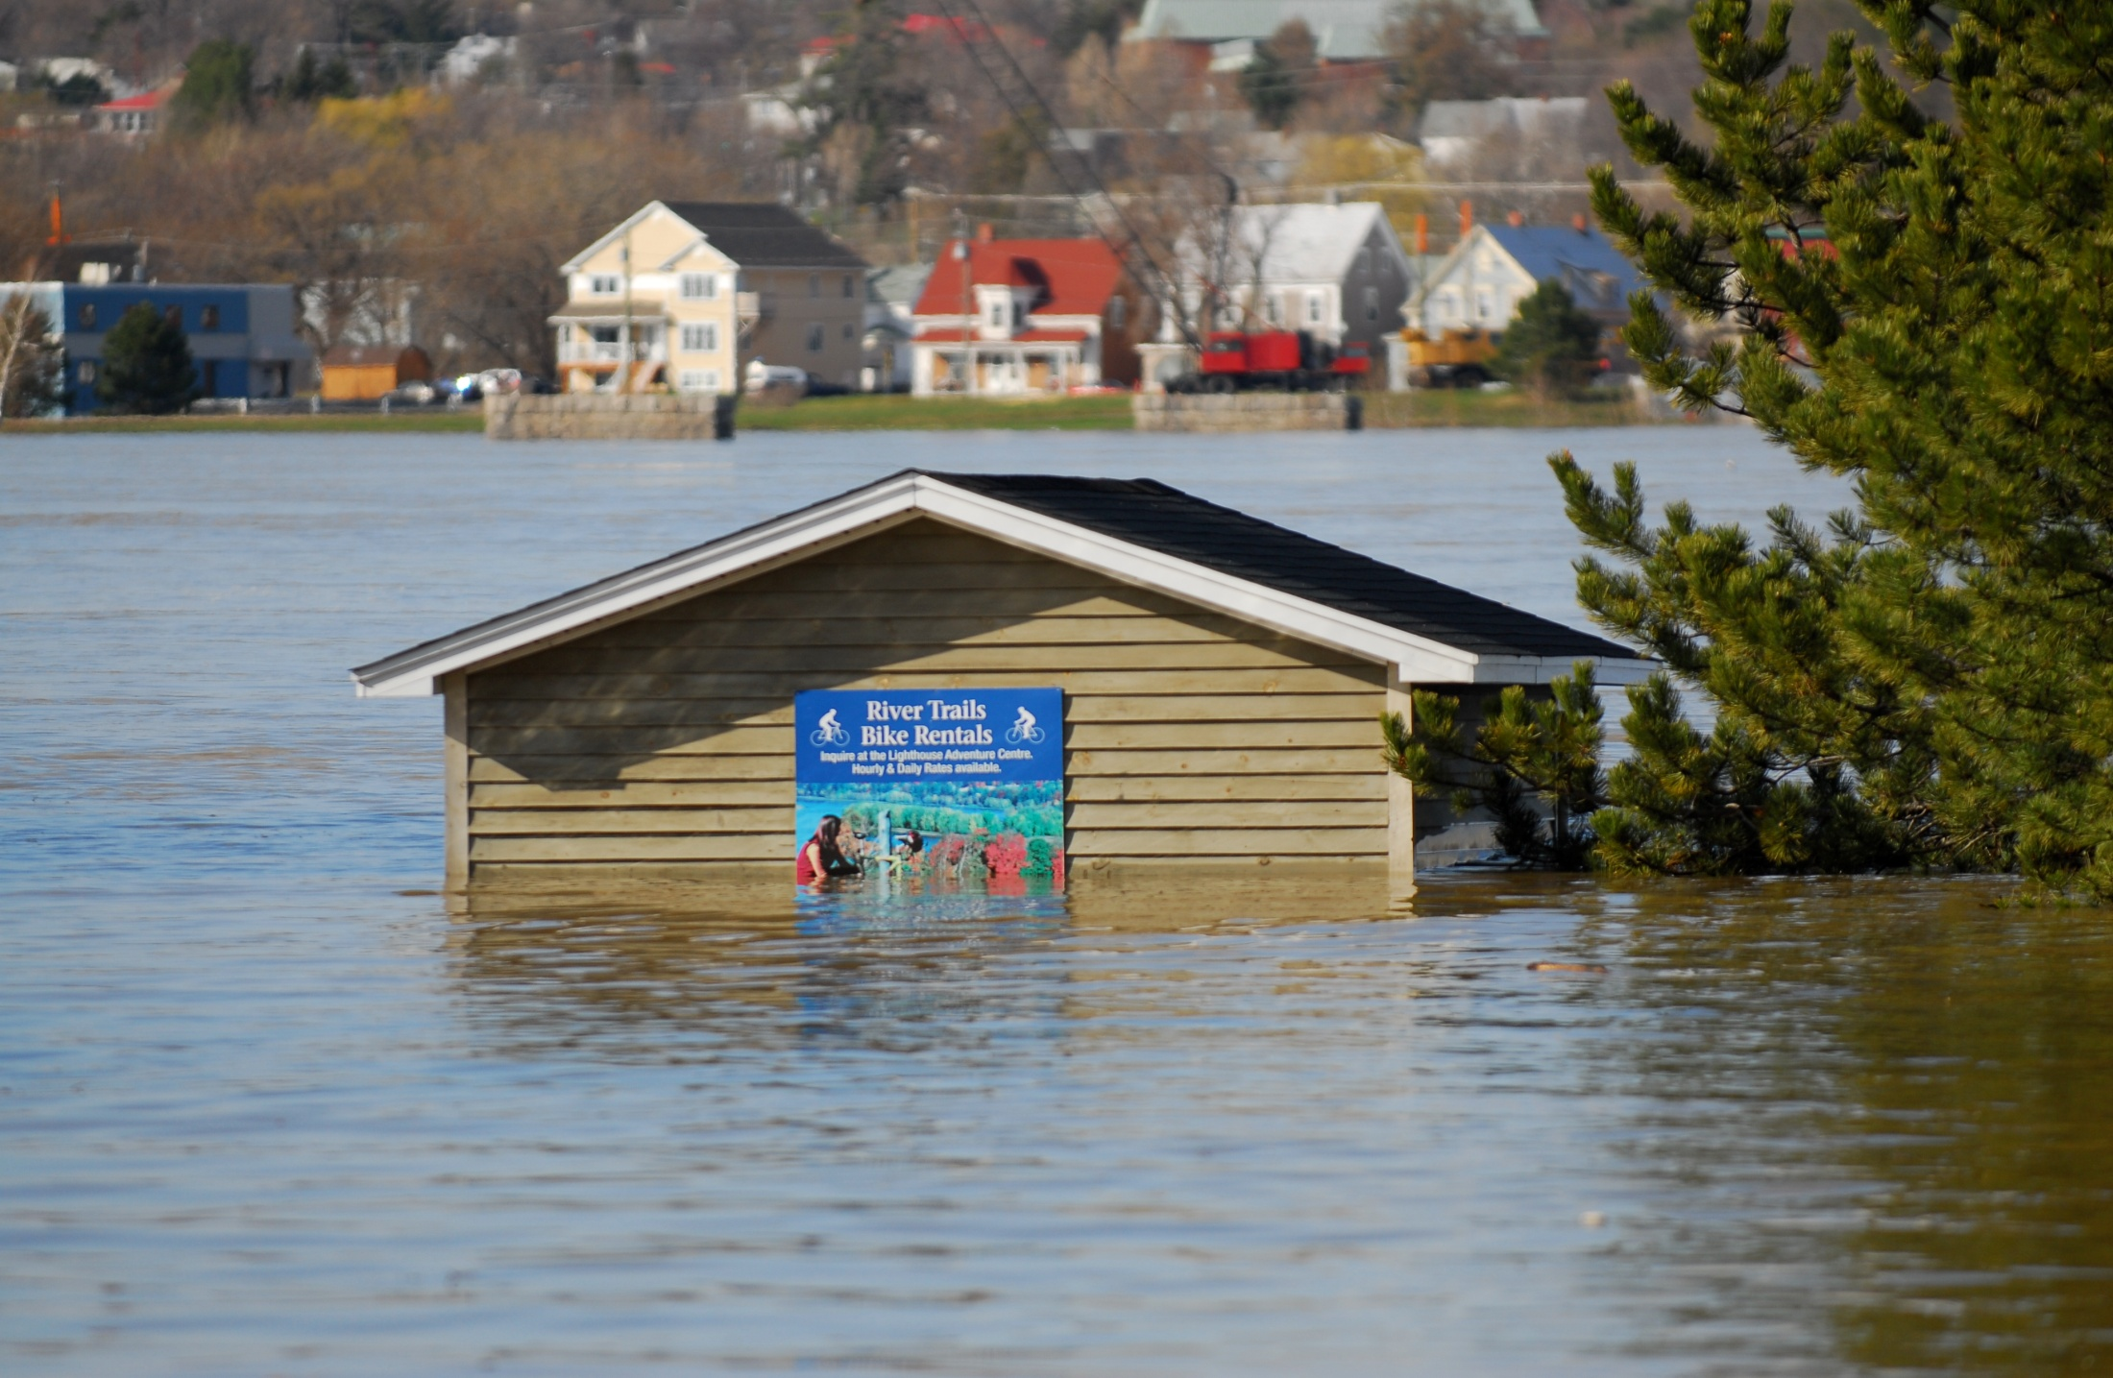
Atlantic Regional Adaptation Collaborative
Primary Partners include:
  Nova Scotia Department of Environment
  New Brunswick Department of Environment
  Prince Edward Island Department of Environment, Energy and Forestry
  Newfoundland and Labrador Department of Environment and Conservation
  Atlantic Planners Institute
  The four Atlantic Engineering Associations
  The Atlantic Municipal Associations/Unions
  Council of Atlantic Premiers Secretariat
  Natural Resources Canada
Fredericton, NB
Notes:
This is a unique collaboration in Canada with four provincial jurisdictions, the federal government, professional associations, municipalities, academia, non-profit organizations and for profit organizations all partnering and working together in a common approach to address the issues of adapting to a changing climate.
No other Regional Adaptation Collaborative in Canada has this many partners. This is a very ambitious initiative in Atlantic Canada to address pressing concerns and issues.
This is a list of the key or primary partners including:
the four Atlantic Departments of Environment
the Atlantic Planners Institute;
the four Atlantic Engineering Associations;
the Atlantic Municipal Associations or Unions;
the Council of Atlantic Premiers Secretariat and Natural Resources Canada.

Slide 11
Atlantic Regional Adaptation Collaborative
Examples of projects:
  Dykeland Risk and Vulnerability Assessment Project - (Amherst, NS and Sackville, NB) will determine potential impacts of a changing climate on infrastructure and land uses.
  Sea-Level Rise and Erosion Risk and Vulnerability Assessments – (Le Goulet, NB; City of Summerside, PE; Minas Basin, NS; Stephenville Crossing, NL). Will determine the impact of present and future sea-level rise on the existing built environment.
  Groundwater Quality and Quantity Assessment – Testing of a salt water intrusion model in Richibucto, NB, Summerside, PE, Minas Basin, NS, - determine the impact of salt water intrusion on municipal aquifers. Will assist communities in finding a sustainable source of potable water.
Notes:
The projects in Atlantic Canada focus on three key areas:
coastal communities,
(2) inland communities and
(3) related infrastructure within those two types of communities.
The projects were built as collaboratives focusing on common adaptation issues in Atlantic Canada. For example, the Dykeland Risks and Vulnerability Assessment Project is a collaborative between NB and NS in the Dykelands area.
All of the Atlantic Provinces are faced with increased sea-level rise and the issues related to storm surges and coastal flooding.
Groundwater Quality and Quantity is presently an issue and will continue to be so in years to come throughout Atlantic Canada.

Slide 12
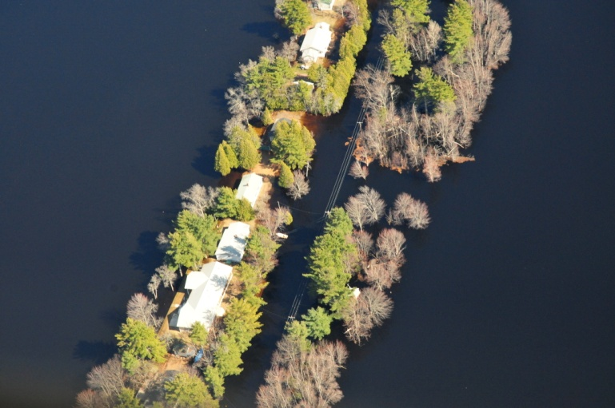
Atlantic Regional Adaptation Collaborative
Project Examples continued:
  Inland Flooding Risk and Vulnerability Assessment – ( Rothesay, NB; Stratford, PE; Bay Roberts, NL; Halifax Regional Municipality, NS).
  Projects will examine how changes in precipitation and flooding will impact infrastructure and land uses.
Princess Point, NB
Notes:
Each of the four Atlantic Provinces presently experience flooding along water ways from extreme precipitation events and spring run-off. These projects will assess the risks and vulnerabilities, propose adaptation solutions along with policy outcomes and new design standards for infrastructure.

Slide 13
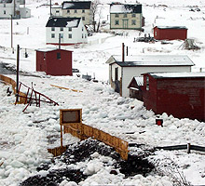
Atlantic Regional Adaptation Collaborative
Deliverables :
  Model by-laws on adaptation for municipalities
  Proposed changes to municipal land use plans
  Recommended adaptation options both structural and policy
Newfoundland
Notes:
Some of the deliverables or outcomes from the project will include:
Recommended changes to provincial legislation and policy allowing it to incorporate adaptation planning and management.
The development of model by-laws for municipalities and planning authorities
Proposed changes to municipal land use plans in communities involved in the projects.

Slide 14
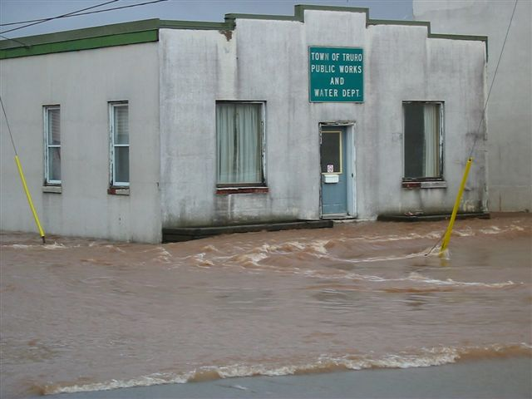
Atlantic Regional Adaptation Collaborative
Deliverables:
  Recommended changes to infrastructure design standards
  Recommended changes to municipal emergency management plans
  An Atlantic climate change adaptation tool kit
  Build the capacity of professional engineers, planners and municipal officials by supporting learning experiences on adaptation
Truro, NS
Notes:
The projects will result in proposed or recommended changes to the design and placement of infrastructure, for example the size of culverts, or the location of a sewage stations.
Some communities will use the information from the study to make changes to their emergency management plans.
A key deliverable will be a tool kit which can be used by any community in Atlantic Canada
Tool kit will include such items as the model by-law and a development officer’s development checklist for evaluating projects.
We will build the capacity of our professional engineers, land use planners and municipal officials by assisting in the hosting of annual general meetings on the theme of adaptation to climate change.

Slide 15
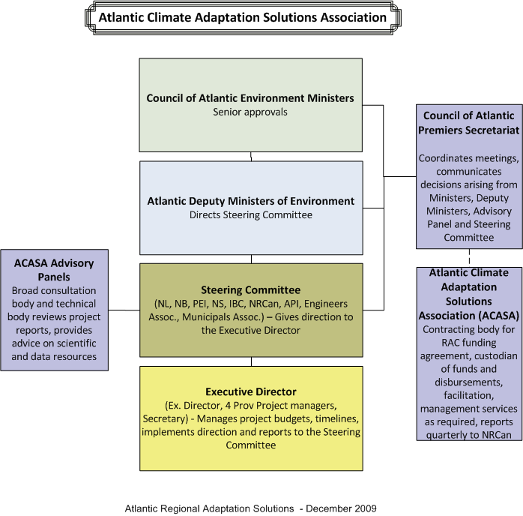
Atlantic RAC Governance
Notes:
The Governance Structure includes the establishment of an incorporated non-profit organization called the Atlantic Climate Adaptations Solutions Association.
The proposed governance structure for the Atlantic Regional Adaptation Collaborative includes oversight by the four Provincial Departments of Environment
The multi-stakeholder Steering Committee will provide direction and leadership on the Atlantic projects, ensuring they are meeting the deliverables and outcomes.
An Executive Director will be responsible for the management of the projects and will report to the Steering Committee.
Four provincial project managers will be hired who will report to the Executive Director.
The Role of the Provincial Project Managers is to manage the day to day activities of the projects taking place in each province.
The ACASA Advisory Panel consists of many stakeholders, for-profit groups, non-profit groups, industry and other interested organizations and agencies
The Council of Atlantic Premiers Secretariat will manage the financial aspects of the overall project.

Slide 16
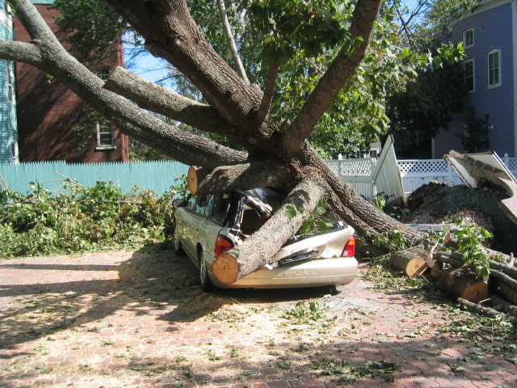
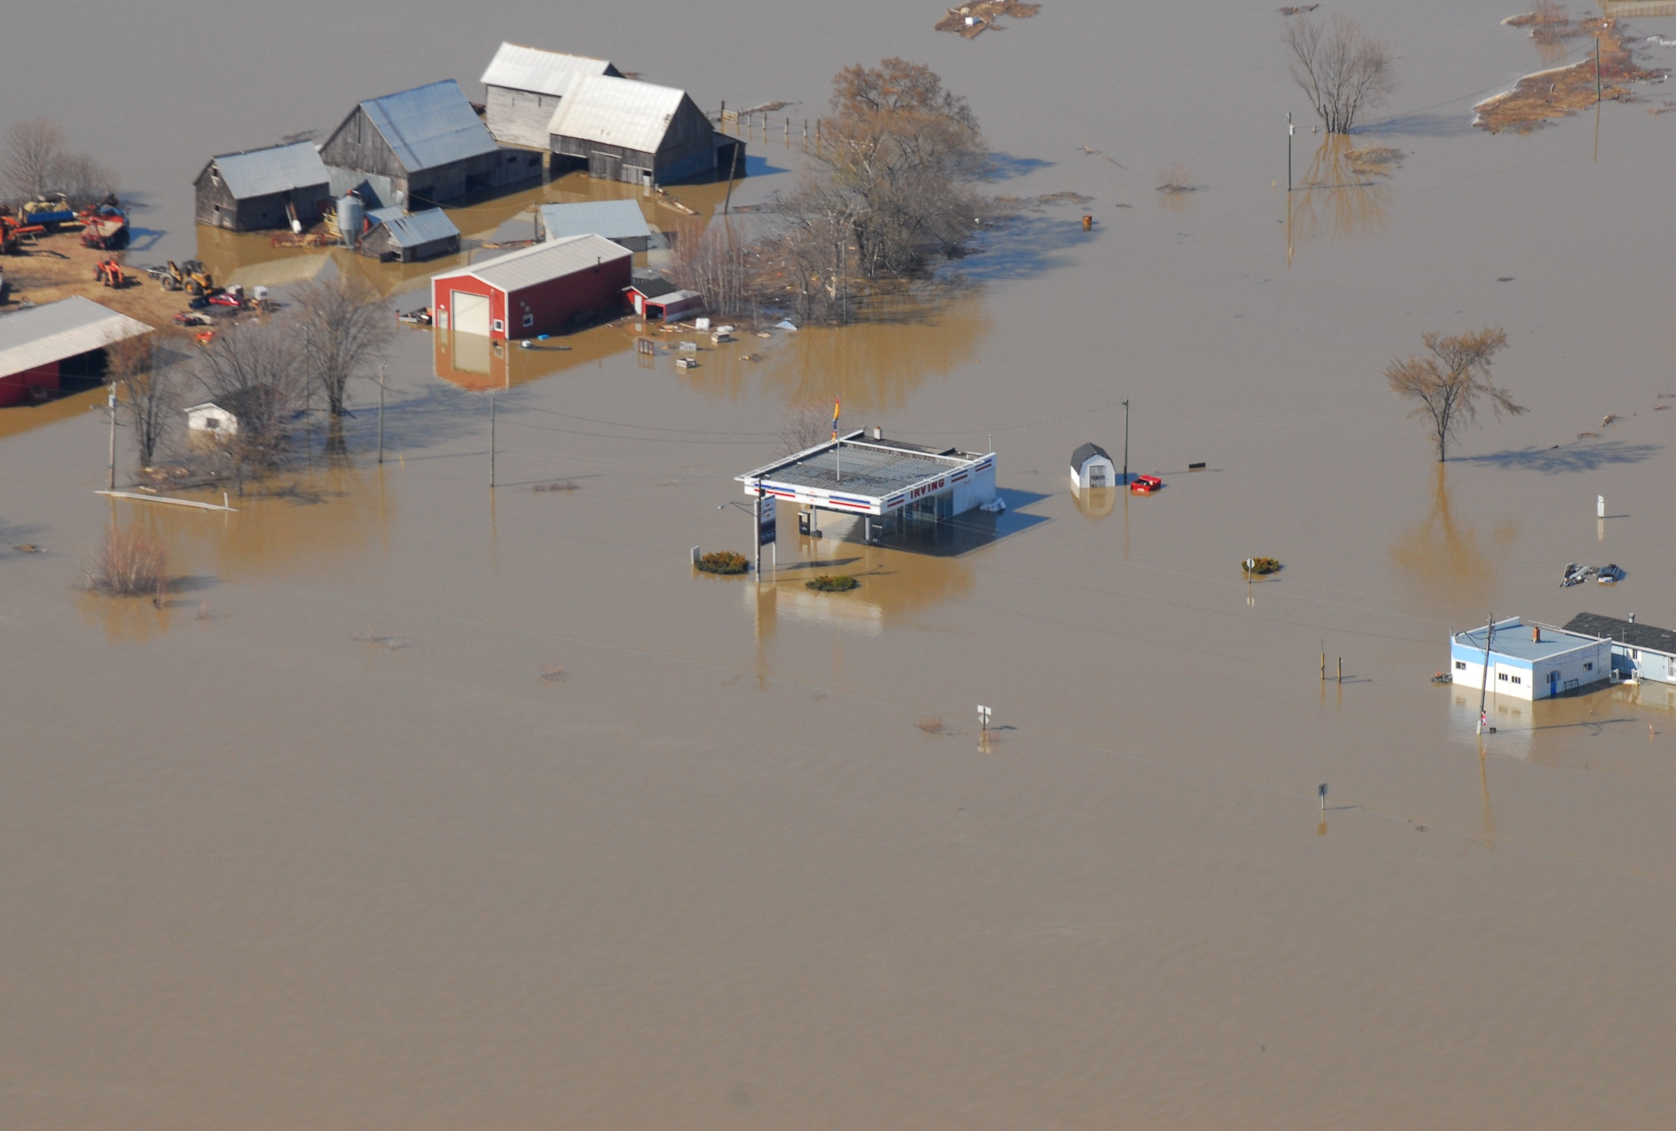
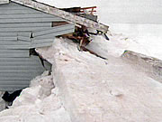
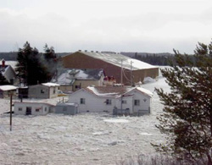
Thank You/Merci
Nova Scotia
New Brunswick
Prince Edward Island
Newfoundland and Labrador
Notes:
Thank you for your time and I will be happy to answer your questions.

