Slide 1
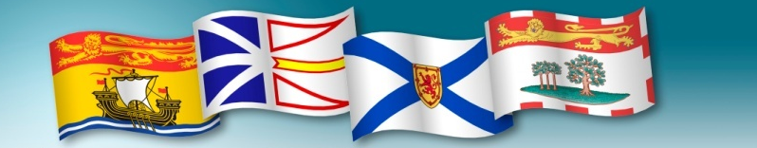




The Regional Adaptation Collaborative Project
Gulf of Maine Council on the Marine Environment
Saint John
Dec 8 2011

Slide 2
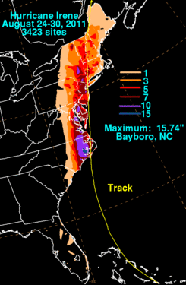
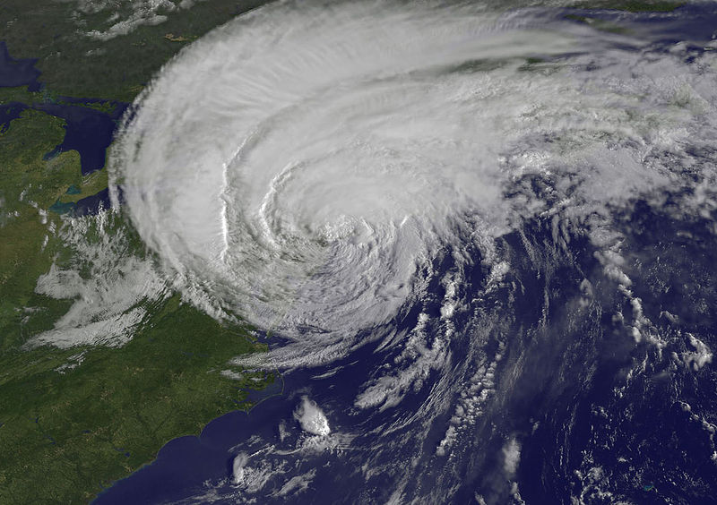
Hurricane Irene Aug 2011
Costs: $ tens of millions

Slide 3
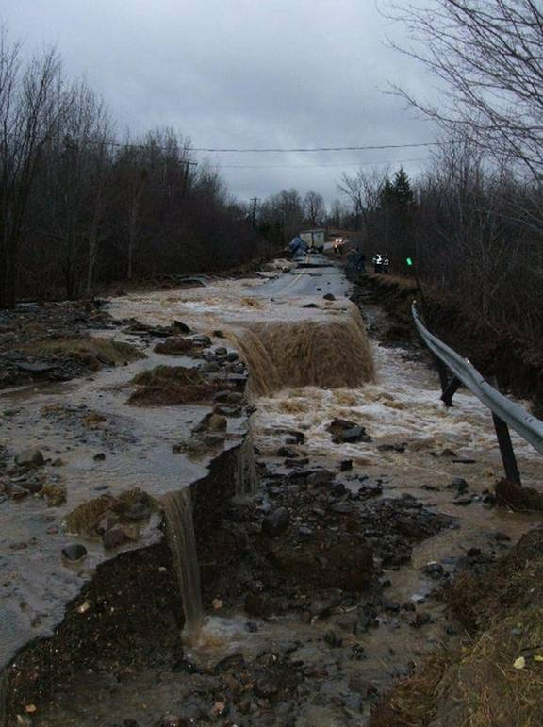
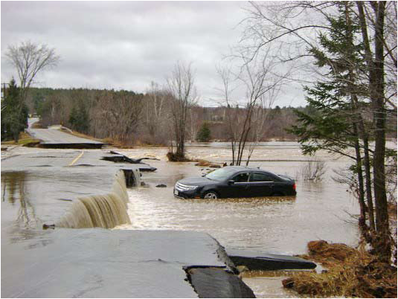
Fall rains 2010
Southern New Brunswick
Nov-Dec 2010
Flooding, storm surge
$40-50 Million

Slide 4
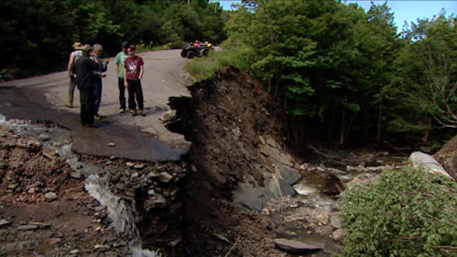
Nova Scotia Flash floods Aug 2010
Meat Cove, Cape Breton
Aug 21 and 22, 2010
Torrential Rains, Severe Flash Flooding
$7 Million

Slide 5
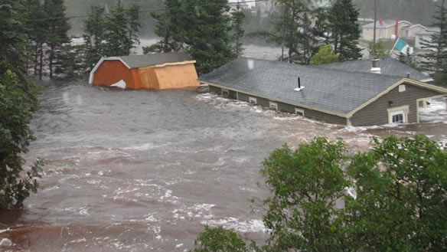
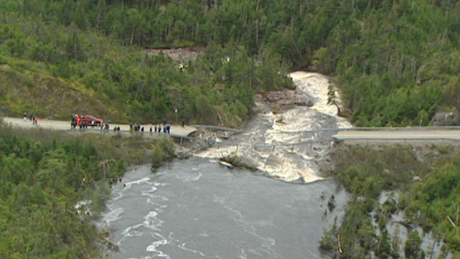
Hurricane Igor NL Sep 2010
Sep 20 and 21, 2010
Hurricane Igor - Rain and Wind
$165 Million

Slide 6
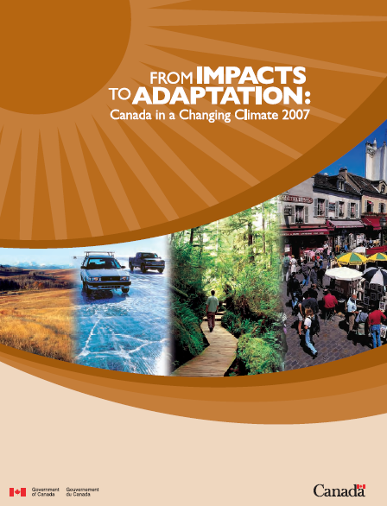
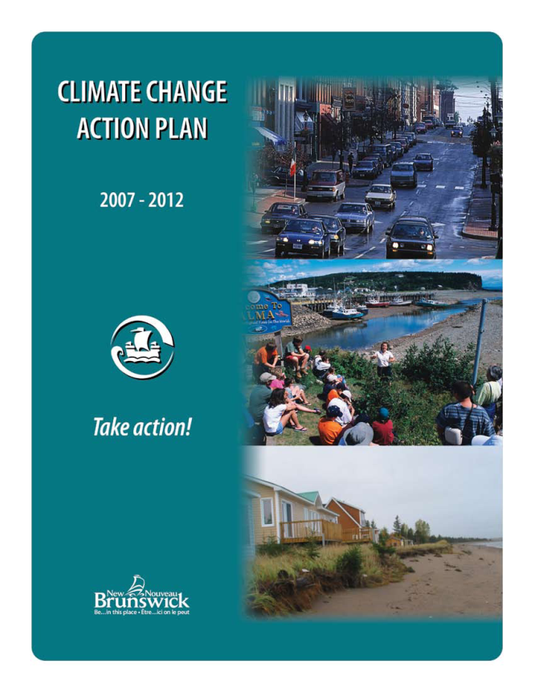
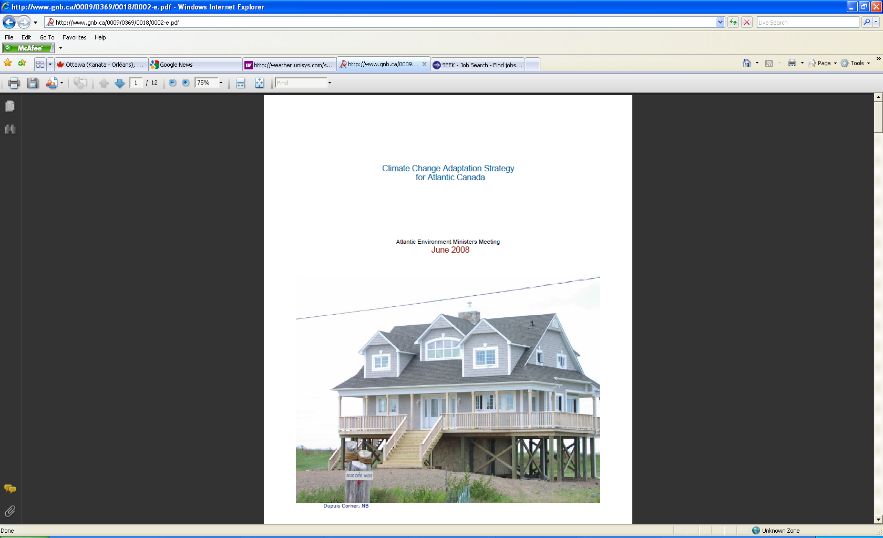
Background/history
2004-7 2007 2008

Slide 7
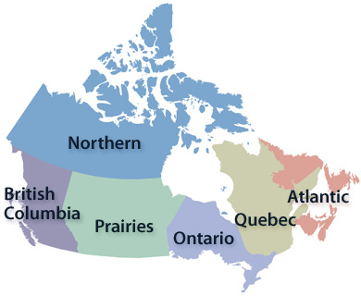
Regional Adaptation Collaborative Program
2009-2012
$33M Nationally
Goal: to catalyze coordinated and sustained adaptation planning, decision-making and action, across Canada’s diverse regions
Atlantic RAC total project value $8.5M

Slide 8
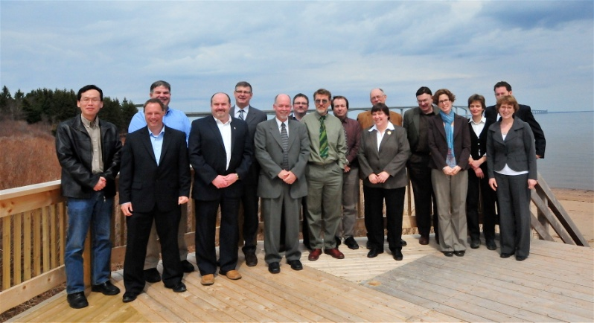
Timeline
April 2008: National Regional Adaptation Collaborative (RAC) Program announced
September 2009: Atlantic RAC Proposal was accepted
February 2010: Contribution Agreement signed
April 23 2010: Official A-RAC announcement at Cape Jourimain, NB

Slide 9
Primary RAC Partners
  NS Department of Environment
  NB Department of Environment
  PEI Department of Environment, Energy and Forestry
  NL Department of Environment and Conservation
  Natural Resources Canada
  Environment Canada
  Atlantic Planners Institute
  Atlantic Engineering Associations
  Atlantic Municipal Associations/Unions
  Individual municipalities
  Council of Atlantic Premiers Secretariat
  Insurance Bureau of Canada
  Universities

Slide 10
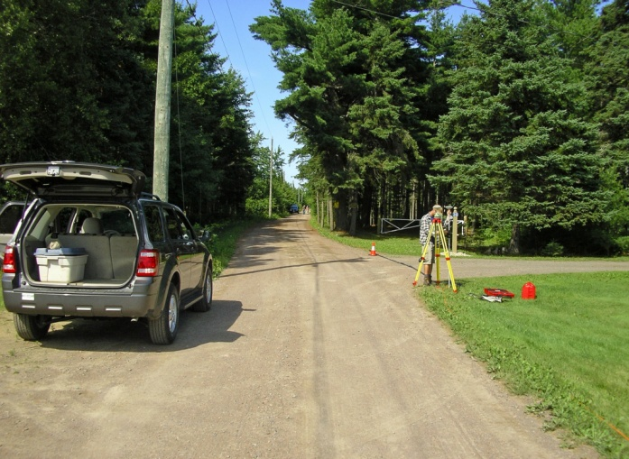
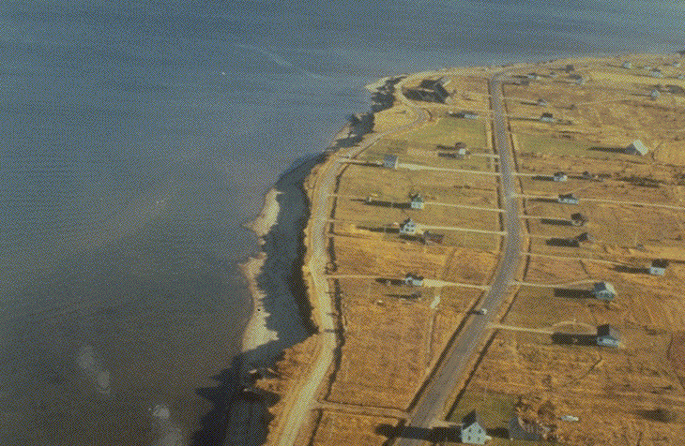
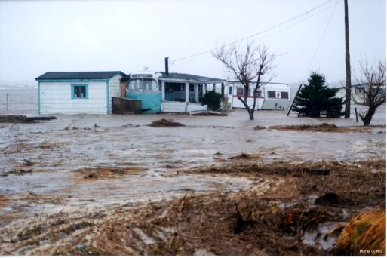
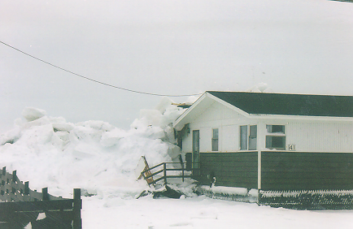
Issues
Salt water intrusion
Coastal erosion
Coastal flooding
Storm surge

Slide 11
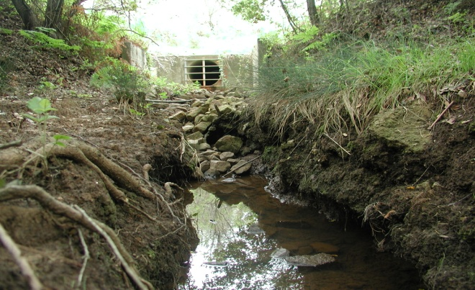
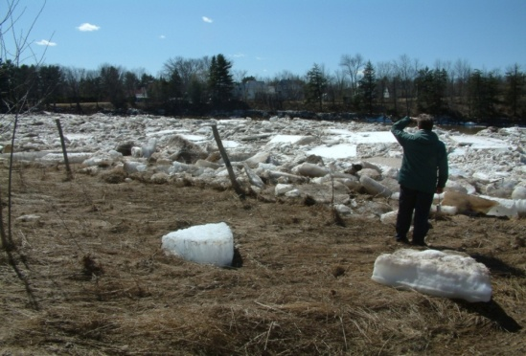
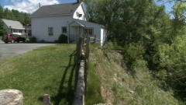
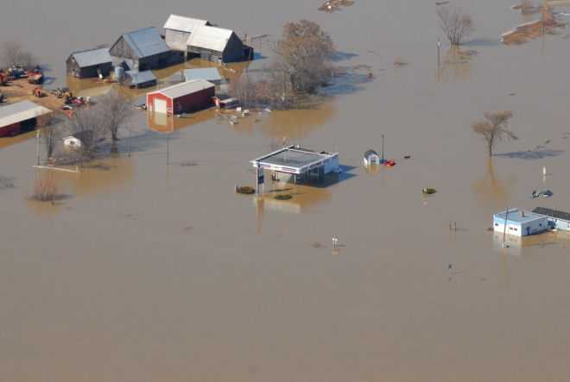
Issues
Erosion
Ice jam flooding
Erosion / property damage
Inland riverine flooding
Notes:
Property and infrastructure damage
Siltation
Water supply impacts
Surface runoff, contamination

Slide 12
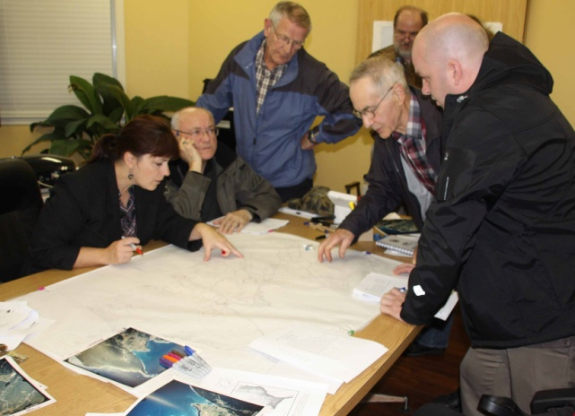
Project components
Vulnerability/risk assessment
Acquiring survey data, often LiDAR
Mapping of areas at risk
Additional analyses: infrastructure at risk, critical resources, emergency management
Technical studies (engineering, geotechnical, geophysical), monitoring
Technical and management recommendations (adaptation solutions)
Planning, zoning, land use recommendations

Slide 13
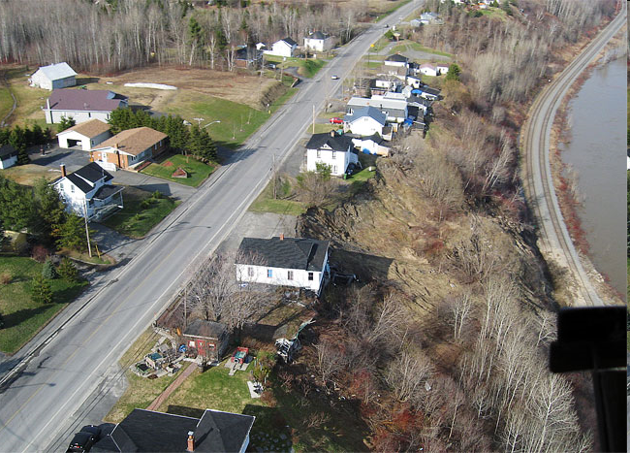
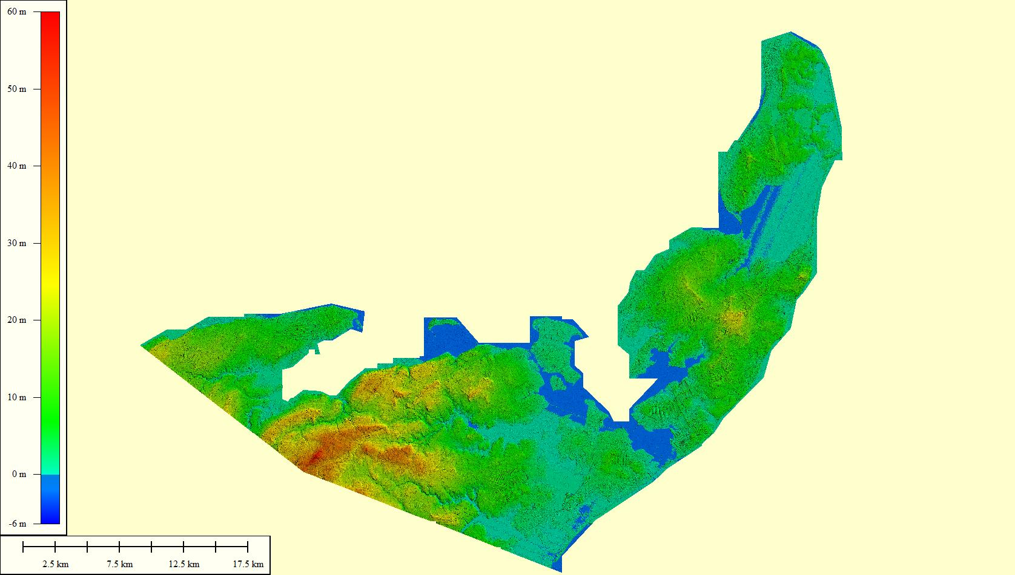
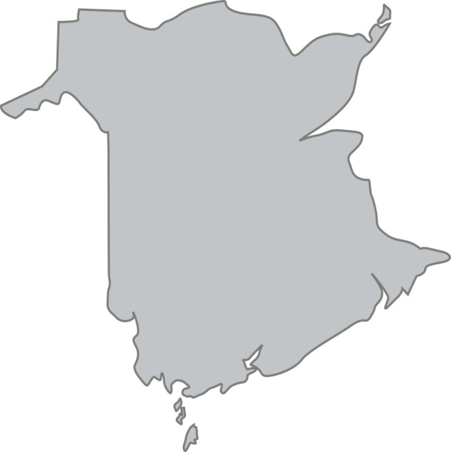
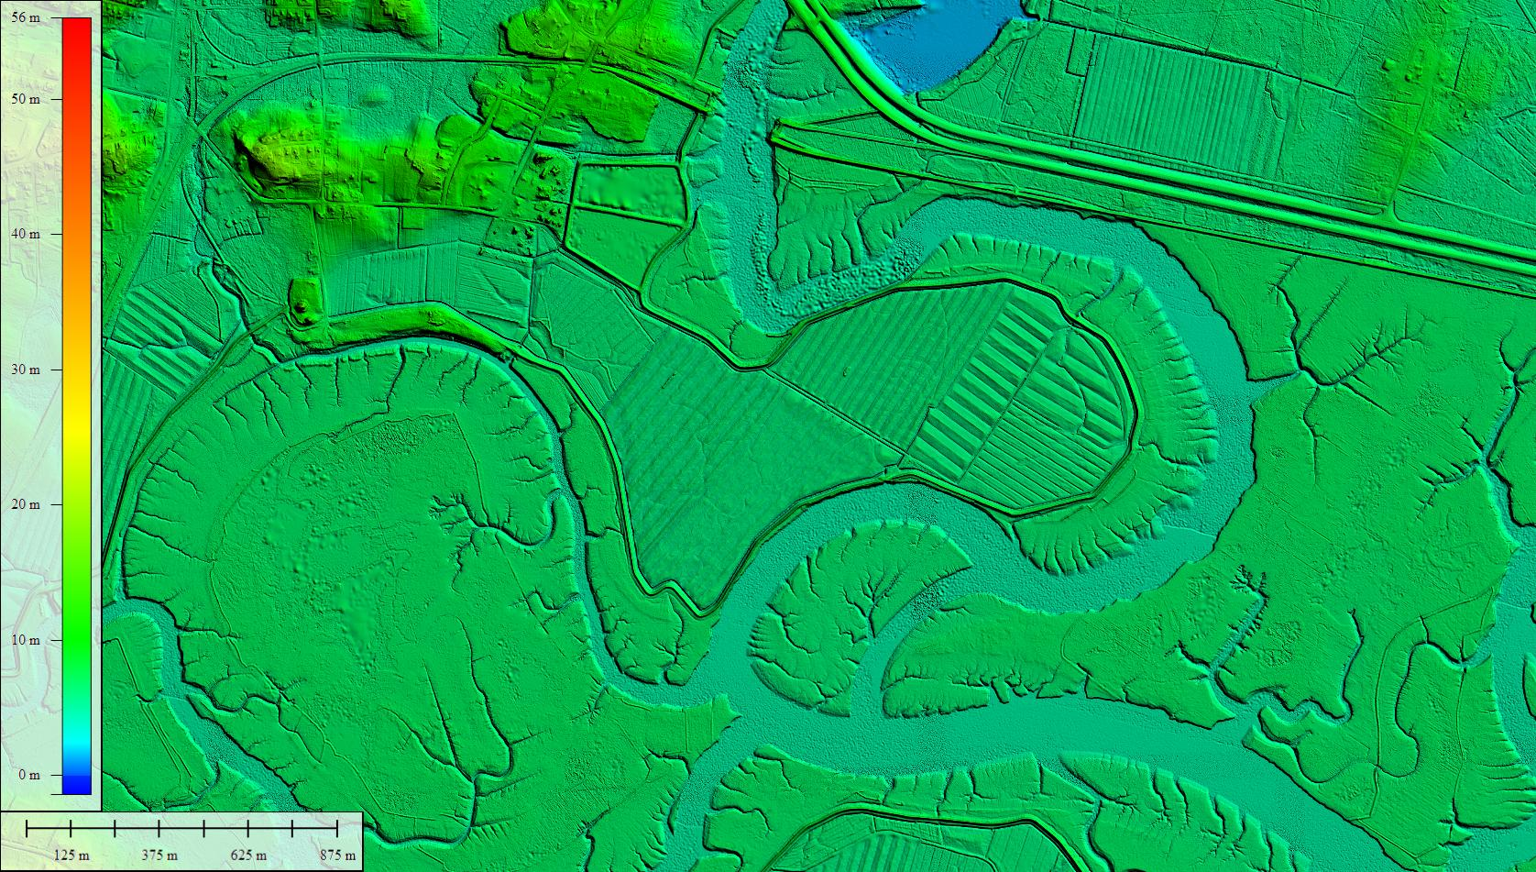
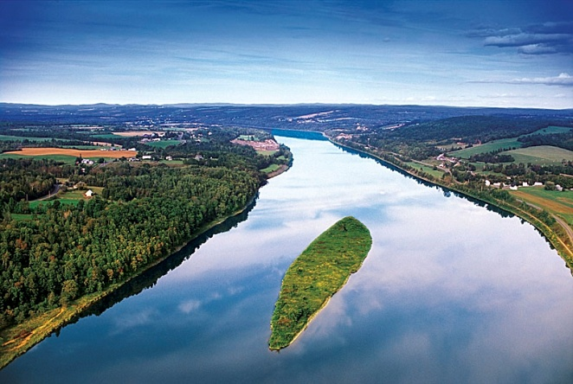
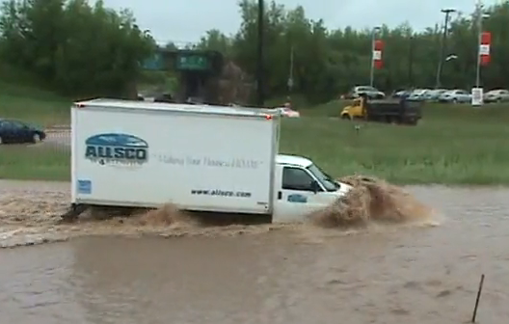
Acadian Peninsula
Grand Falls
Richibucto
Greater Moncton
Sackville-Tantramar
Lower Saint John River

Slide 14
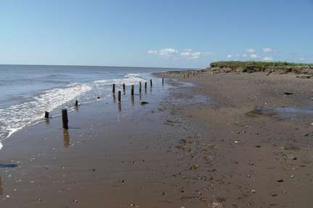
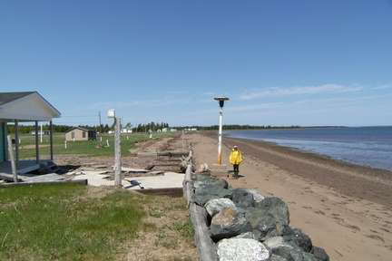
Acadian Peninsula Project

Slide 15
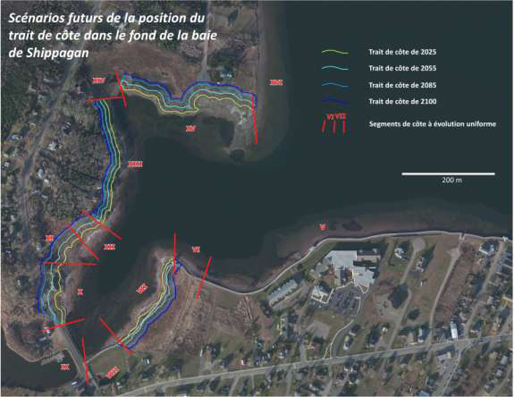
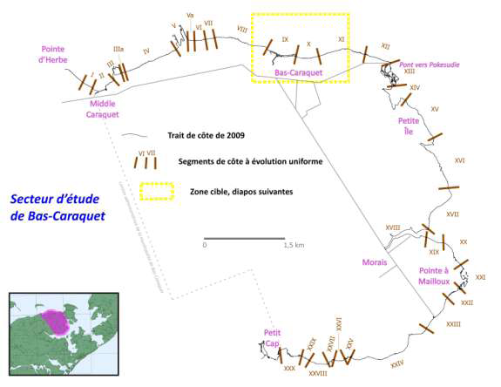
Acadian Peninsula Project

Slide 16
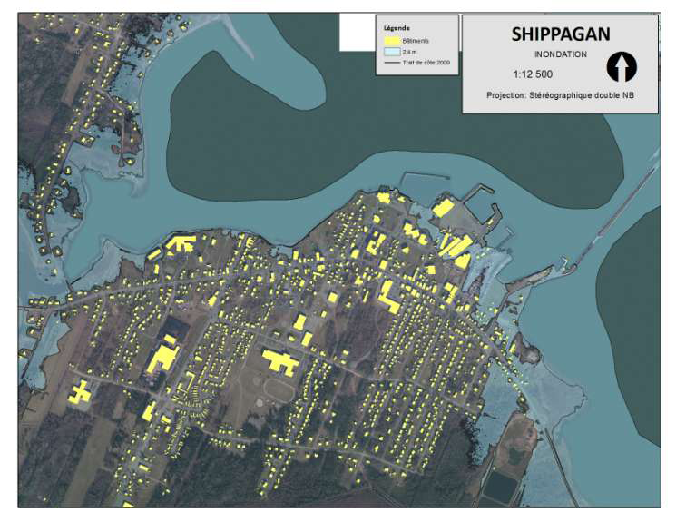
Acadian Peninsula Project

Slide 17
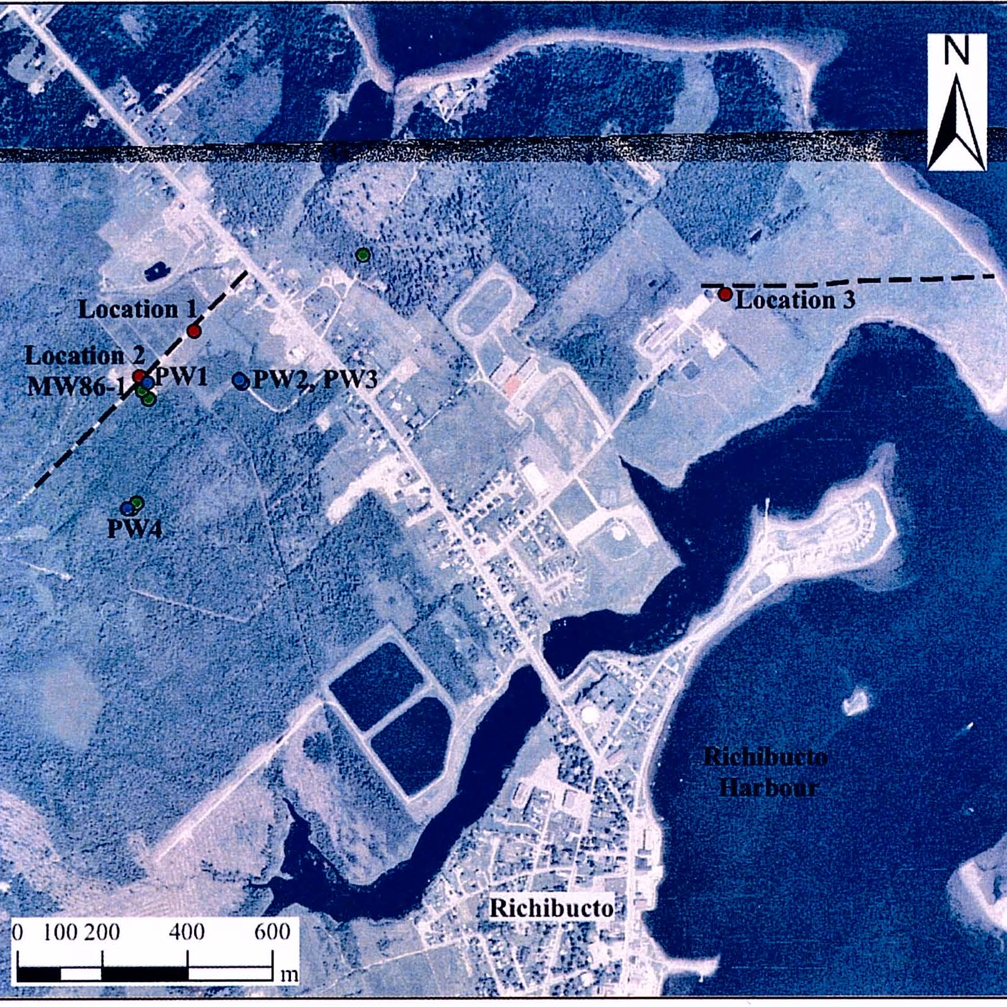
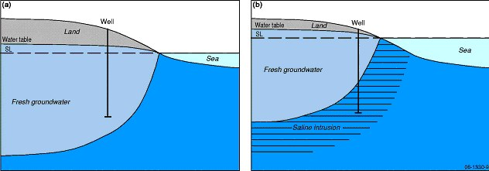
Richibucto Groundwater Project

Slide 18
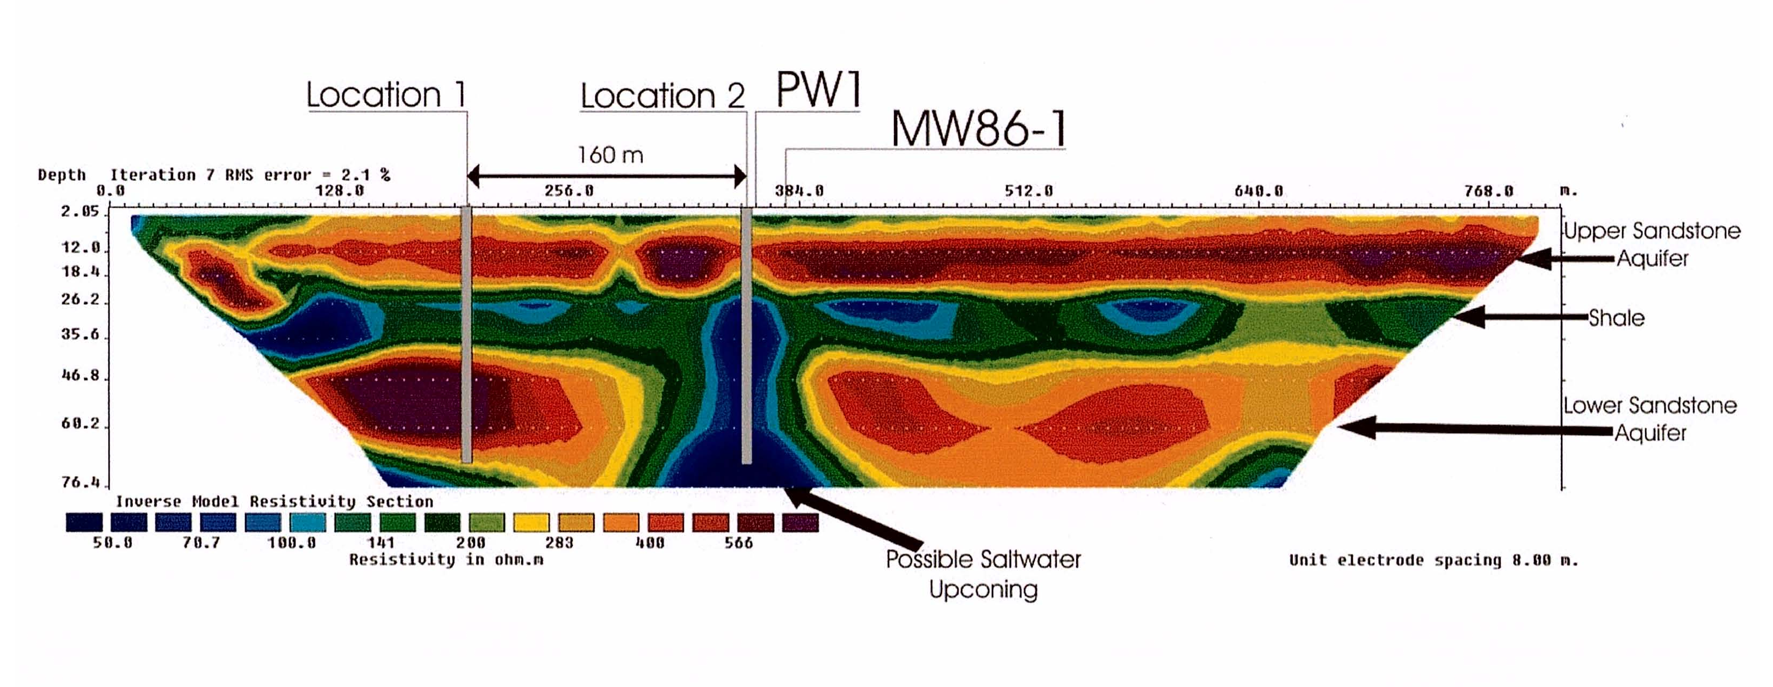
Richibucto Groundwater Project

Slide 19

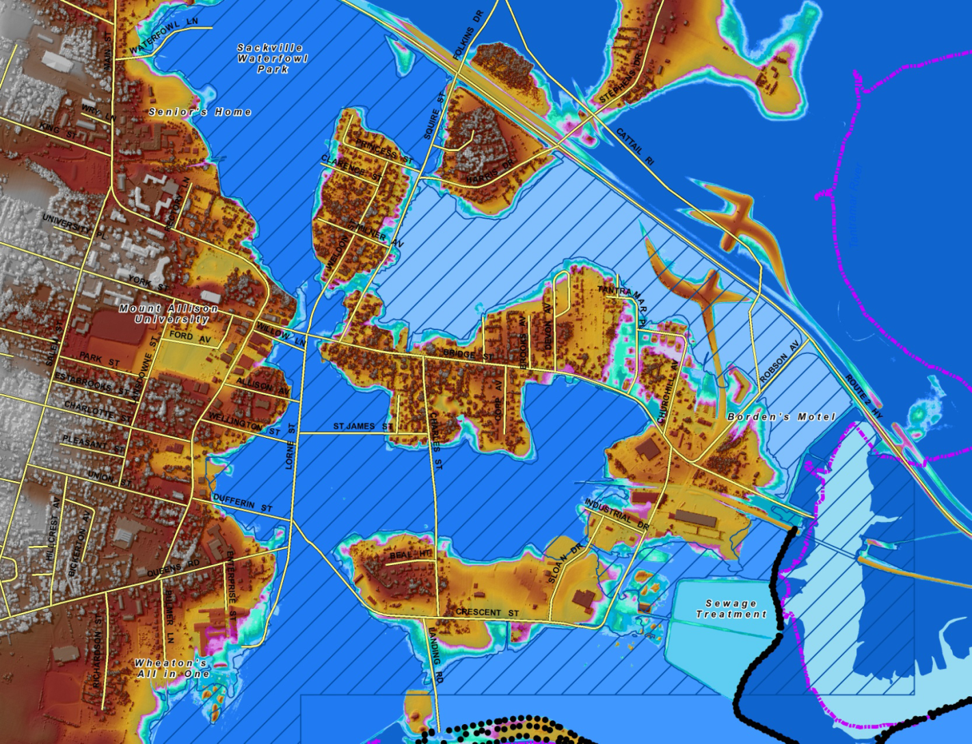
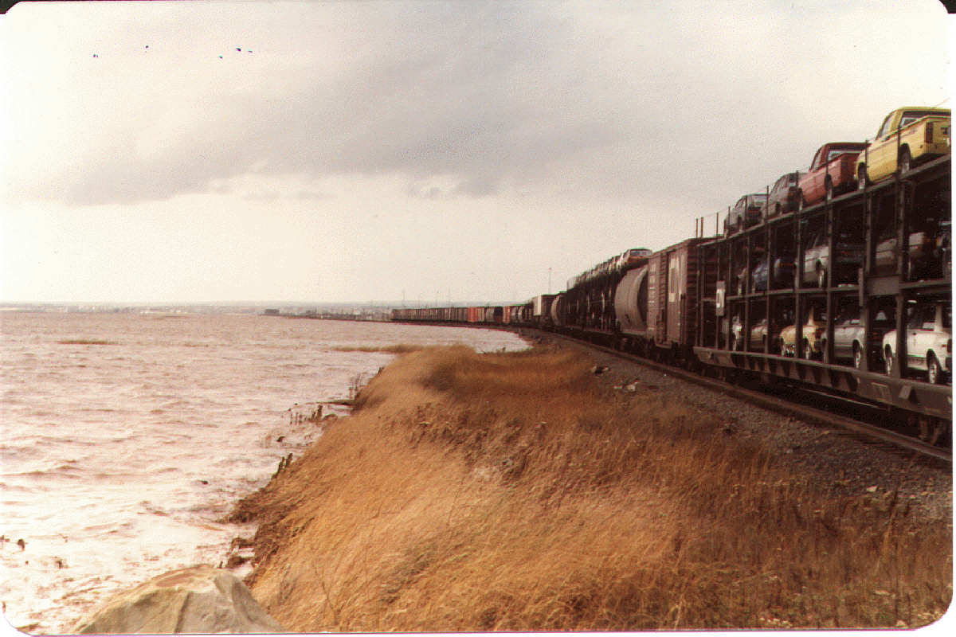
Sackville-Tantramar project

Slide 20
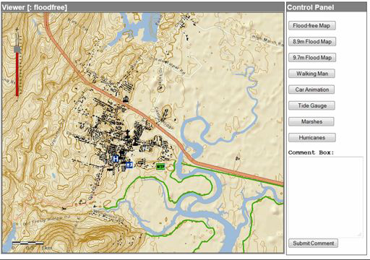
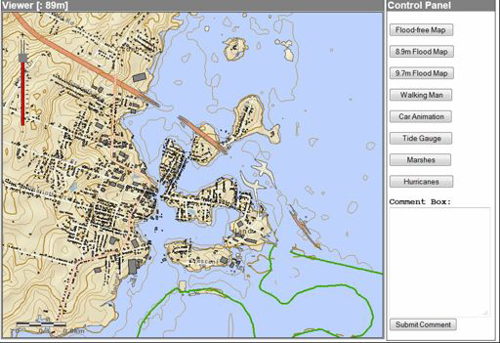
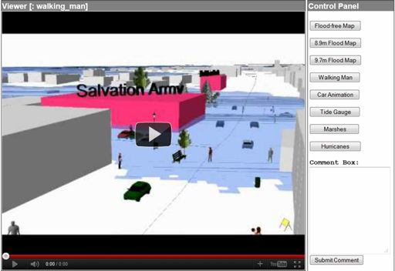
Sackville-Tantramar project

Slide 21
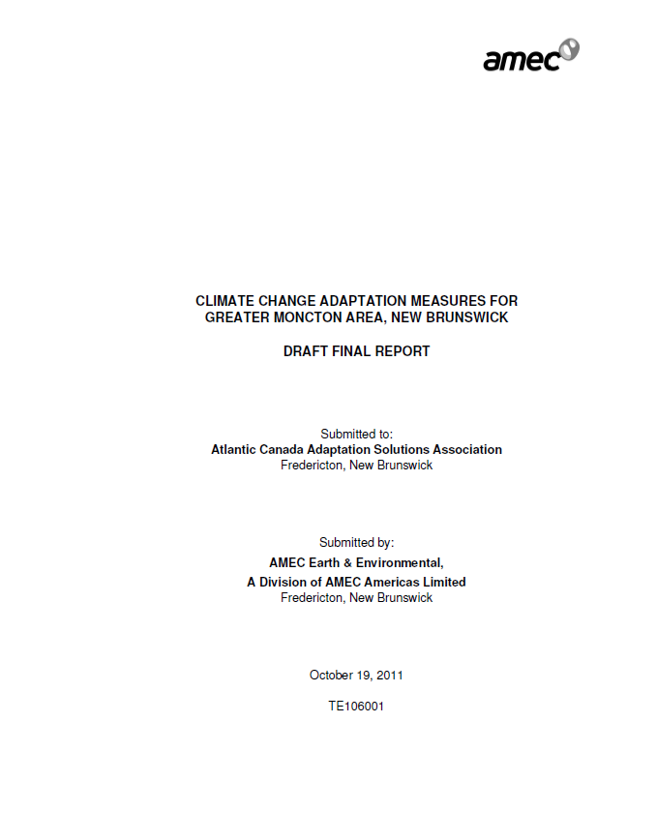

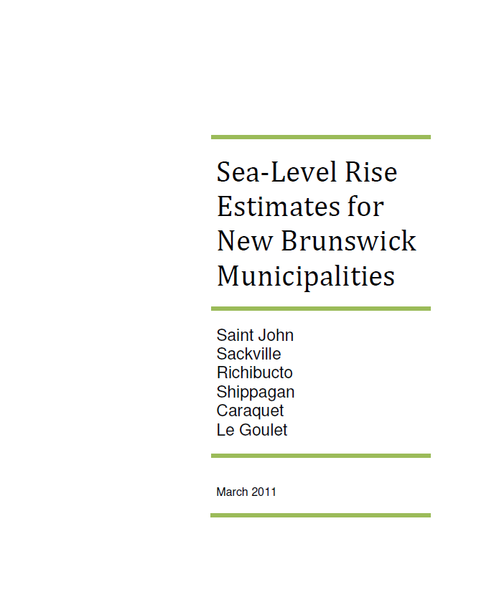
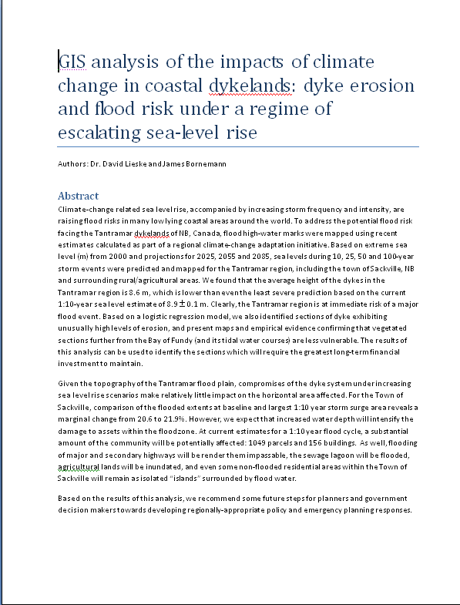
Other products

Slide 22
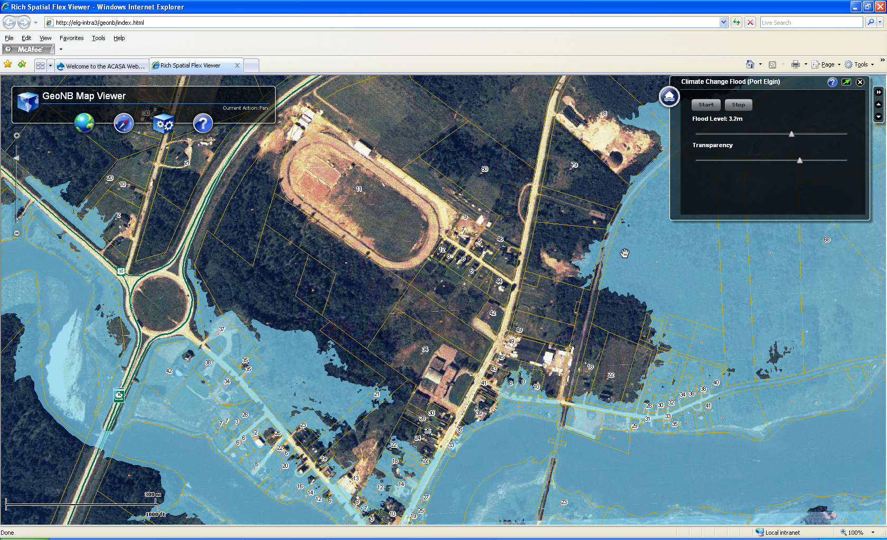
Other products

Slide 23

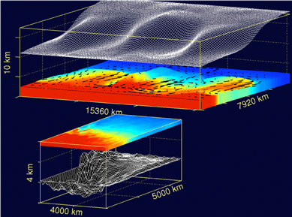
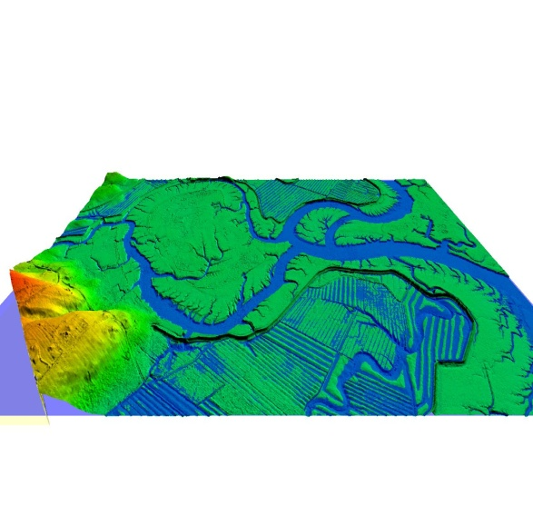
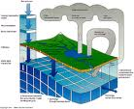
Outputs and Deliverables
Engineering studies
Risk and vulnerability assessments
Highly detailed flood risk mapping, infrastructure at risk mapping
Improved environmental models (flood forecasting, groundwater )
Toolkits, guidance documents
Research and technical teams
Technical, operational and planning recommendations

Slide 24
Challenges –and what else is needed…
Logistics and management, staffing
Need to balance many differing priorities
Inter-provincial/group communications
Many different groups, many moving parts
Multiple parallel projects
Integration into broader sustainability efforts
Long-term vision, mainstreaming
More support for planning
Updated, refocussed programming

Slide 25
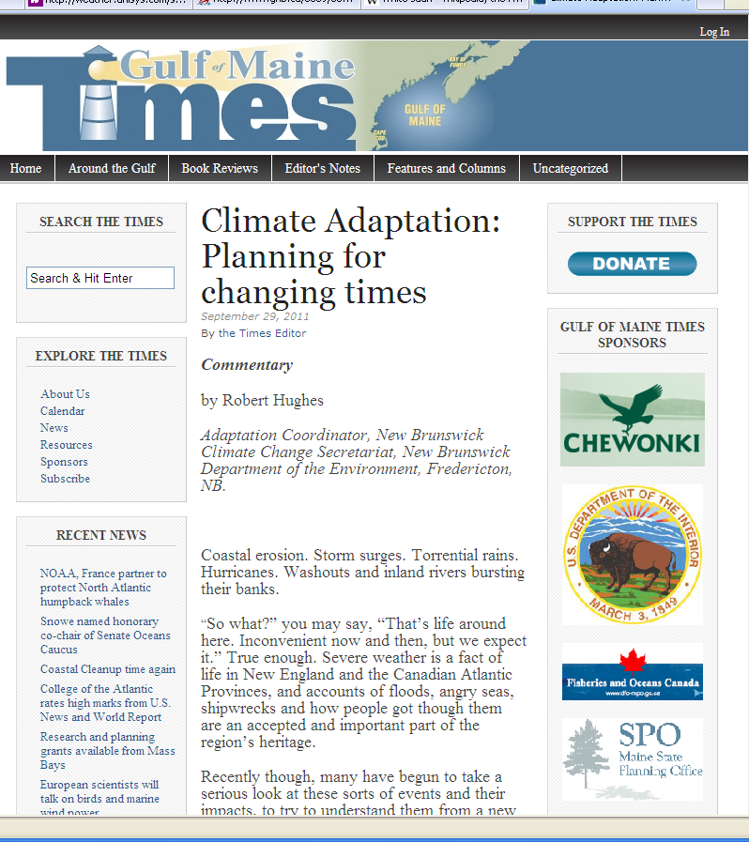
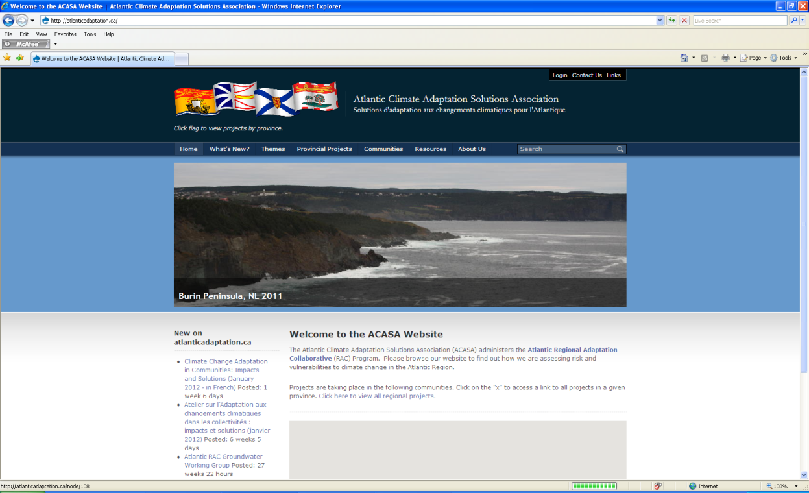
More info:
http://atlanticadaptation.ca/

