Slide 1
www.GulfofMaine.org
7 December 2011
Our new website
Ready to “Go Live”
Jennifer Hackett
Department of Fisheries and Oceans and
Information Management Committee Canadian Co-chair
Jim Cradock
@Yellahoose and
GOM Contractor

Slide 2
Discussion Purpose
Background:
At the September meeting the Working Group reviewed the website changes being proposed and discussed the need to find additional funding for Jim Craddock to accomplish this work.
Environment Canada provided the funding needed to continue the work in preparation for the December release of the Action Plan web page.
Outcome/Desired Action:
Working Group review and approval of the resulting website changes and updates in functionality.

Slide 3
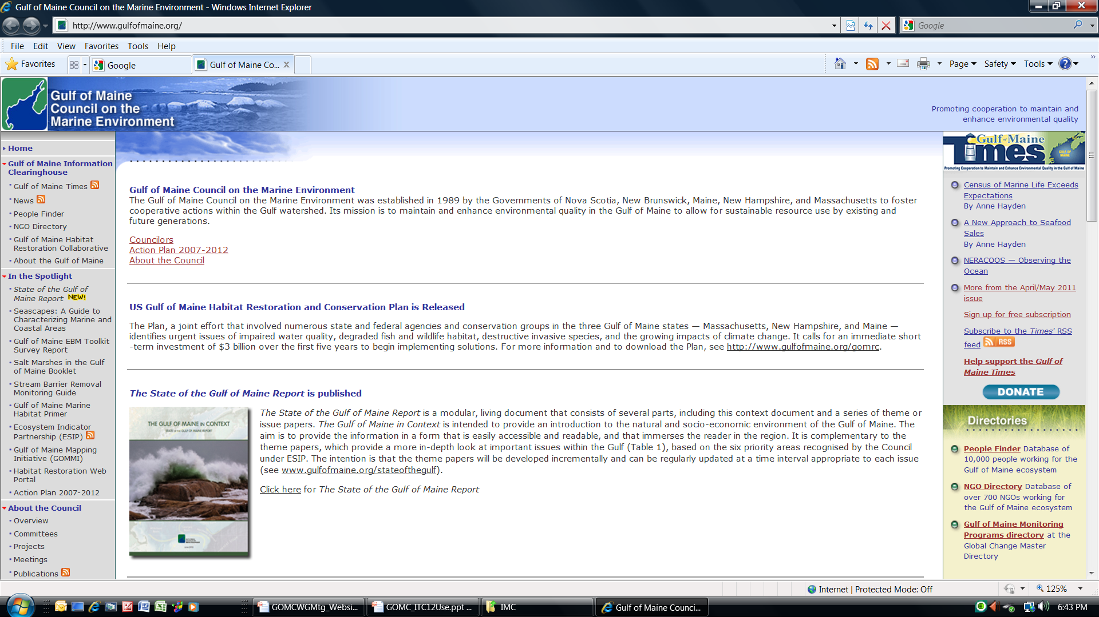
GOMC Splash Page Comparison
Notes:
The current splash page is like an accordion. It looks different on different screens. It will widen to the full width of the window. But you still can’t see to the bottom!

Slide 4
Discussion Purpose
Discussion:
Do you feel the new website is ready to “Go Live” today?
Is there interest in using the Content Management System (CMS) to continue to make minor updates to your specific web pages?
What’s Next:
IT Committee (presently Jennifer Hackett, Kathryn Parlee, Jim Cradock and Michele Tremblay) always welcome additional members with IT needs (web, mapping, data, etc.)
IT Committee Workplan will begin with tying up any loose ends and will train interested members of other committees to do minor content changes to portions of the website
IT Committee aims to not only “keep the lights on” but to become “energy efficient” and “dynamic”!

