Slide 1

Marine Environmental Information: an Update on the EIUI Initiative
Bertrum MacDonald & Peter Wells
Dalhousie University, Halifax
www.eiui.ca
GOMC Working Group Meeting, 5 March 2013

Slide 2
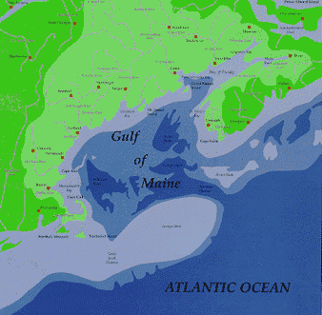
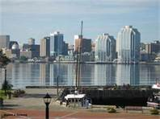
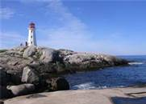
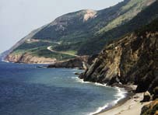
Agenda
Background of the EIUI Initiative
2 Possible Activities and Next Steps
3. Actions and Outcomes Requested

Slide 3
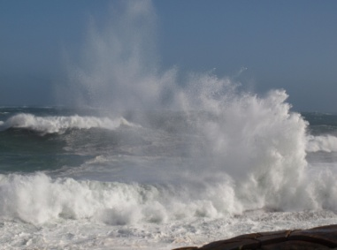
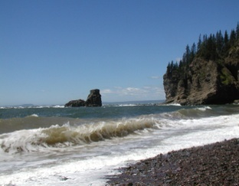
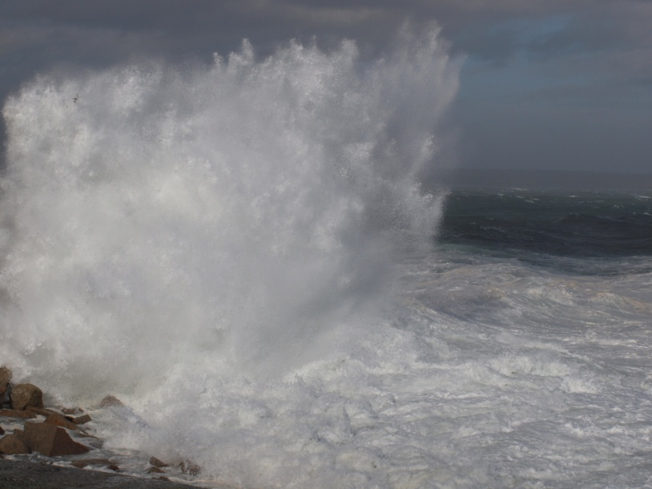
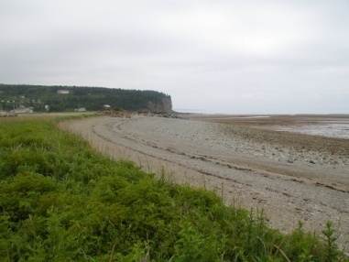
1. Background (1)
The EIUI research initiative – operating since 2006
Support for this research has been provided by:
Social Sciences and Humanities Research Council of Canada
Department of Fisheries and Oceans Canada
Nova Scotia Department of Fisheries and Aquaculture
International Maritime Organization, London, UK
Gulf of Maine Council on the Marine Environment
School of Information Management, Dalhousie University
Notes:
I’d like to thank the organizations that supported the case studies. Also, details of the information presented today can be found at our website.

Slide 4
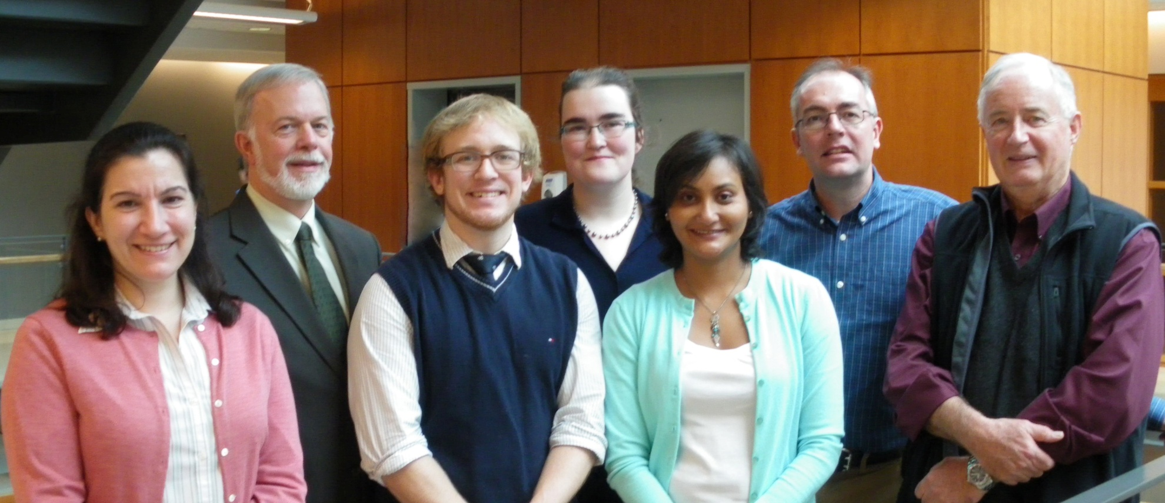
1. Background (2)
New members in the interdisciplinary EIUI team, including new students
Dalhousie Faculty of Management
Information Management / Public Administration
Resource and Environmental Studies / Marine Affairs Program

Slide 5
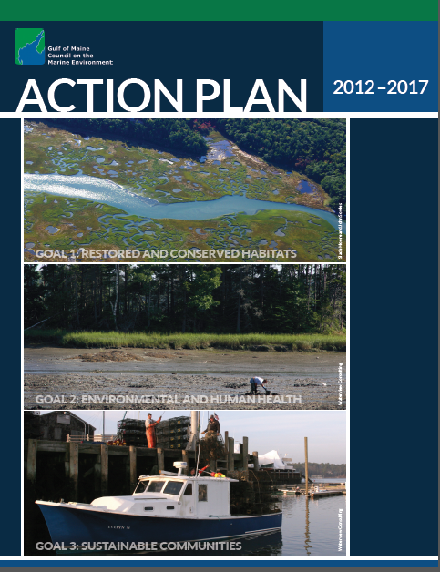
1. Background (3)
EIUI Research & GOMC Action Plan
Goal 1 – Restored and Conserved Habitats
Outcome 1.3: “Coastal decision-makers have the data and information required to conserve coastal and marine habitats…”
Goal 2 – Restored and Conserved Habitats
Outcome 2.3: “Decision-makers receive up-to-date information about impacts of a changing climate on coastal and ocean areas…”

Slide 6

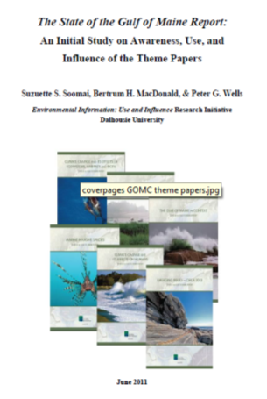

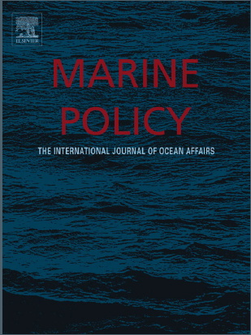
1. Background (4)
The EIUI research team has completed three projects with GOMC
Comprehensive bibliography of GOMC publications & citation analysis study (Cordes, 2006; MacDonald, Cordes, & Wells, 2007)
Master’s thesis on enablers and barriers to distribution, use, and influence of GOMC’s publications (Cossarini 2011; Cossarini, MacDonald, & Wells, (forthcoming 2013))
Study of The State of the Gulf Report (Soomai, MacDonald, & Wells, 2011; 2013)

Slide 7
Theme Papers Read by the Three Surveyed Groups

Slide 8
Theme Papers Used by the Three Surveyed Groups

Slide 9
1. Background (4)
Current Research: Three-Year Partnership Development Grant (SSHRC).
Title: “Investigating and enhancing the policy relevance of marine scientific information (especially grey literature) through multi-partner collaboration”
Governmental | Department of Fisheries and Oceans Environment Canada Nova Scotia Department of Fisheries and Aquaculture
Intergovernmental | UN Food and Agriculture Organization Northwest Atlantic Fisheries Organization
Non-Governmental | WWF-Canada Bay of Fundy Ecosystem Partnership Canadian Parks and Wilderness Society

Slide 10
2. Possible Activities and Next Steps
Grant Applications Pending
EIUI team is a partner in an application, entitled, “Strengthening Environmental Stewardship Decision-Making,” submitted by David Keeley to the Environmental Protection Agency, Fall 2012.
EIUI team submitted an application, entitled “Understanding the Use and Influence of Information and the Role of Networks at the Science-Policy
Interface in Marine Environmental Decision Making” to SSHRC, October 2012.

Slide 11
2. Possible Activities and Next Steps
Workshop
Planned for September 2013
Why – To Address Questions about Environmental Information at the Science-Policy Interface
Who – Speakers: Arthur Mol (Netherlands); William Ascher (USA), Elizabeth De Sombre (USA)
Where – Halifax
Coastal Zone Canada 2014
Planned for June 2014
EIUI Contributed session

Slide 12
3. Actions or Outcomes Requested
EIUI team welcomes your continued engagement
with this research initiative
How can EIUI continue to link to and support GOMC projects, such as
- the digitization of early GOMC publications
- another survey of Gulf of Maine Times readership
Is there interest among GOMC Working Group members for continued study on the awareness, use, and influence of The State of the Gulf Report?
Despite being recognized by GOMC in its Action Plans as vital, why is Information Management often the elephant in the room in Integrated Coastal and Ocean Management?

Slide 13
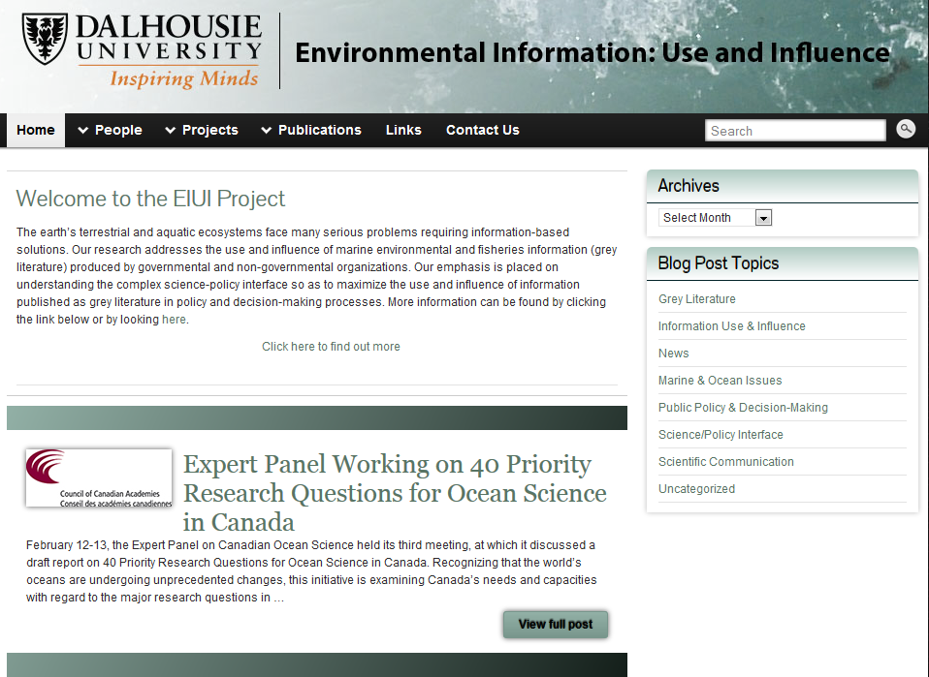
www.eiui.ca

