Slide 1
Re-establishing the GOMC Climate Network:
Products and Planned Activities
Ellen Mecray, NOAA
Bill Appleby, Environment Canada, Meteorological Service
March 6, 2013

Slide 2
Outline
Background (History and Drivers)
Current products (NExUS and Quarterly Outlooks)
Planned Activities (May meeting, EC proposal)
Requests to GOMC/WG (steer comm and participants)

Slide 3
BACKGROUND
History of the Gulf of Maine Climate Network:
March 2006, A need for a climate network
June 2007, Inaugural meeting, on impacts in GOM region, and indicators/monitoring with ESIP
October 2009, Adaptation Info Session to link CN to GOM constituents; CN becomes ‘cross-cutting committee’
2012, NOAA obligates funds to CN, co-chair positions both filled, planning underway to re-invigorate the network
Notes:
NOAA has broad mission
Four mission areas or goals
Climate Change impacting or expected to impact all NOAA mission areas
Direct impacts and indirect impacts
Adaptation efforts cut across the mission areas – all depend on climate products and services from the Climate Mission area that provides foundational information for use in development of adaptation activities (linked adaptation solutions across mission areas)

Slide 4
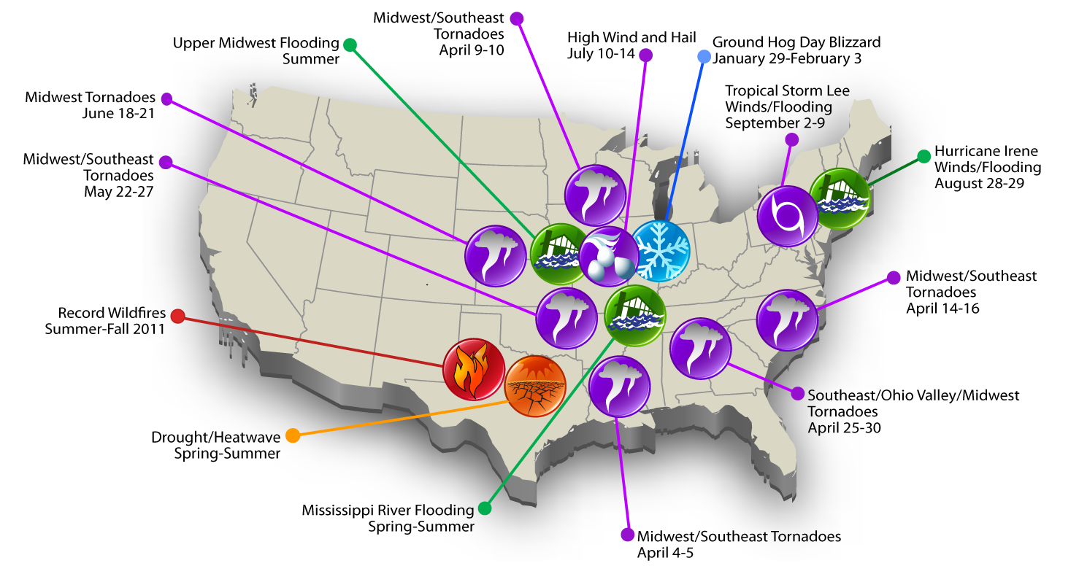
DRIVERS
2011 Billion Dollar Weather/Climate Extremes
14 disasters causing more than $1 billion in the U.S. in 2011 (previous record was 9)
670 lives lost, >6,000 injuries
$55 billion in economic losses
11 disasters causing more than $1 billion in the U.S. in 2012
349 lives lost
Estim >$560billion in economic losses
Source: www.ncdc.noaa.gov/oa/reports/billionz.html
Notes:
Our nation faces frequent and intense extreme events.
In 2011, the U.S. experienced 14 separate weather disasters that have each caused more than $1 billion in economic losses. The total economic impacts for all 14 combined exceed $55 billion. These events also resulted in a loss of 670 lives, and injury to more than 6,000 persons. The previous “record” for number of billion dollar events was 1980, when there were 9 events.
Disasters in Context
While 2011 was certainly a year for the record books in terms of total numbers of disasters, it is also important that we look at all the factors affecting these events.
Our ability to predict, observe and monitor severe events has improved significantly improved over the last several decades.
We now have more powerful instruments aboard satellites, more sophisticated radars, and better land based tools, such as temperature, precipitation and stream flow stations and gauges to allow us to detect individual events and determine their severity.
We also need to look at the growing U.S. population and accompanying expansion of development and infrastructure, particularly in vulnerable areas such as coastal and river floodplains. Quite simply there are more people and more infrastructure in harm’s way.
Finally, the data available to assess economic impacts has improved over time, as it will continue in the future. The effect of these changes on our data is being examined.

Slide 5

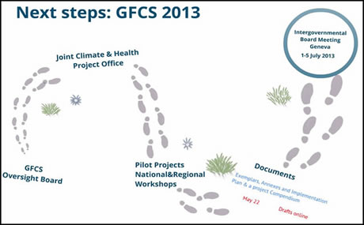
DRIVERS
The main goal of the Global Framework for Climate Services (GFCS) is to "enable better management of the risks of climate variability and change and adaptation to climate change, through the development and incorporation of science-based climate information and prediction into planning, policy and practice on the global, regional and national scale".
(World Climate Conference-3)
Notes:
Drought results in billions of dollars in economic losses annually for many sectors (agriculture, energy, municipal use, forestry, etc.)

Slide 6
DRIVERS
Increasing Demand for Climate Products and Services From Many Sectors
Life and Property
Agriculture
Ecosystems
Aviation
Maritime
Space Operations
Forests
Emergency Management
Commerce
Ports
Energy
Hydropower
Reservoir Control
Recreation
Health
Environment
Infrastructure
Construction
Notes:
Drought results in billions of dollars in economic losses annually for many sectors (agriculture, energy, municipal use, forestry, etc.)

Slide 7
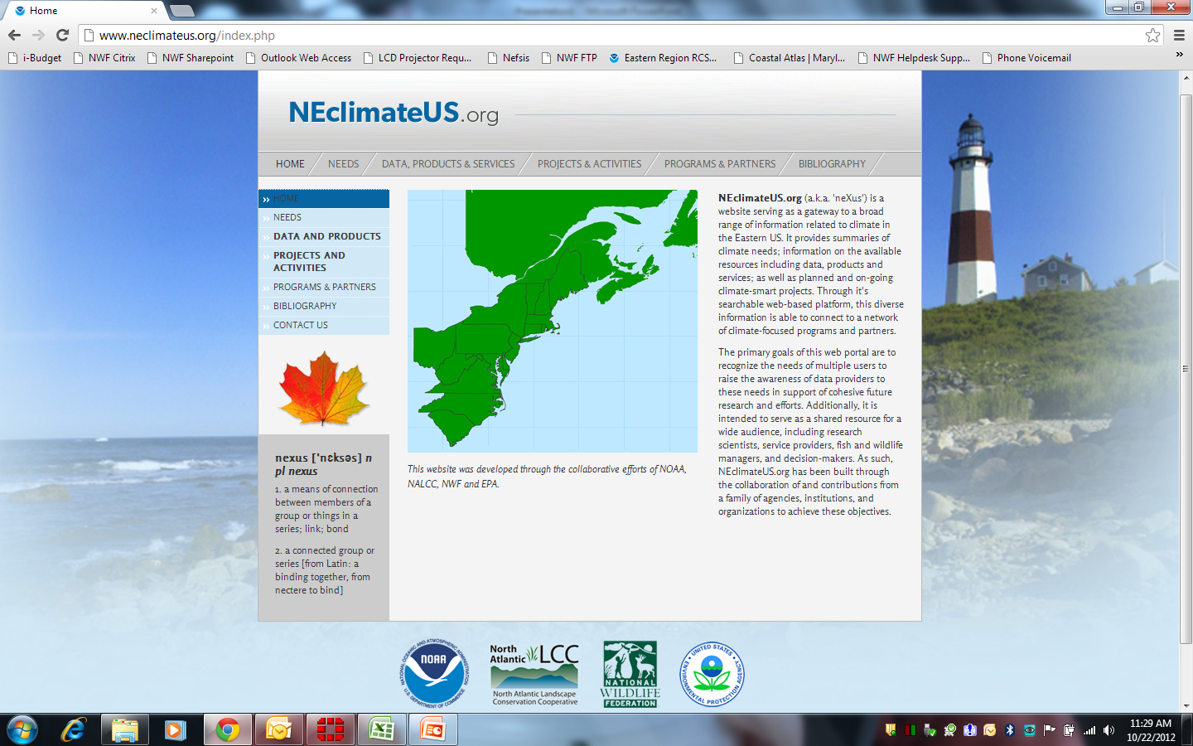
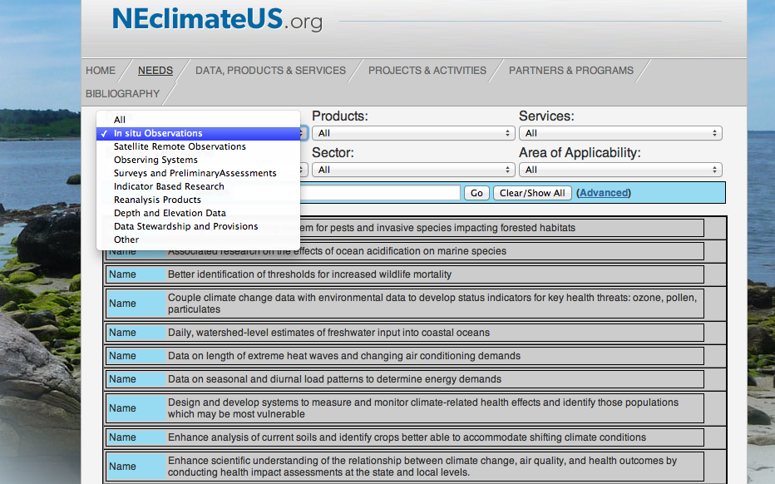
CURRENT PRODUCTS
NExUS
Eastern Region Prototype Portal to be integrated into Climate.gov
RCSD-led partnership with USFWS, EPA, North Atlantic LCC
Searchable online database to catalog climate information needs, existing products and services, current funded projects, and directory of regional partners
Offers end-to-end regional project planning to identify gaps, prioritize collaborative projects, and leverage resources for stronger partnered execution
Notes:
Maritime Commerce: NOAA’s nautical charts function like road maps for navigators, portraying dangerous depths and obstructions that could cause a wreck or ship grounding. NOAA’s tides and currents information and highly accurate positioning help keep the marine transportation system operating safely and efficiently.
When accidents or natural disasters block or close our waterways for safety reasons, NOAA is there to help. Special navigation teams respond quickly to survey harbors and channels for sunken vessels, obstructions, and alternate routes for military and commercial ships.
Our economy — the foundation of our national security — depends on the uninterrupted flow of goods. To ensure that our marine transportation system is the world’s safest, most efficient, and environmentally sound, NOAA is a lead agency for the Committee on the Marine Transportation System — the president’s cabinet-level interagency committee.
NOAA and its committee partners recently proposed a national strategy to improve and enhance our marine transportation system. The objective is to take steps now so that the system can grow with increased ship traffic and demand while remaining safe and efficient.
Coastal Resilience: April 2007’s Patriot’s Day Storm caused significant coastal erosion and millions of dollars in property damage along Massachusetts’ North Shore. In 2008, the Massachusetts Office of Coastal Zone Management (MACZM) launched StormSmart Coasts—a program designed to help local officials in coastal communities address the challenges arising from storms, floods, sea level rise, and climate change. The program includes training workshops, direct technical assistance, and an extensive web site with a menu of tools for successful coastal floodplain management. The StormSmart Coasts web site consolidates and simplifies information from around the U.S. on everything from hazard identification and mapping to legal information and funding. Fact sheets explain the tools and showcase success stories that provide real-world examples of complicated concepts.
Coastal partners and customers:
State coastal management programs
Communities/local governments
Land use planners
Natural resource managers
Policy-makers
Other Federal agencies

Slide 8
CURRENT PRODUCTS
Quarterly Climate Outlooks
Notes:
Coastal partners and customers:
State coastal management programs
Communities/local governments
Land use planners
Natural resource managers
Policy-makers
Other Federal agencies

Slide 9
PLANNED ACTIVITIES
Meeting, May 22-23, 2013, Bangor, Maine
The intentions for this meeting include:
Review and re-establishment of the network membership to include provincial and state representatives, as well as Canadian and US Federal agency partners.
Connect the scientific observing community with the management and decision-making community.
Develop a regional gap analysis and strategic plan for response to climate concerns (e.g. common interests and needs, priority areas for collaboration, common indicators for tracking climate change, and data/monitoring needs).

Slide 10
PLANNED ACTIVITIES
Environment Canada proposal
Results proposed:
Provide follow-up to the May 2013 Workshop including coordination, collaboration and communication for the GOMC/CN by identifying opportunities and critical areas for collaboration between Atlantic Canada and the Northeastern US.
Provide information from Canada for the NExUS website (neclimateus.org) including cataloguing existing products and projects related to climate adaptation in the region and reviewing expressed climate information needs at the provincial and federal levels.
Provide improvements and Canadian input to the GOMC Ecosystem Indicators Partnership (GOMC/ESIP) by evaluating the current use of the website, querying provincial and federal audiences on additional improvements and indicators they would like to see on the site (Tier 2 indicators), and defining needs to build monitoring and data collection capacity with Canadian watershed groups to meet those additional requests.

Slide 11
THE WAY FORWARD
Requests to GOMC WG, March 2013:
Offer names from jurisdictions and federal agencies (Cdn and US) to serve on steering committee for meeting agenda preparation
Propose participant names for meeting in March
Deliverables for June 2013 GOMC:
CN will report out on results from May meeting, incl path forward for CN, workgroup establishment, and goals/objectives

Slide 12
MORE
INFORMATION
Need More Information?
NExUS, Phase 1 regional climate information
http://neclimateus.org
Quarterly Climate Outlook
http://www.drought.gov/drought/content/resources/reports
Climate Portal
http://www.climate.gov

