Slide 1
Update about Research by the EIUI Team
Peter G. Wells & Bertrum H. MacDonald
Gulf of Maine Council Working Group Meeting
Halifax, Nova Scotia
4 December 2013

Slide 2
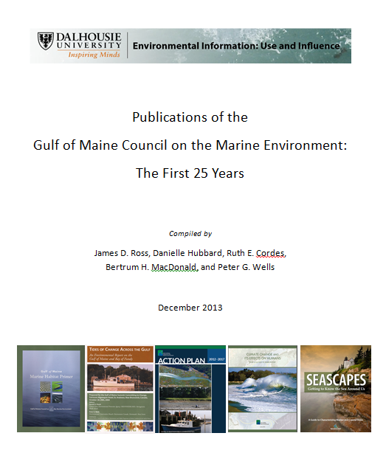
Bibliography of GOMC Publications (1989-2013)

Slide 4
Current Work
Research Funding
Social Sciences and Humanities Research Council of Canada
Partnership Development Grant (2012-2015)
Insight Grant Application (Submitted October 2013; confirmation April 2014)
New Graduate Course
“Role of Information in Policy and Decision Making”
Launched in 2013; next offering in 2014 with 30 students

Slide 5
Research Partners
SSHRC Partnership Development Grant
Governmental Organizations
Canada Department of Fisheries and Oceans
Canada Department of the Environment
Nova Scotia Department of Fisheries and Aquaculture
Intergovernmental Organizations
Food and Agriculture Organization of the United Nations
Northwest Atlantic Fisheries Organization
Non-Governmental Organization
Bay of Fundy Ecosystem Partnership
Canadian Parks and Wilderness Society
WWF Canada

Slide 6
Research Questions
SSHRC Insight Grant Application (October 2013)
1. How and in what forms does scientific information influence policy decisions on marine environmental issues?
2. What drives the production of marine environmental information and what enablers and barriers affect its use at the science/policy interface?
3. Given the vast and growing volume of scientific information, what qualities and filters do policy makers use to select information sources?
4. What role(s) do the news media and/or social media networks and other web-based information dissemination pathways play in the formulation of marine environmental policies?
5. What metric(s) will account for use and influence of information in public policy contexts, which can range from indirect to direct?

Slide 7
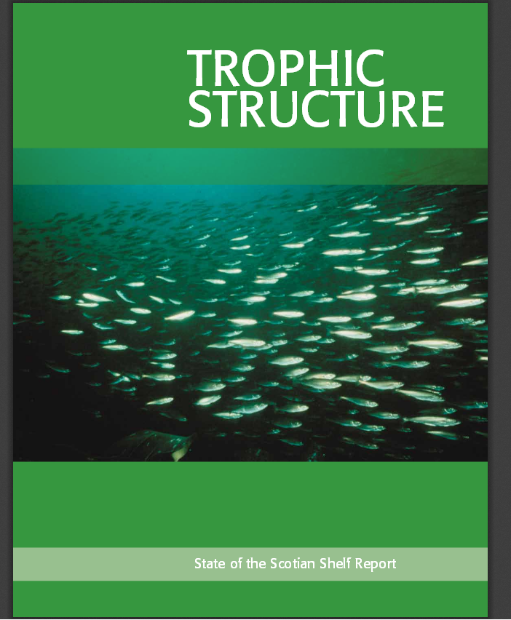
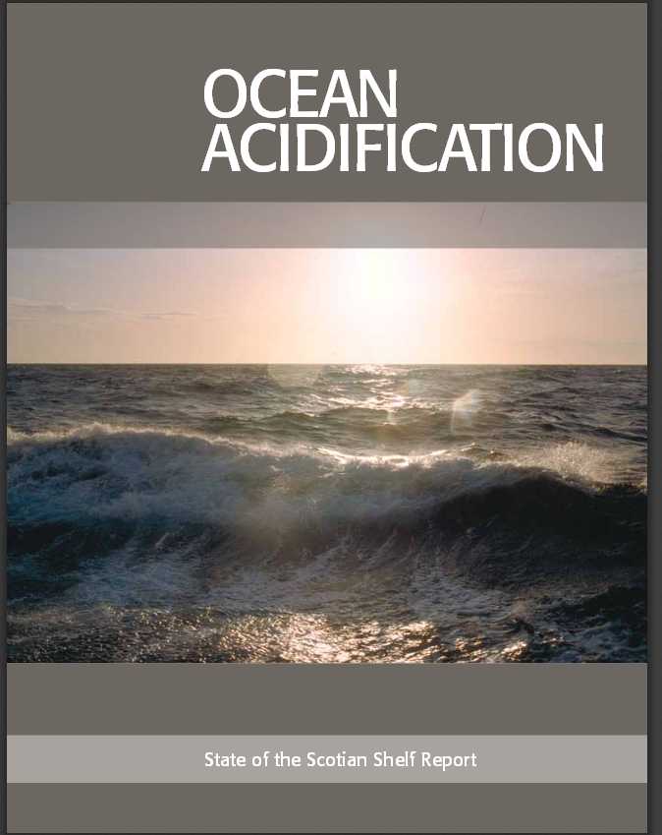
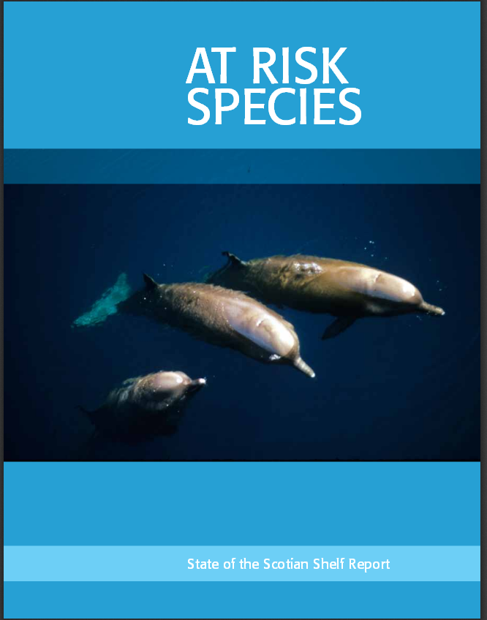
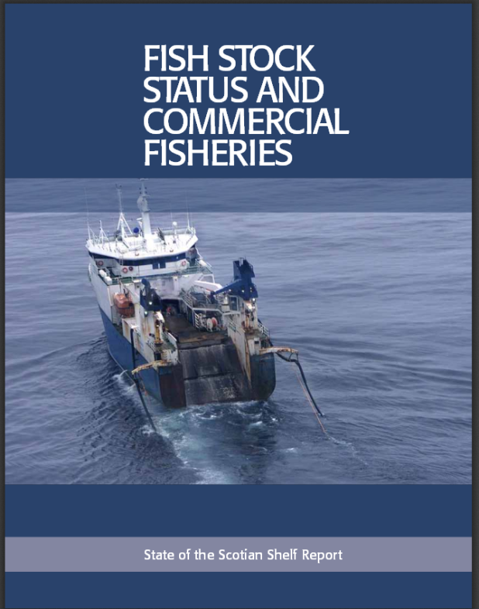
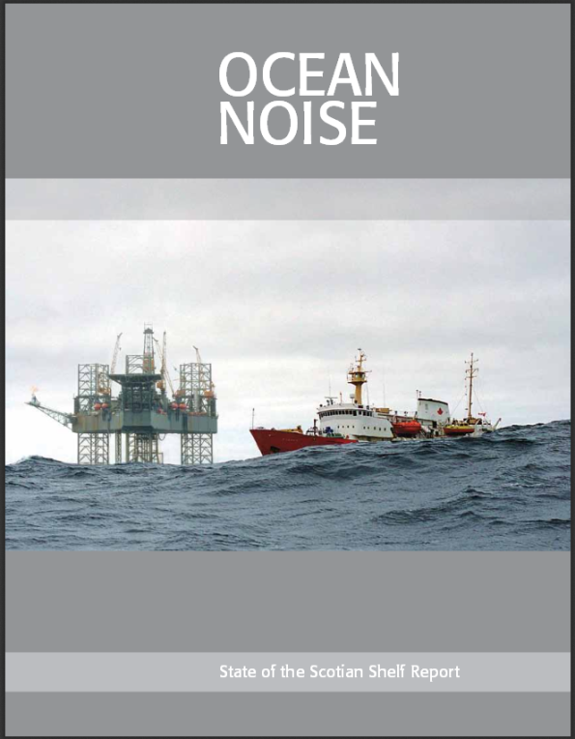
Current Research: State of the Scotian Shelf Report Study
Master’s thesis: James D. Ross

Slide 8
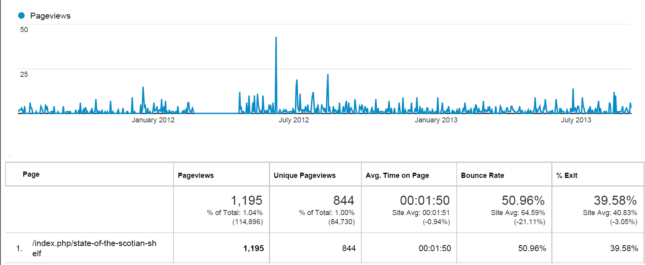
=
State of the Scotian Shelf Report Study
Preliminary Results
Google Analytics
(11 July 2011 - 10 September 2013)
Notes:
-add dal logo and eiui, as on poster
-smaller
8

Slide 9
Future EIUI Projects in Support of GOMC?
We are interested in continuing
collaboration with GOMC personnel
For example, further analysis of the use and influence of GOMC publications using new analytical techniques (such as, web analytics, evaluation of information pathways to decisions, etc.) could be conducted.

Slide 10
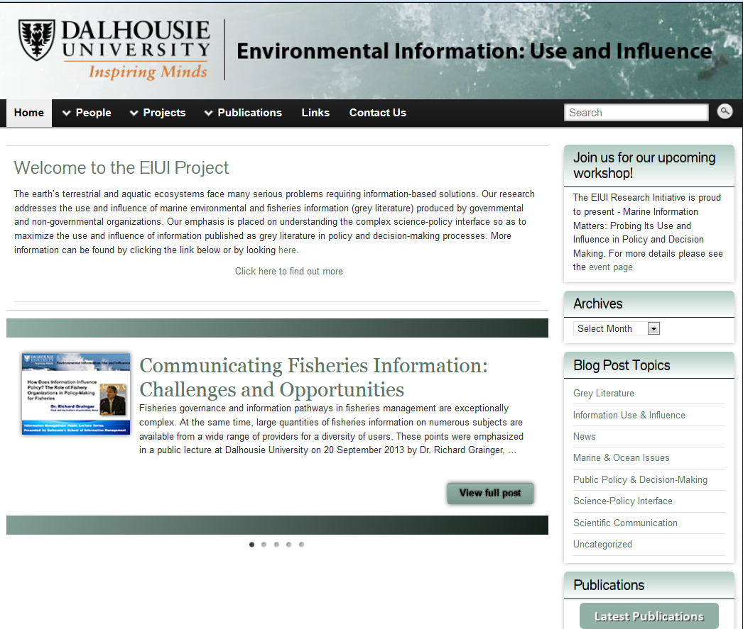
www.eiui.ca

