Slide 1
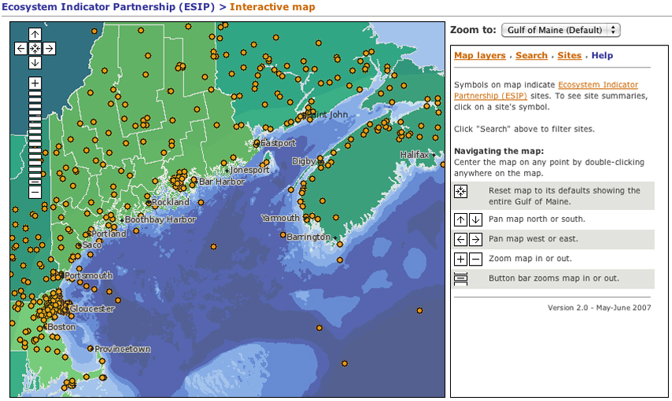
Monitoring Map
Default view:
This is what the map looks like when you first arrive at the web page

Slide 2
Monitoring Map
Example Task 1:
Find climate change data near
Truro, Nova Scotia

Slide 3
Monitoring Map
Example Task 1:
Find climate change data near
Truro, Nova Scotia
First, click on
Map layers
to see how to display climate change sites on the map

Slide 4
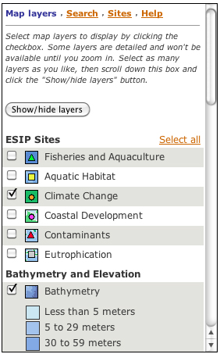
Monitoring Map
Example Task 1:
Find climate change data near
Truro, Nova Scotia

Slide 5
Monitoring Map
Example Task 1:
Find climate change data near
Truro, Nova Scotia
Map legend says orange symbols indicate sites with climate change data, which is what we are trying to find. So we don’t need to change map layers for Example Task 1.

Slide 6
Monitoring Map
Example Task 1:
Find climate change data near
Truro, Nova Scotia
To see the Truro area close up:
• click on the Zoom to menu

Slide 7
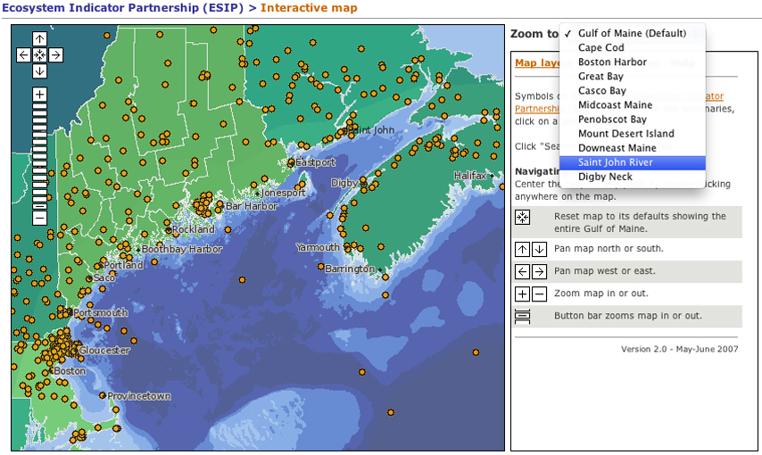
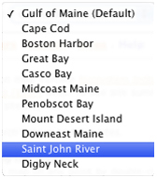
Monitoring Map
Example Task 1:
Find climate change data near
Truro, Nova Scotia
To see the Truro area close up:
• click on the Zoom to menu
• select Saint John River in menu

Slide 8
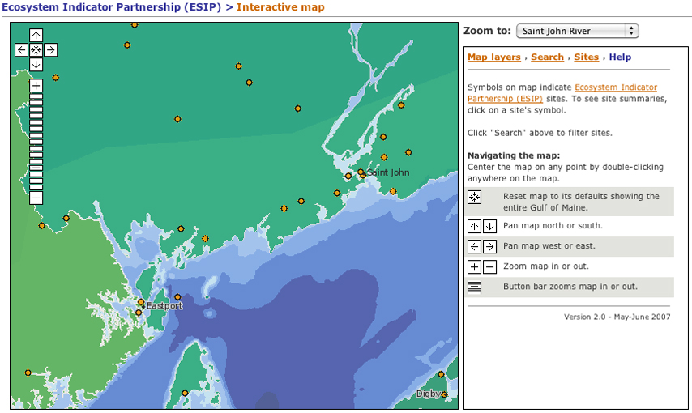
Monitoring Map
Example Task 1:
Find climate change data near
Truro, Nova Scotia
Now the map shows a closer view of the St. John River and Bay of Fundy

Slide 9
Monitoring Map
Example Task 1:
Find climate change data near
Truro, Nova Scotia
Click [-] button once to zoom out slightly

Slide 10
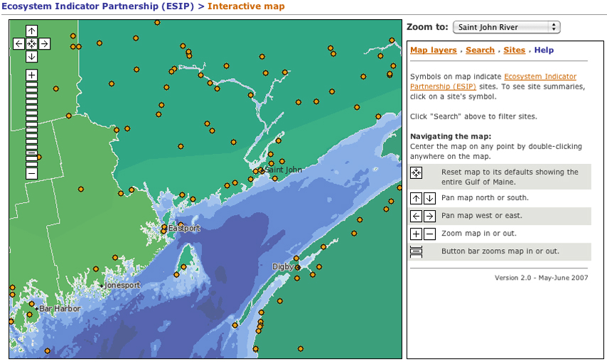
Monitoring Map
Example Task 1:
Find climate change data near
Truro, Nova Scotia
Map shows a wider view of the Bay of Fundy

Slide 11
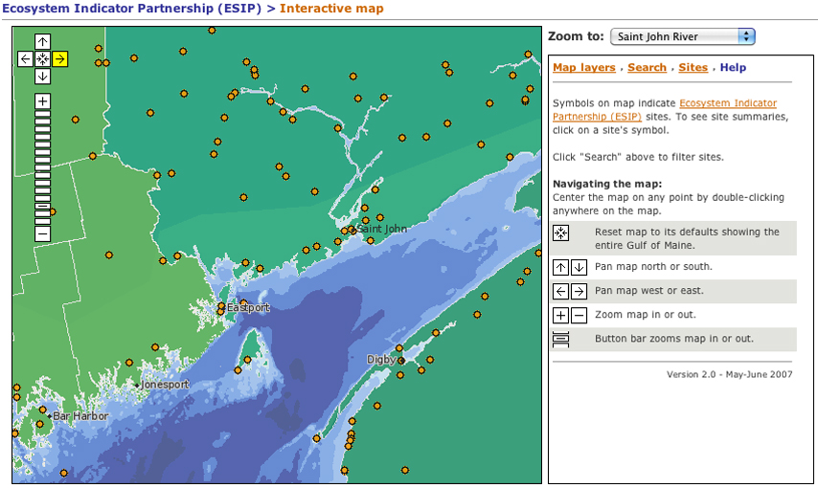
Monitoring Map
Example Task 1:
Find climate change data near
Truro, Nova Scotia
Click [–>] button to move map eastward toward Truro

Slide 12
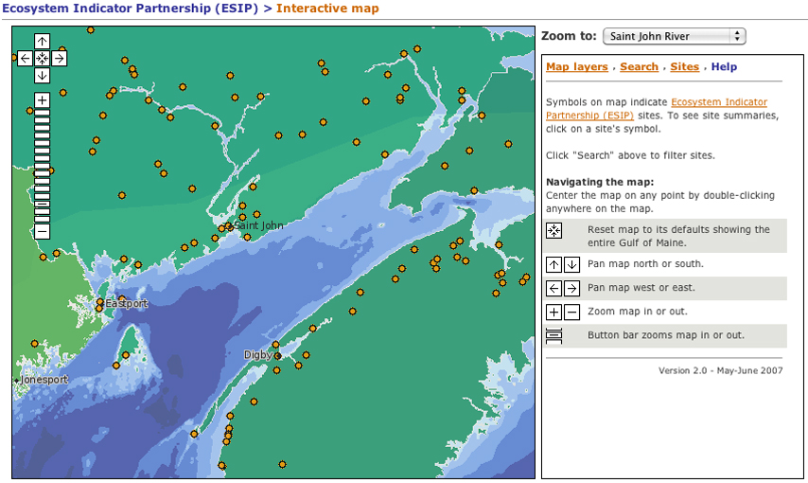
Monitoring Map
Example Task 1:
Find climate change data near
Truro, Nova Scotia

Slide 13
Monitoring Map
Example Task 1:
Find climate change data near
Truro, Nova Scotia
Click [–>] again to move map eastward toward Truro

Slide 14
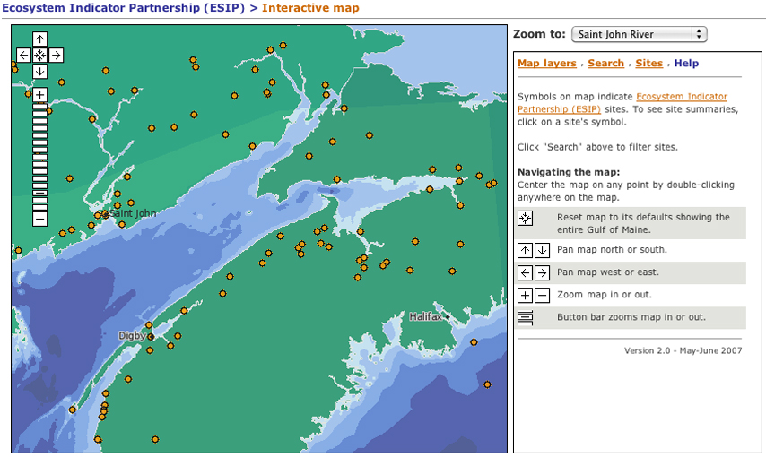
Monitoring Map
Example Task 1:
Find climate change data near
Truro, Nova Scotia
Map now shows the Truro area

Slide 15
Monitoring Map
Example Task 1:
Find climate change data near
Truro, Nova Scotia
Choose one of the sites near Truro and click to see a Site Summary

Slide 16
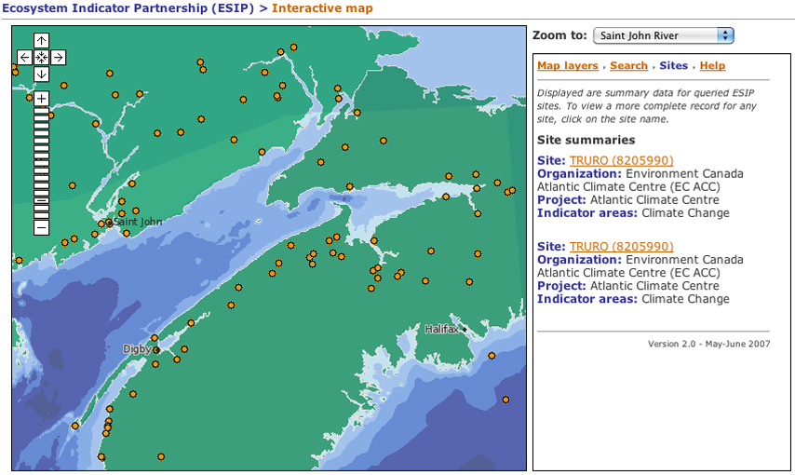
Monitoring Map
Example Task 1:
Find climate change data near
Truro, Nova Scotia
Site Summary appears here

Slide 17
Monitoring Map
Example Task 1:
Find climate change data near
Truro, Nova Scotia
Click link for site detail

Slide 18
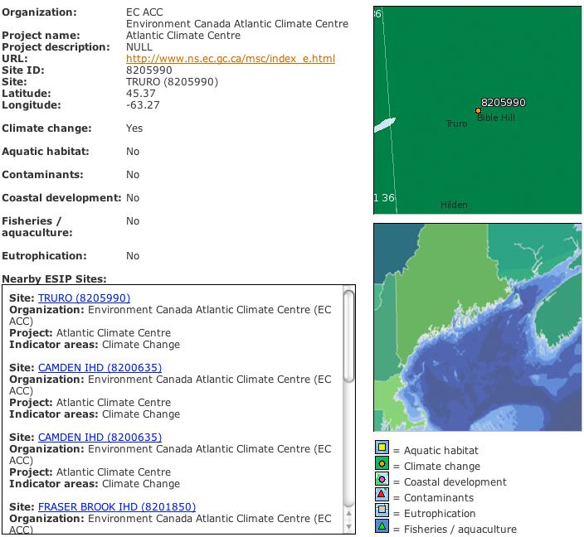
Monitoring Map
Example Task 1:
Find climate change data near
Truro, Nova Scotia
Site has climate change data
Close-up map
of the site
Other nearby monitoring sites

Slide 19
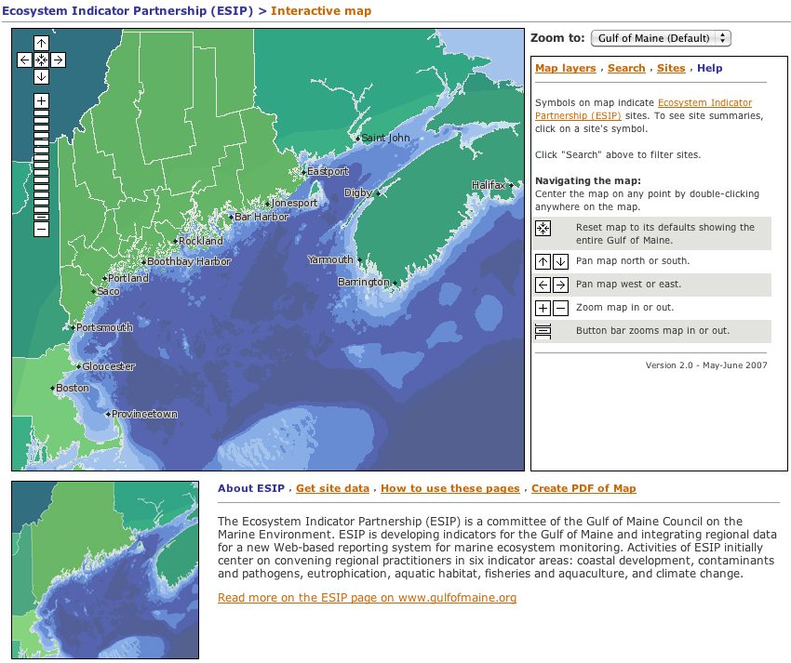
Monitoring Map
Example Task 2:
Create a PDF map of monitoring sites for contaminants
and eutrophication

Slide 20
Monitoring Map
Example Task 2:
Create a PDF map of monitoring sites for contaminants
and eutrophication
Click on
Map layers

Slide 21
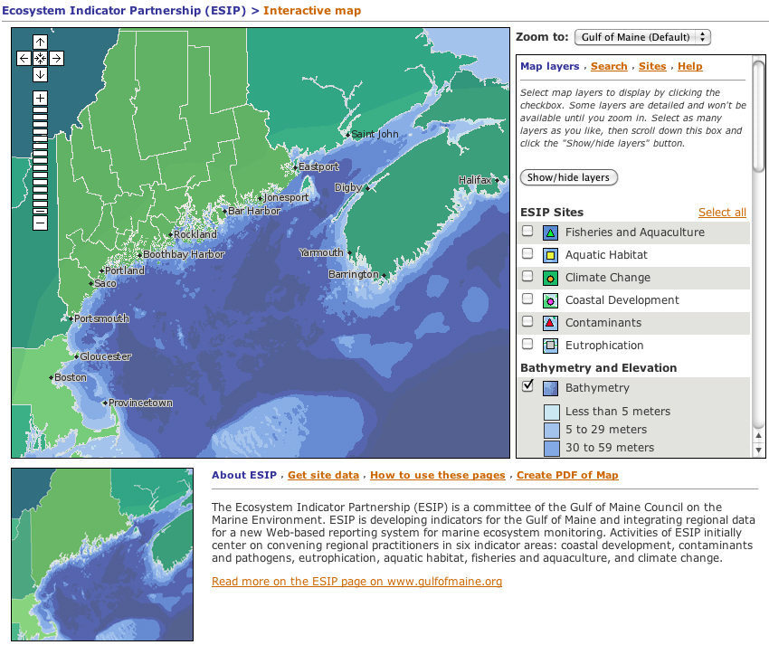
Monitoring Map
Example Task 2:
Create a PDF map of monitoring sites for contaminants
and eutrophication
Click on
checkboxes for contaminants and
eutrophication

Slide 22
Monitoring Map
Example Task 2:
Create a PDF map of monitoring sites for contaminants
and eutrophication
Click on
Show/hide layers

Slide 23
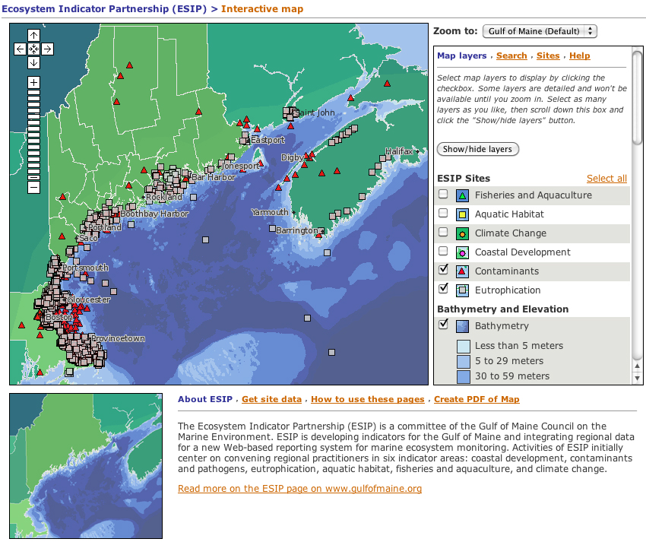
Monitoring Map
Example Task 2:
Create a PDF map of monitoring sites for contaminants
and eutrophication
Click on
Create PDF of Map

Slide 24
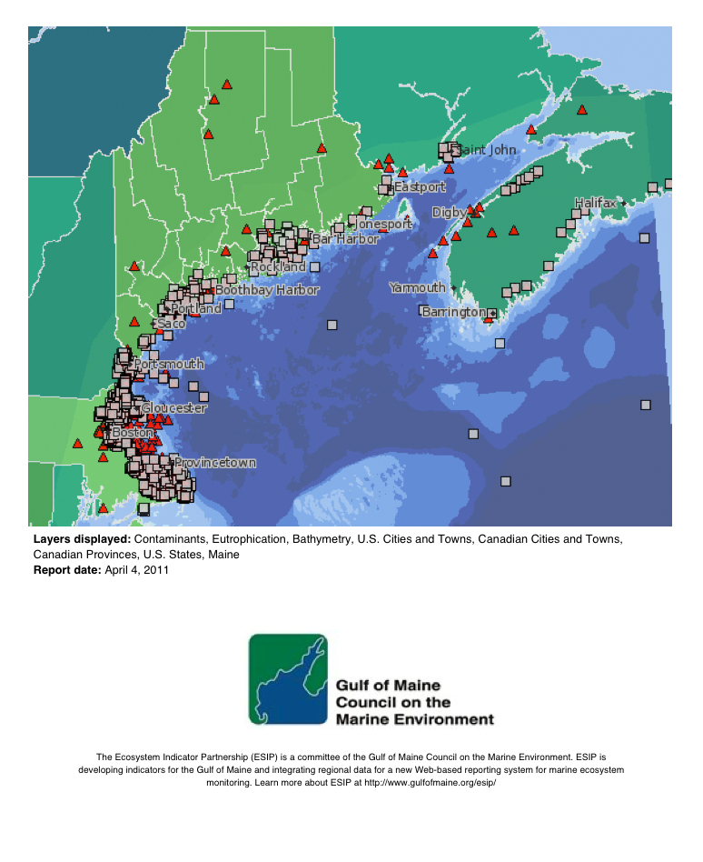
Monitoring Map
Example Task 2:
Create a PDF map of monitoring sites for contaminants
and eutrophication
A PDF version of the map
is generated and can be downloaded for printing.

