Slide 1
Answering Climate Change Questions through ESIP’s Indicators
June 2014

Slide 2
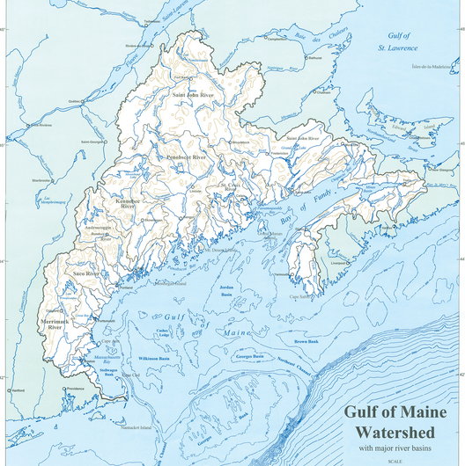
What is the EcoSystem Indicator Partnership?
Partnership of scientists, academics, individuals from nonprofits using indicators to look at change in the Gulf of Maine.

Slide 3
ESIP’s core goal of providing information on change in the Gulf of Maine keeps intersecting the needs of other initiatives in the region.
NEERS
ALSI
BoFEP
CN
ESIP
ACCESS
NERACOOS

Slide 4
How does ESIP intersect with Climate Change?
ESIP tackled priority indicators for Gulf of Maine by looking at seven theme areas – one of which was climate change.
Three* priority indicators were selected for climate change. 22 ESIP indicators in TOTAL.
Sea level
Air temperature, particularly trends in seasons
Precipitation, particularly trends in extreme precipitation

Slide 5
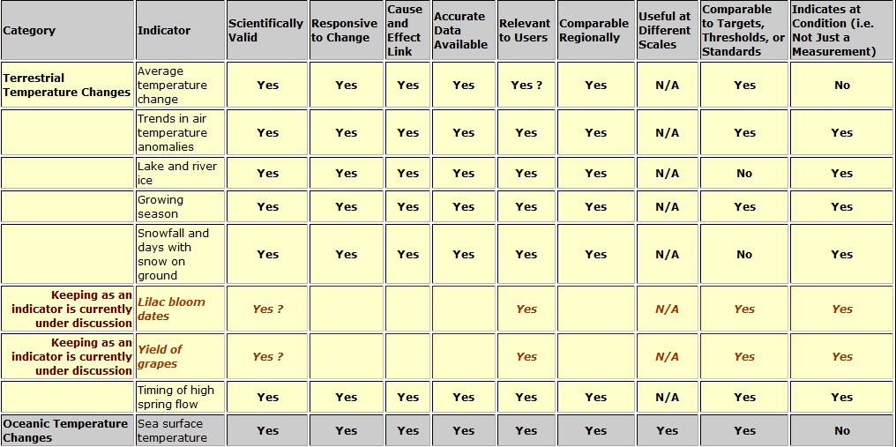
How are indicators selected?

Slide 6
Can we talk about climate change adaptations without a baseline?
Hm…..
Black
Box

Slide 7
ESIP Indicator: Air Temperature
Notes:
ESIP has spent a lot of time looking at baselines in our Climate Change Indicators
Across the region, average air temperatures have been on the
rise over the past three decades at 13 out of 14 sites.

Slide 8
ESIP Indicator: Precipitation
Notes:
ESIP has spent a lot of time looking at baselines in our Climate Change Indicators
Across the region, average air temperatures have been on the
rise over the past three decades at 13 out of 14 sites.

Slide 9
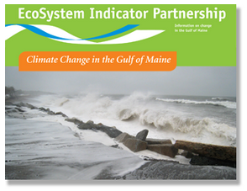
Want more?
Notes:
Also mention Aquaculture Fact Sheet.

Slide 10
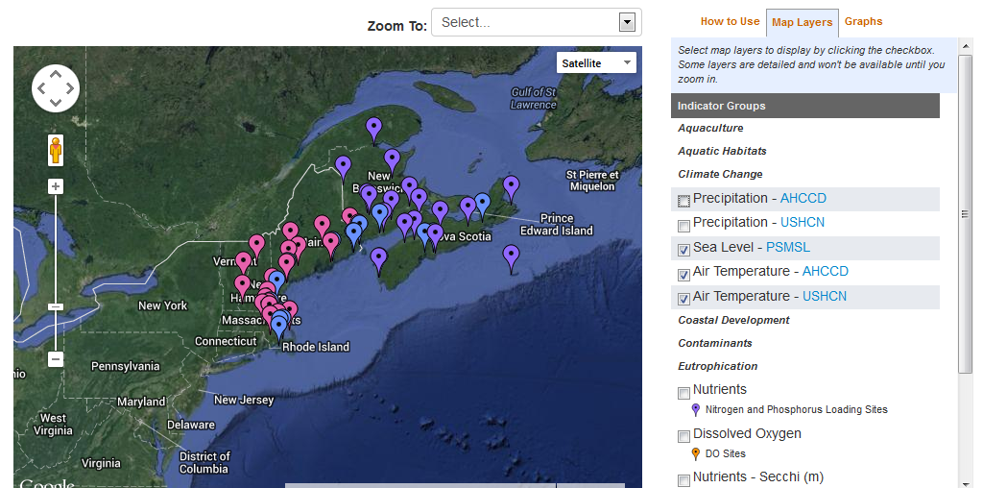
People want to know about what it is happening at their location
Notes:
Indicator Reporting Tool

Slide 11
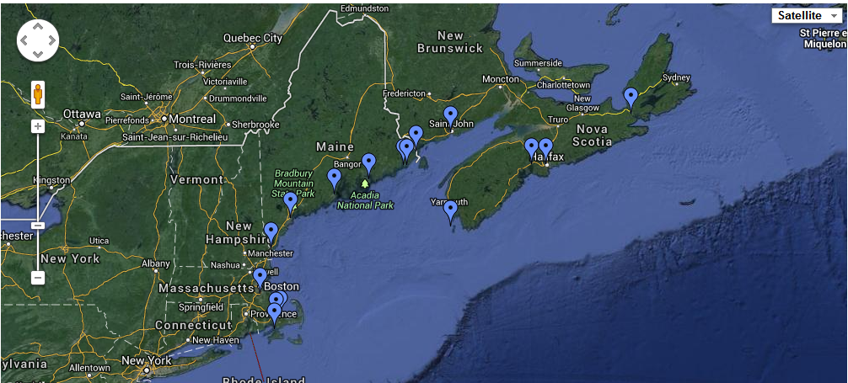
Indicator Reporting Tool
Permanent Service for Mean Sea Level (http://www.pol.ac.uk/)

Slide 12
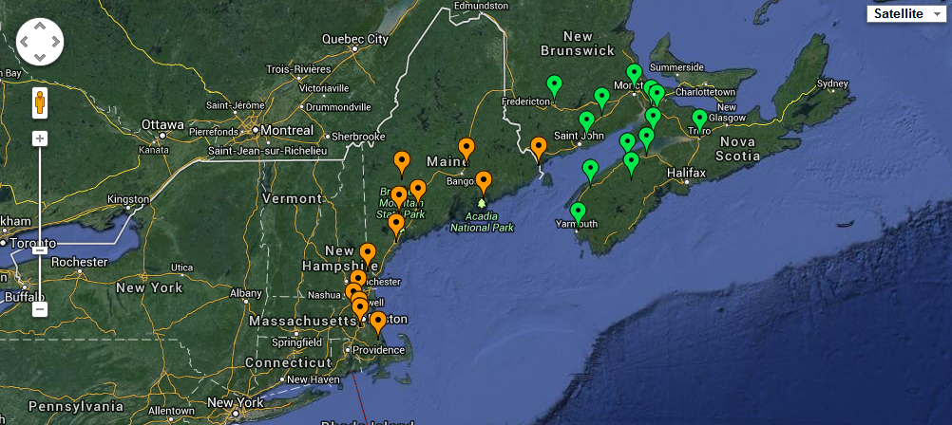
Indicator Reporting Tool
Precipitation Canadian: Adjusted Historical Canadian Climate Data
Precipitation U.S.: Historical Climatology Network Data

Slide 13
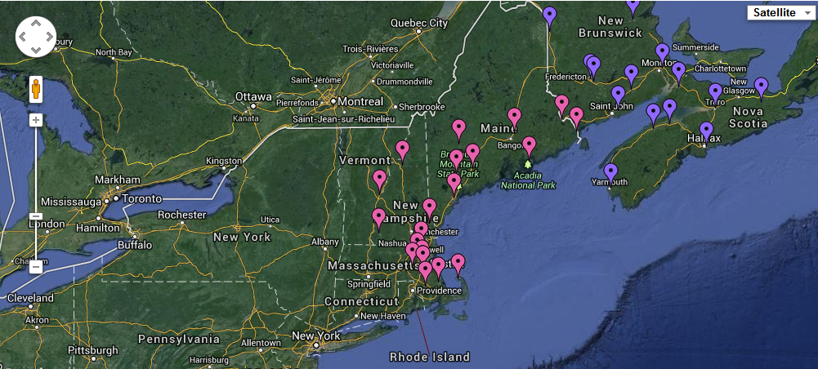
Indicator Reporting Tool
Air Temperature Canadian: Adjusted Historical Canadian Climate Data
Air Temperature U.S.: Historical Climatology Network Data
Notes:
Air temp

Slide 14
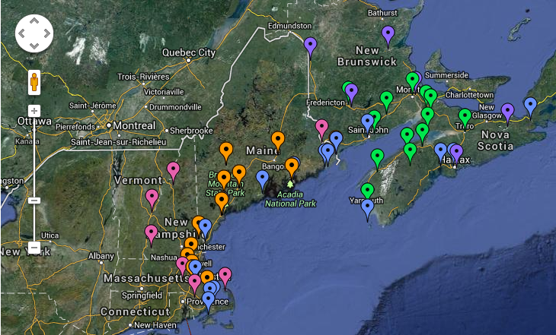
Together, builds the network of monitoring that is currently available for ESIP indicators.

Slide 15
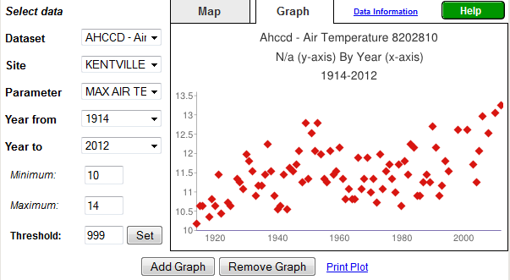
Time Series: Indicator Reporting Tool
www2.gulfofmaine.org/esip/reporting
Notes:
Can graph max, min, mean

Slide 16
Do you follow me?
Knowing baselines allows for appropriate adaptation discussions.
Seeing changes at local sites also engages communities.
Engaged communities can participate more in active adaptation.

Slide 17
Contact Information
Christine Tilburg
ctilburg@securespeed.us
Credit: Nancy Griffin

