Slide 1
Reporting on the Health of the Gulf of Maine
Christine Tilburg, EcoSystem Indicator Partnership,
Gulf of Maine Council on the Marine Environment
Heather Breeze, Fisheries and Oceans Canada
June 2014

Slide 2
Outline
Objectives of reporting
EcoSystem Indicator Partnership
State of the Gulf of Maine Report
The Ripple Effect

Slide 3
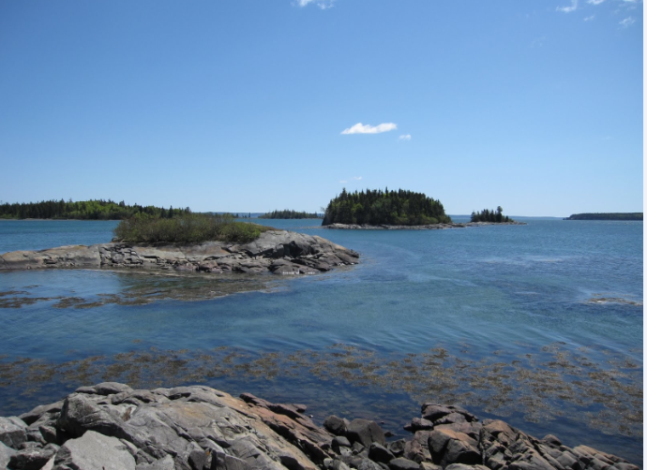
Gulf of Maine Council:
Action Plan 2012-2017
We envision a healthy and resilient Gulf of Maine where people and aquatic life thrive.
Goal 2: Environmental Indicators and Reporting
  Managers receive understandable, useful, reliable information about environmental conditions and trends in the region.

Slide 4

Objectives of Reporting
Produce products that respond to user’s needs.
Identify new and emerging environmental.
Communicate about environmental conditions.
Promote communication about existing monitoring activities, perceived gaps and partnership opportunities in the region.
Notes:
Objectives are slightly modified from the action plan. Produce products that respond to managers’ and decision-makers’ needs.
Identify new and emerging environmental issues in the Gulf of Maine.
Communicate about environmental conditions to managers, decision-makers, other interested parties, including climate-related issues.
Promote communication about existing monitoring activities, perceived gaps and partnership opportunities in the region.

Slide 5
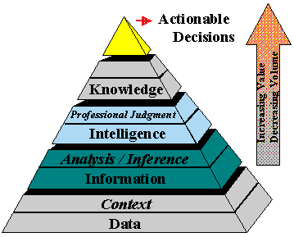
Reporting in context
Reporting is part of a broader system of information that includes:
Monitoring and collecting data
Managing, storing, and accessing data
Providing analytical tools to interpret data
Creating understandable environmental indicators and reports
Developing mechanisms to incorporate environmental knowledge into decision-making

Slide 6
Identifying Indicators
A parameter that provides information about an environmental issue with a significance that extends beyond the parameter itself”, e.g.:
  Human temperature
  Canary in a mine shaft
Indicators can be quantitative or qualitative
Do not necessarily need indicators developed prior to reporting – often indicator development is opportunistic
Some consideration should be given to complex indicators (fishing capacity/TAC)
Data gaps should be identified
Notes:
Data compatibility across jurisdictions makes Gulf-wide comparisons more difficult. However, SOE reporting does not necessarily require compatible data sources; rather it requires the ability to report in the current state using the various information sources in a cohesive manner.

Slide 7
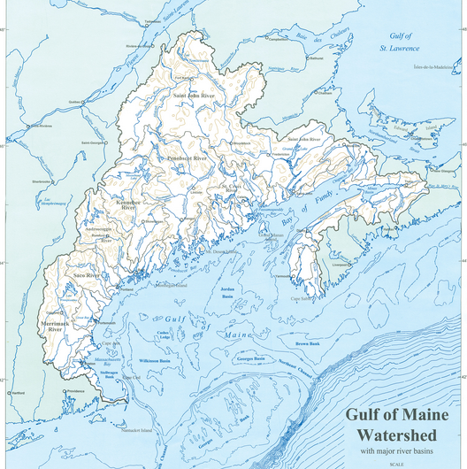
What is EcoSystem Indicator Partnership?
Partnership of scientists, academics, individuals from nonprofits using indicators to look at change in the Gulf of Maine.

Slide 8
EcoSystem Indicator Patnership
ESIP has tapped into expert advisors to select 22 indicators
These 22 indicators are subdivided into seven theme areas
  Aquaculture
  Aquatic habitats
  Contaminants
  Coastal Development
  Climate Change
  Eutrophication
  Fisheries

Slide 9
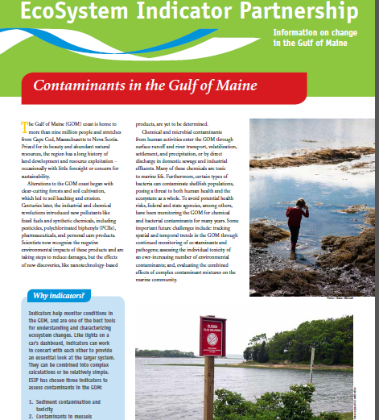
Example: Contaminants Theme
Fact Sheet to be released April 2014
First conference call October 2007
And in here?
Notes:
It might be nice to mention at some point the difficulties of working with datasets from different jurisdictions… here or somewhere else?

Slide 10
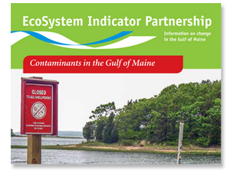
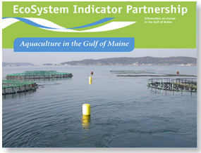
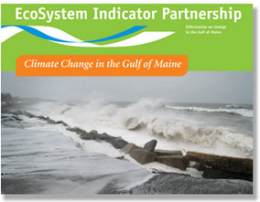
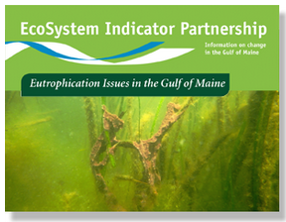
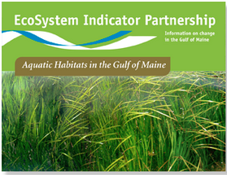
EcoSystem Indicator Partnership
  Aquaculture
  Aquatic habitats
  Contaminants
  Coastal Development
  Climate Change
  Eutrophication
  Fisheries

Slide 11
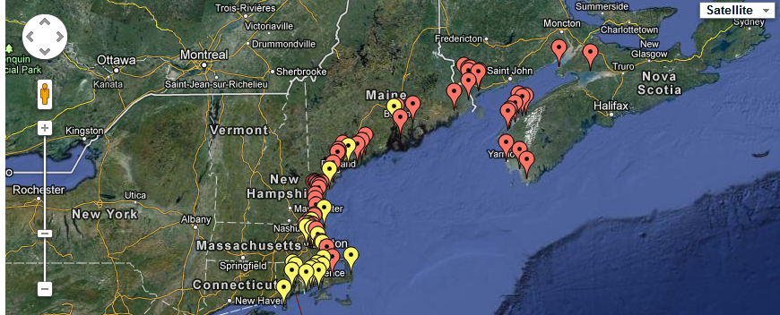
EcoSystem Indicator Partnership
Also delivering indicator information through webtool available at: www.gulfofmaine.org/esip
Notes:
Mapping platform allows user to select any information used with ESIP’s indicators.

Slide 12
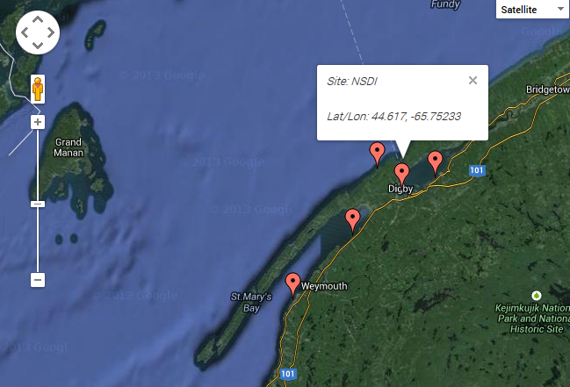
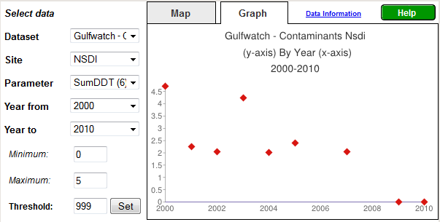
EcoSystem Indicator Partnership
Notes:
Using Gulfwatch example here so that we can mention the program.

Slide 13
State of the Gulf of Maine Report
Provides a comprehensive analysis of environmental conditions and trends
Contributes to informed and open decision-making
Contributes to public awareness by providing scientific information about the environment in an easily understandable form
Assists in identifying data/information gaps
A whole Gulf of Maine Council effort:
  Coordinated by Fisheries and Oceans Canada
  Most GOMC member agencies have contributed time or money to the initiative

Slide 14
State of the Gulf of Maine Report
Build on work already done to date
  Ecosystem Indicator Partnership (ESIP) work
  Make use of existing Gulf of Maine Council committees where possible
  Uses existing documentation
Focus on priority issues in the region
  Climate change; Fisheries and aquaculture; Coastal development; Aquatic habitats; Contaminants; Eutrophication
Flexible format that is readily updatable and affordable
Think outside the box – new ways to disseminate information
Notes:
State of the environment reports are generally reporting on the sustainability of a system, including the social environment, economic environment and biophysical environment.

Slide 15
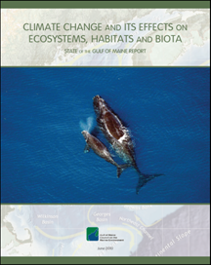
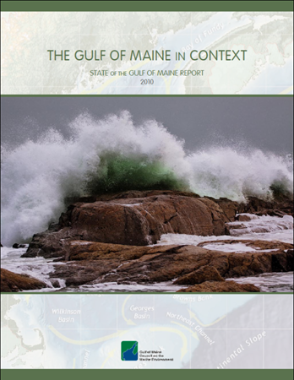
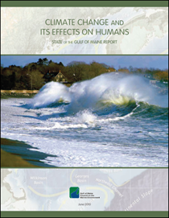
Overview
Relatively static
Provides the context
e.g. boundaries, size of watershed, history, management
Theme papers
Evaluation of priority issues
Regularly updated at
appropriate time scales
Incremental approach

Slide 16
Driving forces-pressure-state-impact-response - DPSIR
DRIVING FORCES
Human influences and activities, and natural conditions driving environmental change
RESPONSES
Responses by government and society to the environmental situation
PRESSURES
Stresses that human activities and natural conditions place on the environment, resulting from the driving forces
IMPACTS
Environmental (ecological and socio-economic) effects of pressures of environmental change
STATE
State or condition of the environment
Notes:
DPSIR: systems-based framework.
Ideally, we would have one to four indicators for each part of the framework.
ESIP helps make sure we are using appropriate indicators. When we update the theme papers, we will continue to draw ontheir work.

Slide 17
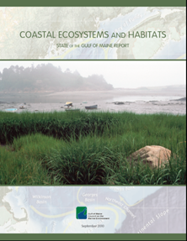
Completed Theme Papers
Climate Change and Humans
Climate Change and its Effects on Ecosystems, Habitats and Biota
Commercial Fisheries
Coastal Land Use and Development
Toxic Contaminants
Microbial Pathogens and Toxins
Eutrophication
Coastal Ecosystems and Habitats
Offshore Ecosystems and Habitats
Invasive Species
Species at Risk
Emerging Issues
Notes:
Used indicators identified by the ESIP working groups and found in the ESIP fact sheets, wherever possible

Slide 18
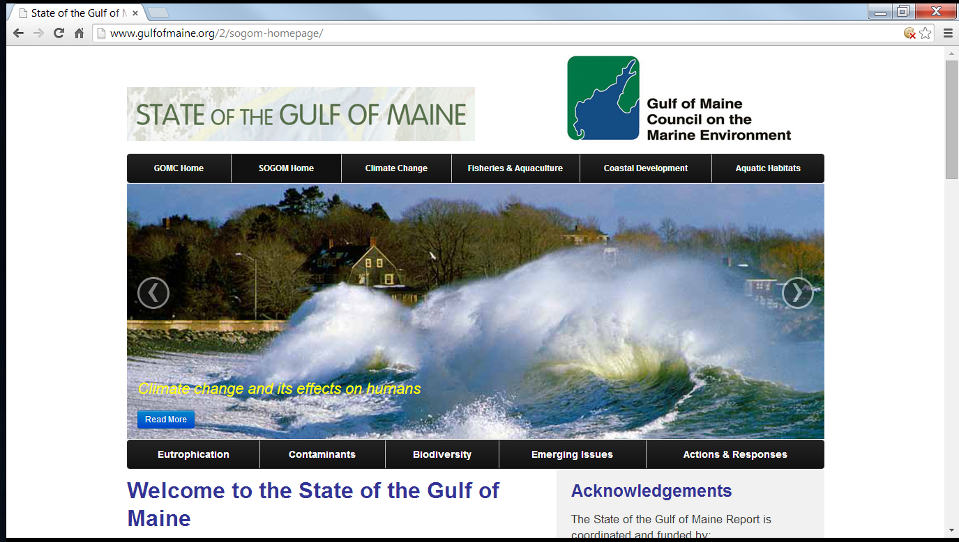
http://www.gulfofmaine.org/2/sogom-homepage/

Slide 19
The Ripple Effect
Gulf of Maine Council reporting work builds on the work of other committees.
State of the Gulf of Maine Report uses indicators identified and data collected by ESIP.
Theme papers can be considered more detailed version of the ESIP fact sheet.
  Include actions and responses to the issue in the region.

Slide 20
Questions? ctilburg@securespeed.us
Heather.Breeze@dfo-mpo.gc.ca

