Slide 1
ESIP & Citizen Science
Christine M. Tilburg
March 2013

Slide 2

H₂O Sampling before I could spell….
Water sampling – included animals
Led to purchase of microscope
Sampling of streams in high school
Sampling of creeks for benthics and chemistry in college
Went underground in graduate school
Tried to follow the money after graduate school
Went to non-profits in 2003

Slide 3


ESIP & Gulf of Maine
ESIP itself formed in 2006

Slide 4
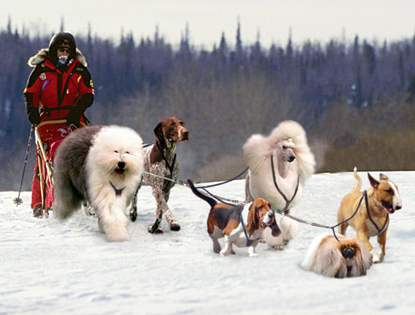
ESIP Itself
Steering Committee & Program Manager
Aquaculture
Climate Change
Aquatic Habitats
Eutrophication
Coastal Development
Fisheries
Contaminants
Notes:
Point out that they hold results from four of these seven efforts in their hands (aquaculture, climate change, eutrophication, & aquatic habitats).

Slide 5
Gulf of Maine
Notes:
Not just marine. Not just US. Huge effort.

Slide 6
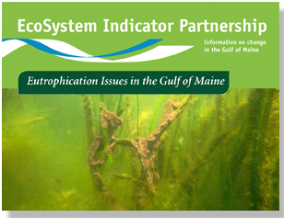
Where does GRTA fit in?
Input into Eutrophication Fact Sheet
GRTA and other citizen group datasets were used in eutrophication fact sheet. Including: Salem Sound Coast Watch and Friends of Casco Bay

Slide 7
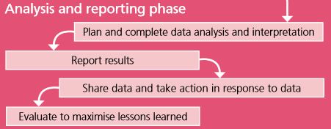

Slide 8
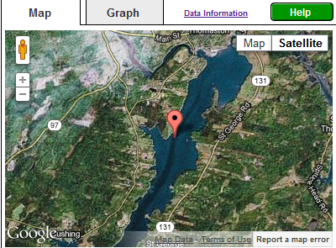
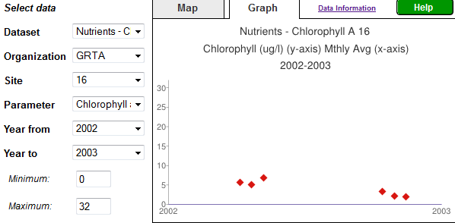
Where did GRTA information go?
Indicator Reporting Tool
www2.gulfofmaine.org/esip/reporting

Slide 9
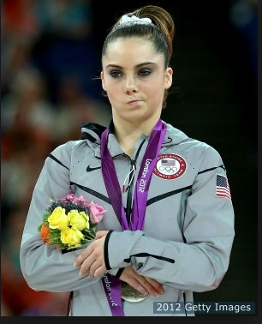
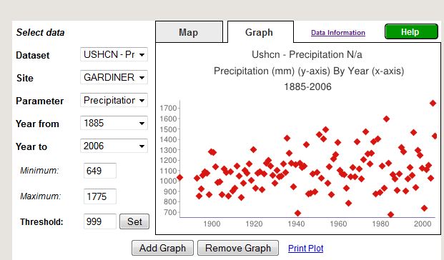
Not impressed?
Precipitation, aquaculture, dissolved oxygen, mussel tissue, contamination, shellfish bed closure, lobster settlement, sea level, point sources…..

Slide 10
Back to citizen science
  Continue to be a pillar of long term monitoring
  Problems in funding long term monitoring
  Local knowledge/passion for specific places

Slide 11
ESIP and next step
“You see, I see” app
  Proposal crafted for mobile app
  Utilizes sentinel sites and “user’s choice sites”
  Collects images and user information
  Real-time information about beach erosion, seasonal responses, etc.

Slide 12
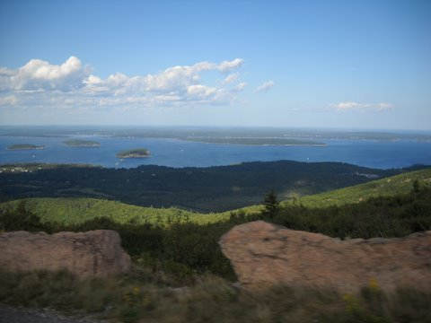
Contact Information
Christine Tilburg
ctilburg@securespeed.us
Credit: Nancy Griffin

