Slide 1
POLICY &
INDICATORS
Why isn’t this working? Or is it?

Slide 2
Can we talk indicators in a new way?
According to a TED Talk by John Bohannon bad Powerpoints are a $250 million/day drain to our global economy so….
Suggestions to use dance instead of Powerpoint?
If you’ve been to a “Christine” TM talk recently, you know that I’ve allowed people to vote on what I talk about….I’m still experimenting….

Slide 3
What is ESIP?
ESIP is quite young. Active since 2006 – getting our toes wet compared with other efforts in the region - but under the umbrella of GOMC (which is over 20 years old).

Slide 4
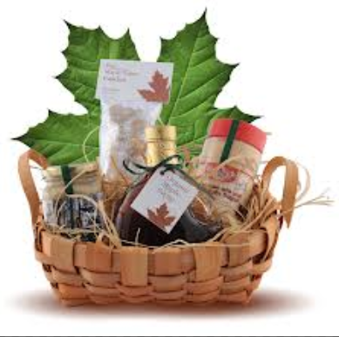
What is ESIP?
ESIP is NOT gift-wrapping indicators and handing it to people in policy positions…..
ESIP is composed of policy makers (along with academics, research scientists, historians…..)
Notes:
Currently composed of over 150 scientists – active volunteer expert advisors (several of whom are on the panel or sitting in the room).

Slide 5
The ESIP process in the GOM
Identified the purposes of the indicators
Look at status and trends in the Gulf of Maine in a scientific and unbiased way
Locate information on those indicators
Stress the importance of pre-existing monitoring programs

Slide 6
Gulf of Maine
ESIP has tapped into expert advisors to select 23 indicators
These 23 indicators are subdivided into seven theme areas
Aquaculture
Aquatic habitats
Contaminants
Coastal Development
Climate Change
Eutrophication
Fisheries

Slide 7
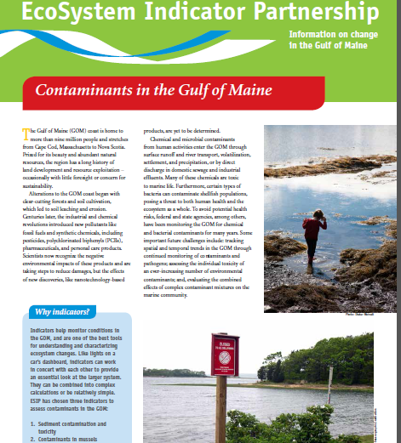
Example: Contaminants Theme
First conference call October 2007
Fact Sheet to be released April 2013
And in here?

Slide 8
Just…..
Hundreds of hours of conference calls, e-mails, GIS hours, analysis….etc…..
Also: the idea that for big ideas one should use few words to make things easier to understand - OTHERWISE KNOWN AS - holding ~ 20 scientists to a four page fact sheet.

Slide 9
But…here is the hard part….
Is this the hurdle or the barrier….

Slide 10
Getting the information out…
Talk nerdy to me? Webtools
On the fly? You see/I see “app”
Give me the info as brief as possible: fact sheets

Slide 11
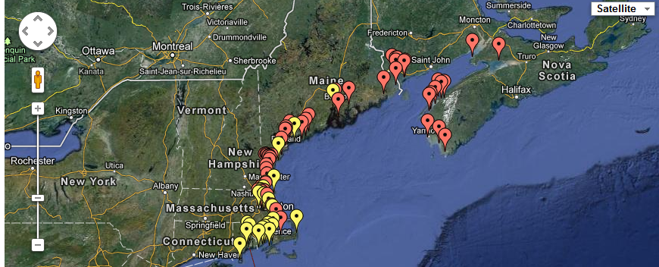
Talk nerdy to me? Webtools
Mapping platform allows user to select any information used with ESIP’s indicators.

Slide 12
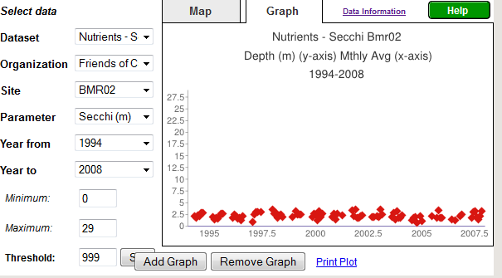
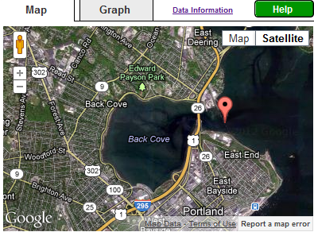
Talk nerdy to me? Webtools
User can locate any station location and graph time series (if appropriate) or download datasets.

Slide 13
On the fly? You see/I see “app”
Proposal crafted for mobile app
Utilizes sentinel sites and “user’s choice sites”
Collects images and user information
Real-time information about beach erosion, seasonal responses, etc.

Slide 14
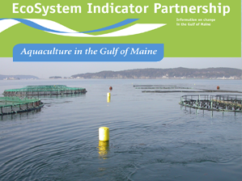
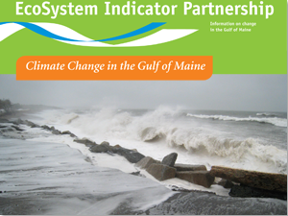
Give me the info as brief as possible: fact sheets

Slide 15
Which of those fits our users who are shaping policy?
If we go back to Slide 4

Slide 16
Which of those fits our users who are shaping policy?
If we go back to Slide 4

Slide 17
So, how do we know?
ESIP 2.0
A new frontier.
Choosing indicators that fairly assess policy.

Slide 18
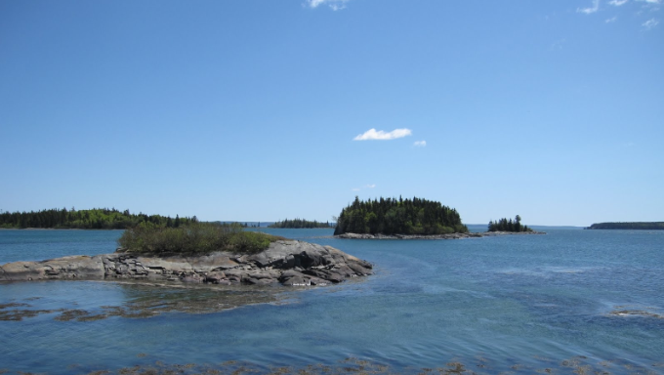
Questions
Christine Tilburg
ctilburg@securespeed.us
www.gulfofmaine.org/esip

