Slide 1
ESIP’s
Network of Indicators for the Gulf of Maine
June 2013

Slide 2
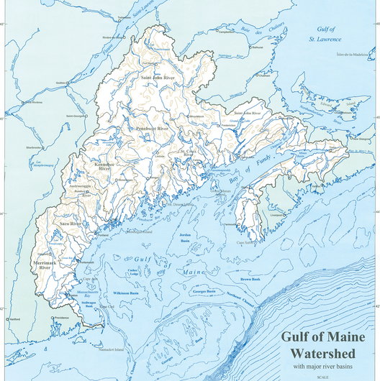
What is ESIP?
Partnership of scientists, academics, individuals from nonprofits using indicators to look at change in the Gulf of Maine.

Slide 3
ESIP’s core goal of providing information on change in the Gulf of Maine keeps intersecting the needs of other initiatives in the region.
NEERS
ALSI
BoFEP
CCN
ESIP
?
NERACOOS

Slide 4
How does ESIP intersect with Climate Change?
ESIP tackled priority indicators for Gulf of Maine by looking at seven theme areas – one of which was climate change.
Three* priority indicators were selected for climate change. 23 ESIP indicators in TOTAL.
Sea level
Air temperature, particularly trends in seasons
Precipitation, particularly trends in extreme precipitation

Slide 5
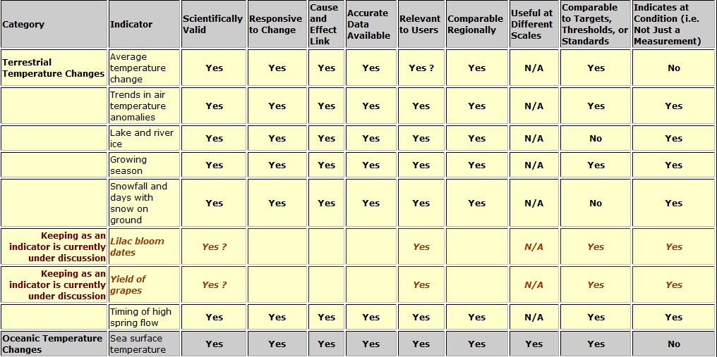
How are indicators selected?
www2.gulfofmaine.org/esipplanning

Slide 6
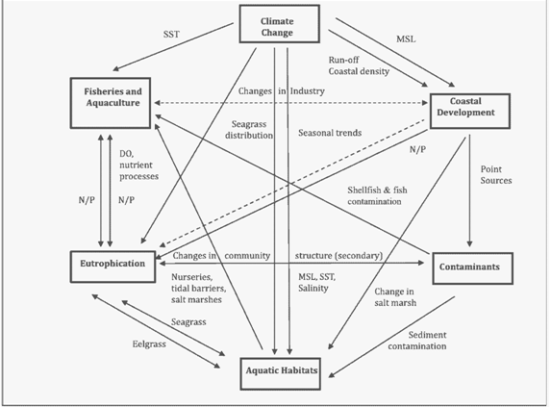
Web of indicators

Slide 7
How does ESIP intersect with Climate Change?
Three priority indicators were selected for climate change.
Sea level
Air temperature, particularly trends in seasons
Precipitation, particularly trends in extreme precipitation
Indicators selected by other ESIP subcommittees that are affected by climate change: Eutrophication indicators (nitrogen/phosphorus loading, dissolved oxygen & water clarity), Aquatic Habitat (salt marsh distribution), Fisheries (fisheries structure), and Coastal Development (population density at the coast).

Slide 8
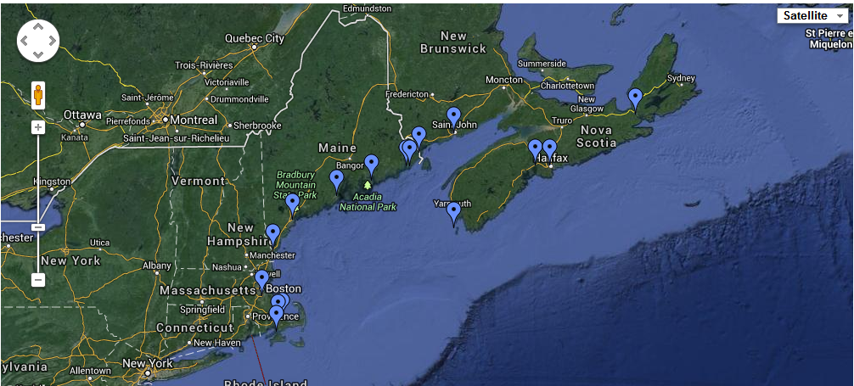
Indicator Reporting Tool
Permanent Service for Mean Sea Level (http://www.pol.ac.uk/)

Slide 9
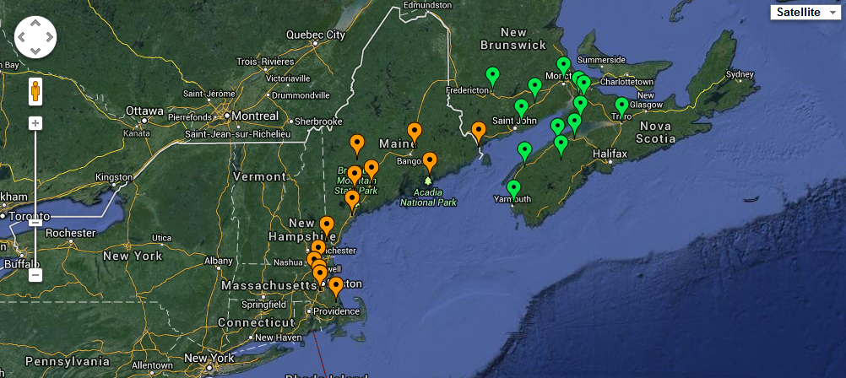
Indicator Reporting Tool
Precipitation Canadian: Adjusted Historical Canadian Climate Data
Precipitation U.S.: Historical Climatology Network Data

Slide 10
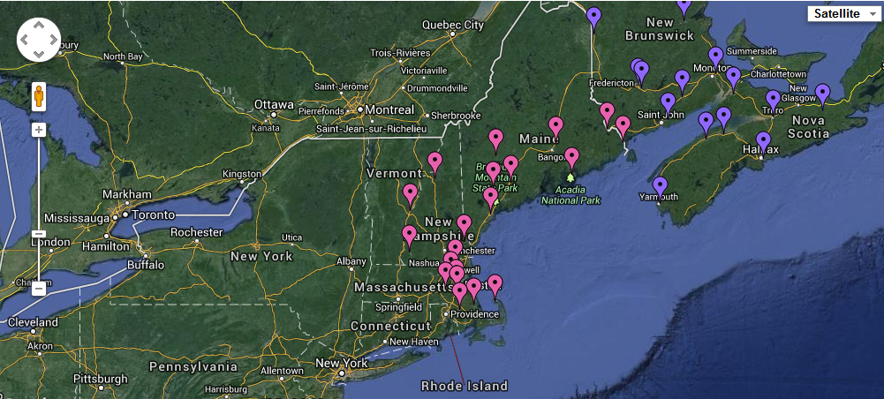
Indicator Reporting Tool
Air Temperature Canadian: Adjusted Historical Canadian Climate Data
Air Temperature U.S.: Historical Climatology Network Data
Notes:
Air temp

Slide 11
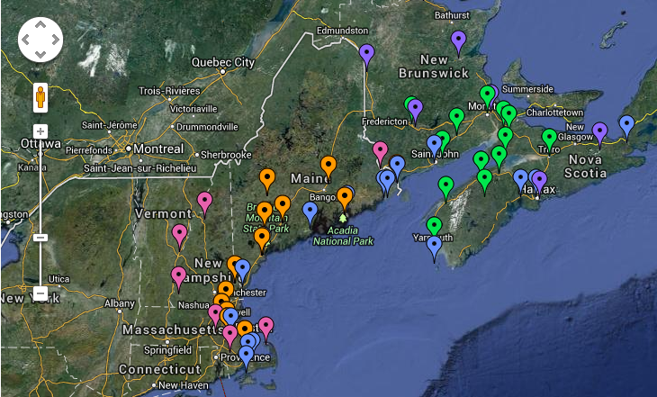
Together, builds the network of monitoring that is currently available for ESIP indicators.

Slide 12
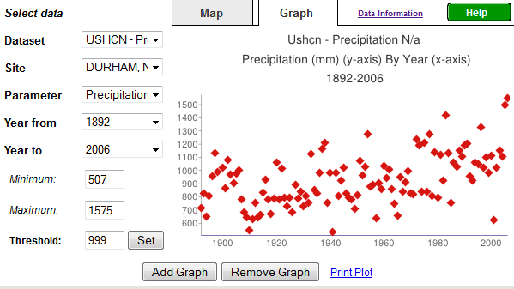
Time Series: Indicator Reporting Tool
www2.gulfofmaine.org/esip/reporting

Slide 13
ESIP’s concerns:
Availability of these datasets as ESIP continues forward.
Availability of the next set of indicator datasets.
Advocates for monitoring in the future.

Slide 14
Other delivery mechanism:
Climate Change Fact Sheet.

Slide 15
Contact Information
Christine Tilburg
ctilburg@securespeed.us
Credit: Nancy Griffin

