Slide 1
Shellfish Management Implications
Gulf of Maine Council on the Marine Environment
2014 Climate Related Priorities
Notes:
0-

Slide 2
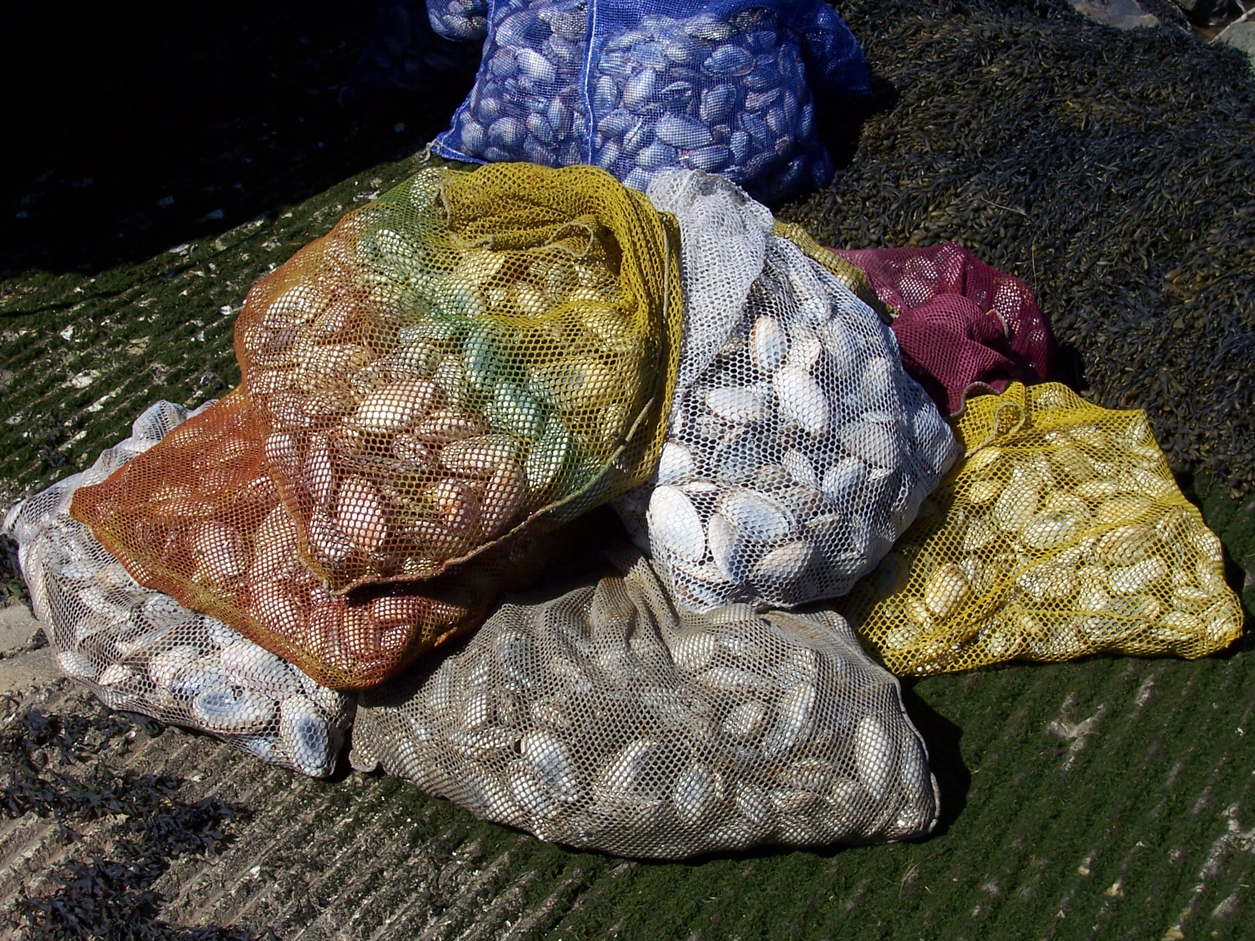
Massachusetts Division of Marine Fisheries Shellfish Project
Mission
public health protection
Fecal coliform
Indicators
Rainfall
PSP
Pathogens
V.p.
Notes:
1-Brief description of our project;
primarily public health focus to ensure safe shellfish supply; via NSSP
Fecal (indicator)
Rainfall (indicator)
PSP (pathogen)
V.p. (pathogen)
direct and indirect management of state’s molluscan resources
aquaculture
depuration
contaminated relays
dredge fisheries
size, harvest and season limits

Slide 3
Massachusetts Division of Marine Fisheries Shellfish Project
aquaculture
shellfish enhancement
depuration
contaminated relays
dredge fisheries
size, harvest and season limits
Mission
public health protection
molluscan resource management
Notes:
2-Brief description of our project;
primarily public health focus to ensure safe shellfish supply; via NSSP
Fecal (indicator)
Rainfall (indicator)
PSP (pathogen)
V.p. (pathogen)
direct and indirect management of state’s molluscan resources
Aquaculture
Shellfish enhancement
depuration
contaminated relays
dredge fisheries
size, harvest and season limits

Slide 4
Notes:
3- More than 2 million of states 6 million population lives on the coast in these 78 communities.

Slide 5
Shellfish Management Implications
Climate Related Priorities
Ocean Acidification
Increasing Ocean Temperatures
Ecological Alterations
Notes:
4-

Slide 6
Climate Related Priorities
Ocean Acidification
Issue:
Reduction in pH impacting larval shellfish recruitment from low saturation state of calcium carbonate in seawater and interstitial water
Notes:
5-

Slide 7
Reduction in pH impacting larval recruitment
Notes:
6- We’ve done one study comparing softshell clam larval recruitment in 3 buffered plots vs a control. This shows how significant the increase in the average density of larval recruitment in the buffered plots vs. the unbuffered control over two 2-week study periods.

Slide 8
Reduction in pH impacting larval recruitment
Notes:
7- Here are the three treatments of buffer- Lime/Marble Chips/Surf Clam/Softshell Clam at 5%/10%/15% by weight of the top layer of sediment. Here we’re comparing the saturation state or Omega value of the two forms of calcium carbonate over a two week period in interstitial water. The blue line is calcite and green is aragonite. (one-time addition of each buffer) Of Note here, the residence of omega (doesn’t drop below 0.5 even after two weeks) with the crushed surf clam shell at 15%. Not coincidentally, this buffer showed the most significant larval recruitment.

Slide 9
Climate Related Priorities
Ocean Acidification
Increasing Ocean Temperatures
Issue:
Higher frequency of bivalve disease
Increased risk of Vibrio sp. Incidence
Changes to HAB season
Notes:
8- Our next Issue – increasing ocean temps

Slide 10
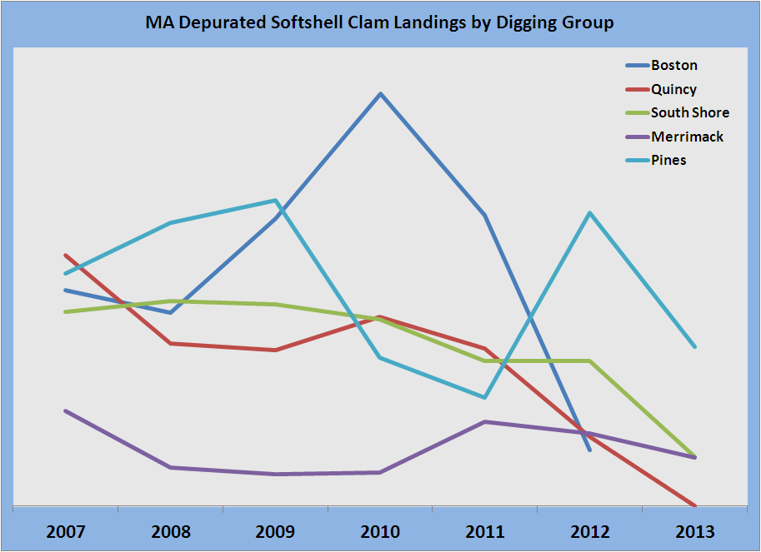
- Higher frequency of bivalve disease
Notes:
9- Dropoff in landings after 2010 by digging group.

Slide 11
- Higher frequency of bivalve disease
Notes:
10- Heamic neoplasia in softshell clams is a disease which limits the uptake of oxygen. It’s been blamed for mortality in clams (and mussels). These die-off events are typically associated with environmental and reproductive stressors. These die-off events typically occur in the late spring (reproductive related) and late summer (higher water temperatures result in less oxygen in the water) and sometimes in winter.
The chart goes from the Merrimack River at the top, down to Buzzards Bay at the bottom.

Slide 12
Increased risk of
Vibrio parahaemolyticus
2011 – 11 Vp cases
2012 – Vp Control Plan for
Eastern Cape Cod Bay
- 27 Vp cases
2013 – Vp Control Plan
statewide
- 58 Vp cases
Notes:
11-

Slide 13
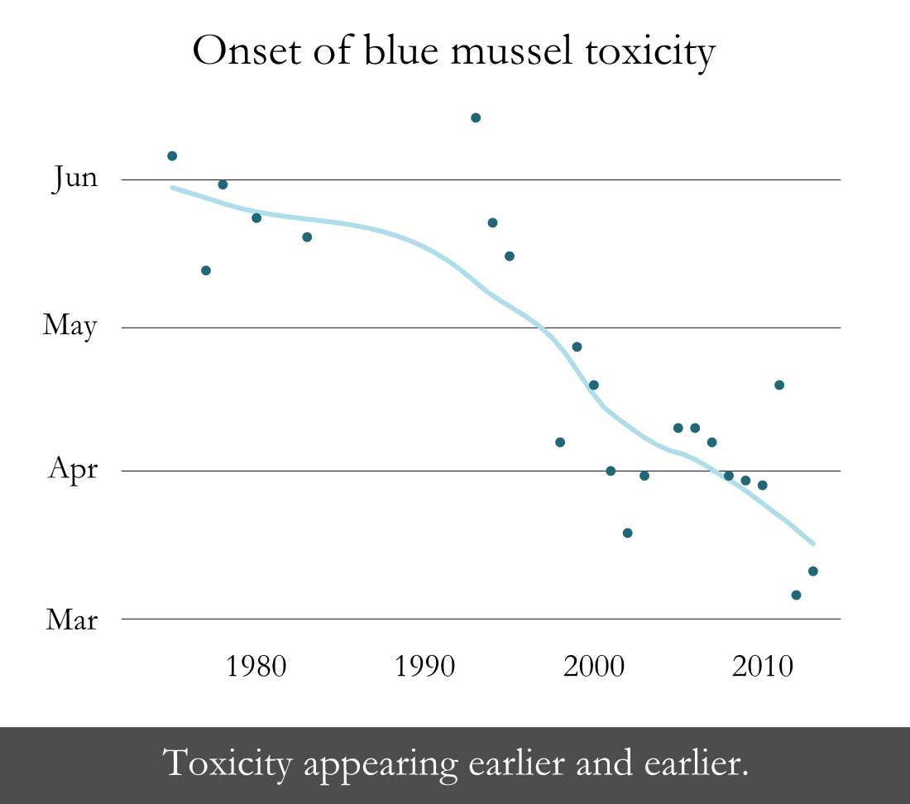
- Changes to HAB season
Notes:
12- This shows toxicity in blue mussels in the Nauset system on Cape Cod. Nauset has an in-situ bloom of PSP – Alexandrium, bloom occurs almost annually without fail. (Only 2 years we have not seen closures, 2004 and this year) Over approx the last 40 years, the onset of toxicity in mussels in Nauset has occurred earlier and earlier, last year in early March.

Slide 14
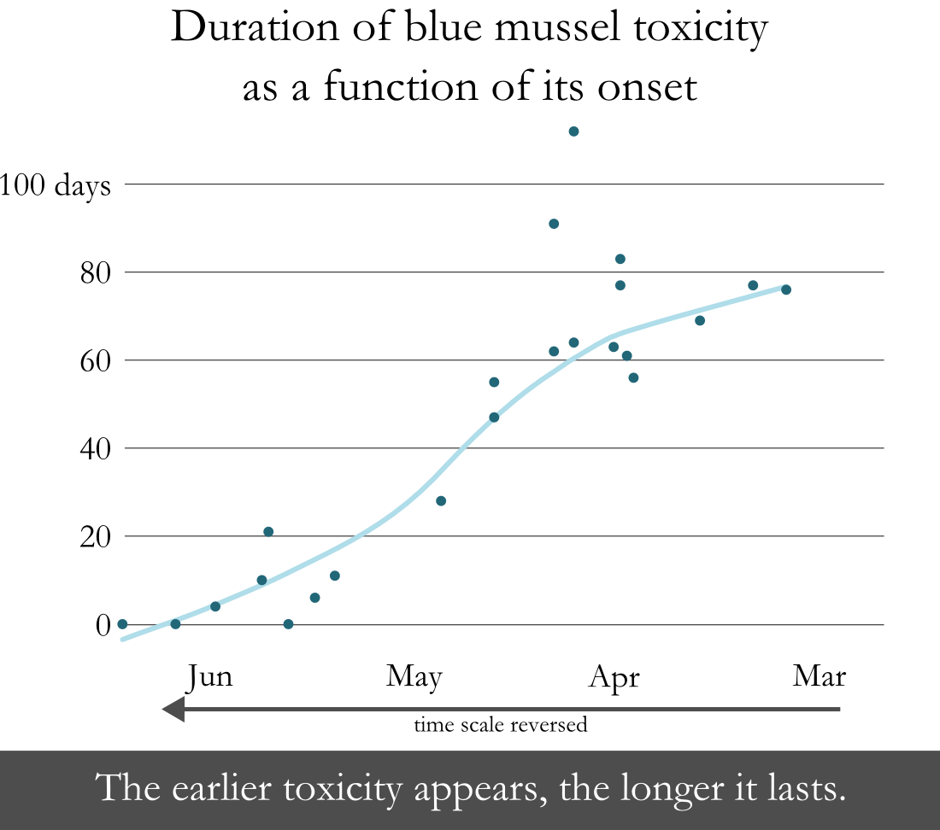
- Changes to HAB season
Notes:
13- This shows the duration of mussel toxicity ( how long mussels have toxicity –NOT the duration of closures ) Note the timeline is reversed. If toxicity appears late in the season, the duration of the toxic event is relatively short. BUT when the initial occurrence of toxicity occurs earlier in the season, the duration of toxicity in the shellfish is longer.
So over the last 40 years, PSP events have occurred earlier in the season and lasted longer.
Nauset is different than coastal blooms since it is in-situ – relatively isolated.

Slide 15
Climate Related Priorities
Ocean Acidification
Increasing Ocean Temperatures
Climate Induced Ecological Alterations with Higher Shellfish Predation
Issue:
Loss of shellfish recruitment/survival
Loss of supporting habitat
Notes:
14-

Slide 16
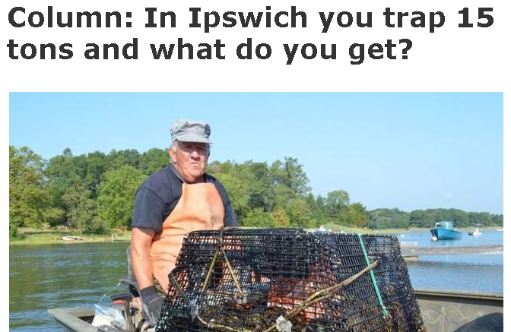
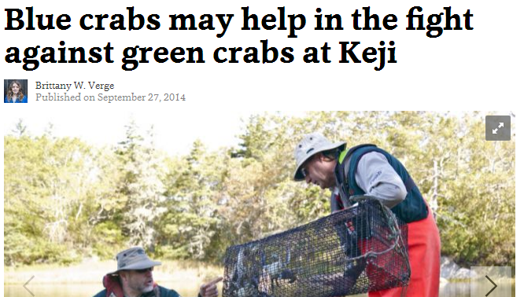
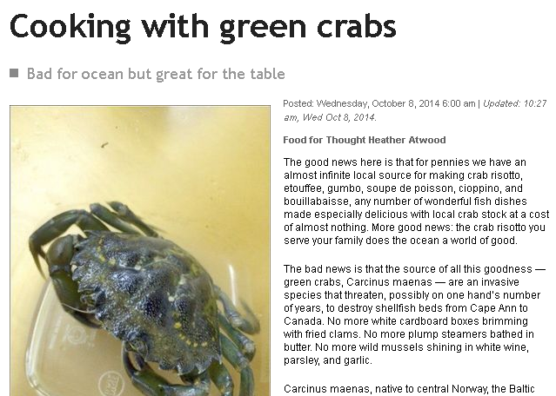
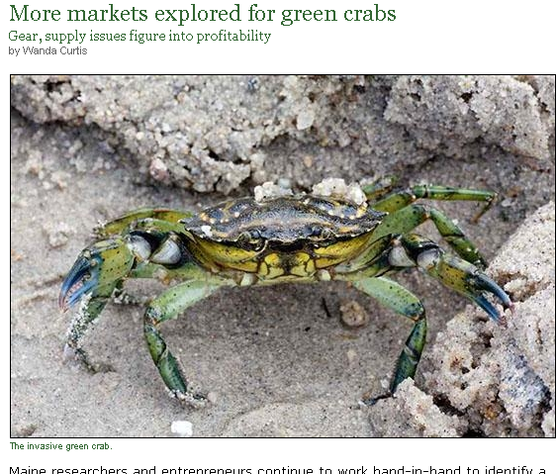
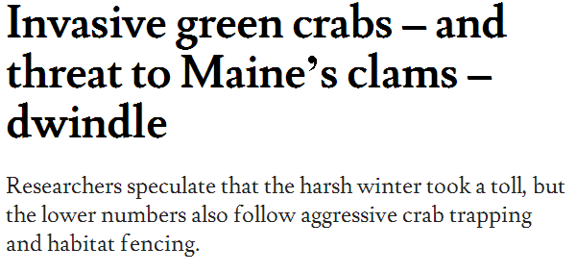
- Loss of shellfish recruitment/survival
- Loss of shellfish recruitment/survival
Notes:
15- Green crabs are a problem and in the news no matter where, Massachusetts or Maine.

Slide 17
Massachusetts Restricted Area Harvest Softshell Clams in Bushels
Notes:
16- Over the last 30 years there has been a near continuous decrease in landings from restricted areas for depuration. It is without doubt this decline is not due to a single cause but rather from multiple causes; acidification, predation, shellfish disease, fishing pressure (death by a thousand cuts). Currently in Massachusetts, softshell clams are harvested from Restricted Areas for depuration in greater Boston Harbor, the Pines River in Revere and Saugus and the Merrimack River in Newburyport and Salisbury. In addition, softshell clams for depuration have come from the Annisquam and Ipswich Rivers in Gloucester and Ipswich in the past.

Slide 18
Notes:
17- To put a finer point on it, here are the individual areas harvest from 2007-2013. The take-away here is that almost all area harvests are going down. The exceptions being the Merrimack River N2.1 which has enjoys high fresh water flows with a corresponding low salinity, has a very restrictive rainfall policy allowing only 90-100 days/year harvesting and therefore relatively low fishing pressure. AND the Wood Island flat in Boston GBH5.4 in which all shellfish died-off in 2010-2011. The harvest then switched to other areas GHB5.5, GBH3.9 and GBH3.10.

Slide 19
Massachusetts Great Marsh Green Crab Depletion Program
$133,000 for green crab depletion
MarineFisheries provides 200 traps
Communities contract fisherman
Environmental research
Market research
- Loss of shellfish recruitment/survival
Notes:
18- MarineFisheries will provide 200 traps to the communities of Gloucester, Essex, Ipswich, Rowley and Newbury to contract with select fishermen to trap and remove green crabs. Fishermen will receive a stipend of .40/lb. If they have a market they can continue to use that market as well as be compensated by this program. At present we view this as a one time/year fund program. Some funds will go towards environmental research of green crabs in the Great Marsh as well as research into development of a markets for green crab. Daily catch reports are required, including location of traps, number fished and type; soak time; quantity captured; and dispostion.
$88K for trapping, market development and 200 standardized traps, $45K for research and administration ($20K to MVPC and 20 to SSU, $5 for administration)

Slide 20
Climate Related Priorities Needs
Ocean Acidification
Increasing Ocean Temperatures
Ecological Alterations
Notes:
19-

Slide 21
Climate Related Priorities Needs
Ocean Acidification
Research implications of large scale pH buffering e.g. lime, marble, shell
Increasing Ocean Temperatures
Ecological Alterations
Notes:
20- Investigate large scale pH buffering using lime or marble chips or crushed shell. Appears to be a need to develop shell recycling programs for collection, aging, and dispersal. In Massachusetts this would most likely be accomplished through the local muncipalities. But a state program may have some funding and regulatory benefits.

Slide 22
Climate Related Priorities Needs
Ocean Acidification
Increasing Ocean Temperatures
Science based Vibrio controls
Adaptive management to address shifting fishing pressure between species
Disease-resistant strains
Ecological Alterations
Notes:
21- Currently there is a lot of ongoing Vibrio research locally, nationally and internationally. Developing effective vibrio controls are a priority of the ISSC (the Interstate Shellfish Sanitation Conference) which develops the NSSP (National Shellfish Sanitation Program). The NSSP was first published in 1925 and continues to the day as the regulatory framework for the harvest and handling of all shellfish in the US.
As shellfish landings for one species declines, harvest pressure moves to different species, for example softshell clams to razor clams in Massachusetts. Or even declines in lobster south of Cape Cod into the whelk/conch fishery. Also as temperatures increase new marginal species may become more common – eg oysters north of Cape Cod. We need to plan to manage our fisheries in a more flexible manner as many of the fishermen are the same individuals only targeting different species.
And the development of hatchery raised disease resistant strains has never been more important. This is needed for quahogs of course, oysters, as well as softshell clams.

Slide 23
Climate Related Priorities Needs
Ocean Acidification
Increasing Ocean Temperatures
Ecological Alterations
Bivalve molluscan stock assessment
Cross discipline management strategies to mitigate increasing predation
Notes:
22- The long term NOAA funded commercial fisheries stock assessments are never more important than today and yet individual states almost completely lack any current state-waters stock assessment of bivalve shellfish. We universally use landings as a proxy for population stock assessments – that is if we do that at all. There are many problems with using landings as a population surveys AND without a good assessment of the current stock, loss due to any cause is impossible to document. In the face of climate change we need good stock assessments now before we are faced with declines in every region –not just marginal fisheries such as Boston Harbor softshell clam depuration fishery.
AND we need to adopt a multi-disciplinary approach to dealing with new and increasing predation (-perhaps no as far as an ecosystem based approach). In the green crab example we need to employ bivalve shellfish and crustacean biologists along with fisheries managers to address not only the crab problem but management of the “mobile” fishermen as well.

Slide 24
WANTED Dead or Alive
Notes:
23- Specifically for green crabs we need to move away from “Bounty” programs. Doesn’t make sense in todays financial climate, it only kicks the can down the road and does not address the long term problem. Development of a market or markets is the goal of all involved in the Massachusetts program and this bounty program was seen only as a bridge to a new model. Ultimately, considering the size of the problem multiple markets are needed to provide an outlet for green crab harvest from spring to fall.

Slide 25
Climate Related Priorities Needs
Ocean Acidification
Increasing Ocean Temperatures
Ecological Alterations
Bivalve molluscan stock assessment
Cross discipline management strategies to mitigate increasing predation
Research shellfish impacts of habitat degradation
Notes:
24- And finally we need to understand how the loss of, and changing habitat impact shellfish populations. Studies point to the green crab impacting eelgrass and salt marsh grass – the next question is how does that indirectly impact our shellfish beds. And finally there is a need to develop long term disease monitoring where absent and continue those studies where they exist now. Again, without knowing what disease is present in our shellfish populations we can’t document changes, assess risk and forecast outcomes.

Slide 26
Economic Impacts
Public Health
$
Resource
Notes:
25- There are economic impacts to changes in the resource but also economic impacts around public health threats to shellfish.

Slide 27
Economic Impacts
Resource Impacts resulting in Decreased Landings
Decrease in Recruitment due to Acidification or Temperature Changes
Shellfish Disease Die-offs
Predation
Ecosystem Alterations
Public Health Impacts resulting in Decreased Landings
OR Human Illness
New / Larger / Longer / More Frequent Sanitary Closures
either human vector pathogens or naturally occurring pathogens
New / Larger / Longer / More Frequent Marine Biotoxin Closures
Notes:
26-
27- The focus so far as been on the Issues and Needs concerning the impact for shellfish resources, as well as impact of naturally occurring pathogens (Vibrio and PSP/HAB’s). But I would be remiss if I didn’t mention and plug the need for resilency in our infrastructure, specifically wastewater infrastructure.

Slide 28
Notes:
27- Is this resiliency?

Slide 29
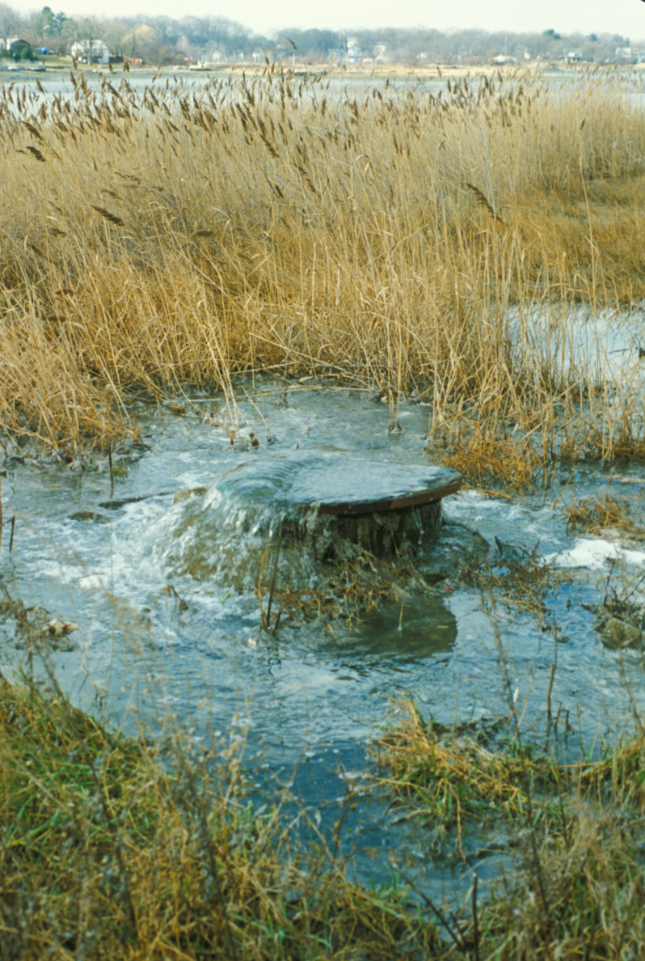
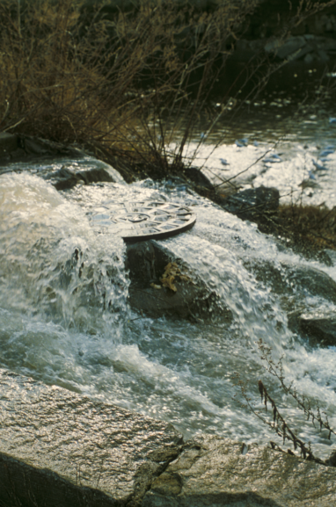
Notes:
28- Resilency, hardening is needed everywhere. Without it, we can expect longer harder rainfall events, longer and more frequent rainfall closures, higher contamination levels, as well as larger geographic closures. All this will negatively impact the value of our shellfish landings and the supply of shellfish in the marketplace.

Slide 30
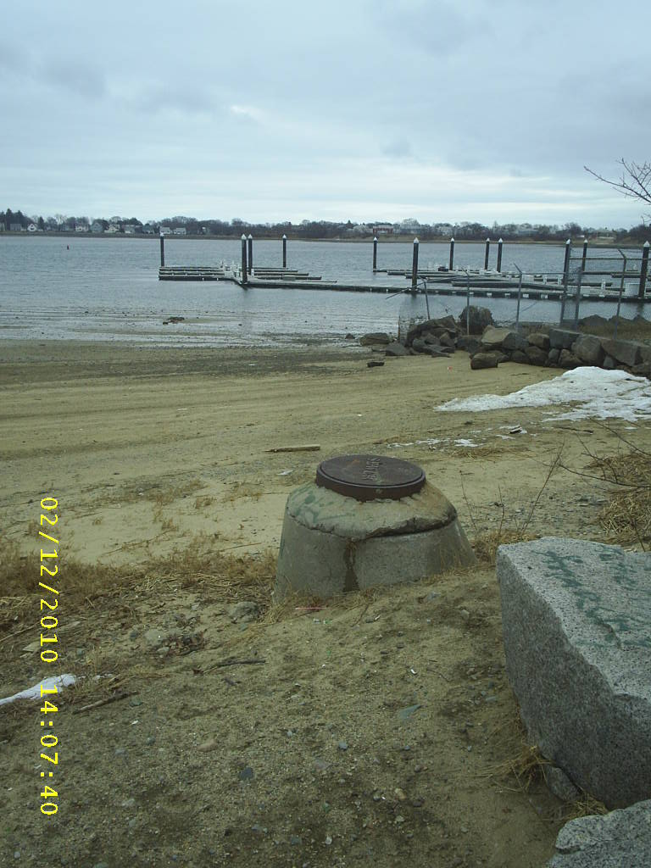
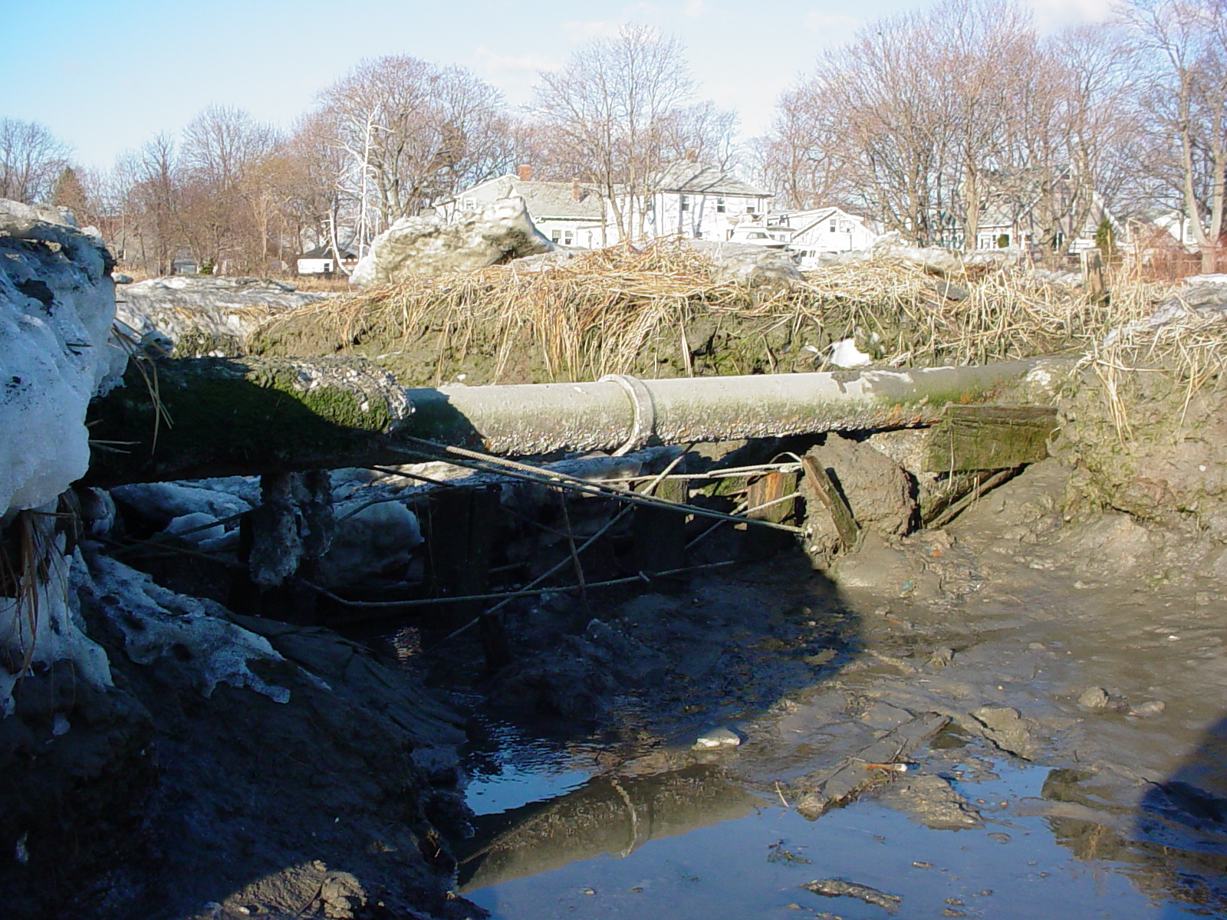
Notes:
29-

Slide 31
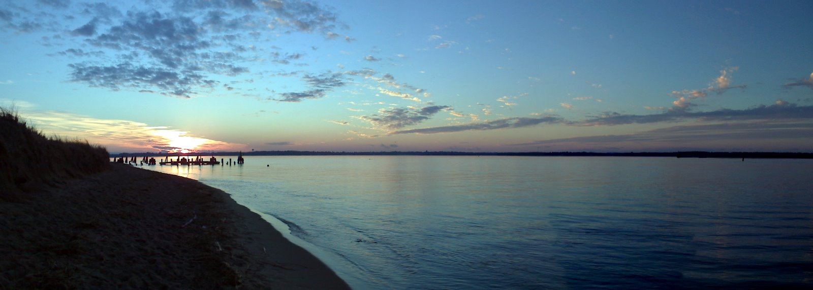
Questions?
Notes:
30-

