Slide 1
Overview of DFO’s Aquatic Climate Change Adaptation Services Program (ACCASP)
Case research: Which species will lose or gain habitat under warming expected by 2030, and by 2060?
Nancy Shackell ¹,
Christine Stortini ³, Jen Mullane ², Blair Greenan ¹
¹ Oceans and Ecosystem Science Division, ² Policy and Economics Branch,
Fisheries and Oceans Canada
³School for Resource and Environmental Studies, Dalhousie University Halifax

Slide 2
Outline
Overview of ACCASP –
  Aquatic Climate Change Adaptation Services Program
Program Example Research: Species Vulnerability Assessment (VA): Part 1. Habitat Loss/Gain.
Climate projections in 20 and 50 years provide insight, but are they useful to fishery agencies who plan on much shorter time scales? (and for whom fishing is still the dominant driver)
Ecosystem Approach to Fisheries is incorporating Environmental drivers and Predator/prey into stock assessment
  role of environmental drivers AND warming is just a “directional” environmental driver. SO-Use VA approach to triage stocks and incorporate “thermal habitat indicator” into their stock assessments.

Slide 3
Overview of DFO’s Aquatic Climate Change Adaptation Services Program (ACCASP)
Slides courtesy of, and modified from, Policy and Economics Branch, Jen Mullane, Ocean Climate Section, Blair Greenan

Slide 4
Background
In 2010, Government of Canada renewal of climate change adaptation funding included Fisheries and Oceans Canada totalling 9 Federal departments.
Theme: Enhance the Science Foundation to Understand, Predict and Assess Climate Change Impacts:
  DFO launched a five year science-based climate change program focused on adapting the delivery of Fisheries and Oceans Canada’s mandated areas of responsibility
  Fiscal Year 2014-15 is the fourth year of the program

Slide 5
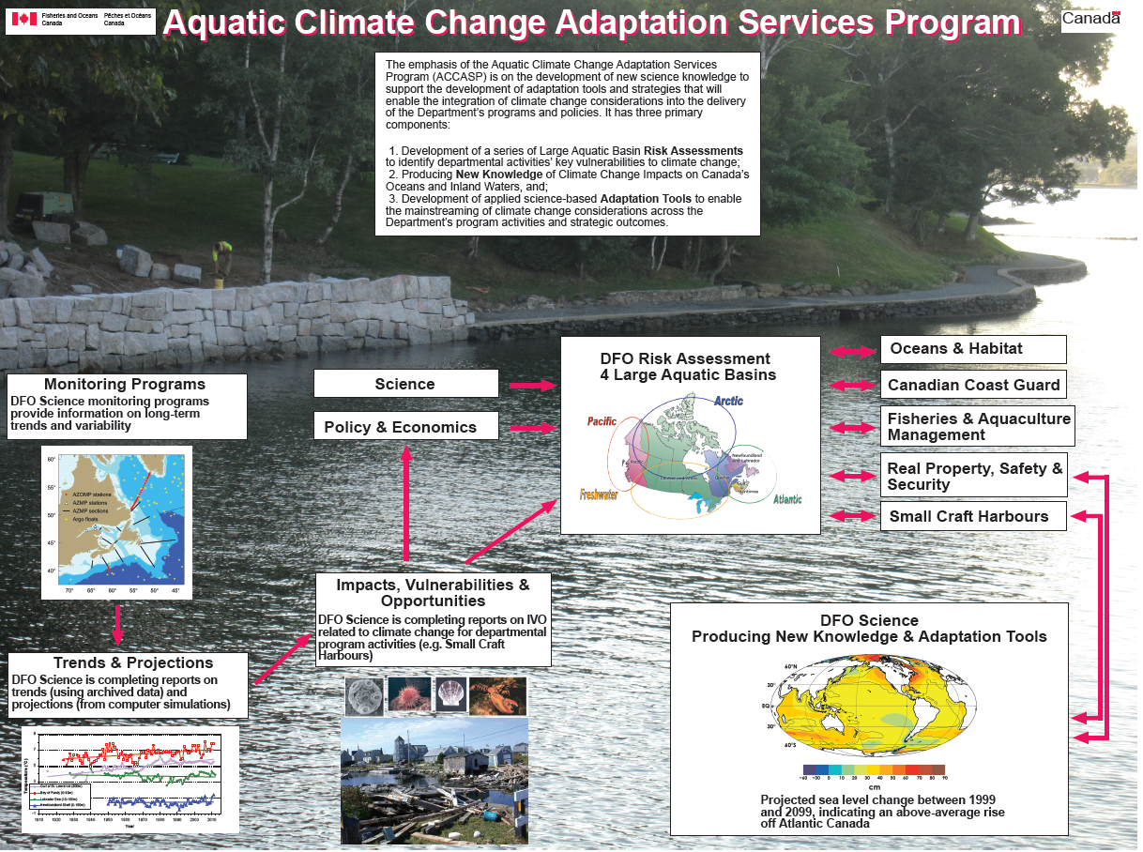

Slide 6
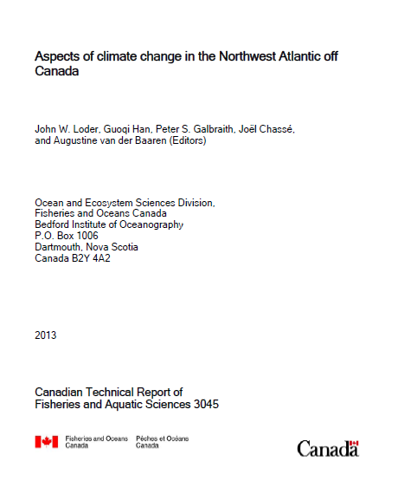
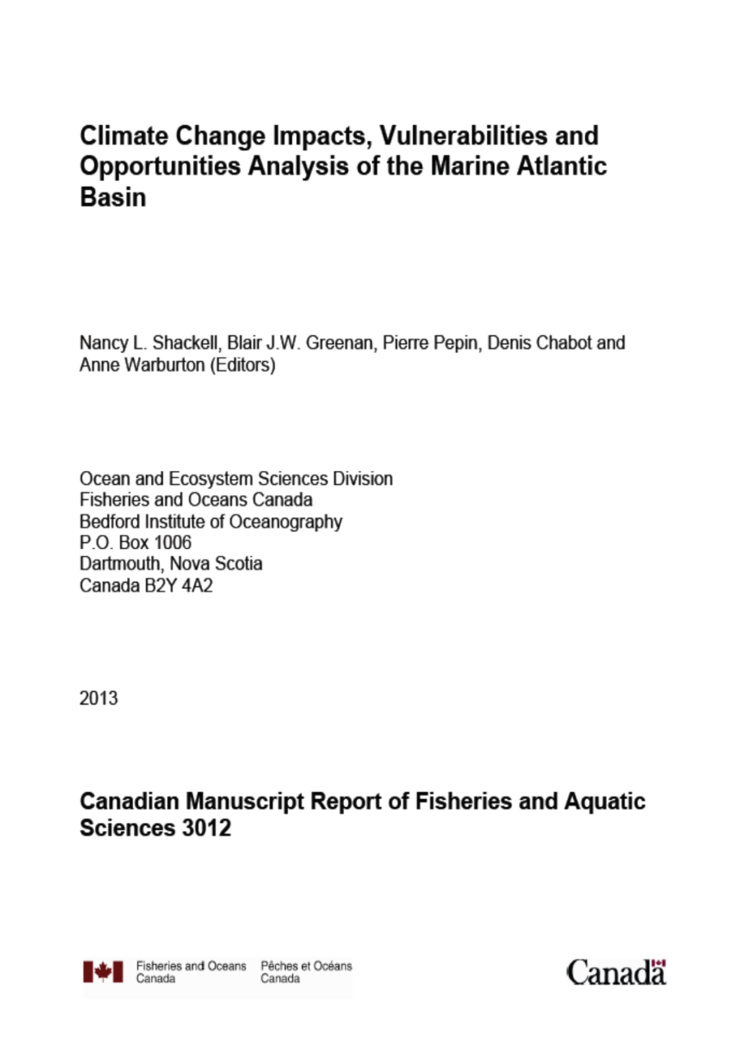
PHYSICS
BIOLOGY

Slide 7
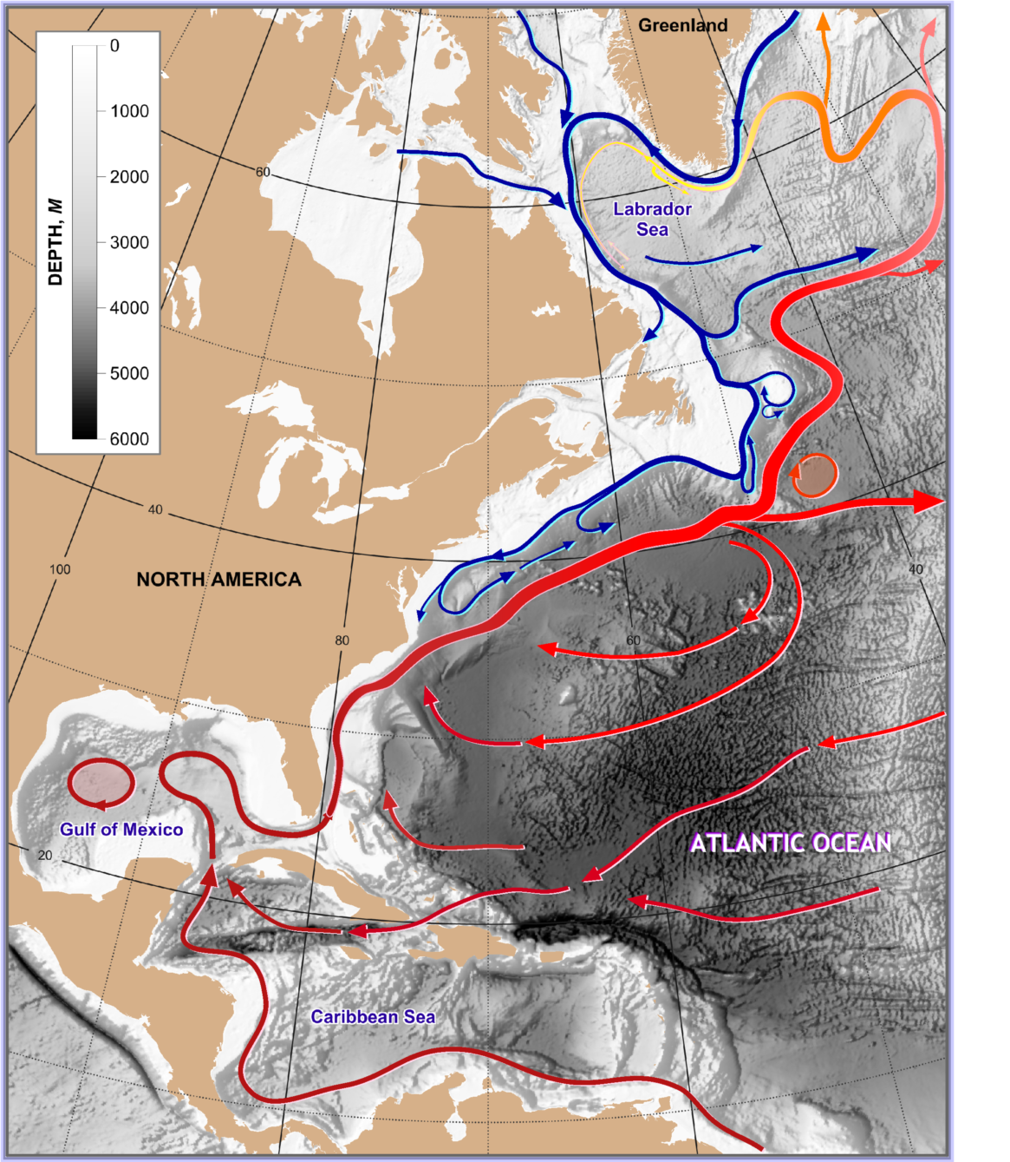
The need for high resolution – in particular for future climate modelling
Labrador Current & Subpolar Gyre
Eastern seaboard of Canada lies in the confluence zone of warm subtropical waters and cold subpolar waters
Processes occurring on the SS/GoM are affected by the interaction between the GS and Labrador Currents, so these features have to be modelled accurately
… →
Gulf Stream & Subtropical Gyre

Slide 8
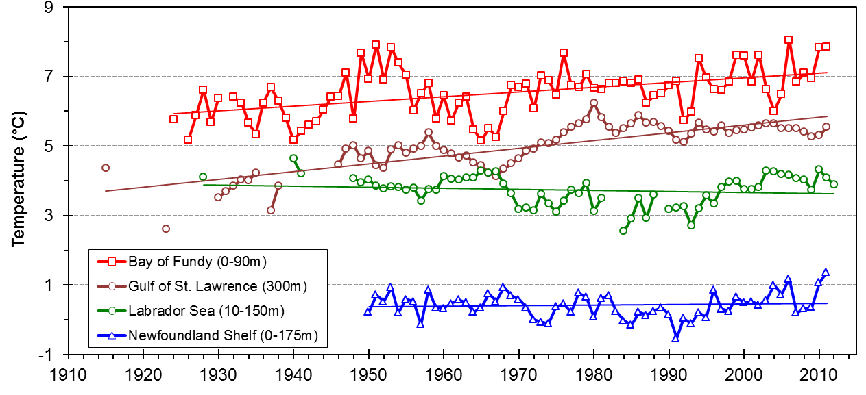
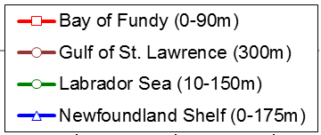
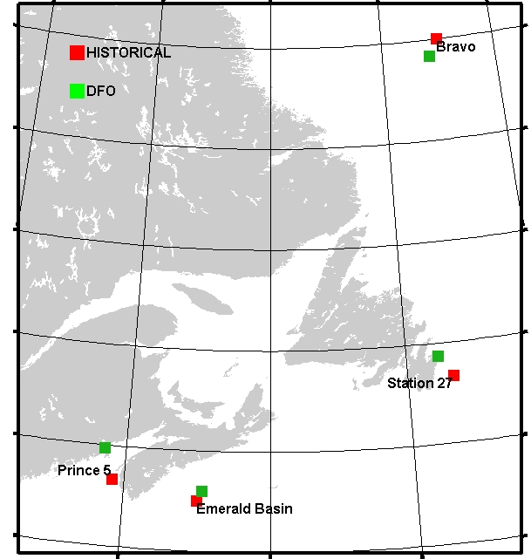
Observed Variability in Upper-Ocean Temperature in the NWA
DFO AZMP & AZOMP
Temperature
Net warming since 1930
by ~1ºC (~0.1ºC/dec) in outer Bay of Fundy and
by ~2ºC (~0.2ºC/dec) at depth in Gulf of St. Lawrence
No net warming
on Newfoundland Shelf and
in Labrador Sea
Large decadal variability
1910
2010
Labrador Sea / Bravo
Gulf of St. Lawrence
Newfoundland Shelf / Station 27
Bay of Fundy / Prince 5

Slide 10
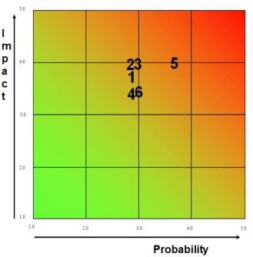
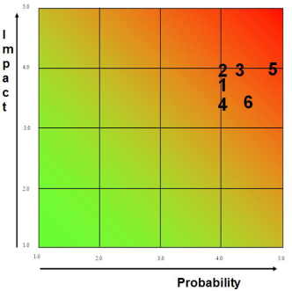
Atlantic LAB Risk Assessment
Science Risk Assessment (November 2012 – St John’s)
  Impact and Probability of occurrence in the Atlantic LAB for each DFO Climate Change Risk, on the 10 year and 50 year horizons.
Risk Exposure – 10 year horizon
Risk Exposure – 50 year horizon
DFO main climate change Risks
Ecosystem and Fisheries Degradation & Damage
Changes in Biological Resources
Species Reorganization and Displacement
Increased Demand to Provide Emergency Response
Infrastructure Damage
Changes in Access and
Navigability of Waterways
Notes:
SCIENCE RISK ASSESSMENT
For each LAB, some foundational science work was conducted on climate change trends and projections as well as the impacts, vulnerabilities and opportunities that climate change may present for DFO’s areas of responsibility (ecological/biological aspects as well as the infrastructure that we are responsible for).
There was a meeting in St John’s NL in November of 2012 to confirm that science work and using that new understanding, to produce the heat maps that you see on the left hand side of this slide – essentially telling you what the departmental risks mean for the Atlantic LAB, in terms of impact and likelihood, on two timescales – 10 years and 50 years.
You can see that in both cases, the highest risk is Risk #5 – infrastructure damage but that all of the risks are actually pretty high, especially on the 50 year timeline.
It is also worth noting that the three biological Risks (1,2,3) have more significant program overlap and are more closely connected than the infrastructure/services based Risks (4,5,6).
INTEGRATED RISK ASSESSMENT
Moving to the right of the slide, less than half a year later an integrated risk assessment workshop was held.
Along with the science work, other elements were considered.
New heat maps were generated.
You can see that there were some slight changes but that we are still pretty focused in that upper right quadrant.

Slide 11
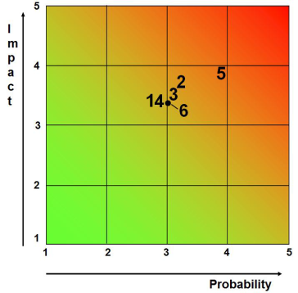
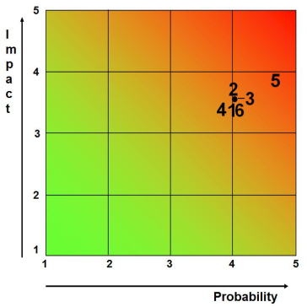
Atlantic LAB Risk Assessment
Science Risk Assessment (November 2012 – St John’s)
  Heat maps showing the Impact and Probability of occurrence in the Atlantic LAB for each DFO Climate Change Risk, on the 10 year and 50 year horizons.
Integrated Risk Assessment (March 2013 – Moncton)
  Science – projected impacts: e.g., sea water warming and/or decreased oxygen
  Socio-economic threats: e.g., increased demand for knowledge, analysis; economic sector(s) most affected
  Policy considerations: e.g., increased management challenges; uncertainty in implementing policies
  Departmental vulnerabilities: e.g., conflicting interests, external communication
  Opportunities: e.g., some species may benefit from warmer water
Risk Exposure – 10 year horizon
Risk Exposure – 50 year horizon
DFO main climate change Risks
Ecosystem and Fisheries Degradation & Damage
Changes in Biological Resources
Species Reorganization and Displacement
Increased Demand to Provide Emergency Response
Infrastructure Damage
Changes in Access and
Navigability of Waterways
Risk Exposure – 10 year horizon
Risk Exposure – 50 year horizon
Notes:
SCIENCE RISK ASSESSMENT
For each LAB, some foundational science work was conducted on climate change trends and projections as well as the impacts, vulnerabilities and opportunities that climate change may present for DFO’s areas of responsibility (ecological/biological aspects as well as the infrastructure that we are responsible for).
There was a meeting in St John’s NL in November of 2012 to confirm that science work and using that new understanding, to produce the heat maps that you see on the left hand side of this slide – essentially telling you what the departmental risks mean for the Atlantic LAB, in terms of impact and likelihood, on two timescales – 10 years and 50 years.
You can see that in both cases, the highest risk is Risk #5 – infrastructure damage but that all of the risks are actually pretty high, especially on the 50 year timeline.
It is also worth noting that the three biological Risks (1,2,3) have more significant program overlap and are more closely connected than the infrastructure/services based Risks (4,5,6).
INTEGRATED RISK ASSESSMENT
Moving to the right of the slide, less than half a year later an integrated risk assessment workshop was held.
Along with the science work, other elements were considered.
New heat maps were generated.
You can see that there were some slight changes but that we are still pretty focused in that upper right quadrant.

Slide 12
happening in NorthEast US…
--Calls for more development, and species-specific examinations

Slide 13
Knowledge and Understanding Projects (MAR)
2013-14 Funding Round
  Ed Trippel, Michel Starr: Effects of Ocean Acidification on Marine Fauna and Ecosystem Processes in the Northwest Atlantic
  Ed Trippel, Joanne Morgan: Impact of Environmental Change on Growth, Reproduction and Survival and on Estimation of Productivity/Fishery Reference Points
  Will Perrie: Climate change and the cumulative impacts of environmental stresses
  David Brickman: High Resolution Simulation of Future Ocean Climate in the Northwest Atlantic
  Will Perrie: Projections of climate change impacts in the Arctic Ocean
  Will Perrie: Impacts of climate change on waves and storm surge in the Arctic
Notes:
Project selection guided by:
Outcome of science and risk work
As the program went on, identification of gaps in areas that hadn’t had much attention.
Climate-sensitive decisions
Knowledge and Understanding: Development of new knowledge through science and technology to improve the Department’s understanding of the impacts of climate change across its business lines

Slide 14
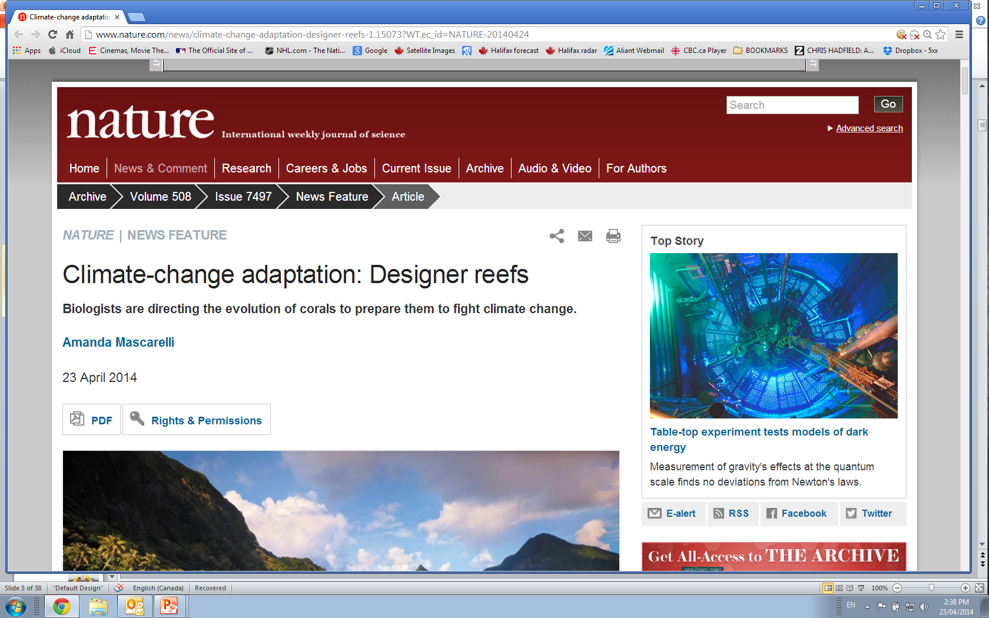

Slide 15
Adaptation Tool Projects (MAR)
2013-14 Funding Round
  Nancy Shackell: Vulnerability of key invertebrate and fish species to climate change and the likelihood of significant changes in spatial distribution
  Blair Greenan: EWLAT - Extreme Sea Level Adaptation Tool
  Jim Hamilton: Ice Forecasts and Real-time Ice Data for Canadian Coast Guard Operations in the Canadian Arctic Archipelago
2014-16 Funding Round: decisions made in June 2014 AND acidification is starting to gain NCR attention.
  Nancy Shackell: Vulnerability of key invertebrate and fish species to climate change and the likelihood of significant changes in spatial distribution (Stortini—Oxygen and Halibut in Gulf of St. Lawrence with Denis Chabot)
Notes:
From Risk Assessment to Adaptation : Adjusting DFO’s decisions to consider the vulnerabilities, risks, impacts, and opportunities associated with a changing climate
Adaptation Tools: Adaptation to climate change through the development of science-based and applied climate change adaptation tools for use by departmental decision makers and Canadians

Slide 16
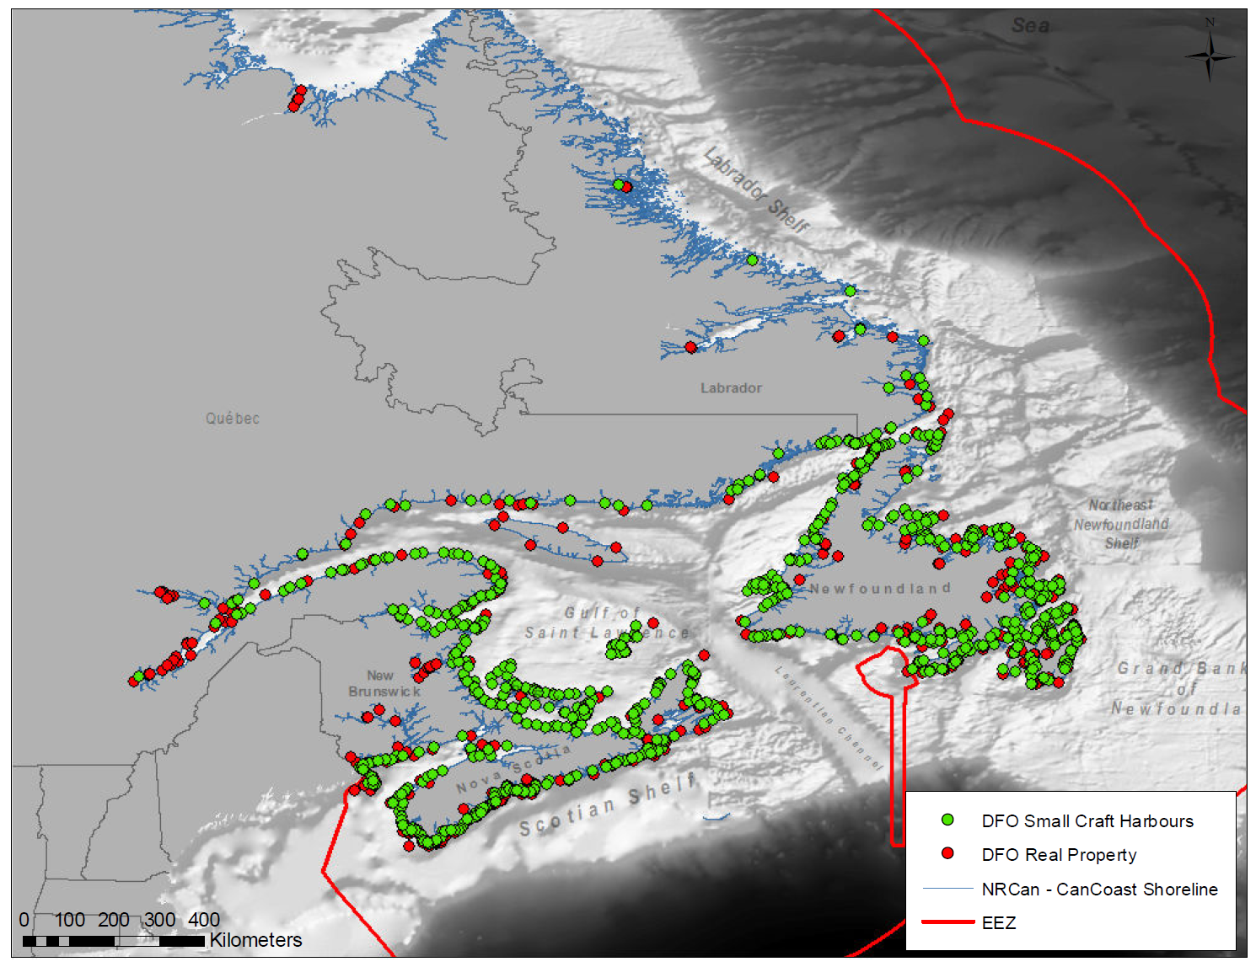
CAN-EWLAT: Canadian Extreme Water Level Adaptation Tool
Objective: Develop a web-based planning tool for SCH and RPSS to enable adaptation to extreme sea level associated with climate change.
We apply a statistical method to compute a vertical allowance, which is the amount that infrastructure should be raised above its current height in order to maintain the risk of flooding to be the same as it is today

Slide 17
Which economically and ecologically important species are vulnerable to projected warming?
Fishery and Ecosystem Managers-
How important is warming relative to other issues?
Do we really need Marine Protected Areas if all the species are going to move north?
Where do we start? --Triage
Notes:
Management: must incorporate climate change into operations =>adaptation

Slide 18
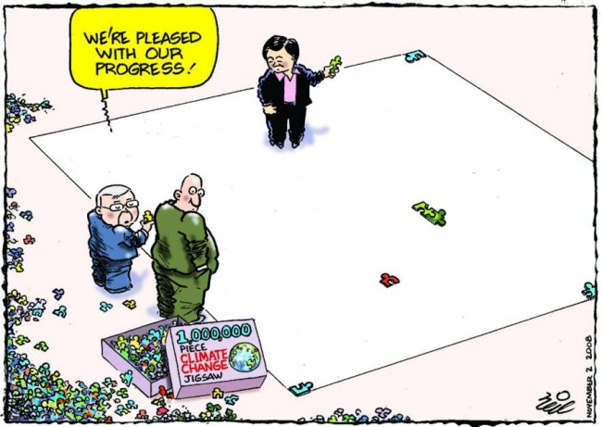
Puzzle
PHYSIOLOGY, PHENOLOGY, DISTRIBUTION
“Climate Change” by Neil Matterson
Sunday Mail Brisbane, 2 Nov. 2008
http://climatographer.com/2013/01/
Puzzle Piece:
Which Species are vulnerable to expected warming?
Notes:
Habitat gain loss is small small part of gigantic puzzle
…)
Phytoplankton (base of food chain)
-Recruitment
-Habitat
-cumulative effect

Slide 19
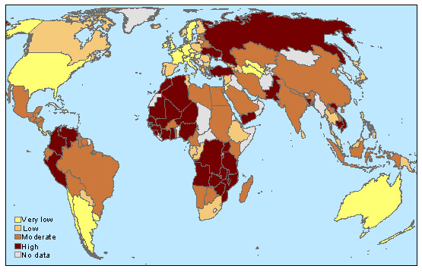
Vulnerability of National Economies
of potential Climate Change impacts on Fisheries
http://onlinelibrary.wiley.com/doi/10.1111/j.1467-2979.2008.00310.x/abstract
Exposure X Sensitivity X Adaptive Capacity= Vulnerability

Slide 20
Exposure X Sensitivity X Adaptive Capacity= Vulnerability
Projected Change
in 2030 and 2060
of Preferred:
-Bottom Habitat
-Larval window
-Spawning window
Extent of:
-Lat range
-Diet
-Habitat Type
Extent of:
-Population Size
-Life History
-Larval Dispersal
-Adult Mobility
How do we measure Exposure???

Slide 21
How do we measure Exposure??? ACCASP Physical Oceanographers produce
LOTS of info on Trends and Projections—(available online)
Scotian Shelf scenarios =
2060: mid-range (3°C) from ensemble of AR5 ESM August SST projections
2030: SST empirical trends since 1985 (0.7°C)
How does warming affect habitat availability?
Shackell, N.L., Ricard, D., Stortini, C. (2014) Thermal Habitat Index of Many Northwest Atlantic Temperate Species Stays Neutral under Warming Projected for 2030 but Changes Radically by 2060. PLoS ONE, 9(3): e90662. doi:10.1371/journal.pone.0090662.

Slide 22
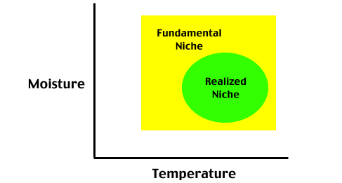
Species Distribution Models → used to explore Climate Change Impacts; “Niche Modelling”
Where a species “could” live
(Potential)
Where a species “actually” lives
(due to competition, predation)
Pidwirny, M. (2006). "Concept of Ecological Niche". Fundamentals of Physical Geography, 2nd Edition.
http://www.physicalgeography.net/fundamentals/9g.html
Notes:
SDMs
-First Response: animal follows temperature.

Slide 23
GLOBAL PROJECTION
On Scotian Shelf
From 2005-2050
POLEWARD
Demersal Spp.: 2-4km/yr
Pelagic Spp.: 4-6km/yr
(surface layers warm faster
And pelagic spp move more)
Pereira, et al. Science 330, 1496 (2010);
Notes:
Many terrestrial studies predicting poleward movement. Here is example of a marine study
--very impt work and then followed by study showing that change may not be poleward.(next slide)
see hake eg. In US)

Slide 24
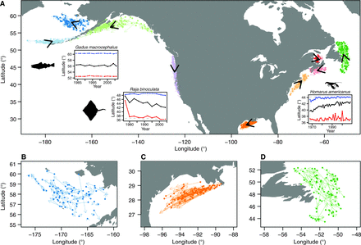
MEANWHILE…..
Pinsky et al. 2013
—should not expect simple POLEWARD progression but marine organisms track rate and direction of local climate
“bioclimate envelope methods are valuable but can be improved by the use of fine-scale climate data.”
Issue: Real Estate-Location, Location, Location…and
Fig. 1Shifts in the distribution of marine taxa.
(A) Vectors show the average shift in latitude and longitude for each taxon (colors) and the mean shift in each region (black). Insets show the mean (black), maximum (blue), and minimum (red) latitude of detection for Pacific cod (Gadus macrocephalus) in the Gulf of Alaska, big skate (Raja binoculata) on the U.S. West Coast, and American lobster (Homarus americanus) in the Northeast. Gray dashed lines in insets indicate the range of surveyed latitudes. Detailed views are also shown of (B) the Eastern Bering Sea, (C) the Gulf of Mexico, and (D) Newfoundland.
Science 13 September 2013:
Vol. 341 no. 6151 pp. 1239-1242
DOI: 10.1126/science.1239352
Notes:
--fish
Pinsky et al. 2013 -climate velocity= rate and direction of temperature: marine organisms track temperature.
follow temperature.
2 Arrows facing Poleward

Slide 25
SPECIES DISTRIBUTION MODEL:
42+yrs of Probability of Occurrence
Habitat Fit=s(Location)+s(Depth)+s(Temperature)+s(Yr)
Warming Scenarios
Long Term 2060:
Short Term 2030:
Habitat Projections
GAIN OR LOSS (change in area occupied of most probable habitat)
Notes:
Used logistic regression to describe probability map of all those species. Predict probability under different temperatures and estimate diff between now and projeciton.

Slide 26
-Model
Family: binomial
Link function: logit
Formula:
presence ~ s(YEAR) + s(BOTTOM_TEMPERATURE, bs = "ts", k = 4) + s(SDEPTH, bs = "ts", k = 3) + te(SLONG, SLAT)
REALIZED Habitat
Fit=s(Location)+s(Depth)+s(Temperature)+s(Yr)
Notes:
Examples of non-parametric curve fit smoothed component plot, transformed from logit scale to prob scale with only temperature in model. Cod like cold, Haddock bit warmer.

Slide 27
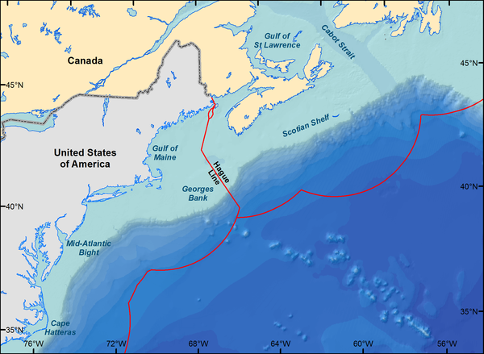

Figure 1. Northeast Continental Shelf (United States) and Scotian Shelf (Canada) in the Northwest Atlantic.
Shackell NL, Ricard D, Stortini C (2014) Thermal Habitat Index of Many Northwest Atlantic Temperate Species Stays Neutral under Warming Projected for 2030 but Changes Radically by 2060. PLoS ONE 9(3): e90662. doi:10.1371/journal.pone.0090662
http://www.plosone.org/article/info:doi/10.1371/journal.pone.0090662

Slide 28
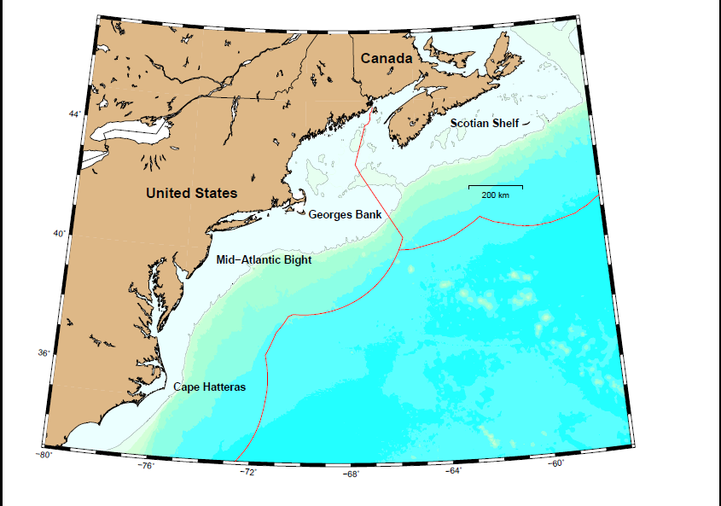
Ocean_Pout
Offshore_Hake
Plaice
Pollock
RadiatedShanny
Red_Crab
Red_Hake
Redfish
Rock_Crab
Sandlance
Scallop
SeaRaven
Shortfin_Squid
Silver_Hake
Smooth_Skate
Snow_Crab
Summer_Flounder
Thorny_Skate
Turbot
White_Hake
Windowpane
Winter_Flounder
Winter_Skate
Witch_Flounder
Wolffish
Yellowtail_Flounder
Barndoor_Skate
BlackBelly_Rosefish
Capelin
Cod
Cunner
Cusk
Dogfish
Dory
GulfStream_flounder
Haddock
Hagfish
Halibut
Herring
JonahCrab
Little_Skate
Lobster
Longhorn_Sculpin
Monkfish
Moustache_Sculpin
Northern_Shrimp
Fit Generalized Additive Model (GAM) to each species
Notes:
Most spp from 40N to 47N
-note no angel shark etc.

Slide 29
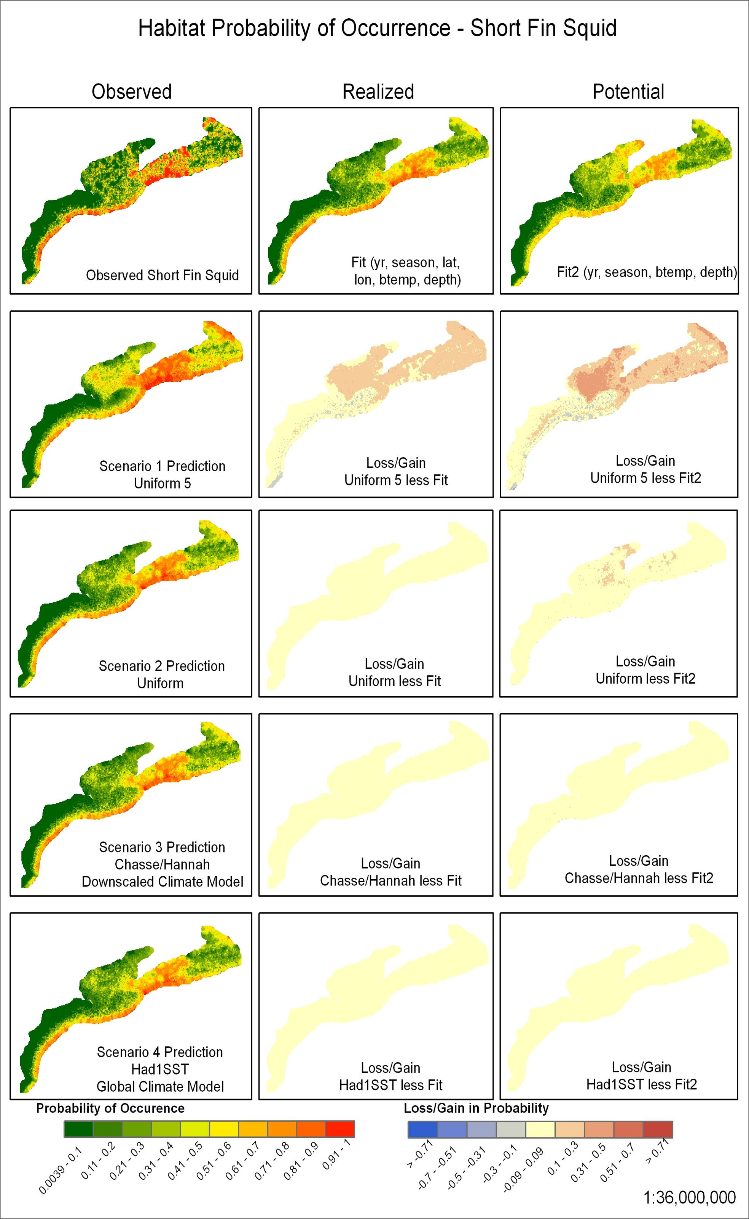
Short-Fin
Squid
Difference between Future and Present
5 C increase
Prediction of Future 5 C increase

Slide 30
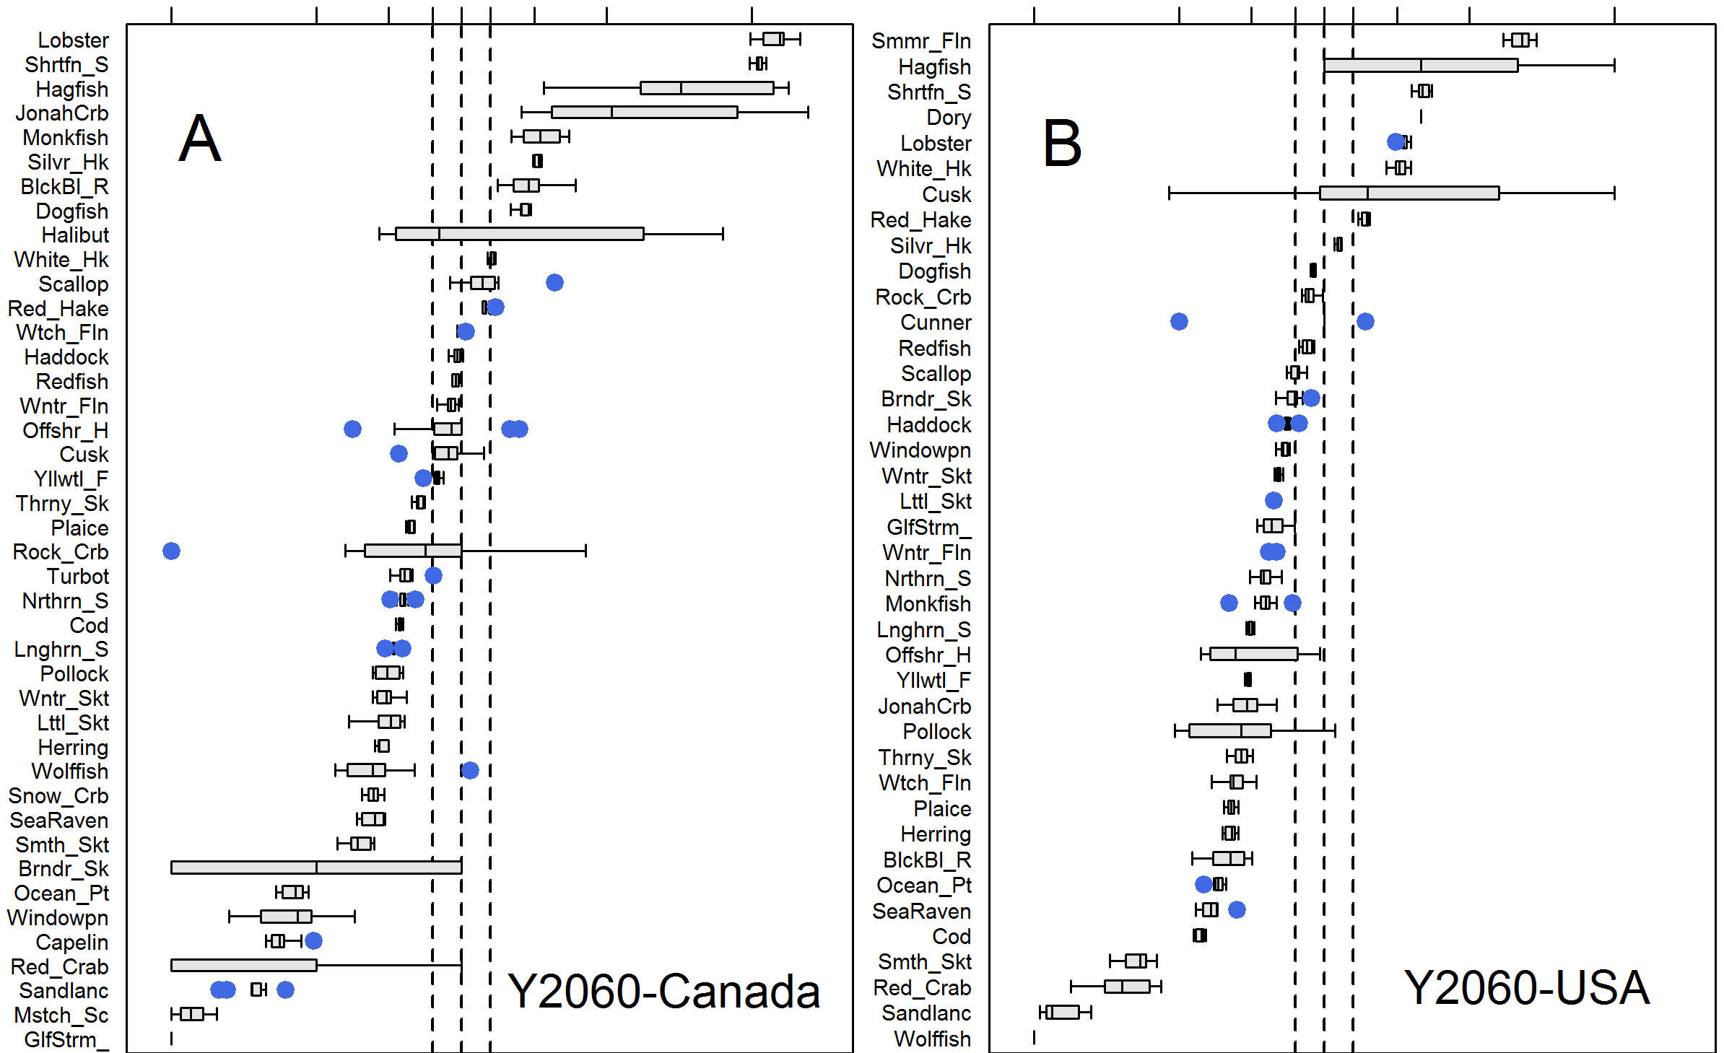
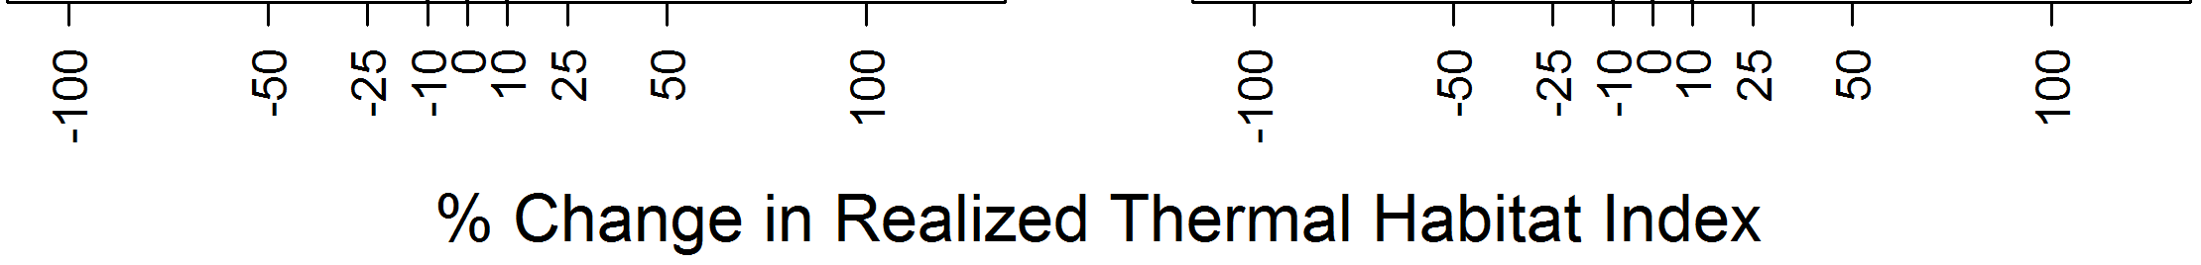
76% Change
85% Change
…insight, but not real

Slide 31
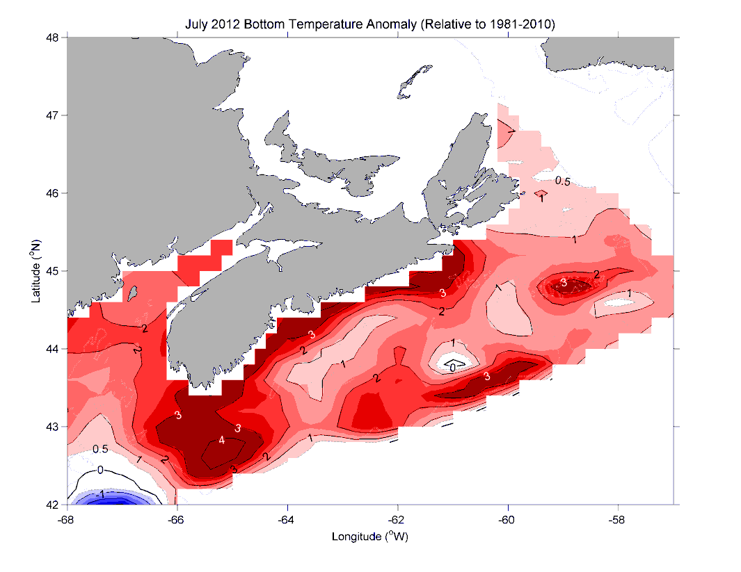
The 2012 warm event
Above average Temperatures SAME AS Expected Average Temp in 2060

Slide 32
On shorter
Time scale
Only 25%
Change
BUT…..
This is on
national scale.
What happens at
smaller scales?

Slide 33
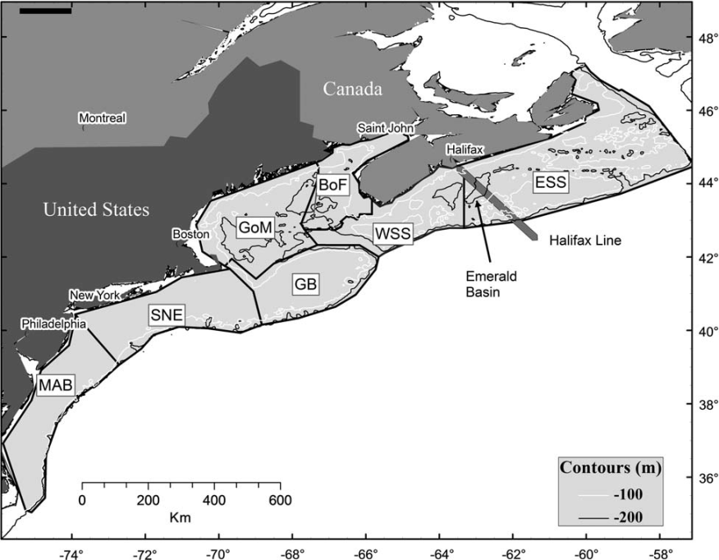
Figure S1. Percent change in realized habitat index for cod (Gadus morhua) in 6 subregions.
Subregions are defined in Shackell et al 2012 [1] and describe ecoregions from Cape Breton Canada to Cape Hatteras, USA. MAB=Mid-Atlantic Bight, SNE=Southern New England, GB=Georges Bank, BoF=Bay of Fundy, WSS =Western Scotian shelf, ESS=eastern Scotian Shelf (see Figure 1 in[1]). No estimates were made for MAB where amount of cod most likely habitat was too low.

Slide 34
Exposure X Sensitivity X Adaptive Capacity= Vulnerability
Projected Change
in 2030 and 2060
of Preferred:
-Bottom Habitat
-Larval window
-Spawning window
Extent of:
-Lat range
-Diet
-Habitat Type
Extent of:
-Population Size
-Life History
-Larval Dispersal
-Adult Mobility
Best measured and very important -bottom habitat, population size

Slide 35
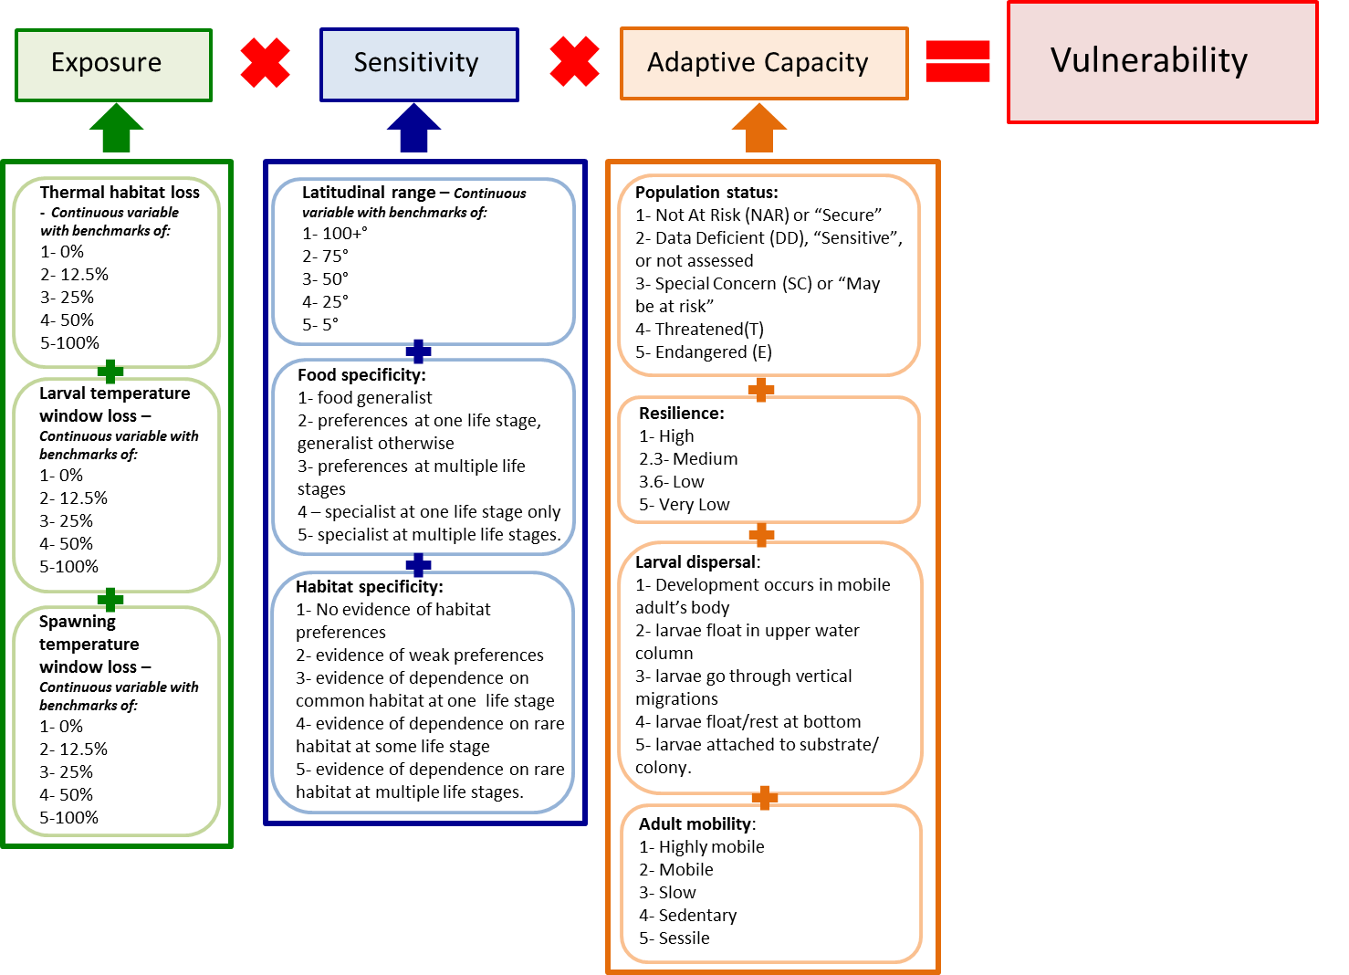

Slide 36
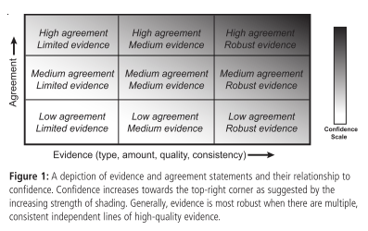
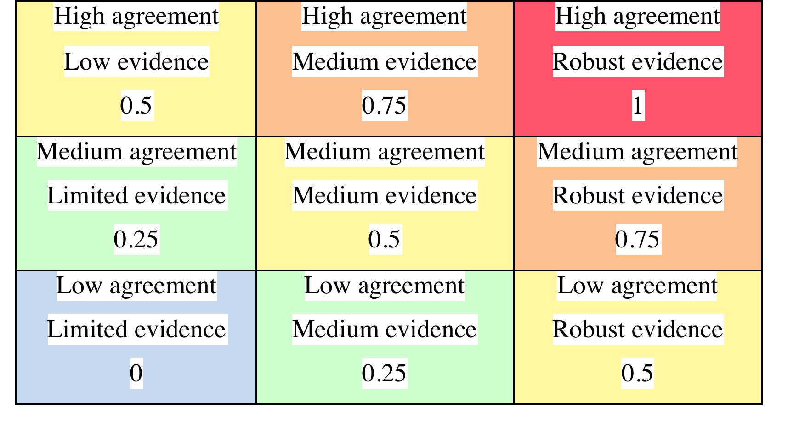
Dealing with uncertainty
IPCC/Mastrandrea et al., 2010
Medium
High
Very High
Medium
Low
Medium
High
Low
Medium
High
Very Low
Low
Medium
Very Low
Medium
Notes:
Where species were significantly lacking in data (one reference or no references; i.e. a certainty score of 0 or 0.25 for more than two factors), these species were not assessed (Table A2). Where a species had no references for one or two factors, it was given a neutral score (i.e. 3) for these factors in order not to over- or under- estimate vulnerability (Table A1).

Slide 37
RESULTS ON HOLD:
…Reviews back from ICES J Mar Sci but have been talking with USA (NOAA) –Wendy Morrison, Roger Griffis, Mark Nelson and want to compare methodologies.
--will meet with NOAA and Pacific DFO in early November.

Slide 38
Fishery and Ecosystem Managers-
How important is warming relative to other issues?
Notes:
Management: must incorporate climate change into operations =>adaptation

Slide 39
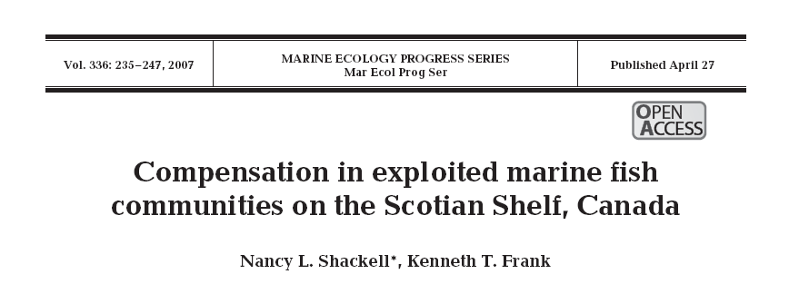
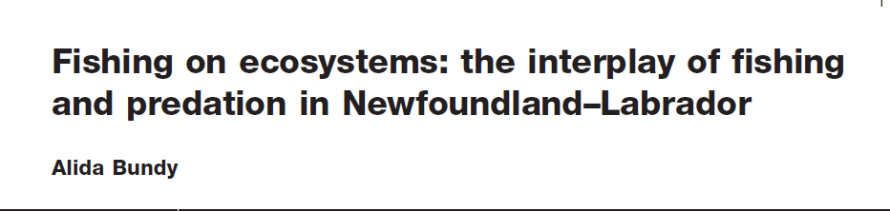
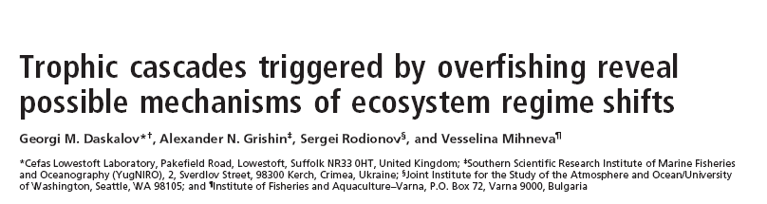



NF:
Black Sea
WSS
Baltic Sea
Trophic Cascade: Decline in Top Predators; Changing Climate
Baltic Sea
Over the past 10-20yrs… Common Patterns :
Heavy Fishing has dominated ecosystems, Climate modifies
LOCAL Observations:
Notes:
A lot of work in lakes and terrestrial systems about the ecosystem effects of removing top predatrs
-A lot of work in the ocean, on climated-induced ecological changes.

Slide 40
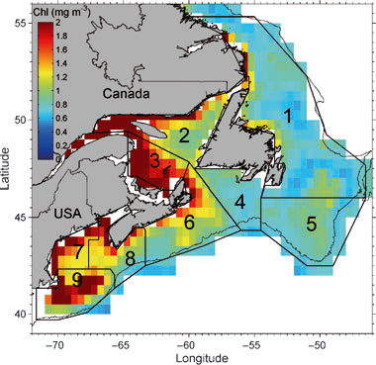
LOCAL OBSERVATIONs:
Fisheries productivity has been more influenced by overfishing than by climate change.
Ability to adapt depends on high levels of variation
Fishing reduces variation (e.g. size truncation, loss of sub-populations)
Thus over-fished populations are less resilient to climate change. ➔MAJOR FOCUS in literature (J.Mar Systems)
Annual Proportion Depletion of Cod SSB

Slide 41
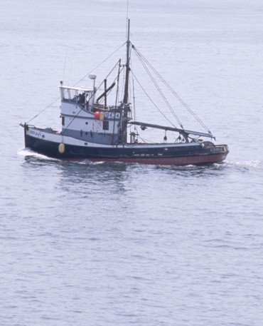
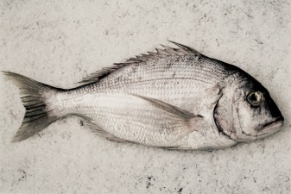
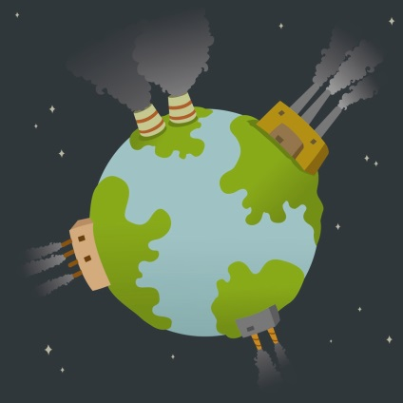
Extinction Vortex (Gilpin/Soule 1986)
Population: Small, fragmented, smaller body size
Overexploitation
Loss of Genetic Diversity, Drift
Reduced Population Adaptability
Lower Reproduction
Higher Natural Mortality
Climate Change
Smaller Population
Demographic Stochasticity
Lower genetic variation=lower adaptability

Slide 42
“Reducing fishing mortality in the majority of fisheries, which are currently fully exploited or overexploited, is the principal feasible means of reducing the impacts of climate change.”
K.M. Brander, 2007. Global fish production and climate change. (www.pnas.orgcgidoi10.1073pnas.0702059104)

Slide 43
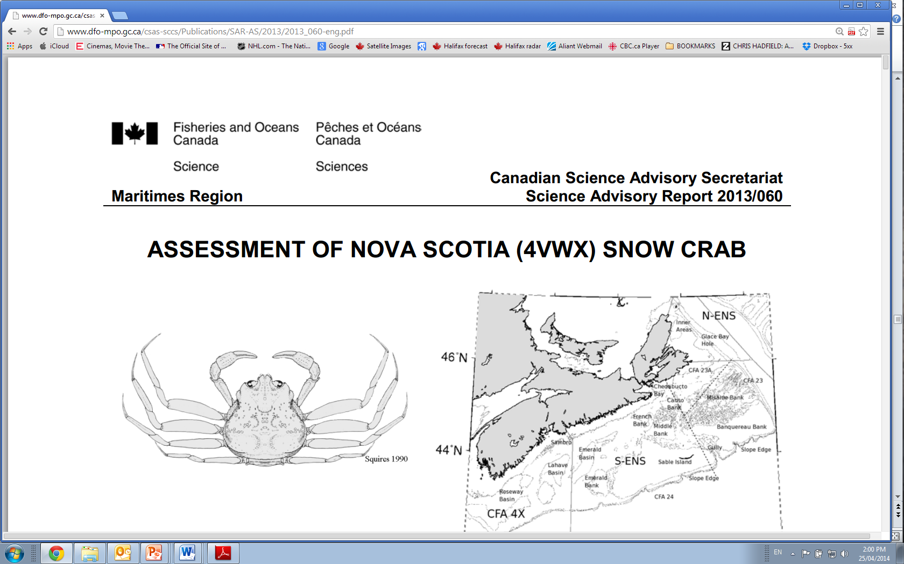

Slide 44
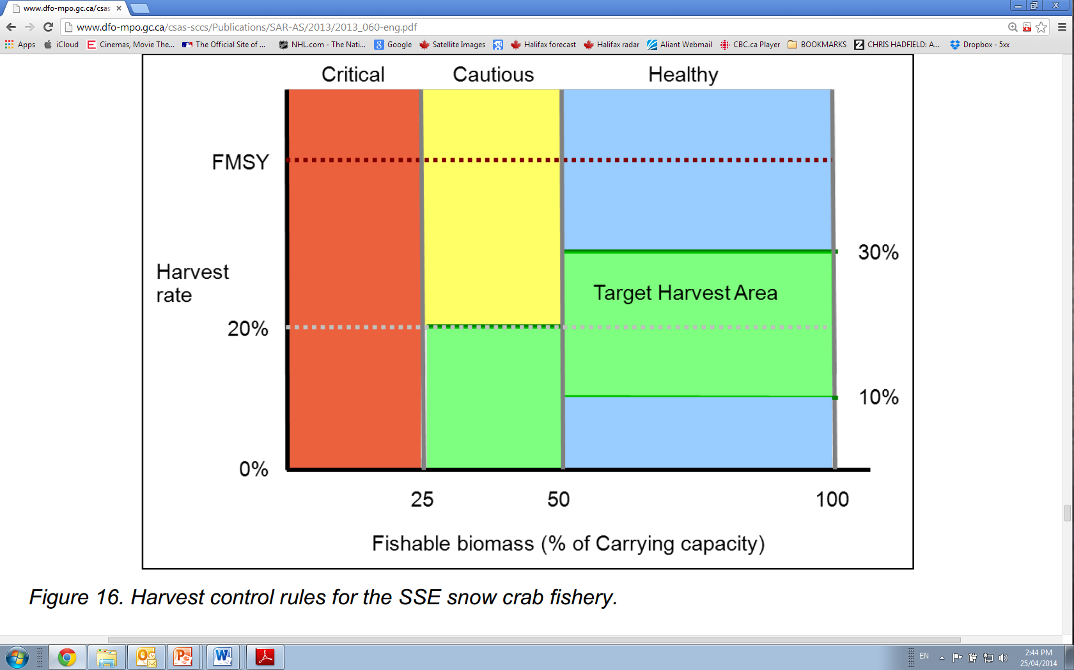
target harvest rates are shaped by a suite of secondary indicators that provide more complete information on the entire stock’s health
SECONDARY INDICATOR: surface area of potential snow crab habitat

Slide 45
Figure 14. Annual variations in the surface area of
potential snow crab habitat. The horizontal line
indicates the long-term arithmetic mean surface
area within each subarea. The estimates for the
period from 1998 to the present are based upon
snow crab surveys while those prior to 1998 are
projected using incomplete data (and so less
reliable). The surface area of potential habitat is
presently above the mean (actually close to the
maximum) for the 1998-2011 period.

Slide 46
Conclusions
US and Canada: ~80% change (winners AND losers) by 2060 or during extremes; 2030 ….not so bad and gives chance to plan…
EXPECT DIFFERENT RESULTS AT SMALLER SCALES e.g. NAFO subdivisions
Climate change are “directional” environmental drivers... Use VA approach to triage stocks and incorporate “thermal habitat index” into stock assessment process of vulnerable species.
Fishing, predator prey interactions and unassessed climate change stressors, may have a greater impact than warming.
NEXT STEPS: smaller scales and consider exposure to acidification and hypoxia (information is currently limited but developing)

Slide 47

END
Thank you.
Questions?
Should I stay or
Should I go Now??
http://www.dfo-mpo.gc.ca/csas-sccs/Publications/SAR-AS/2013/2013_060-eng.pdf

Slide 48
All the following are extra slides….

Slide 49
Table 5-1a “Shelf” sites in the Atlantic LAB with statistics of the projected TOS changes between 1986-2005 and 2046-2065 from the six ESMs and two RCPs (12-model ensemble) for each of February and August. Changes at the sites have been estimated from bilinear interpolation from adjacent grid points. The spread is the difference between the minimum value for RCP4.5 and the maximum value for RCP8.5 (it should be noted that, in a few cases, the actual spread is greater than given here since the minimum change can occur in an RCP8.5 member or the maximum in an RCP4.5 member). See Figure 2-4 for site locations.
AR5 TOS February August
Shelf Sites Min Mean Max Spread Min Mean Max Spread
N Labrador Shelf 0.0 0.4 1.2 1.2 0.7 2.2 3.3 2.5
Hamilton Bank -0.1 1.1 2.4 2.6 -0.1 1.8 3.4 3.5
NE Nfld Shelf -0.1 1.2 2.4 2.5 -0.2 1.8 3.7 3.9
Flemish Cap 0.2 1.4 2.4 2.2 0.9 2.7 4.5 3.5
Grand Bank 1.0 1.7 2.5 1.5 0.6 2.3 4.2 3.6
S Grand Bank 0.9 2.0 3.4 2.5 1.2 3.0 4.9 3.7
S Nfld Shelf 0.9 2.0 3.2 2.3 1.1 2.9 4.7 3.6
Gulf St Lawrence 0.5 2.2 3.6 3.1 1.1 2.9 4.7 3.6
E Scotian Shelf 1.1 2.4 4.7 3.6 1.0 3.0 4.8 3.8
Scotian Shelf 0.9 2.3 3.9 3.0 1.2 3.0 4.7 3.5
W Scotian Shelf 1.0 2.3 4.1 3.1 1.4 3.0 4.4 3.0
Georges Bank 0.7 2.0 3.6 2.9 1.3 2.6 3.8 2.5

Slide 50
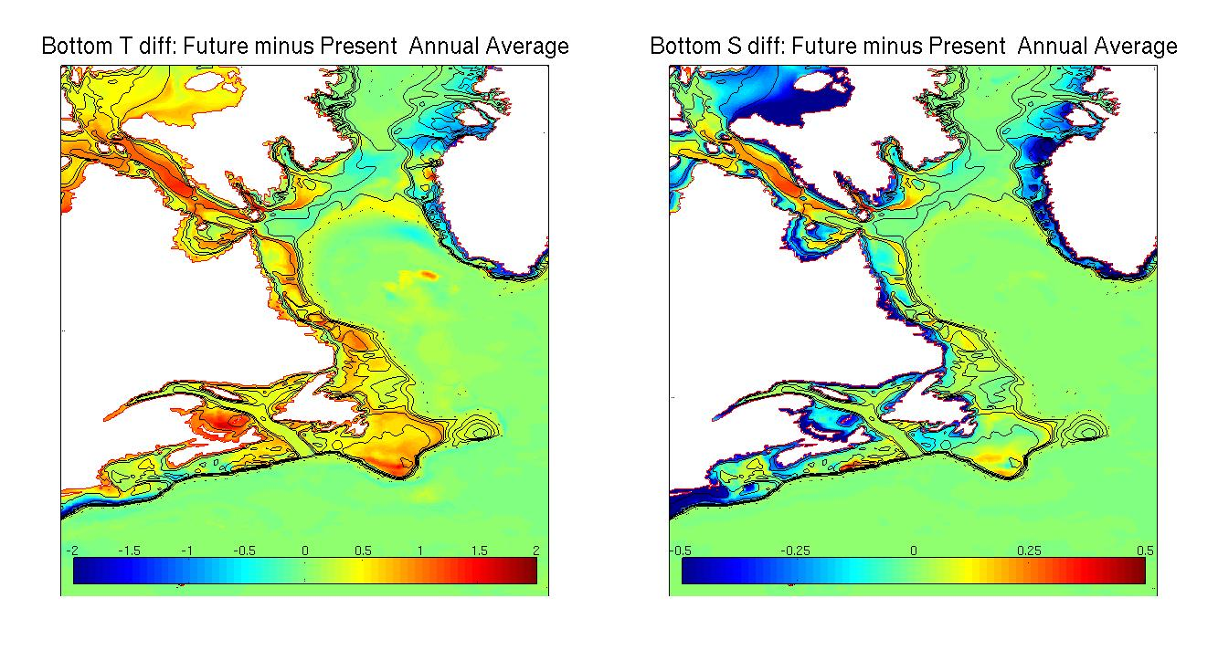
ACCASP high resolution model output for fisheries modelling
Annual TS Bottom Future (2046-2065)-Present

Slide 51
-Example of
ESM
Change Fields-
Figure 5-5 Bi-decadal monthly TOS change fields from 1986-2005 to 2046-2065 for the NWA for RCP8.5 from interpolated data from the six ESMs for August. The white contour is the 0°C isotherm.
Notes:
Figure 5-5 Bi-decadal monthly TOS change fields from 1986-2005 to 2046-2065 for the NWA for RCP8.5 from interpolated data from the six ESMs for a) February and b) August. The white contour is the 0°C isotherm. Gulf Stream not well resolved in hindcast model,
so Changefields are affected
So much Var
Among
IPCC use Ensemble

Slide 52
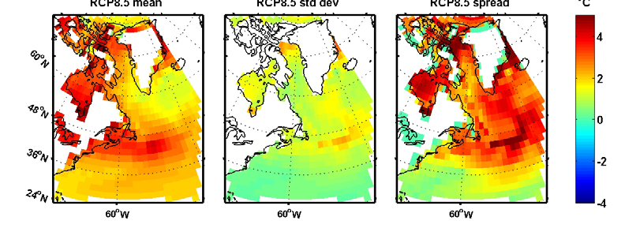
Figure 5-6 Mean, standard deviation, and spread (maximum minus minimum) of bi-decadal TOS changes for the NWA for RCP8.5 in ugust, computed from the ensemble of bi-decadal change fields from the six ESMs (e.g. Fig. 5-5 for RCP8.5). The white contour in the “mean” panels is the 0°C isotherm.
MESSAGE:--Spread among Models can be as large as predicted Change

Slide 53
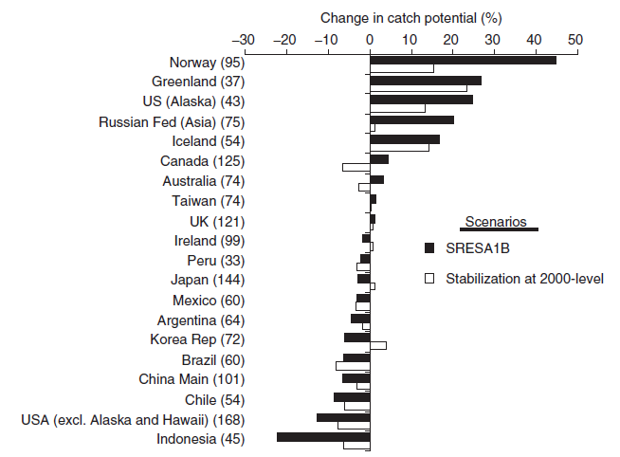
Fish and Invertebrate Production
GLOBAL PROJECTION: Climate change is expected to redistribute the global fish catch potential
Cheug et al. Global Change Biology (2010) 16, 24–35
Canada:
➔increase by ~ 5% by 2050 in a high GHG emission scenario but
➔ decrease ~8% if emissions stabilized at 2000 levels
NB Cheung et al. 2011.=updated DO/A
Notes:
Cheung et al. 2011.Ocean acidification and reduction in oxygen content reduce growth performance, increase the rate of range shift,
and lower the estimated catch potentials (10-year average of 2050 relative to 2005) by 20–30% relative to simulations without considering
these factors. Consideration of phytoplankton community structure may further reduce projected catch potentials by 10%.

Slide 54
Acidification and O2 decline -- reduces growth & increases rate of range shift
-lower the estimated catch potentials (10-year average of 2050 relative to 2005) by 20–30%
Cheung et al. 2011.
ICES Journal of Marine Science; doi:10.1093/icesjms/fsr012
Notes:
Changes in phytoplankton community structure -> reduce projected catch potentials by 10%

Slide 55

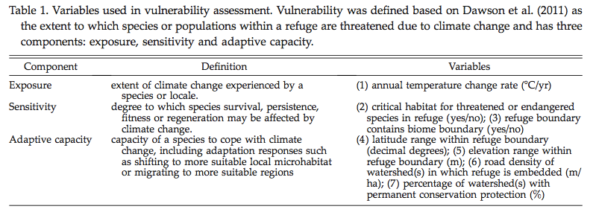
Magness et al., 2011

Slide 56
Limitations:
- Population status can change over time… could change in 50 years (2060) thereby changing vulnerability scores.
- Fairly subjective, but flexible (e.g. COSEWIC vs. IUCN; data availability).
- A more effective vulnerability assessment would consider other climate change factors (acidification, hypoxia, etc.), but currently the effects are difficult to quantify, and data are limited

Slide 58
SPECIES DISTRIBUTION MODEL:Use GAMS to estimate Probable Habitat: 42+yrs of Probability of Occurrence
REALIZED Habitat
Fit=s(Location)+s(Depth)+s(Temperature)+s(Yr)
POTENTIAL Habitat
Fit=s(Depth)+s(Temperature)+s(Yr)
Warming Scenarios
Long Term 2060: 3C/1.5C SST Short Term 2030: 0.7C/-.35C SST
Warming Scenarios
Potential Habitat Projections
Realized Habitat Projections
GAIN OR LOSS (change in area occupied of most probable habitat)
Notes:
Used logistic regression to describe probability map of all those species. Predict probability under different temperatures and estimate diff between now and projeciton.

Slide 59
-Model
Family: binomial
Link function: logit
Formula:
presence ~ s(YEAR) + s(BOTTOM_TEMPERATURE, bs = "ts", k = 4) + s(SDEPTH, bs = "ts", k = 3) + te(SLONG, SLAT)
REALIZED Habitat
Fit=s(Location)+s(Depth)+s(Temperature)+s(Yr)
Notes:
Examples of non-parametric curve fit smoothed component plot, transformed from logit scale to prob scale with only temperature in model. Cod like cold, Haddock bit warmer.

Slide 60
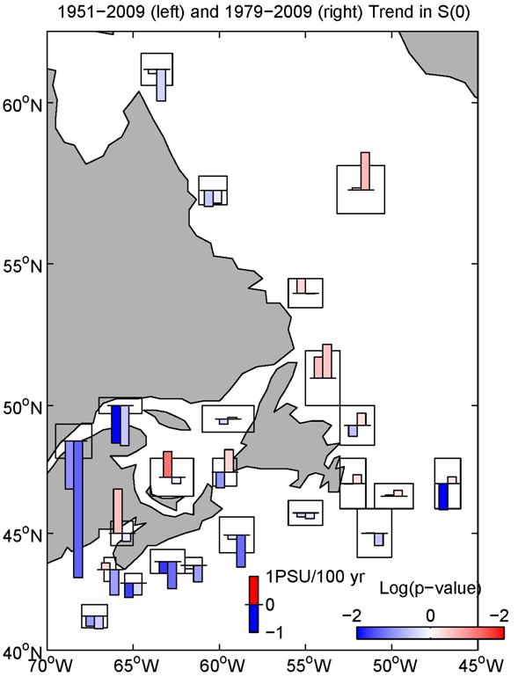
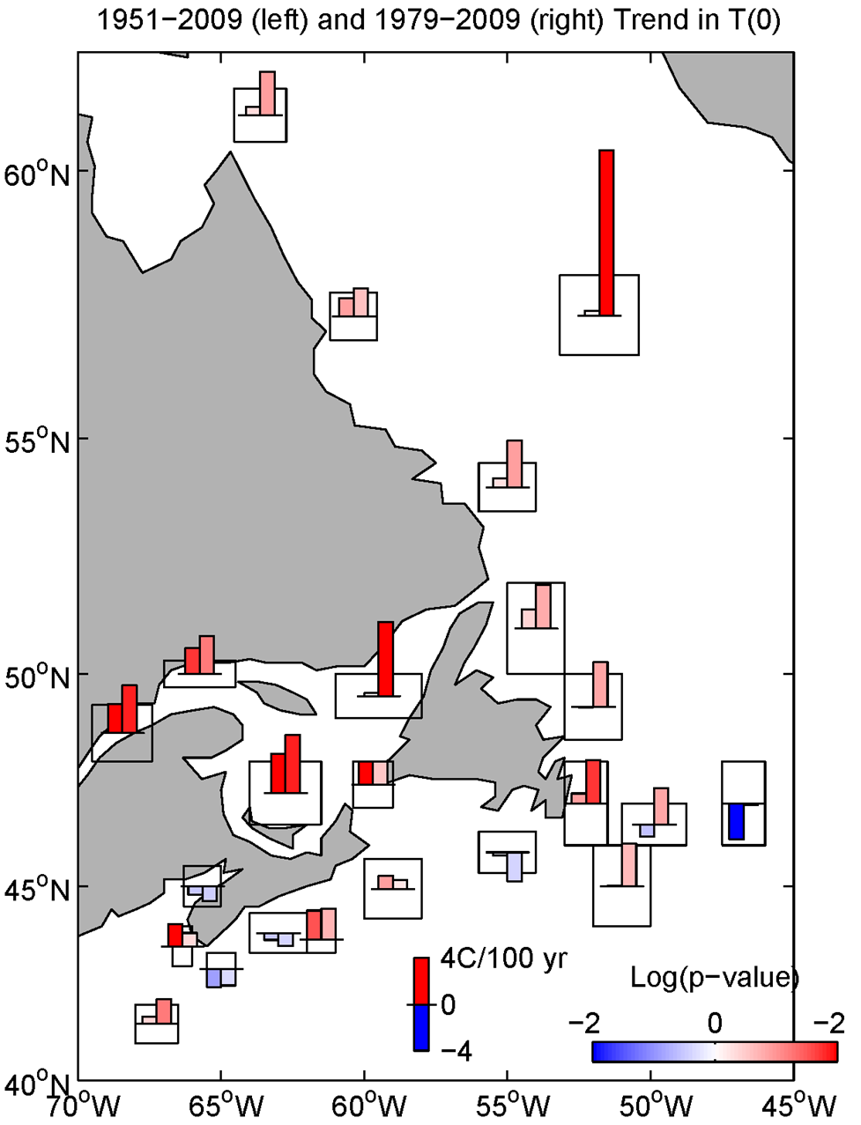
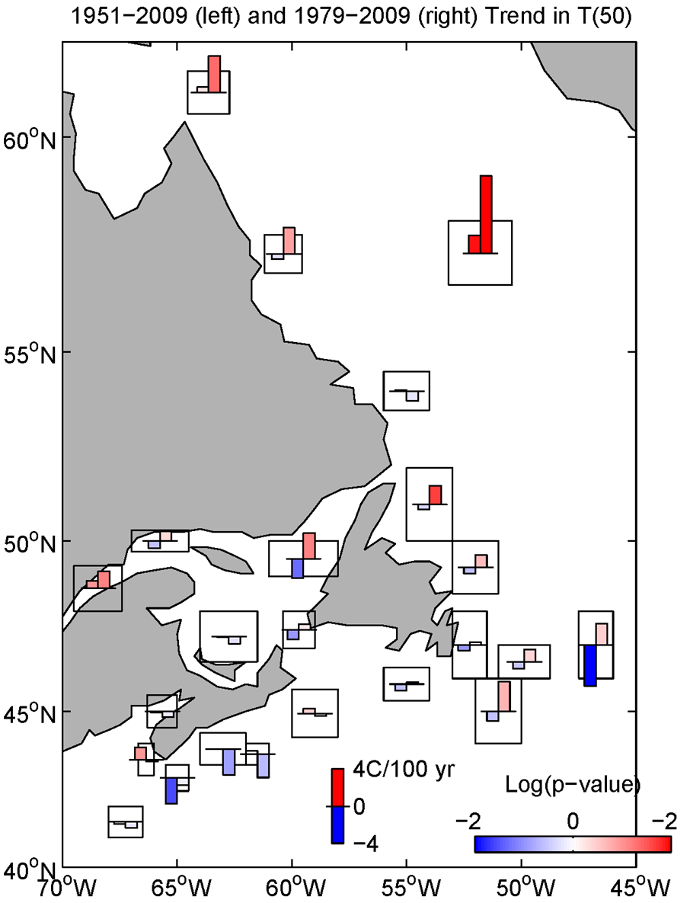
DAVE HEBERT-2013 Tech Report
Temperature at 50m
---No warming
SST Trends: warming in our region
NO TRENDS IN TEMPERATURE AT 50m WHERE MEASURED:
:suggests much greater lag
: adds confidence to conservative estimate
Notes:
The 1951-2009 period was chosen for the longest period with sufficient sampling. The 1979-2009 period represents the last approximate three decades of sampling. The p-value, a measure of how much the trend is significantly different from zero, was determined. The following figures show the trend (positive is red; negative is blue) for each region and parameter as bar graphs. For each region, the left bar is for the period 1951-2009 and the right bar is for 1979-2009. The height of the bar is proportional to the magnitude of the trend. A scale is given at the bottom centre of the figure. The intensity of the red (blue) within each bar is an indication of the p-value with higher intensities indicative of trends more significantly different from zero. The log of the p-value is used and the scale is given in the lower right corner of the figure (e.g. a significance level of 0.1 and 0.01 corresponds to a log scale value of -1 and -2). It should be noted that the Matlab® routine assumes that the number of degrees of freedom is N-2. If the time series has a decorrelation scale greater than a year, the effective number of degrees of freedom would be smaller. Thus, the confidence limited presented could be an overestimate. A proper estimate of the significance of the trend of any autocorrelated series is beyond the scope of this paper.

Slide 62
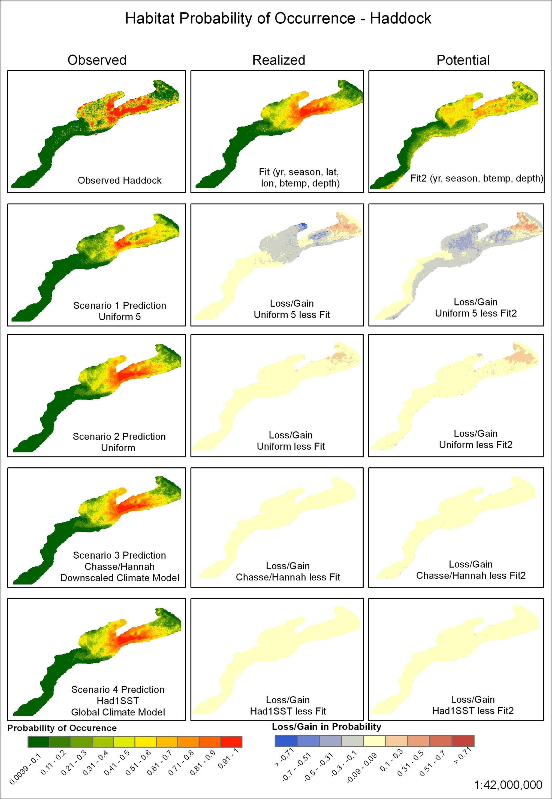
Fit
Fit
Notes:
-Describe all, and then discuss preference of realized (more conservative), for rest of talk , just presenting realized.

Slide 63
Notes:
Can’t see it in 2030, but that’s the advantage of looking at longer term change as it reveals the relationship in upper panel, Most species who lose are less than 25% of total area, meaning thay are relatively not widespread

Slide 64
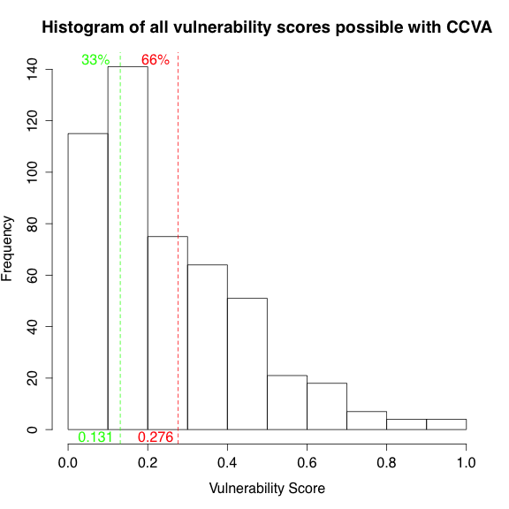
Low
Med
High

Slide 65
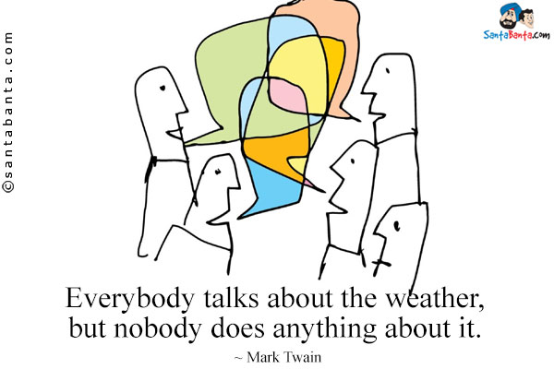
Everybody talks about Climate change
and everybody has to do something about it
Charles Dudley Warner

Slide 66
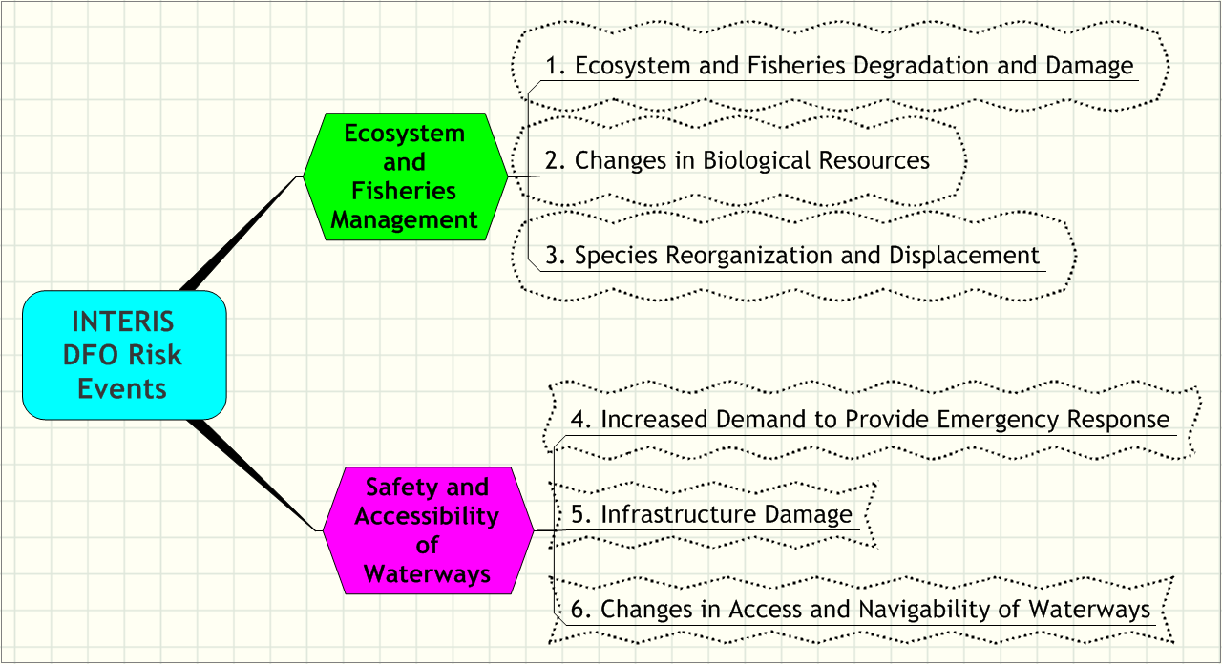
The INTERIS 2005 Analysis of DFO Climate Change Risks

