Slide 1
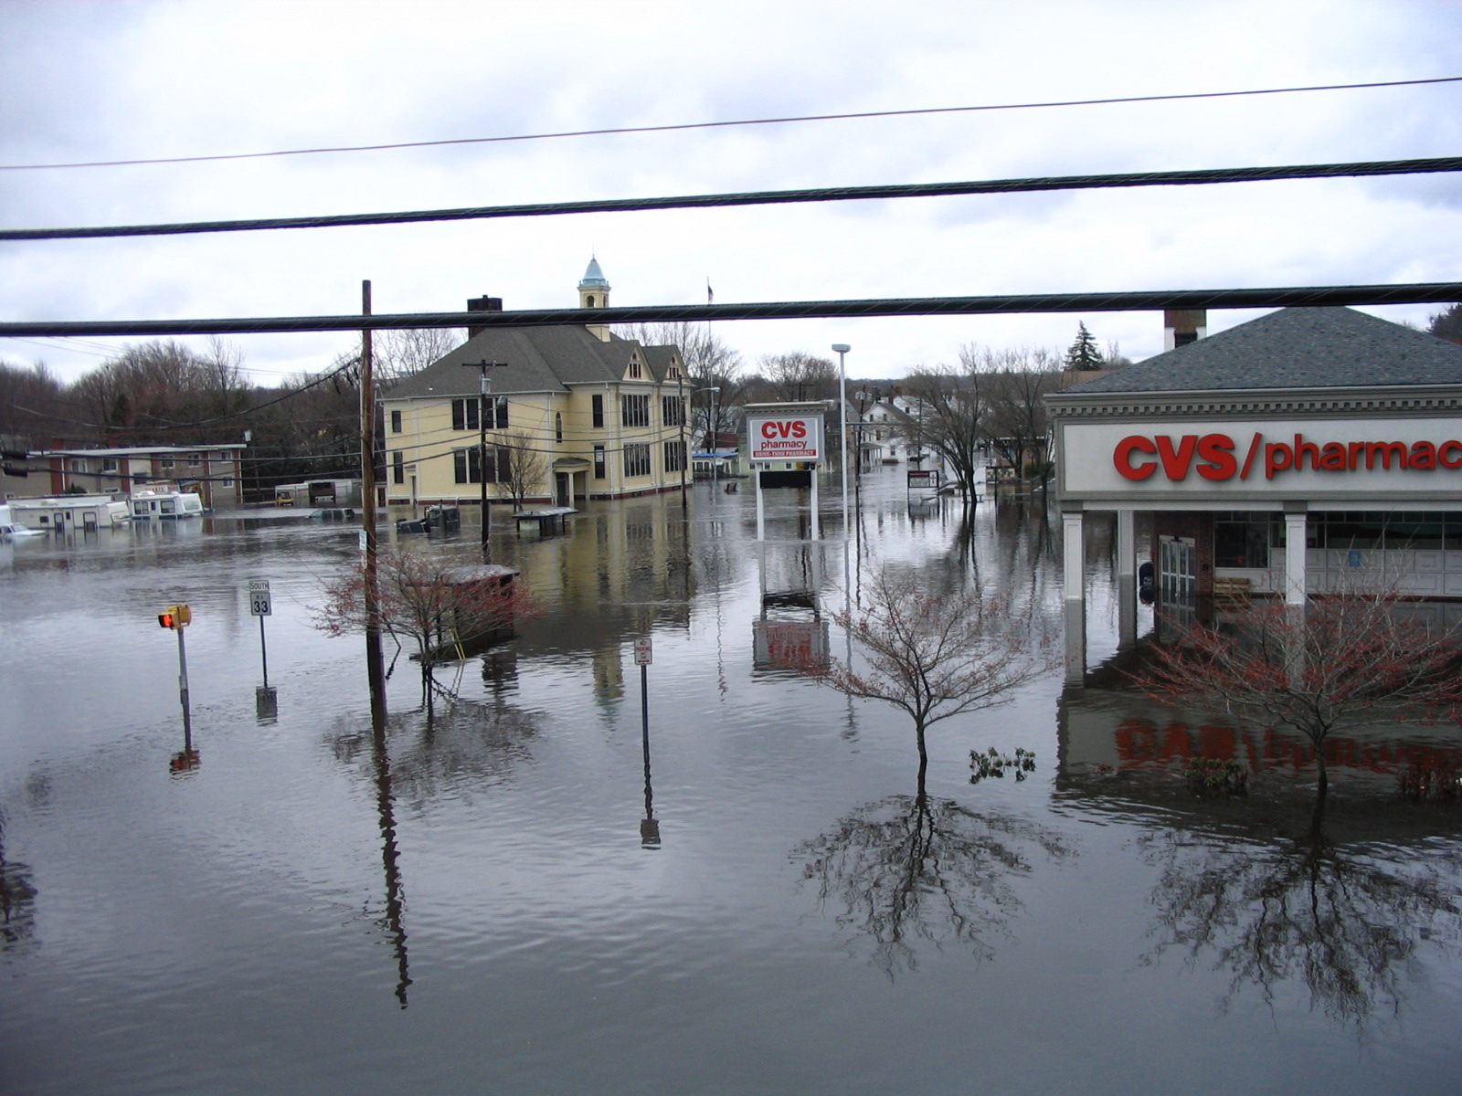
Climate Trends in New England and Its Impact on Storm and Riverine Flood Behavior
David R. Vallee Hydrologist-in-Charge
NOAA/NWS Northeast River Forecast Center
Providence Street – West Warwick, RI at 1030 am Wednesday 3/31/10

Slide 2
Outline
From a “Practitioner’s Perspective”
Touch upon some of our major flood events of the past 10 years
Big Rainstorms & High Impact Tropical Storms
Common themes & characteristics
How may a changing climate be impacting storm behavior in the Northeast?
What does this all mean?

Slide 3
A few caveats
I’m not a climate scientist!
I’m a practitioner
I have the benefit of living in this part of the country my entire life
It’s different now – beyond temps & precip
Changes in vegetation, insects, bird life & river response
Sea level rise
The mission: Develop a better understanding of the current regime vs. the old & what that means to how we model our rivers
“Accumulation of Ingredients” – not one single “source”
Where we are headed: that’s the million $$ question!

Slide 4
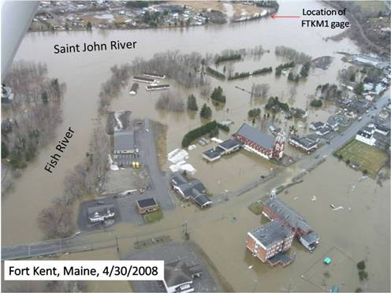
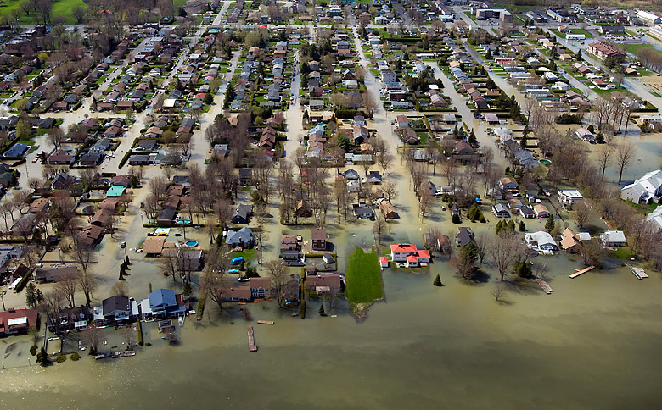
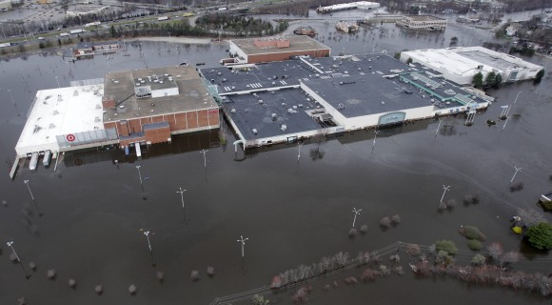
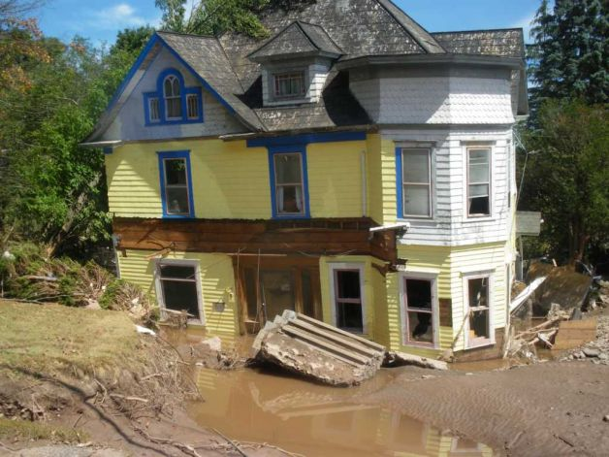
I've been a little busy these past 7 years! Job Security in the face of changing flood behavior!!
Record flooding along the Fish and Saint John Rivers – northeast Maine, 4/30/2008
St-Jean-sur-Richelieu, Quebec, Canada, 5/6/11
Photo: AP//Canadian Press, R. Remoirz
Providence Street – West Warwick, RI at 1030 am Wednesday 3/31/10
Home washed off its foundation along the Schoharie Creek, Prattsville, NY – Tropical Storm Irene

Slide 5
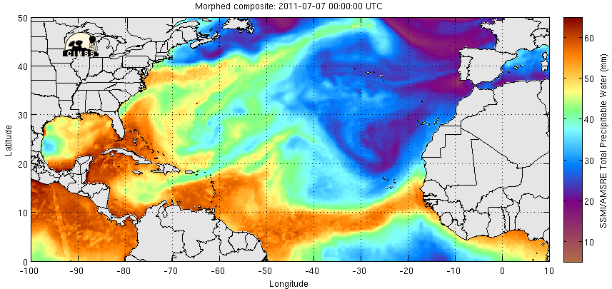
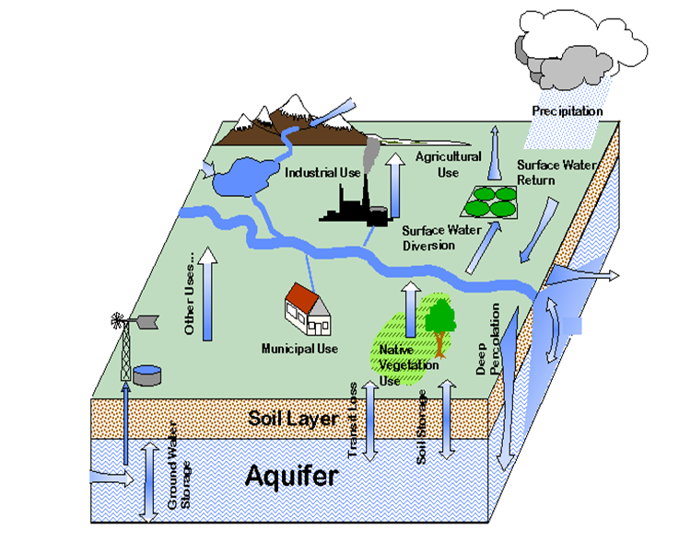
Is there a common theme to recent ?
Several:
Slow moving weather systems – a blocked up atmosphere
Multiple events in close succession or 1 or 2 slow movers
Resulted in saturated antecedent conditions before “main event”
Each fed by a “tropical connection”
Plumes of deep moisture

Slide 6
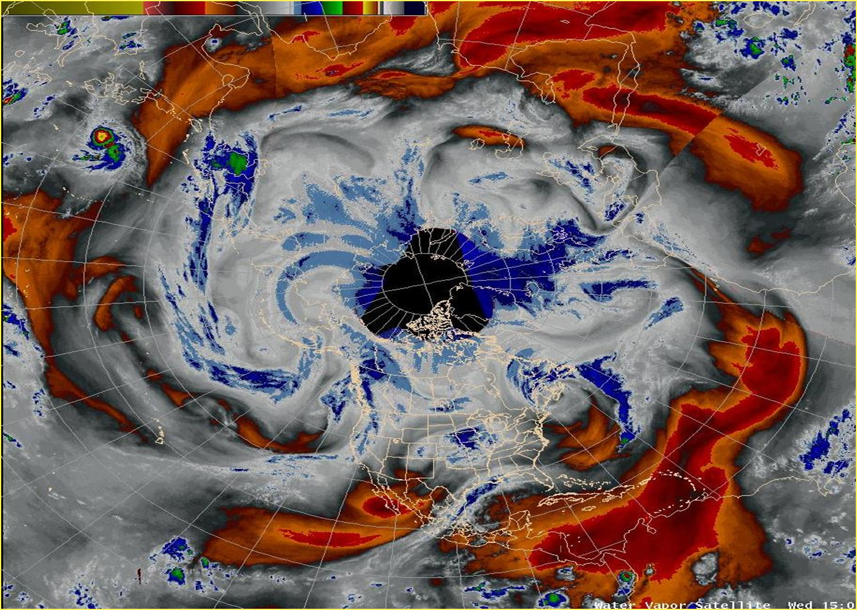
Is there a plausible "Climate Hypothesis"?
Modest changes in air & sea temperatures = atmosphere can hold more moisture
New England is in close proximity to the ocean and the Gulf & Atlantic moisture streams
Affected by dual storm tracks and blocking high pressure over Greenland
These ingredients offer us more “opportunities” to latch onto these plumes
Reduction of sea ice changes upper level wind flow
Blocked up pattern induces slower moving storms or back-to-back-to back events
H
L
L
L

Slide 7
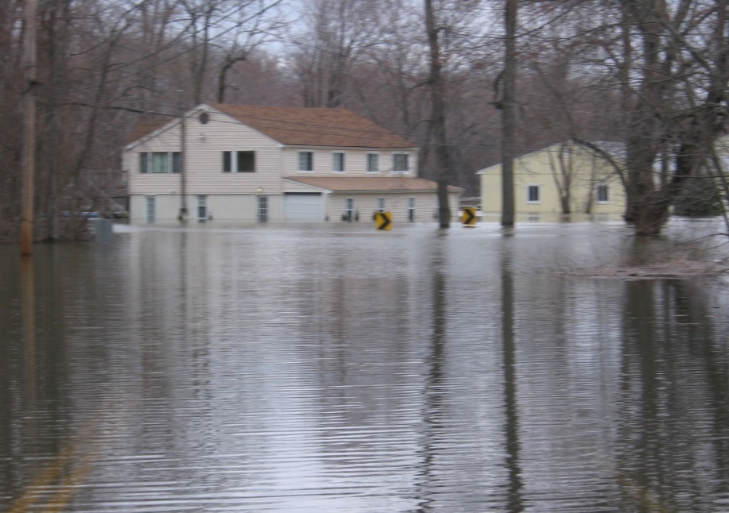
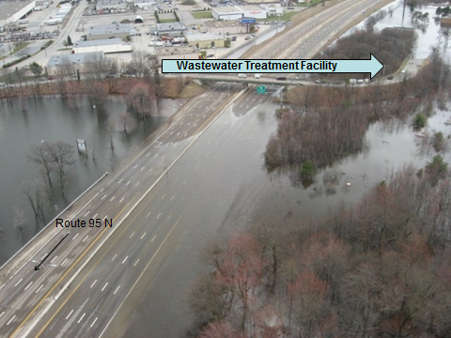
The Changing Climate
Common themes across New England:
Increasing annual precipitation
Increasing frequency of heavy rains
Warming annual temperatures
Wildly varying seasonal snowfall
Shift in precipitation frequency (50, 100 yr – 24 hr rain)
For smaller (<800 sq mi) basins – trend toward increased flood magnitude and/or frequency
Most pronounced where significant land use change and/or urbanization has occurred
Moderate flooding – Connecticut River at Portland, CT, April 2007
I-95 in Warwick with submerged Warwick Waste Water Treatment Facility
March 31, 2010 – photo from RI ANG)

Slide 8
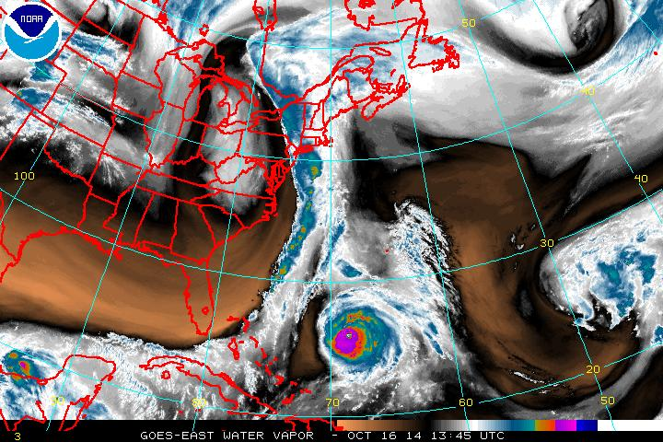
Is there a plausible "Climate Hypothesis"?
Modest changes in air & sea temperatures = atmosphere can hold more moisture
New England is in close proximity to the ocean and the Gulf & Atlantic moisture streams
Affected by dual storm tracks and blocking high pressure over Greenland
These ingredients offer us more “opportunities” to latch onto these plumes
Reduction of sea ice changes upper level wind flow
Blocked up pattern induces slower moving storms or back-to-back-to back events
Today’s situation: slow moving storm with two tropical connections

Slide 9
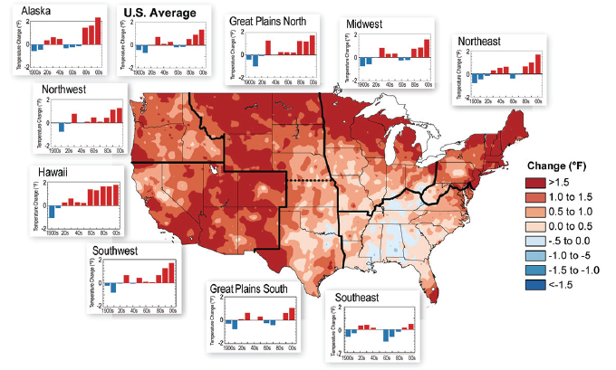
Trends in U.S. Temperature:
Decadal trends and 1991-2011 relative to 1901-1960
Notes:
Map: Difference in precipitation (%) between 1991-2011 and 1901-1960. Most areas have experienced wetter conditions.
Graphs: Average precipitation differences from the 1901-1960 average by decade for each region. The far right bar is for the single year of 2011. The number above each graph is the average precipitation change for 1991-2011 compared to the historical base period of 1901-1960.

Slide 10
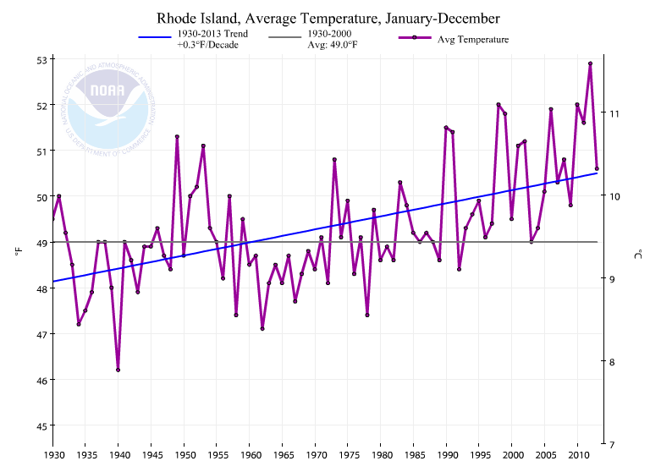
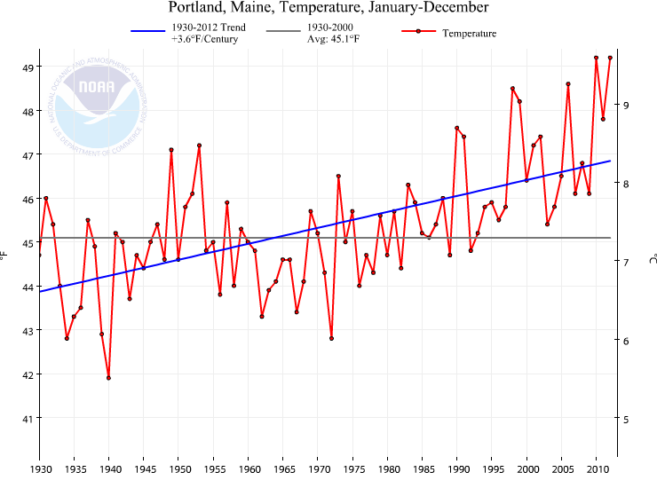
A Look at Temperature and Precipitation Trends http://www.ncdc.noaa.gov/cag

Slide 11
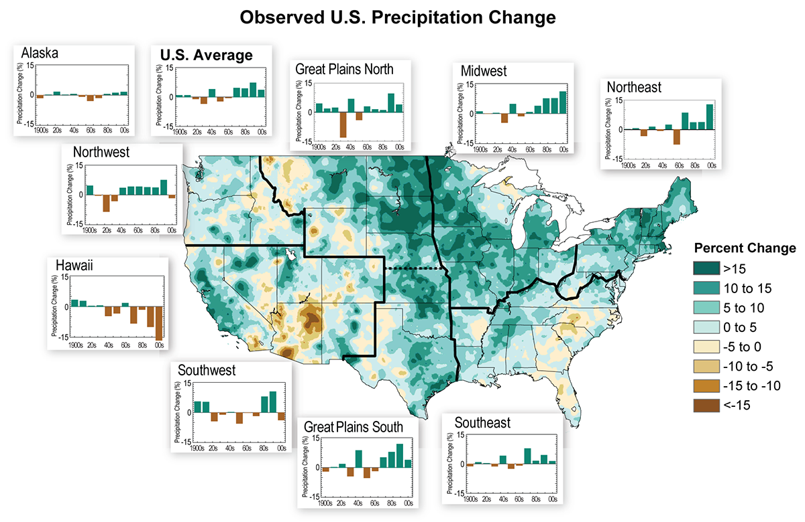
Trends in U.S. Precipitation:
Decadal trends and 1991-2011 relative to 1901-1960
Notes:
Map: Difference in precipitation (%) between 1991-2011 and 1901-1960. Most areas have experienced wetter conditions.
Graphs: Average precipitation differences from the 1901-1960 average by decade for each region. The far right bar is for the single year of 2011. The number above each graph is the average precipitation change for 1991-2011 compared to the historical base period of 1901-1960.

Slide 12
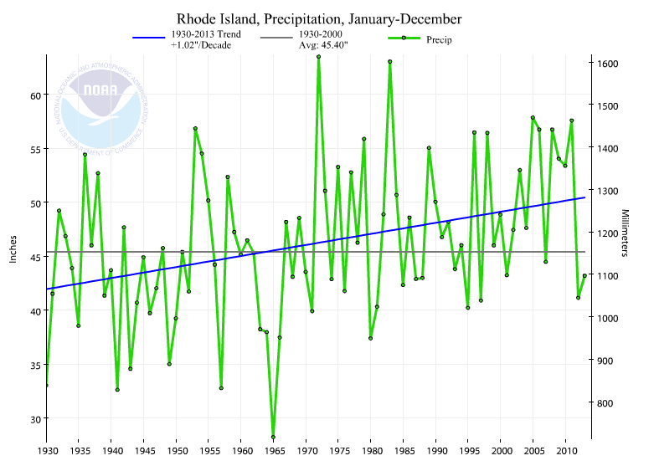
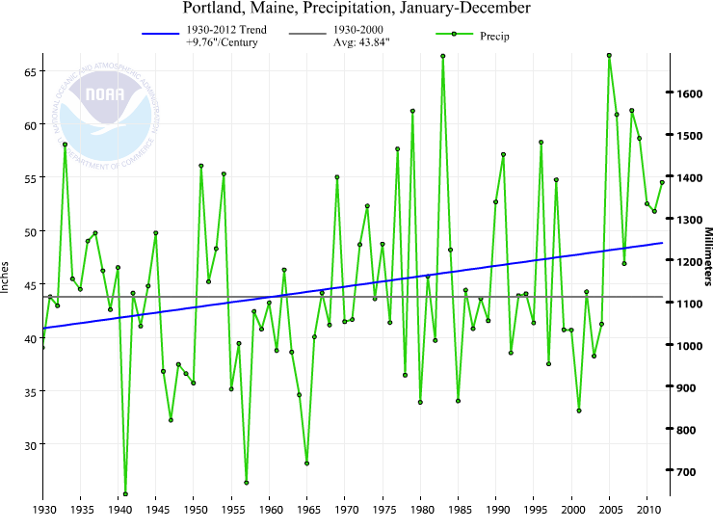
A Look at Temperature and Precipitation Trends http://www.ncdc.noaa.gov/cag

Slide 13
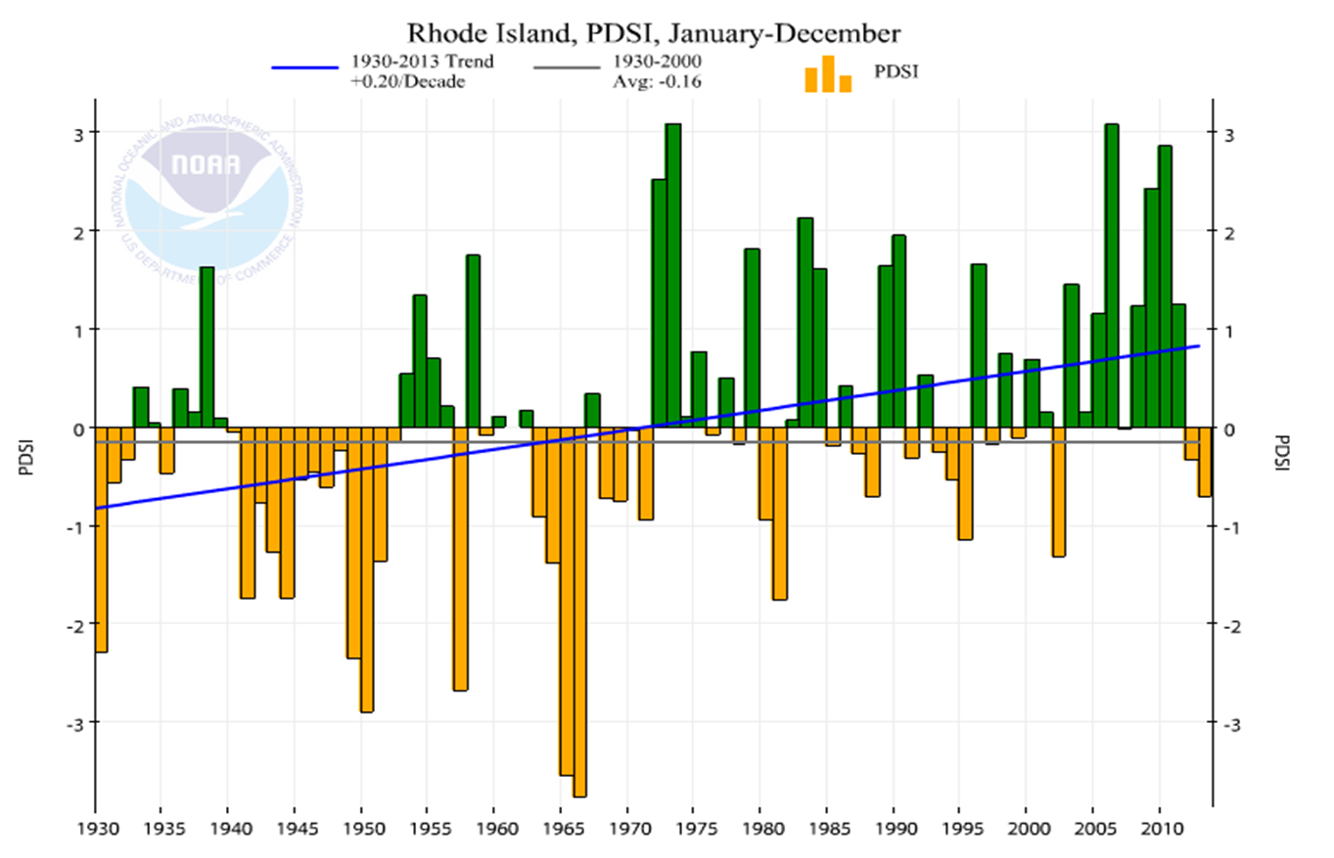
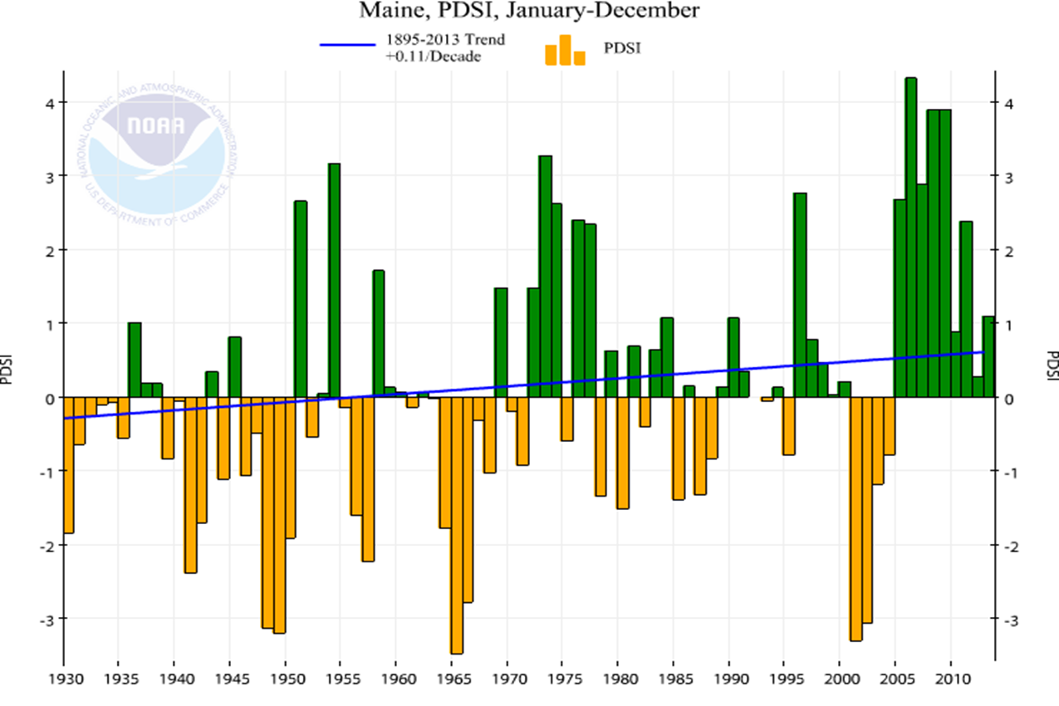
Notice changes in the Palmer Drought Index – per NCDC database
Since the late 60s, similar signature of much shorter, less intense dry periods and longer higher amplitude wet periods

Slide 14
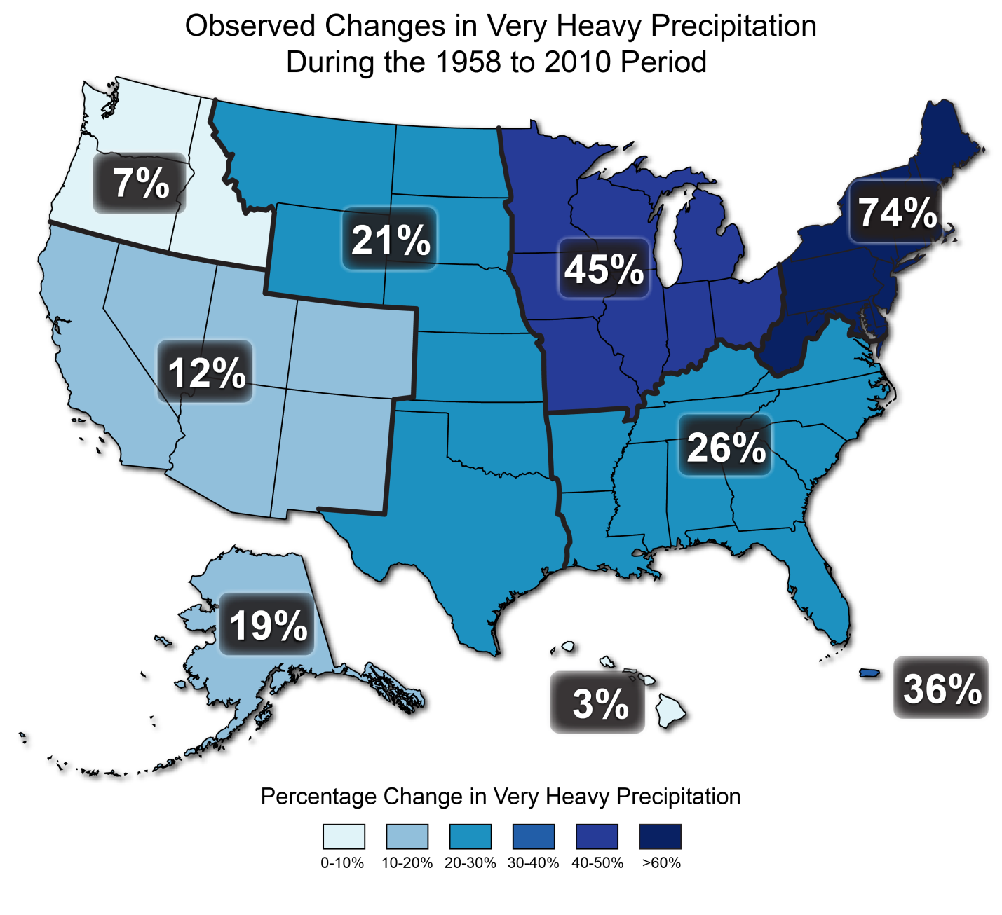
Change in Precipitation Patterns
Intense precipitation events (the heaviest 1%) in the continental U.S. increased by 20% over the past century while total precipitation increased by 7%.
Source: http://www.globalchange.gov/publications/reports/scientific-assessments/us-impacts
14
Notes:
One of the most important changes in precipitations we’ve seen across the nation is that more rain is coming in the form of heavy downpours. There are fewer light rains and more heavy rains in every region.
From 1958 to 2007, there's been a nearly 20% increase in the amount of precipitation falling in the heaviest events throughout the U.S. , including 67% in the Northeast, 31% in the Midwest, and 20% in the South.
An important message from this map is that the heaviest storms are even heavier than before. You can see that the largest percentage increases in the heaviest downpours have taken place in the Northeast and Midwest. So it’s no surprise that we’ve seen some record flooding areas of coastal inundation there. And we understand why warming causes this. Higher temperatures mean more evaporation, putting more water vapor in the air. Then, when a storm system comes along, all that water dumps out in a heavy downpour. This pattern is projected to continue, with higher emissions meaning greater increases in the heaviest downpours.

Slide 15
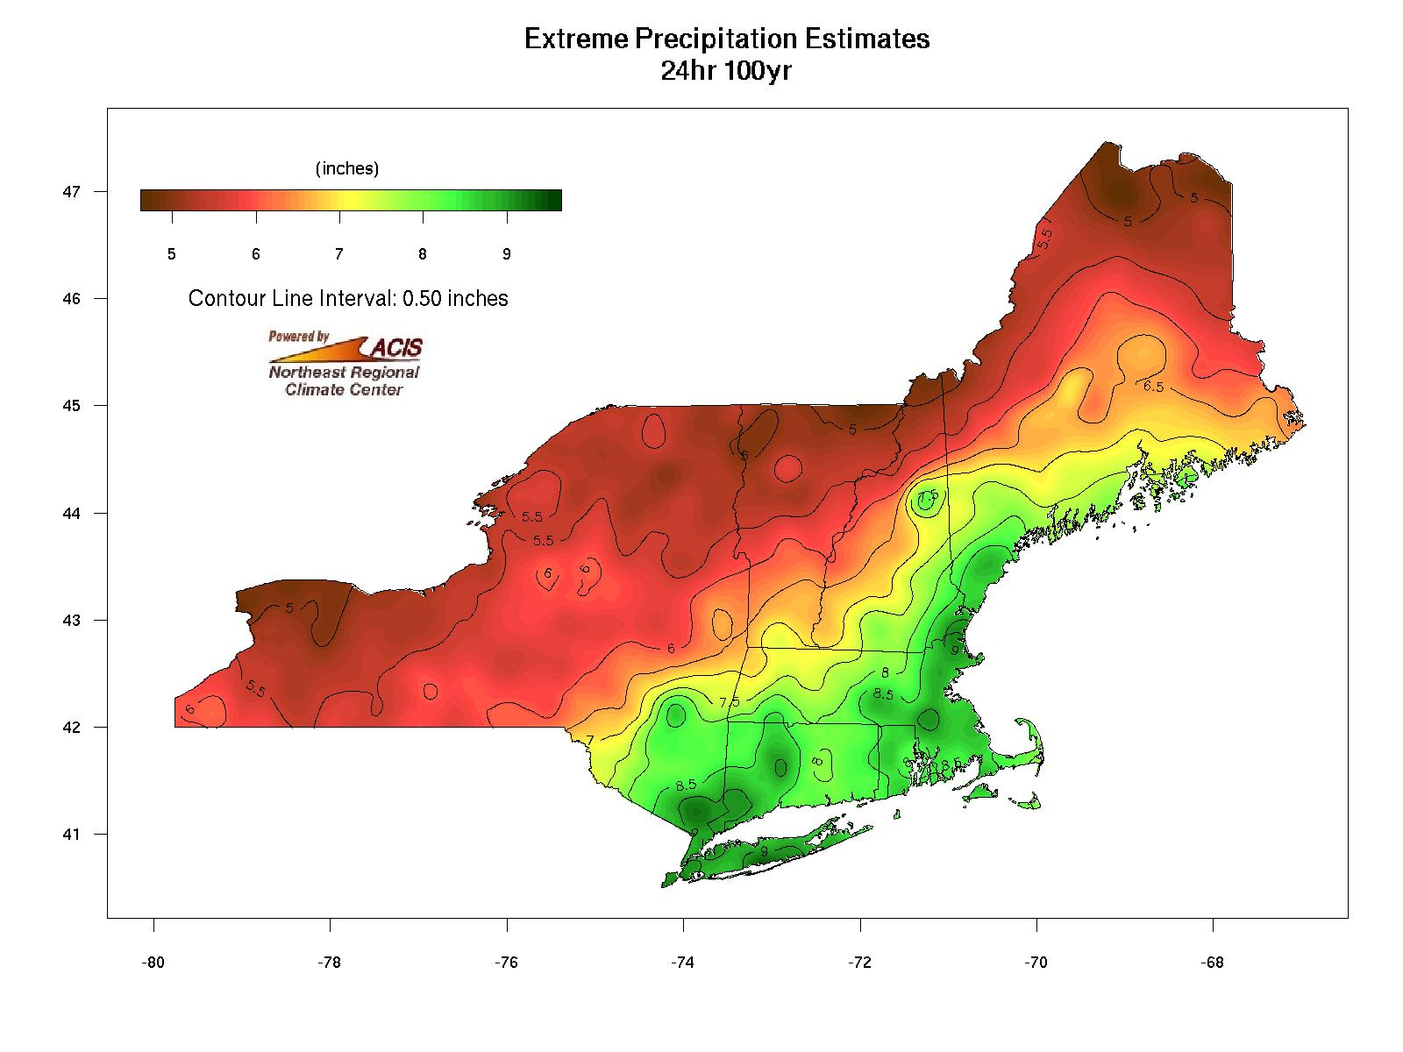
From the 2010 Report
http://precip.eas.cornell.edu/
5”
6”
7”
7”
8”
5”
6”
7”
24 hr 100 yr values from TP-40, 1961
Southeast ½ of NE experience a 1 to 2 inch upward shift!

Slide 16
NOAA Atlas Update for New England http://hdsc.nws.noaa.gov/hdsc/pfds/index.html
Preliminary Draft

Slide 17
Preliminary Peer Review in Progress http://hdsc.nws.noaa.gov/hdsc/pfds/peer_review/

Slide 18
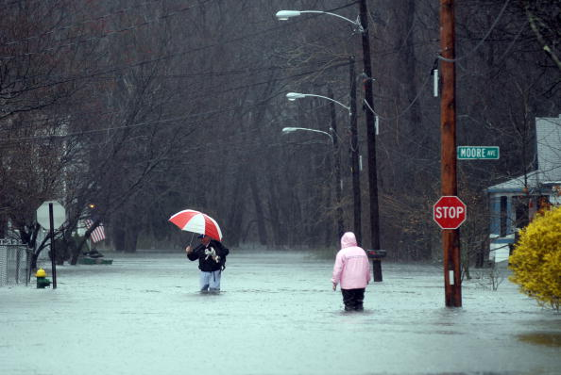
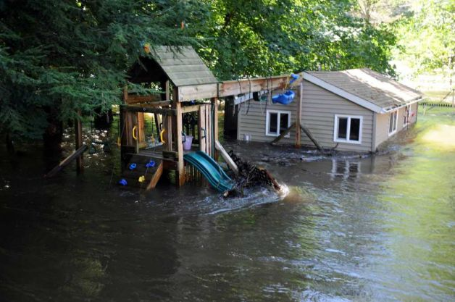
Trends in Flood Frequency: From the Practitioner’s perspective
Small watersheds feeling the effects
Changes in frequency/magnitude
Part land use/urbanization
Compounded by encroachment in the floodplain
Part changing climate
Larger basins with flood control haven’t seen as noticeable a shift
Most USACE reservoirs are built for 6-8 inch runoff events
Greater capacity to handle more rain
Perkins Avenue, Warwick, RI
Tuesday, March 30, 2010
Flooding along the Housatonic River following Lee, Sept 8, 2011.
Photo: A. Driscoll, Connecticut Post

Slide 19
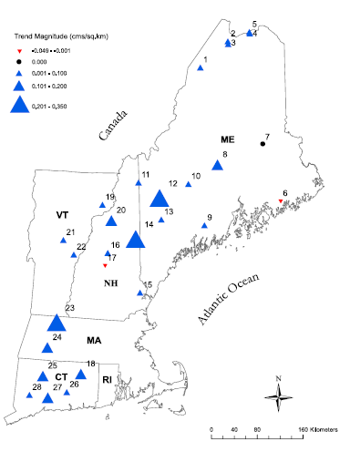
Instantaneous peak flows
Mathias Collins – NOAA NFMS – Restoration center
2009 study of 28 watersheds with minimal human influences
Results indicate basins in central and western Maine experienced increased peak annual flows
Strongest statistical trends noted by the large blue triangles
Spatial distribution of trend directions & magnitudes for based with minimal human influences. Reference: M. Collins, Journal of The American Water Resources Association (JAWRA) April 2009.

Slide 20
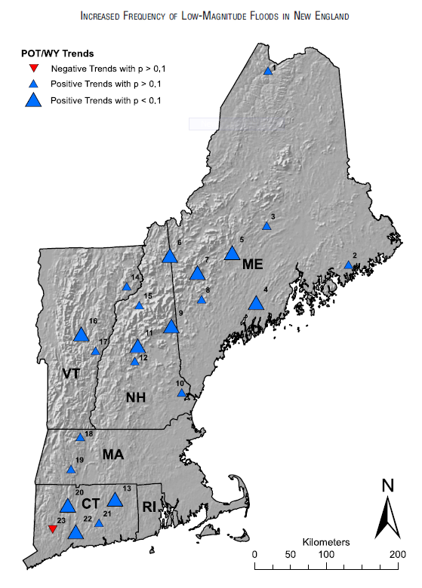
Increased low magnitude floods
Mathias Collins – NOAA NFMS – Restoration center
2011 study of 23 watersheds with minimal human influences
Examined peaks over defined thresholds per water year (direct measure of flood frequency)
More frequent flooding at 22 of 23 locations
Increasing flood magnitude at 17 of 23 locations
Spatial Distribution of Flood Frequency – as measured by peaks over threshold per water year. Reference: W. Armstrong, M. Collins, and N. Snyder Journal of The American Water Resources Association (JAWRA) April 2011.

Slide 21
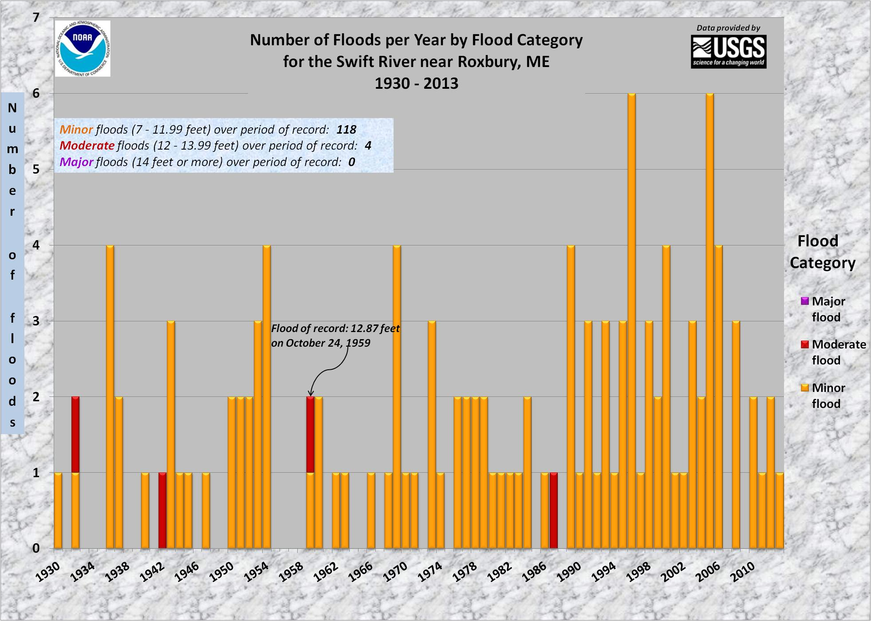
NERFC: Examining Flood Frequency& Magnitude of flood events at NWS forecast points

Slide 23
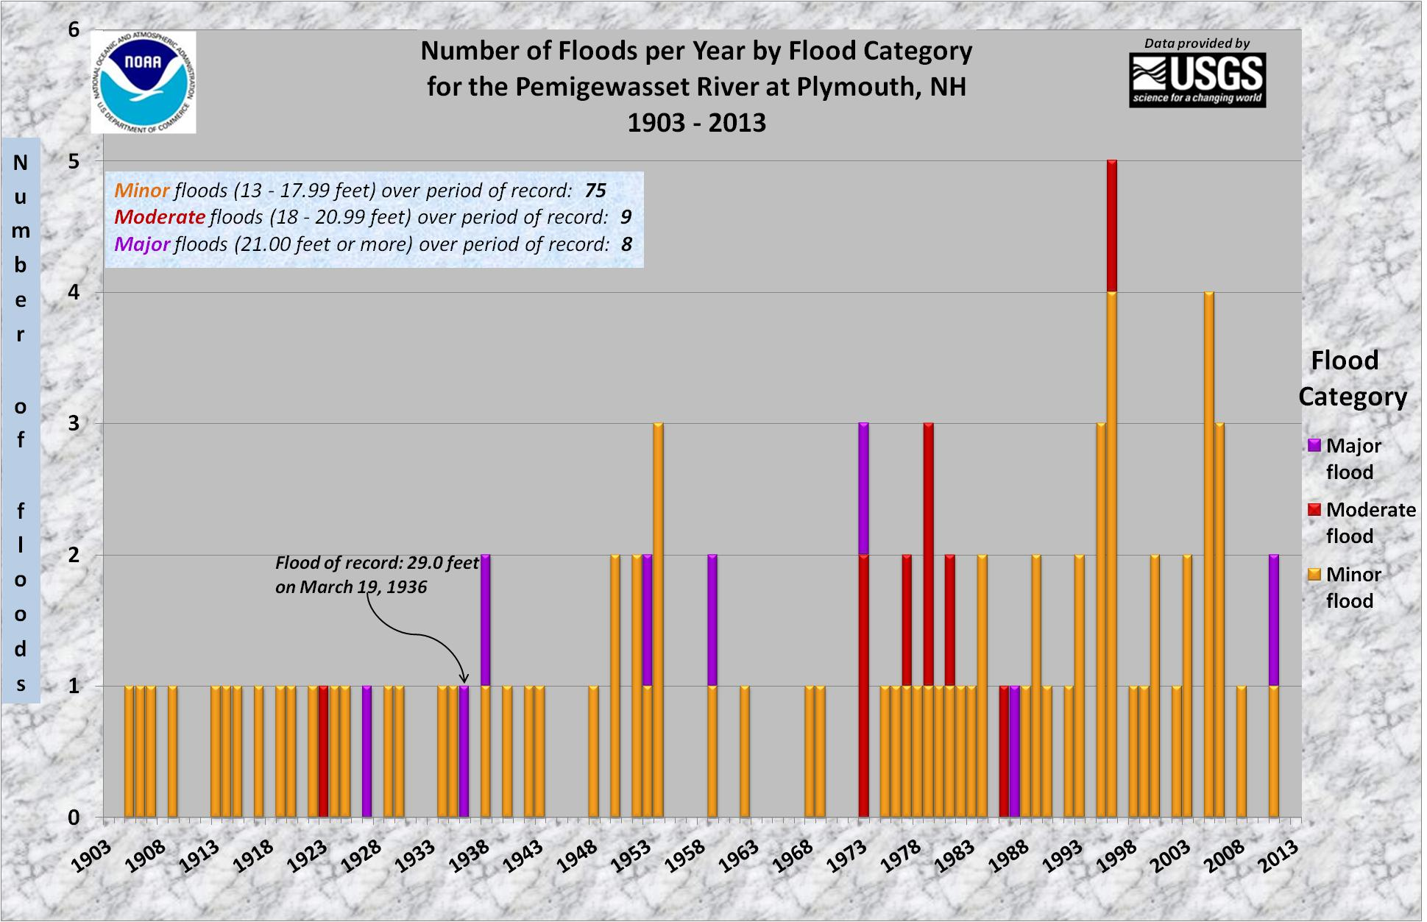

Slide 24
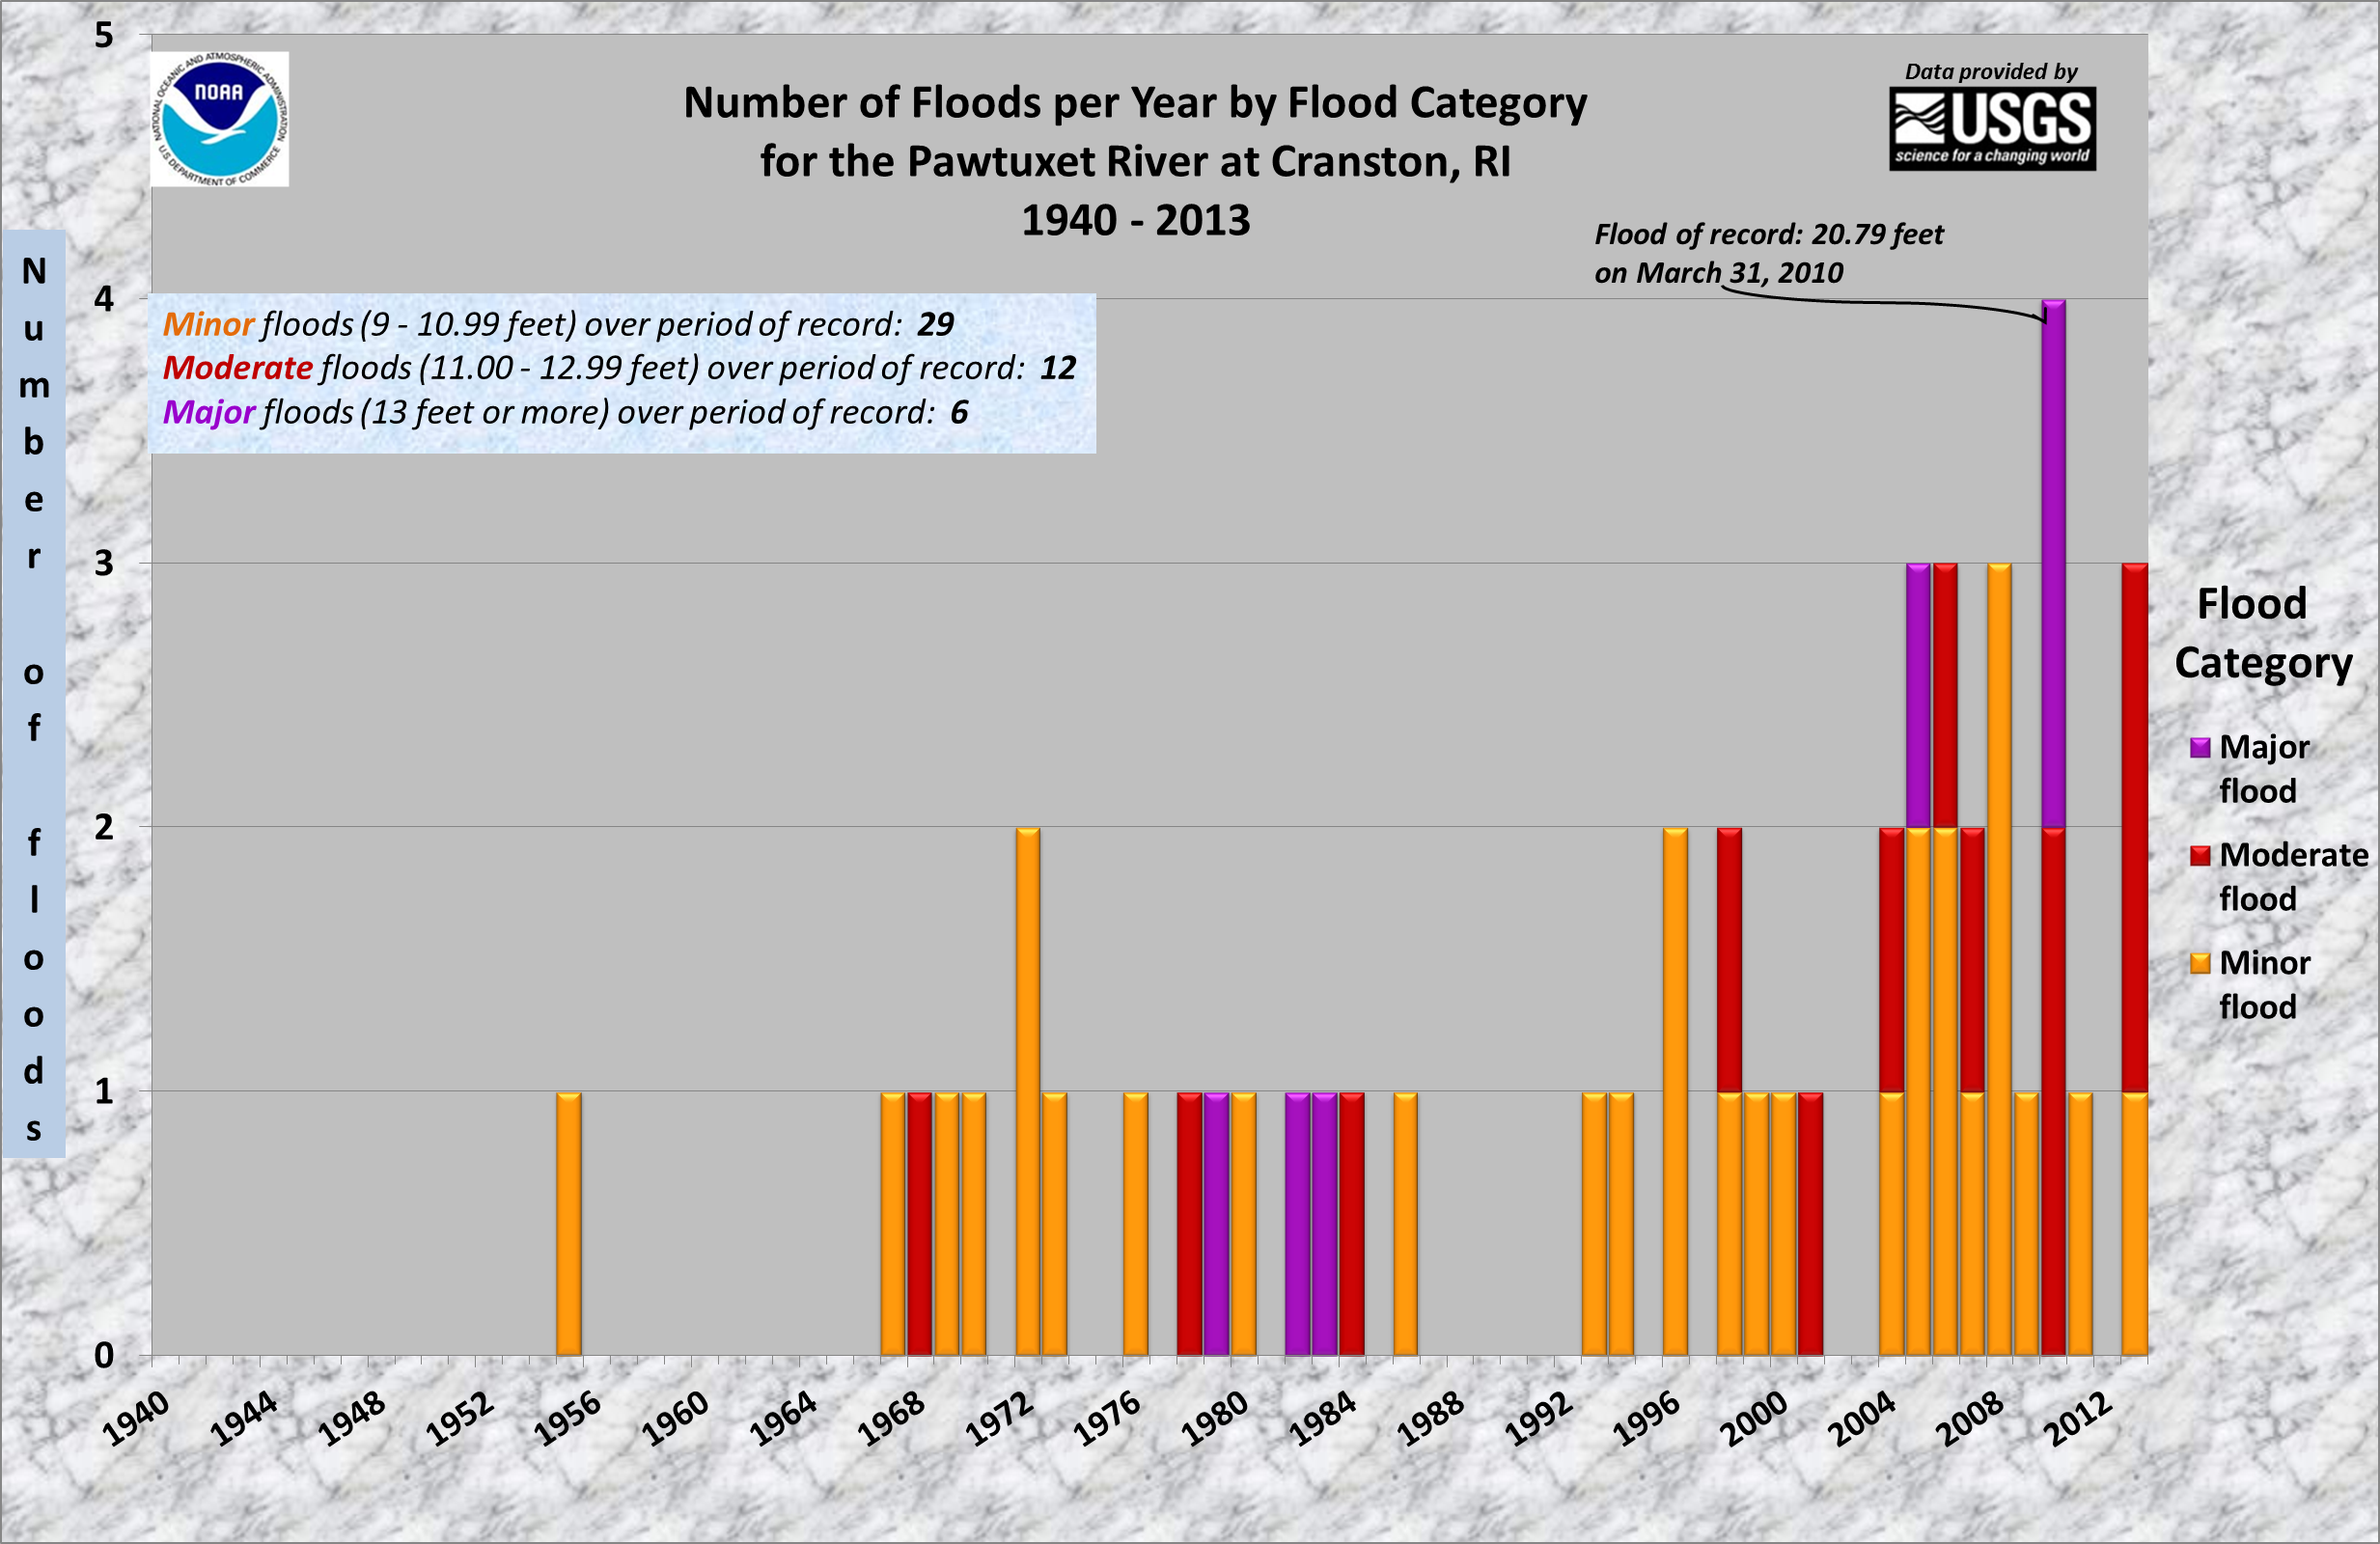
Post Shopping Malls I-95 & I-295 construction

Slide 25
Summary
The Northeast has become a “hot spot” for record floods & heavy rainfall in the past 10 years
Noticeable trends include increased yearly rainfall and increased annual temperatures
Southeast New England has experienced a 1 to 2 inch shift upwards in the 100 yr – 24 hour rainfall
Smaller watersheds & those with significant urbanization are most vulnerable to increased river & stream flooding

Slide 26
Far reaching implications: Protect, Adapt or Retreat???
Floodplain, land use, infrastructure, dam spillway requirements, drainage requirements, non-point source runoff, bridge clearances, “hardening” of critical facilities in the floodplain, property values etc…
Flood Insurance – work to increase participation
How much risk are we willing to insure and accept?
Graphic courtesy of Cameron Wake
University of New Hampshire

Slide 27
Climate Trends in New England and Its Impact on Storm and Riverine Flood Behavior
David R. Vallee Hydrologist-in-Charge
NOAA/NWS Northeast River Forecast Center
Providence Street – West Warwick, RI at 1030 am Wednesday 3/31/10

