Slide 1

The EcoSystem Indicator Partnership: Purpose and Progress
June 2015

Slide 2


ESIP & Gulf of Maine
ESIP itself formed in 2006

Slide 3

ESIP’s Goals and the Action Plan
Goal 1: Restored and Conserved Habitats
Goal 2: Environmental and Human Health
Goal 3: Sustainable Communities
Notes:
ESIP is cross cutting and intersects with GOMC goals. We do this through our monthly journals, two webtools, and subcommittee projects (Fact Sheets).

Slide 4
ESIP’s Own Work Plan
Complete the work of ESIP 1.0
Revise and implement an effective communication and outreach plan.
Embark on the next phase of ESIP (ESIP 2.0).
Improve on the regional use of indicators.

Slide 5
ESIP Community
ESIP Steering Committee
Aquatic Habitats
Coastal Development
Aquaculture
Contaminants
Climate Change
Eutrophication
Fisheries
Notes:
Current ESIP structure.

Slide 6

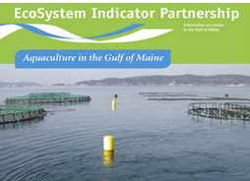
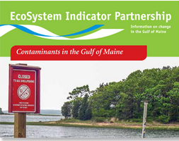
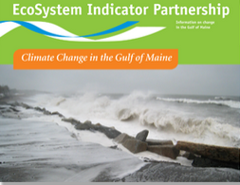
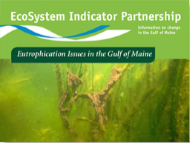
Products from Subcommittees
Aquaculture
Aquatic Habitats
Contaminants
Climate Change
Eutrophication
Notes:
Actually just put out 6th (Coastal Development). And Fisheries Coming. Also have monthly journals. We have accomplished all of this with in-kind from over 150 members and a modest amount of $.

Slide 7

ESIP’s core goal of providing information on change in the Gulf of Maine keeps intersecting the needs of other initiatives in the region.
NEERS
ALSI
BoFEP
CCN
ESIP
?
NERACOOS
ISMP
Notes:
We participate and provide information and guidance to many other groups in the area.

Slide 8
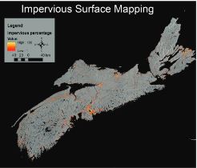
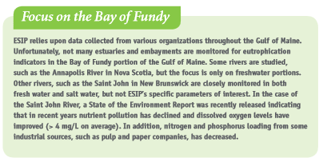
Even more awesome…
Filling in the gaps!!

Slide 9
Your choice…
EPA-ORD Land use and estuary condition
Introduction to ESIP video
Smart phone app…

Slide 10
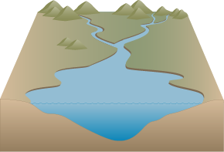


ORD Project From Concept to Analysis
Example Land use Magnitude
40% natural
10% developed
50% agricultural
90% natural
0% developed
10% agricultural
10% natural
90% developed
0% agricultural
estuary state/impact
estuary state/impact
estuary state/impact
Example Land use Distribution
estuary state/impact
estuary state/impact
estuary state/impact

Slide 11
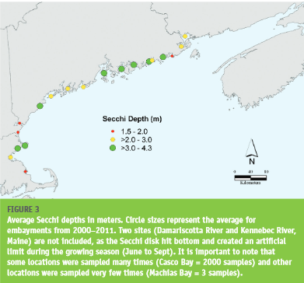
Description of the Study Area

Slide 12
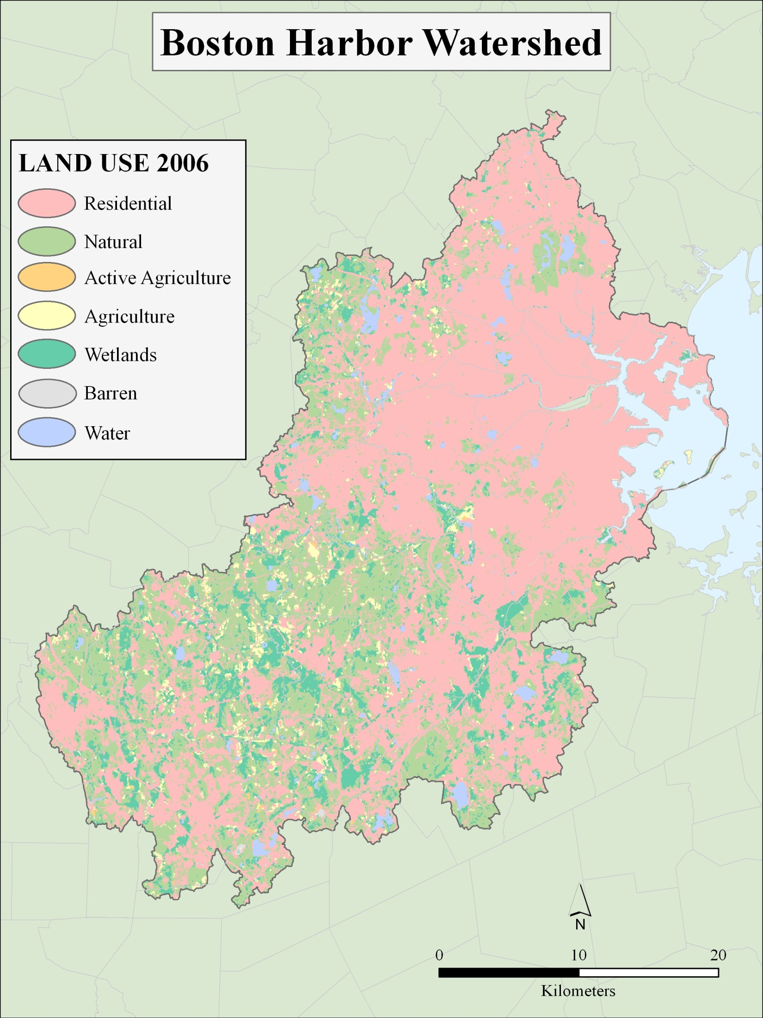
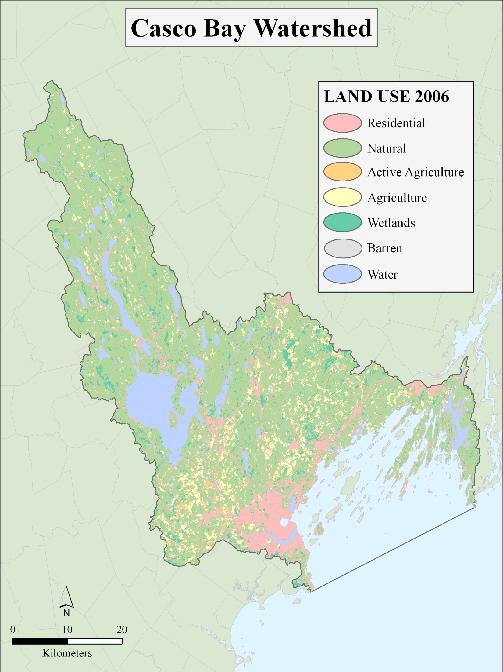
Notes:
Casco Bay = 13% developed and mainly close to estuary
Boston Harbor = 60% developed and close to estuary (and far)

Slide 13
Video…..

Slide 14
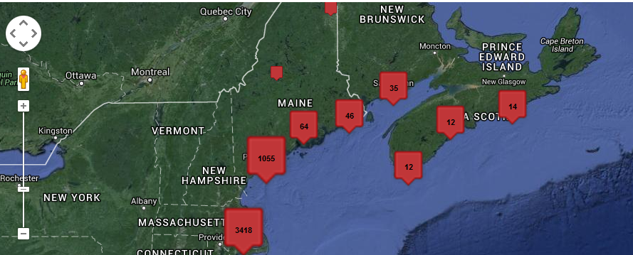
Smartphone app: ICUC
ICUC project has been under development for several years.
Idea is to provide users information on known monitoring locations from ESIP’s improved Monitoring Map
Also allows users to upload images at select or “users’ choice” sites….
Notes:
Citizen science groups excited about the app and including their information in our database. Also discussion of roll-out specific to certain groups (like CBEP).

Slide 15
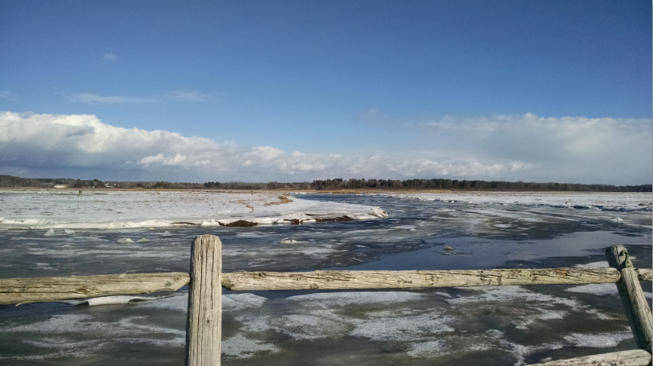
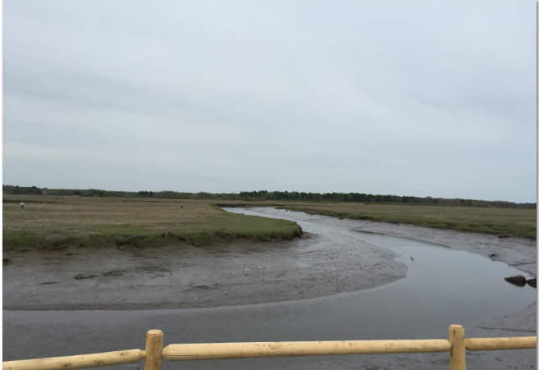
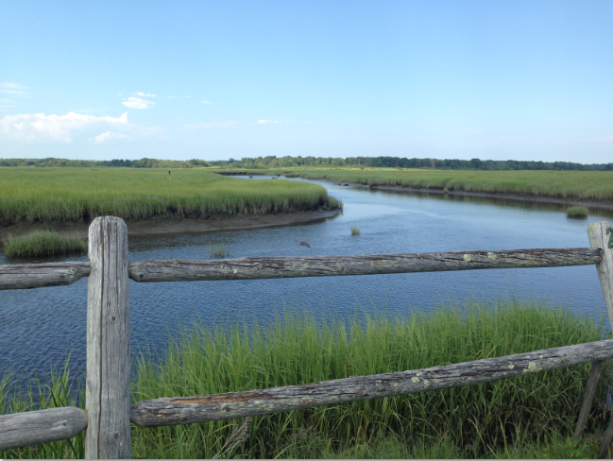
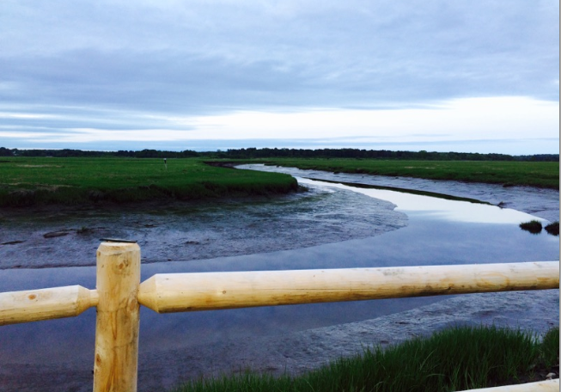
ICUC Smartphone app
January 2015
May 2014
July 2014
June 2015

Slide 16
ESIP 2.0
If GOMC/WG members look at 3 goals of the Action Plan – what are the most important to them? What specific issues?

Slide 17
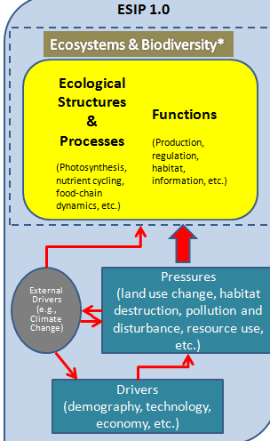
ESIP
1.0

Slide 18
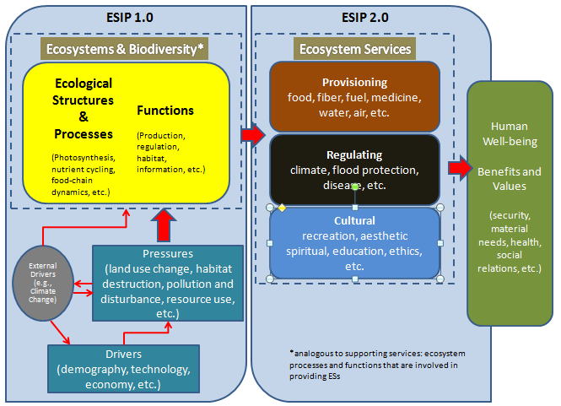
ESIP
1.0 + 2.0
Notes:
Reference: modified from Hattam, C., et al. (2015), Böhnke-Henrichs, et al.(2013) and Kumar, P., Ed. (2010).
WG/Council Meeting: Provide direction on which ecosystem service under ESIP 2.0 should be the initial priority? Provide recommendations on who to engage in the development of specific indicators?

Slide 19
Where are we going?
"If you had to provide evidence that we are achieving our goals for the Gulf of Maine (the three goals from the Action Plan), what would that evidence be? That is, what can we monitor or what existing data can we draw upon to show where we are succeeding and where we need more work? Obviously, there are a lot of possibilities, but what would be most important and convincing?"

