Slide 1
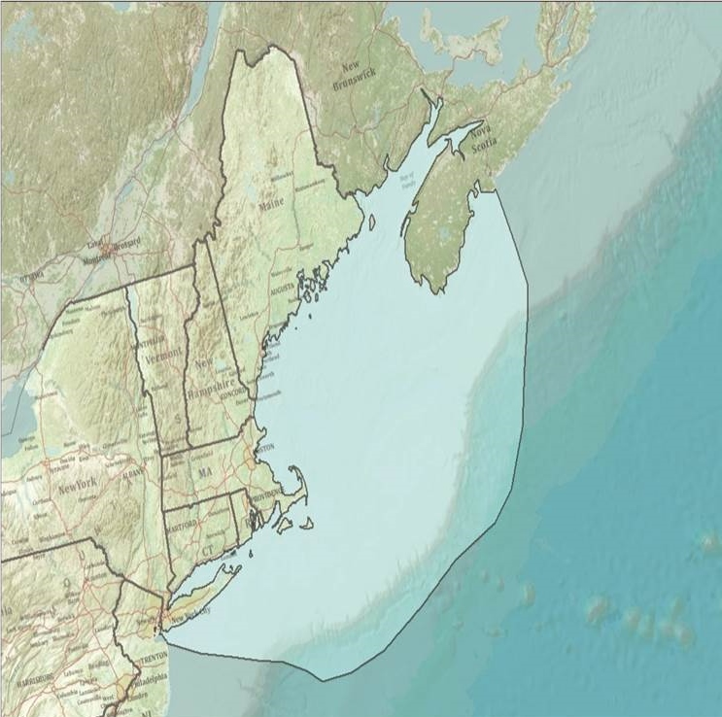
Integrated Sentinel Monitoring Network (ISMN) for Ecosystem Change in Northeastern U.S.
Ocean and Coastal Waters
Notes:
Matt
CHECK TITLE

Slide 2
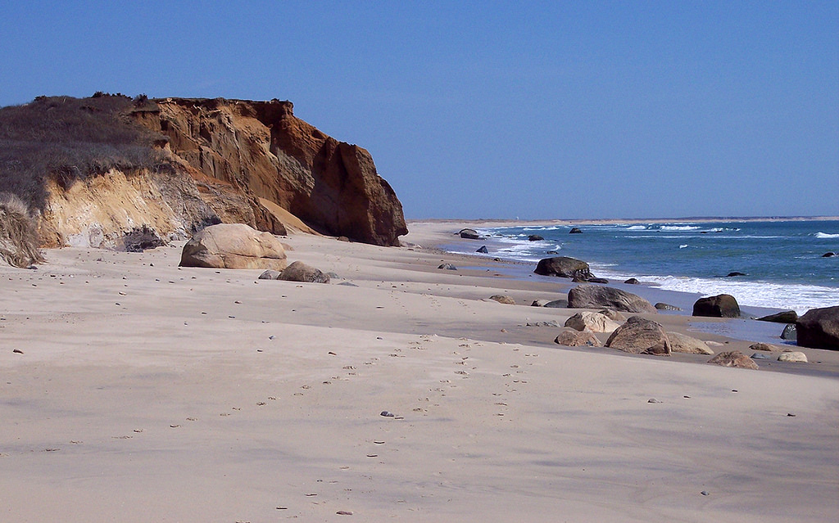
We love our coasts….
Notes:
CHANGE PICTURE
matt

Slide 3
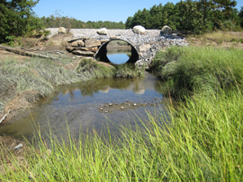
But we have used the coasts to live, do business, discharge sewage, extract resources, and alter habitats
Notes:
CHANGE PICTURE
matt

Slide 4
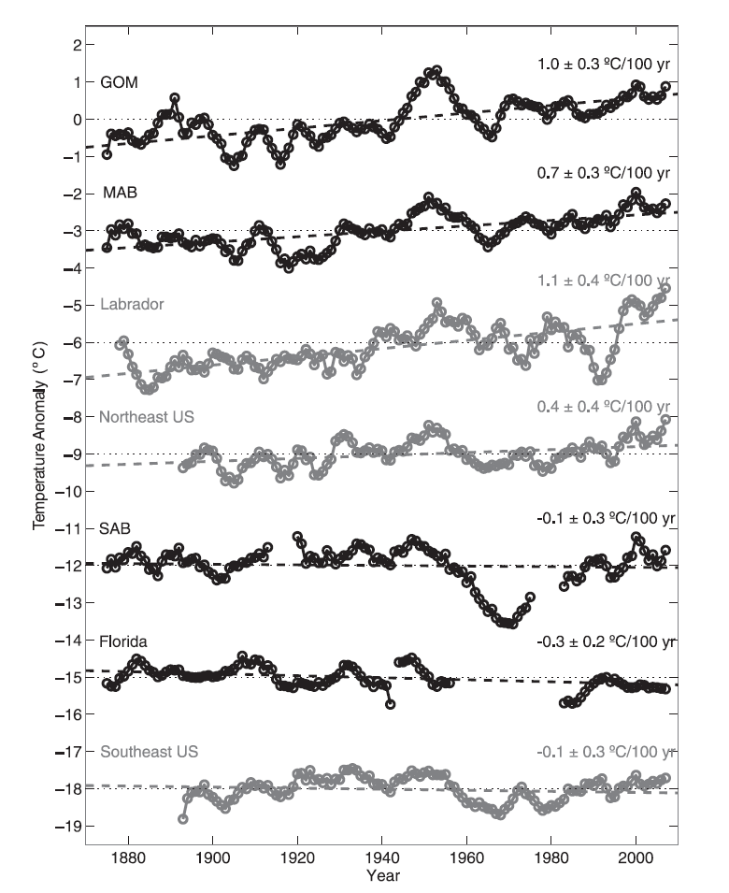
The mean sea surface temperature has been increasing in the past 100 years and more quickly in the past 10 years
What does this mean for ecosystem health?
Can we monitor and quantify these changes to the ecosystem?
1880-2005
1 DEG C per 100 yr
Water temps
Temperature anomaly (Deg. C)
Stratification
Primary productivity
Shearman and Lentz 2010
Notes:
matt
Historical SST observations from lightships and light-houses, combined with recent buoy and shore station observations, show significant long-term warming along the northeast U.S. coast and no significant trend along the southeast coast. To the north of Cape Hatteras, SSTs are warming at a rate 1.8–2.5 times larger than the regional atmospheric temperature trend but similar to atmospheric trends over Labrador and the Arctic, the
source waters for the GOM and MAB. This suggests that along-shelf transport results in coastal ocean warming that exceeds local atmospheric temperature increases. Thus, changes in ice cover (Stroeve et al. 2007) and continued Arctic warming (Steele et al. 2008; Trenberth et al. 2007) could have a profound impact on the north-east U.S. coastal ocean, because temperature plays a key role in coastal ecosystems , affecting livable habitat ranges and spawning behaviors of commercially important species.
Composite average SST anomalies (black) for GOM, MAB, SAB, and FL, smoothed with a 5-yr running mean, plus regional surface air temperature anomalies (gray) for the northeast United States, southeast United States, and Labrador. Best linear fits are plotted (thick dashed lines), and trends with 95% confidence intervals are noted

Slide 5
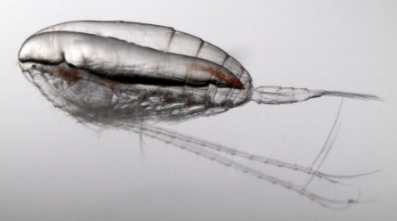
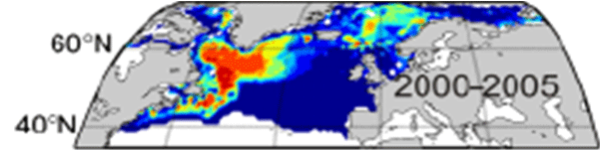
Will warming in NW Atlantic drive Calanus finmarchicus and krill northward?
(Reygondeau and Beaugrand 2011)
The decline of these energy-rich prey may lead to declines in herring, sand lance, groundfish, tuna, seabirds, North Atlantic right whales and other species that rely, either directly or indirectly, on C. finmarchicus as a primary food source.
Notes:
Matt
NOTES FROM THE ISMN S&P Plan:
Calanus finmarchicus, is incredibly abundant in the deep GOM and often along its coastal shelf (Bigelow 1924; Johnson et al. 2011; Runge and Jones 2012). Euphausids, particularly Meganyctiphanes norvegica, are another energy rich zooplankton known to be very abundant in the Gulf of Maine but not well sampled. Recent statistical-based modeling of C. finmarchicus habitat characteristics, especially SST, predicts that ocean warming will drive the distribution of C.finmarchicus northward out of the GOM over the next several decades (Reygondeau and Beaugrand 2011). There is no similar study of M. norvegica or other euphausid species, but since it also resides at the southern edge of its subarctic range in the GOM, its distribution is also likely to be sensitive to these temp changes. By storing energy derived from spring and summer primary production, C. finmarchicus and euphausids sustain a high biomass of energy rich forage fish species, notably Atlantic herring, silver hake and sandlance. These forage species are in turn primary prey for several species of marine mammals, seabirds, groundfish and highly migratory fishes such as Bluefin tuna. As there is no known functional substitute for these energy rich zooplankton in the Gulf of Maine system, substantial reduction in their abundance could trigger a regional ecosystem shift. These components of the Gulf of Maine ecosystems are therefore hypothesized to be sentinel candidates for enhanced observing in the ISMN.

Slide 6
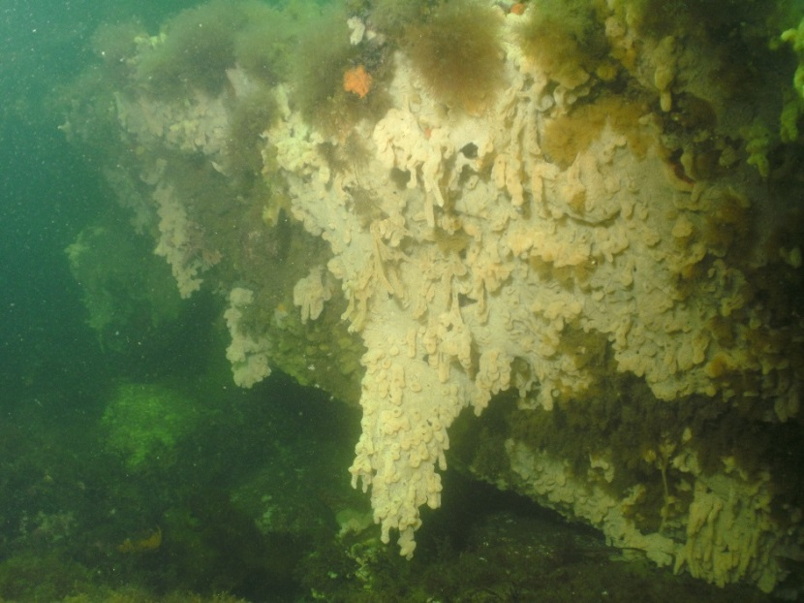
Can we better monitor, detect and quantify these changes to the ecosystem in a “network of networks” and tell the public what is happening?
Which are the best sentinel indicators to monitor?
Existing monitoring efforts and networks have detected changes in species composition, population shifts, onset/duration of plankton blooms etc….
But some observations are anecdotal
And there is need to provide context for these observations
Credit: P. Colarusso, EPA
Folly Cove, Gloucester, 2012, Didemnum
Notes:
matt

Slide 7
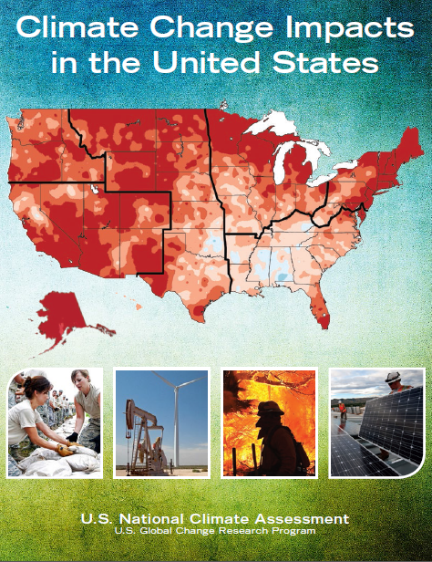
The U.S. Government has mandated that we should get a better understanding of climate change impacts on ecosystems
June 25, 2013 – “The President’s Climate Action Plan” is released with section on preparing for climate change, including: Using Sound Science to Manage Climate Impacts
  Developing Actionable Climate Science
  Assessing Climate Change Impacts in the U.S.
  Launching a Climate Data Initiative
May 2014 - Third National Climate Assessment released as part of the mandate of the U.S. Global Change Research Program (USGCRP) to “assist the Nation and the world to understand, assess, predict, and respond to human-induced and natural processes of global change.”
Notes:
matt

Slide 8
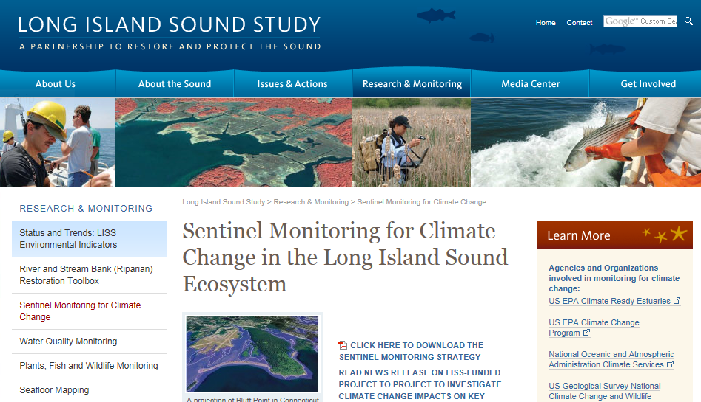
  Our regional scientific community has consistently identified as a priority: Sentinel monitoring of ecosystem health to better understand regional climate change impacts
New England-Canadian Maritime Collaboration and Planning Initiative
NERACOOS and NROC Ocean and Coastal Ecosystem Health Committees
Gulf of Maine Ecosystem Indicator Partnership
Long Island Sound Study
“The Sentinel Monitoring for Climate Change in Long Island Sound Program is a multidisciplinary scientific approach to provide early warning of climate change impacts to Long Island Sound ecosystems, species and processes to facilitate appropriate and timely management decisions and adaptation responses.”
Notes:
Matt

Slide 9
History
2011
NERACOOS - 5 year strategic plan calls for establishment of Integrated Regional Sentinel Monitoring Program
NROC - identified ecosystem monitoring in its strategic planning
Spring 2012
NERACOOS’ Ocean and Coastal Ecosystem Health Committee
NROC’s Ocean and Coastal Ecosystem Health Committee
Ocean and Coastal Ecosystem Health Committee
July 2012
IOOS Community White Paper - Integrated Sentinel Monitoring for the Northeast Region: Gap Assessment J. Runge et al.
Jan 2013
16 member Steering Committee
(3 co-chairs)
Spring 2013
ISMN established from Long Island South/New York Bight to Canadian Maritimes
Notes:
NERACOOS Strategic Priorities, 2011-2016
Ocean and Coastal Ecosystem Health:
Create an Integrated Regional Sentinel Monitoring Program from the Canadian Maritimes to the New York Bight and Long Island Sound that includes current efforts. Key partners include but are not limited to OOI, MWRA, SBNMS, NMFS, NERRs, LISS, Estuaries Programs, and AZMP. Standardization of protocols and quality assurance where possible together with repeated sampling at fixed locations is important to allow regional scale comparisons. A variety of sampling platforms will be used as applicable (remote sensing, moorings, gliders, drifters, research vessels, ships of opportunity, etc.). Elements include;
Water column properties including physical, biogeochemical, and pelagic community structure and species richness
Benthic properties including community structure, species richness, and habitat characterization with surficial sediment composition, and
Online environmental event reporting tool for fish kills, algae blooms, sudden wetland dieback, invasive species, etc.
Spring 2012: OCEH Committees of NERACOOS and NROC mergeJ. Runge, M. Coté and B. Thompson as co-chairs

Slide 10
What is the ISMN?
The ISMN is a new regional infrastructure that:
  Represents an agreement among a wide range of federal and state agencies, researchers and non-government organizations of the need for a more integrated approach to assessing ecosystem change
  Coordinates collection of consistent and long-term data on NE coastal and ocean critical ecosystem properties
  Supports a comprehensive, centralized and easy-to-use system for managing observations data
  Supports integrated analysis, interpretation, and prediction of change in regional coastal and ocean ecosystems
  Connects managers, industry and the public to timely information about the status and implications of change in coastal ecosystems
Notes:
Jeff

Slide 11
Goal of the ISMN
VISION: To create and sustain an adaptive sentinel monitoring and data management program that informs researchers, managers and the public about ecosystem status and vulnerabilities, and supports an integrated, ecosystem-based management framework for adaptive responses to climate change and related ecosystem pressures.
GOAL: To improve our ability to detect and understand the causes of long-term change in the composition, structure, and function of Northeastern U.S. and Canadian maritime coastal and ocean ecosystems.
How was this done?
Notes:
matt

Slide 12
1) 5 Workshops – convened 50 scientists and managers to discuss the establishment and implementation of an ISMN framework
Bigelow Laboratory for Ocean Sciences
Casco Bay Estuary Partnership
Connecticut Department of Energy and Environmental Protection
Fisheries and Ocean Canada
Great Bay National Estuarine Research Reserve
Gulf of Maine Council Ecosystem Indicator Partnership
Gulf of Maine Research Institute
Maine Department of Marine Resources
Maine Geological Survey
MassBays National Estuary Program
MA Department of Marine Fisheries
MA Office of Coastal Zone Management
Massachusetts Water Resources Authority
MIT Sea Grant
NOAA/NMFS
NERACOOS
New England Interstate Water Pollution Control Commission
New Haven University
Northeastern University
Center for Coastal Studies
Rhode Island Department of Environmental Management
Stellwagen Bank National Marine Sanctuary
The Nature Conservancy
Suffolk University
U.S. Army Corps of Engineers
U.S. Environmental Protection Agency
U.S. Geological Survey
University of Connecticut
University of Maine
University of Massachusetts Boston
University of New Hampshire
University of Rhode Island
Wells National Estuarine Research Reserve
Woods Hole Oceanographic Institution
Notes:
both

Slide 13
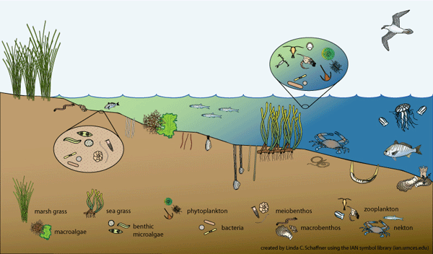
2) Steering Committee formed 3 work groups focusing on pelagic, benthic and coastal/estuarine habitats
Pelagic: water column 10 meters to offshore
Estuarine/nearshore
head of tide to coastal ocean
Benthic covers oceanfloor from high tide to canyons
Notes:
matt

Slide 14
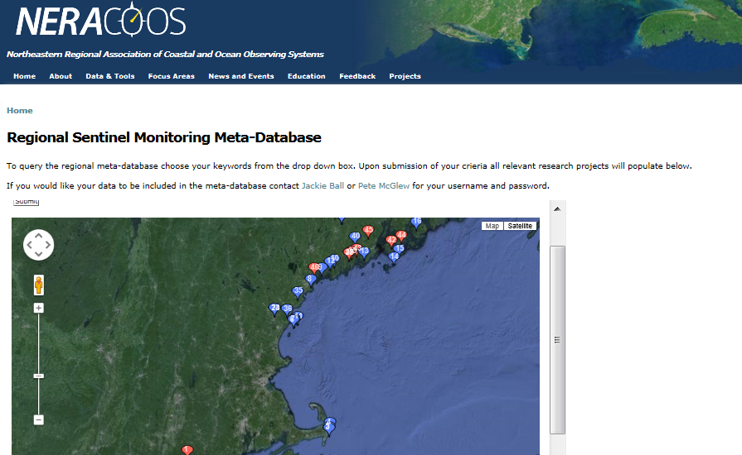
3) Developed an inventory of monitoring programs in the region (NERACOOS website)
Database of projects will be utilized to continue to identify gaps and add sentinel networks to our network
Notes:
Matt
Metadata base of monitoring programs across the region
Housed on NERACOOS website
Searchable and currently in development
These will help identify sentinel sites and indicators to measure at those sites

Slide 15
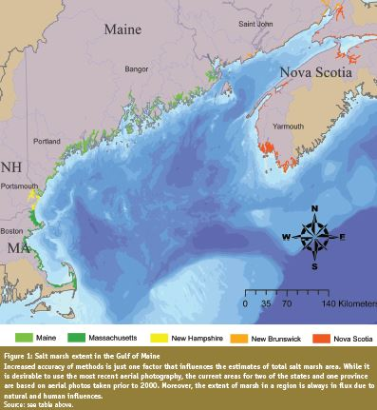
We have identified gaps of monitoring:
Spatial location of salt marsh elevation monitoring
Notes:
matt
At the meeting, I was informed about work being done by FWS and NPS in Acadia as well.

Slide 16
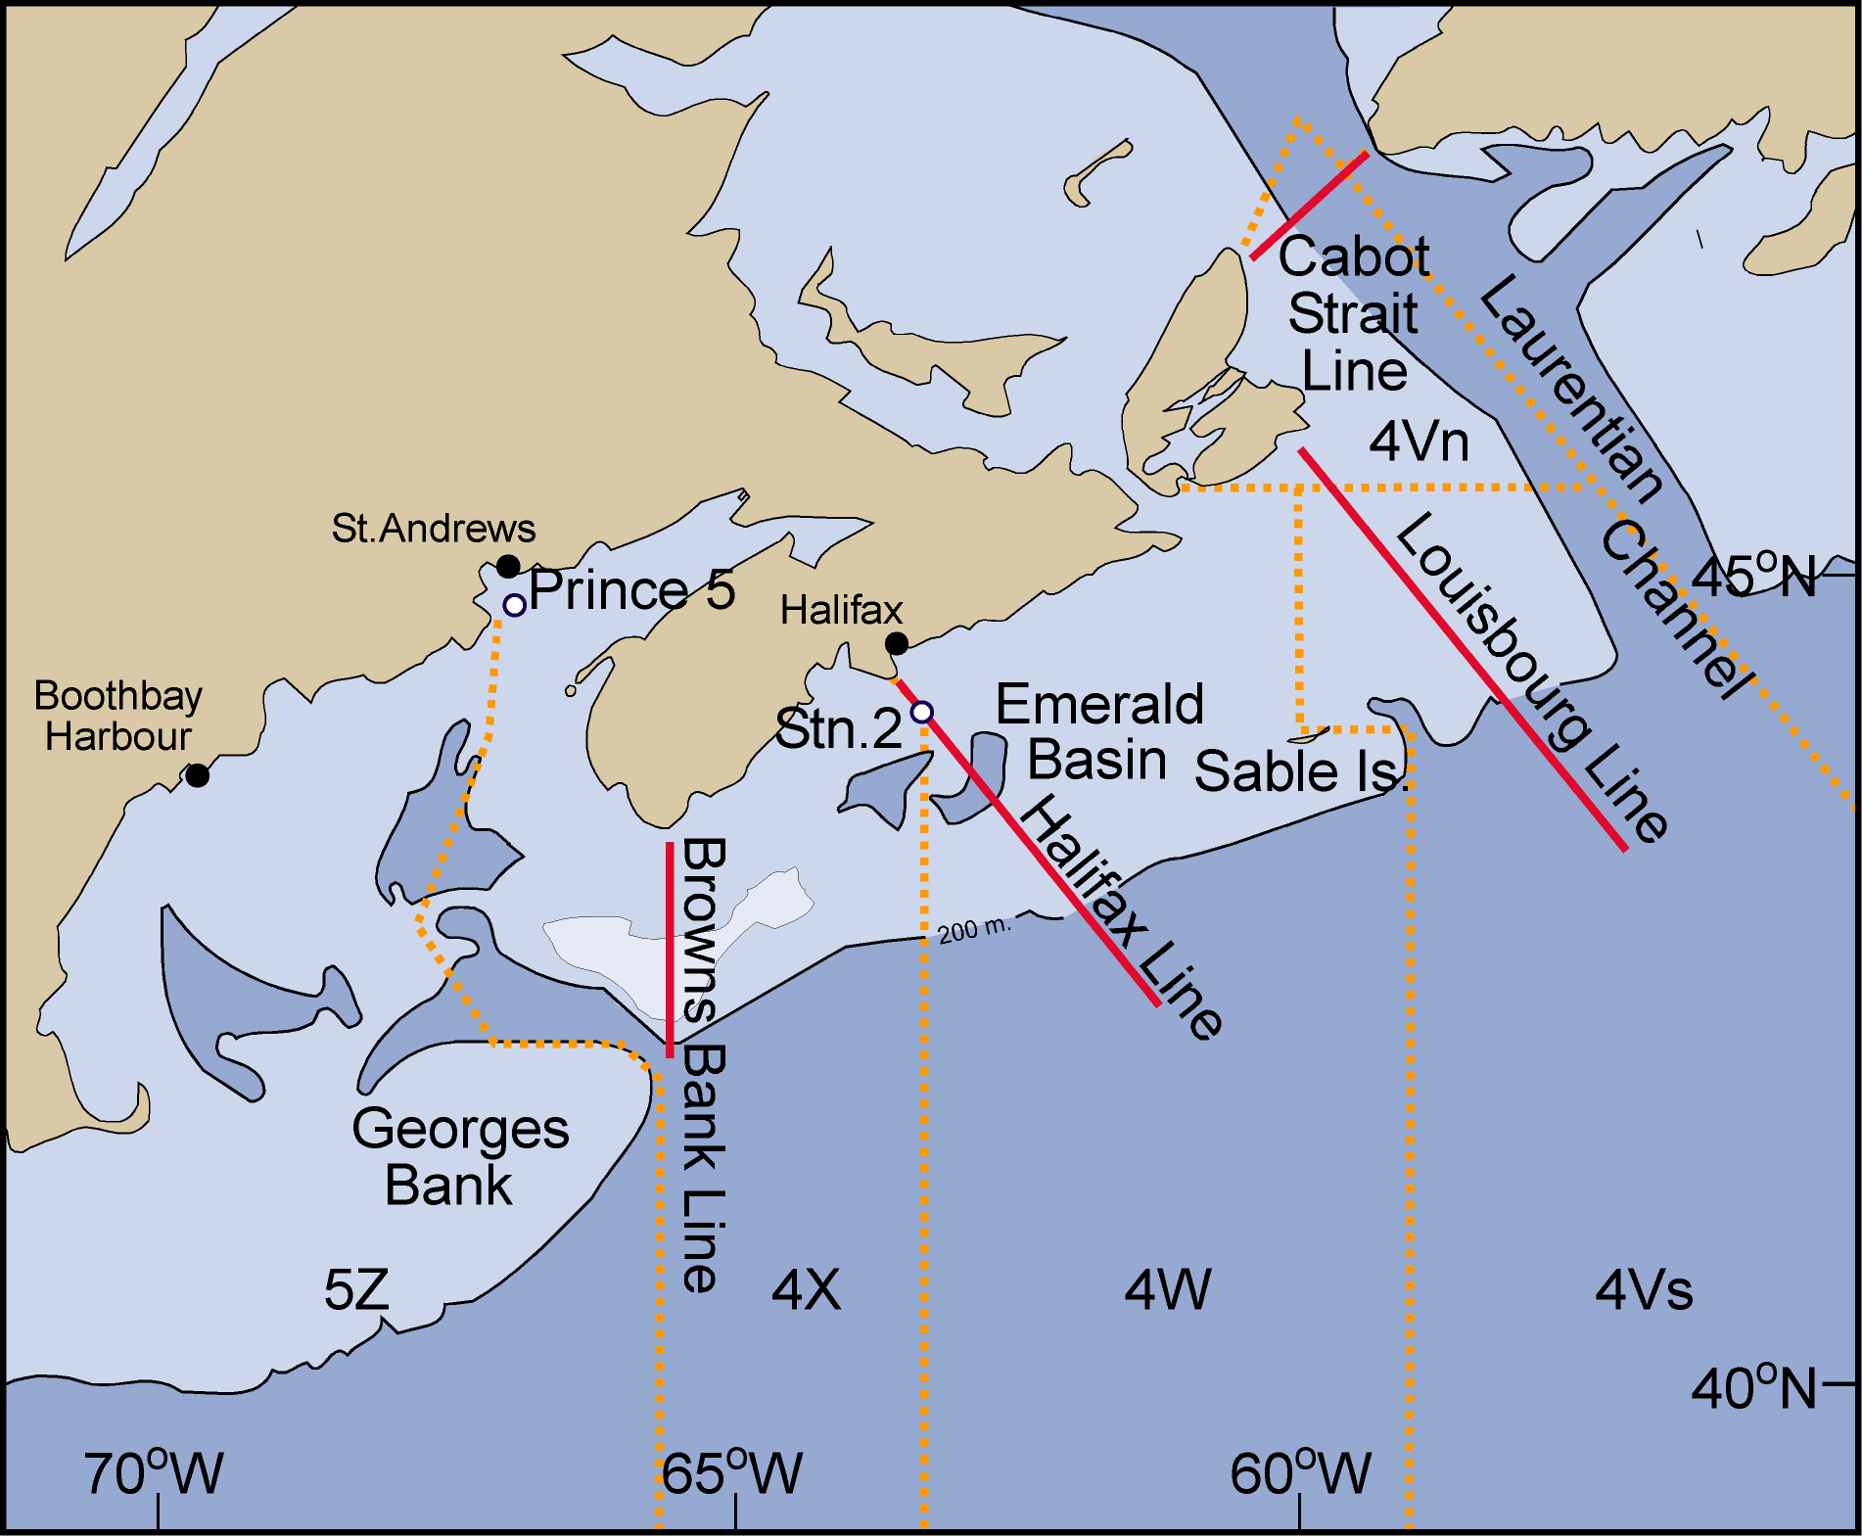
Example of a long term monitoring program that would be part of the network:
Atlantic Zonal Monitoring Program (Maritime Region): 1998-Present
Standard protocol
CTD
Bottle samples (6 depths)
Net tow (vertical, 3/4m ring 202 mm mesh net)
Hydrographic variables :temperature, salinity, DO, fluorescence, chlorophyll a and nutrients
Plankton variables:
Phytoplankton cell counts
Zooplankton biomass, species composition and abundance
Notes:
Matt

Slide 17
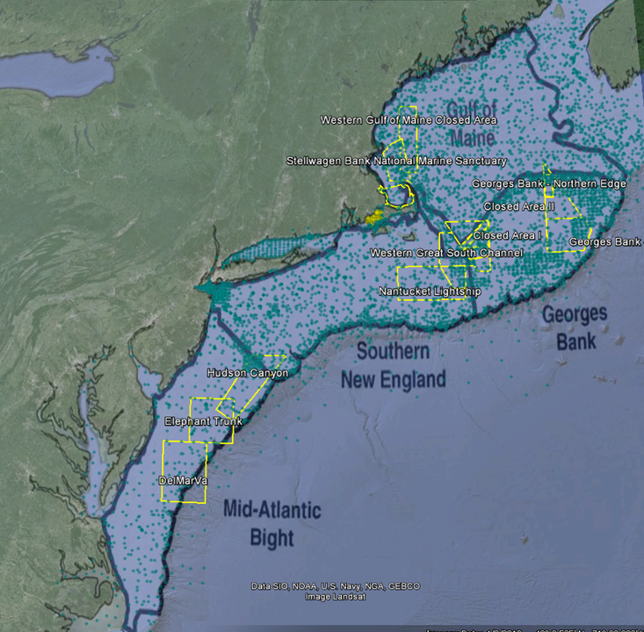
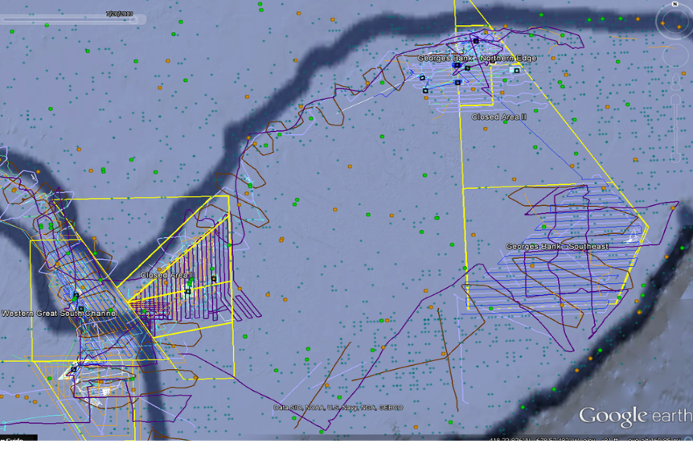
Benthic work group has identified multiple datasets and has identified sentinel sites
Aqua- NOAA Benthic database
High resolution grids conducted in NEBO sentinel sites by HabCam 2007-2010.
Notes:
Matt
Gulf of Maine, Stellwagen Basin: Massachusetts Water Resources Authority (MWRA);10-36 stations, 1992- present; >1000 samples
Gulf of Maine: northern Massachusetts coastal waters; MA Coastal Zone Management (CZM); 2012; 207 samples
Massachusetts and Cape Cod Bay: MA CZM; 2010; 100 samples; coastal waters
Buzzards Bay, Cape Cod Bay and waters around Martha’s Vineyard and Nantucket: MA CZM 2011; 214 samples
Buzzard Bay and Vineyard Sound; Database developed by Richard Osman (Smithsonian, SERC Lab) from Sumner et al.(1911); 1903 -1907; 450 samples; data on invertebrates, but also macroalgae, sea grasses, and fish
Buzzards Bay; Coastal America Foundation / US ACOE; 2011- present; comparative re-sampling of the Sanders (1958) 19 stations in Buzzards Bay, MA
Georges Bank Monitoring program; 1981-1984; 190 samples
Atlantic Continental Slope & Rise Study (ACSAR); 1984-1986; 190 samples; 14 stations
New England Coastal Waters: US Army Corps of Engineers; various sites in Maine, Massachusetts, Rhode Island and Connecticut coastal & estuarine waters related to the Disposal Area Monitoring System program; 1977 – present; primarily environmental data and sediment profile imagery that can be used to assess habitat characteristics, but some species data sets.
Block Island Sound – recent studies for RI Ocean SAMP, plus data from Theroux and Wigley
Long Island Sound; various data sets (see Zajac 1998; Zajac et al. 2000; Zajac et al. 2013, and references therein); >2000 samples; 1958 – present; current Long Island Sound Mapping project will add to both historical / recent biodiversity
analyses and integrated analyses planned for the BDP-MBON project using data collected during the project period.
New York Bight REMAP; US EPA; 1993-1994; 169 stations

Slide 18
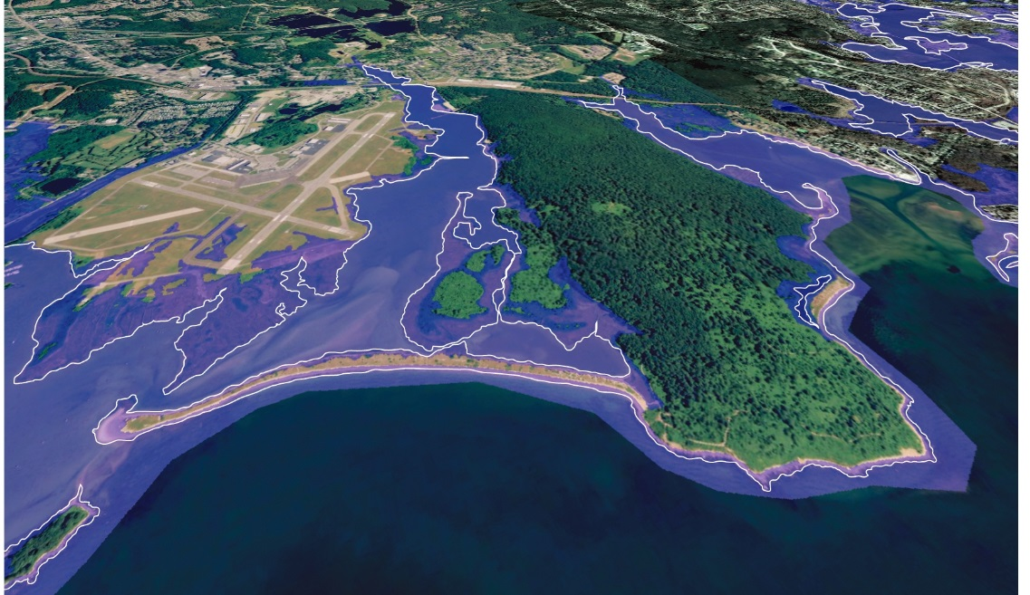
4) Established sentinel indicators to detect and measure changes in ecosystems
Sentinel - a habitat, (abiotic) condition or process, or a species, population or community; its change in state or condition indicates some aspect of ecosystem change (good or bad).
Indicator - a metric that provides information about the direction of change in the state or condition of a Sentinel.
Example: If salt marshes are considered a Sentinel, then the change in state of the salt marsh as measured by aerial extent (the indicator) tells you the salt marsh is changing due to some stressor (sea level rise) and indicates there may be important changes in your ecosystem, like potential loss of commercial fish nursery habitat.
Indicators are based on conceptual models that link drivers to ecosystem responses
Source: LISS Sentinel Monitoring project
Notes:
Matt
Consensus definition to distinguish between Sentinel and Indicator

Slide 19
Example of sentinels: Coastal and Estuarine Ecosystems
7 sentinel habitats of the coastal and estuarine environment that gauge climate and ecosystem change impacts:
estuaries and embayments
tidal wetlands
eelgrass and submerged aquatic vegetation
rocky shore biological communities
Saccharina latissima kelp beds
[coastal barriers]
[coastal forests]
Sentinel Question | Indicators
Is there evidence of change in distribution of SAVs? | Areal extent, TSS, light availability, cover/shoot density/biomass, temperature, chlorophyll a, sediment grain size and carbon content.
Notes:
The Coast and Estuarine work group identified the following specific criteria to help guide the selection of Sentinel Indicators.
Can be consistently measured at multiple sites, so that comparison among sites can be made;
Is hypothesized to be responsive to climate change stressors (based on scientifically valid conceptual models of ecosystem changes in response to climate change – see table below) and can be potentially distinguished from natural variations or anthropogenic stressors with the appropriate sampling resolution;
Key species/groups or ecosystem properties that are known to be fundamental to ecosystem structure and function (cover for the unexpected);
Representative regional biological communities and/or a species at the edge of its range or in a habitat that is limited;
Has an existing or forthcoming data record (or time series) that would allow comparison of historic current, and future conditions to identify long term trends;
Can be measured and studied feasibly with respect to cost and available technology; and
Is relevant to users (managers/decisions makers) and stakeholders (general public) and easily explained (i.e. who cares?).
Coastal barriers and Coastal forests may not be part of this iteration of this plan since no “champions” could be identified for these sentinel habitats. But this will serve as a good example of how the plan will evolve as champions are identified and this would be one of the roles of CAIP.

Slide 20
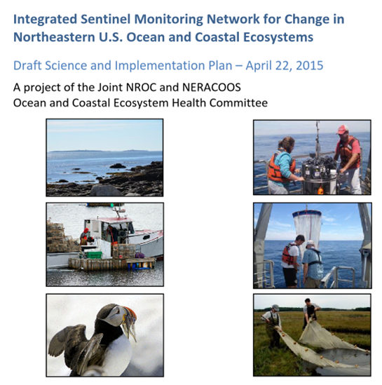
The plan is the foundation to secure funding
Implementing the plan will fill monitoring and data gaps for the ISMN and create a “network of networks”
5) Develop a Science and Implementation Plan
Notes:
matt

Slide 21
Back to the Goal
GOAL: To improve our ability to detect and understand the causes of long-term change in the composition, structure, and function of Northeastern U.S. and Canadian maritime coastal and ocean ecosystems.
How will this be coordinated and implemented?
Notes:
matt

Slide 22
ISMN Functions: Coordination
Coordination of observing activities for all the participating federal and state agencies that are presently involved in regional monitoring
  Oversight and support for collection of data on key indicators of ecosystem change
  Dynamic inventory of observing activities
  Central station for distribution of observing data and information
  Supports technical committees dealing with common issues, e.g. standardization of collection protocols, taxonomic capacity building, data quality control, model intercomparison, statistical methods, informatics solutions for genetic analysis, etc.
  Interface citizen science monitoring activities and data with federal, state and other observing programs
Notes:
jeff

Slide 23
ISMN Functions: Analysis and Interpretation
Supports a Center for Analysis, Interpretation and Prediction (CAIP)
  Experts and managers assemble to report and synthesize information on indicator trends and predictions of ecosystem status
  Will be a source of information and expertise to users such as NOAA Integrated Ecosystem Assessments, Northeastern Region Ecosystem Advisories, ESIP
  Will support use of physical and ecosystem models to diagnose and predict trends
  Link experts, information and models to specific state, federal and industry needs
Notes:
jeff

Slide 24
Implementation of the ISMN
Building ISMN infrastructure for sustained data collection, management and synthesis of sentinel/ indicator and other observing data.
  Support a website
  Develop data management capacity
  Establish and oversee technical committees
  Establish and manage the CAIP
  Support bridging of data and processed information to managers and the public
Notes:
jeff

Slide 25
Implementation: Building the infrastructure
Data manager
Project Coordinator
ISMN Director
Webmaster
Liaison Support
ISMN Oversight
Committee
Center for Analysis. Interpretation and Prediction (CAIP)
Technical Science
Committees
Notes:
Jeff
With its present data management capability and neutral, science-based recognition, NERACOOS is the logical organization to be the home for the ISMN.

Slide 26
Implementation: A database subcommittee evaluating data structure
Interoperability
Quality control
Distributed data system, accessibility to all
Analyzing , interpreting, synthesizing data to tell stories and inform management
Standardization
Coordinate with Northeast Coastal and Ocean Data Partnership
Notes:
matt

Slide 27
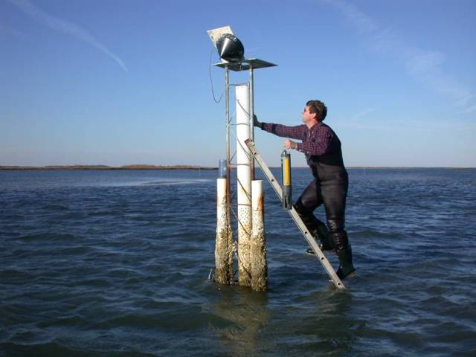
Next steps
Completion of the S&I Plan: June, 2015
Send out for formal review: Summer, 2015
Revise and formal publication: Fall, 2015
Seek funding sources for components of the ISMN
For more information visit the website: http://www.neracoos.org/sentinelmonitoring
Image source: Jeremy Miller, NERRS
Notes:
jeff

Slide 28
Acknowledgements
Jeff Runge GMRI
Andrew Allyn UMass Amherst
Mel Cote, Matt Liebman EPA
Paul Stacey Great Bay NERR
Ron Rozsa, Roman Zajac – LISS

