Slide 1
Gulf of Maine Council
Council / Working Group Meeting
June 17-18, 2015
Proposed GOMC Framework
Joan LeBlanc
GOMC Council Coordinator

Slide 2
Proposed GOMC Framework
Organizational Structure
Leadership
Membership
How We Work
  Networking
  Work Plans / GOMC Initiatives

Slide 3
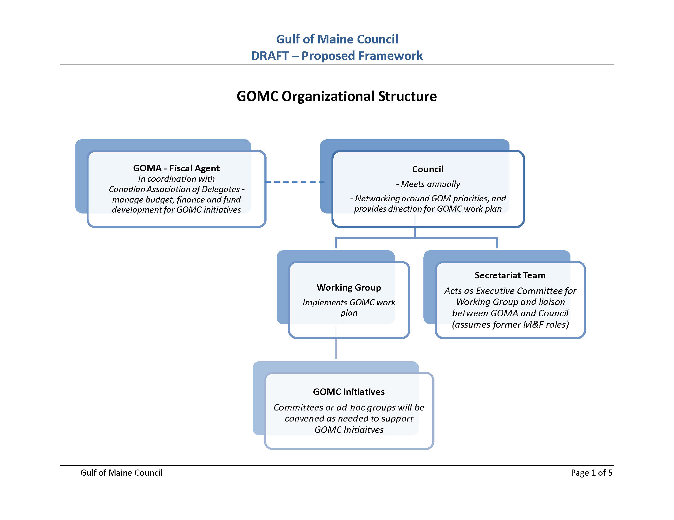

Slide 4
Key Highlights - Structure
Simplified structure without M&F reduces demands on leadership, members and contractors
Council and WG remain separate entities but may meet jointly to promote efficiency
Maintain minimal baseline approach where Council / WG meet in-person on annual basis
Options for broader approach

Slide 5
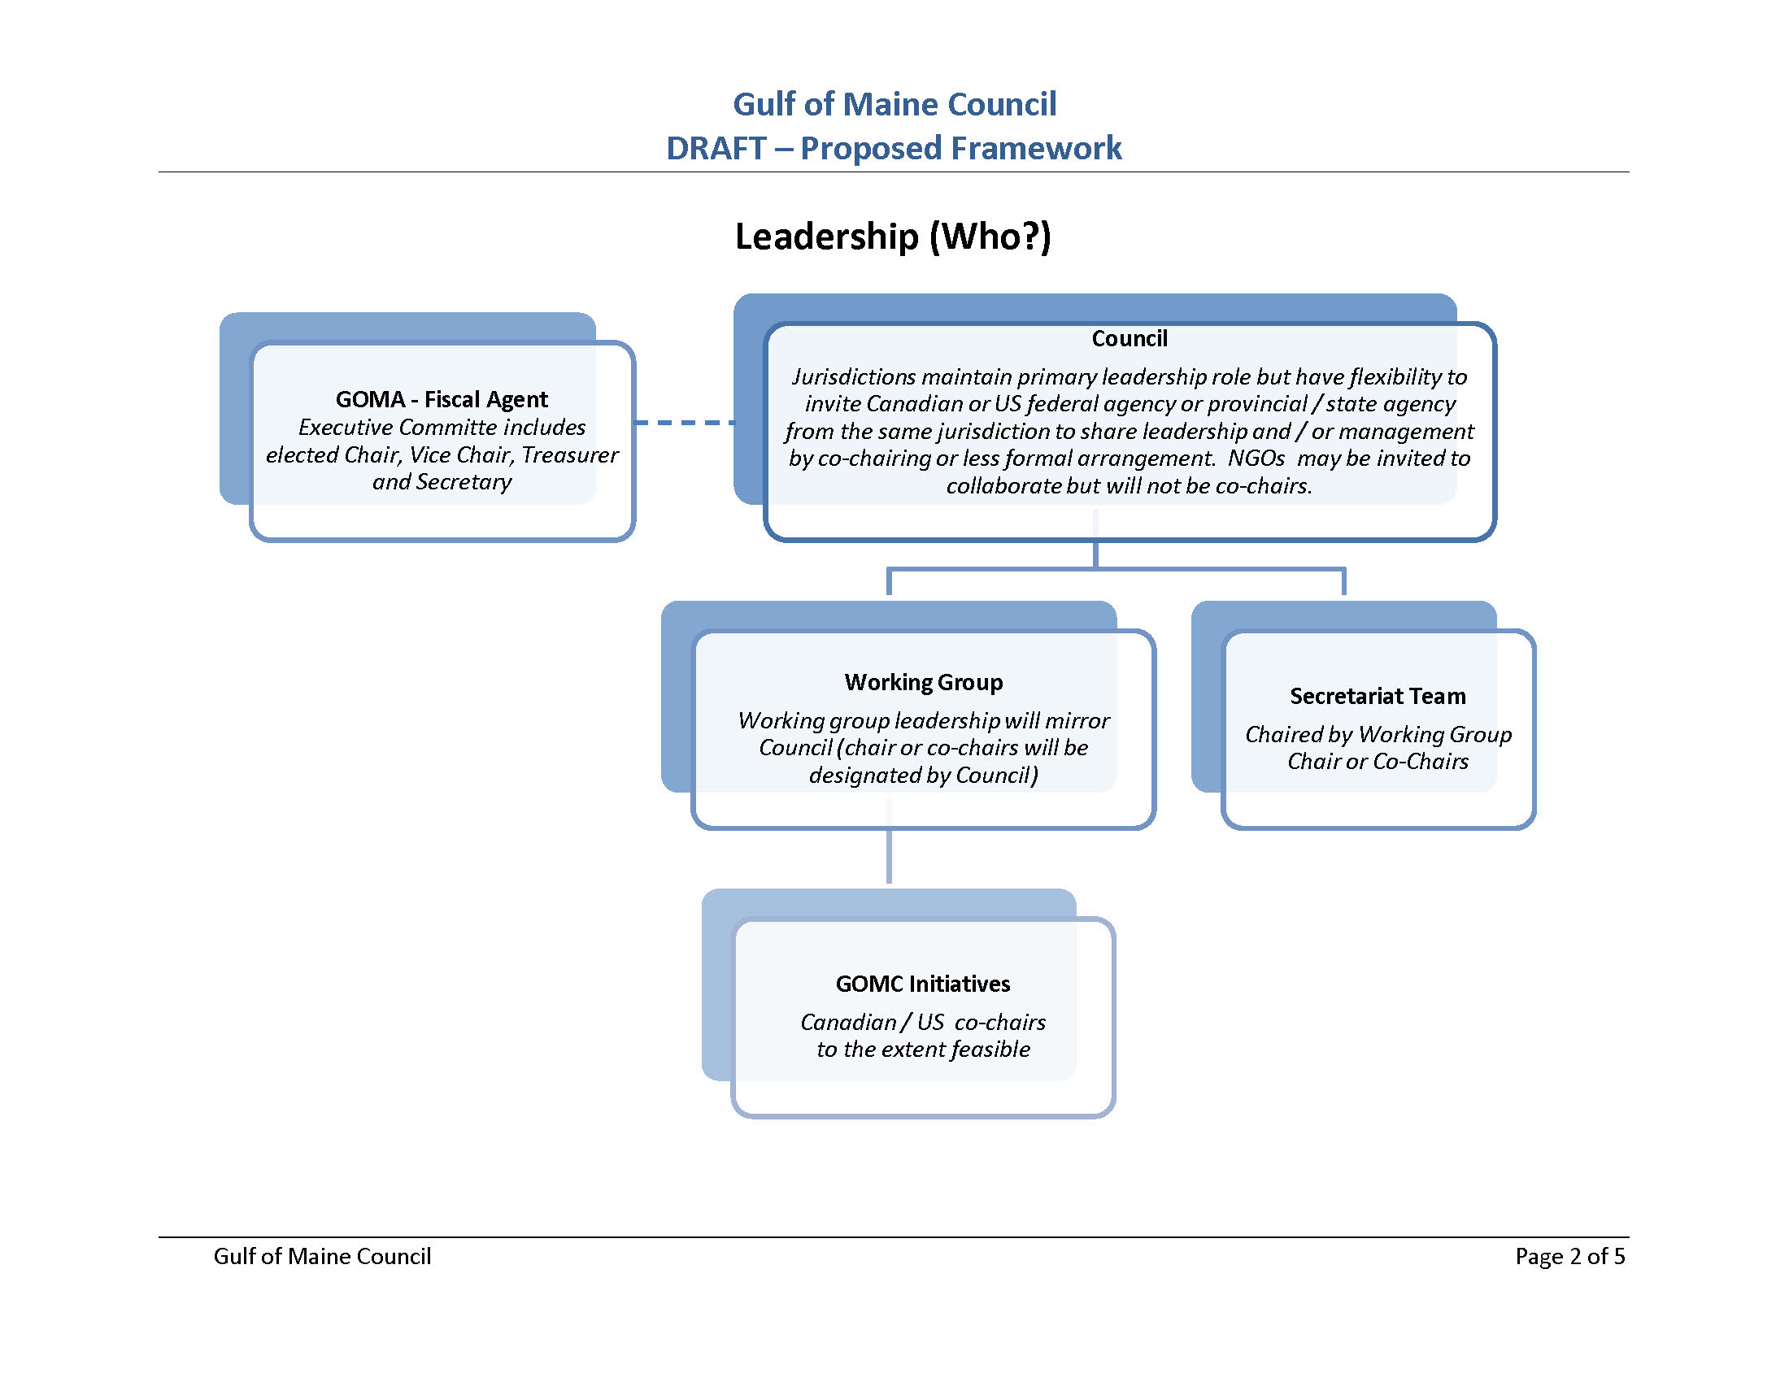

Slide 6
Key Highlights - Leadership
Flexible leadership approach accommodates jurisdictional preferences, management capacity, and resources
Jurisdictions maintain leadership but with added flexibility to ‘share the work load’
  Rotation: NH, NB, ME, NS, MA
Note that federal partners or NGOs that agree to collaborate would have increased work load
Federal leadership is optional – no formal order of rotation

Slide 7
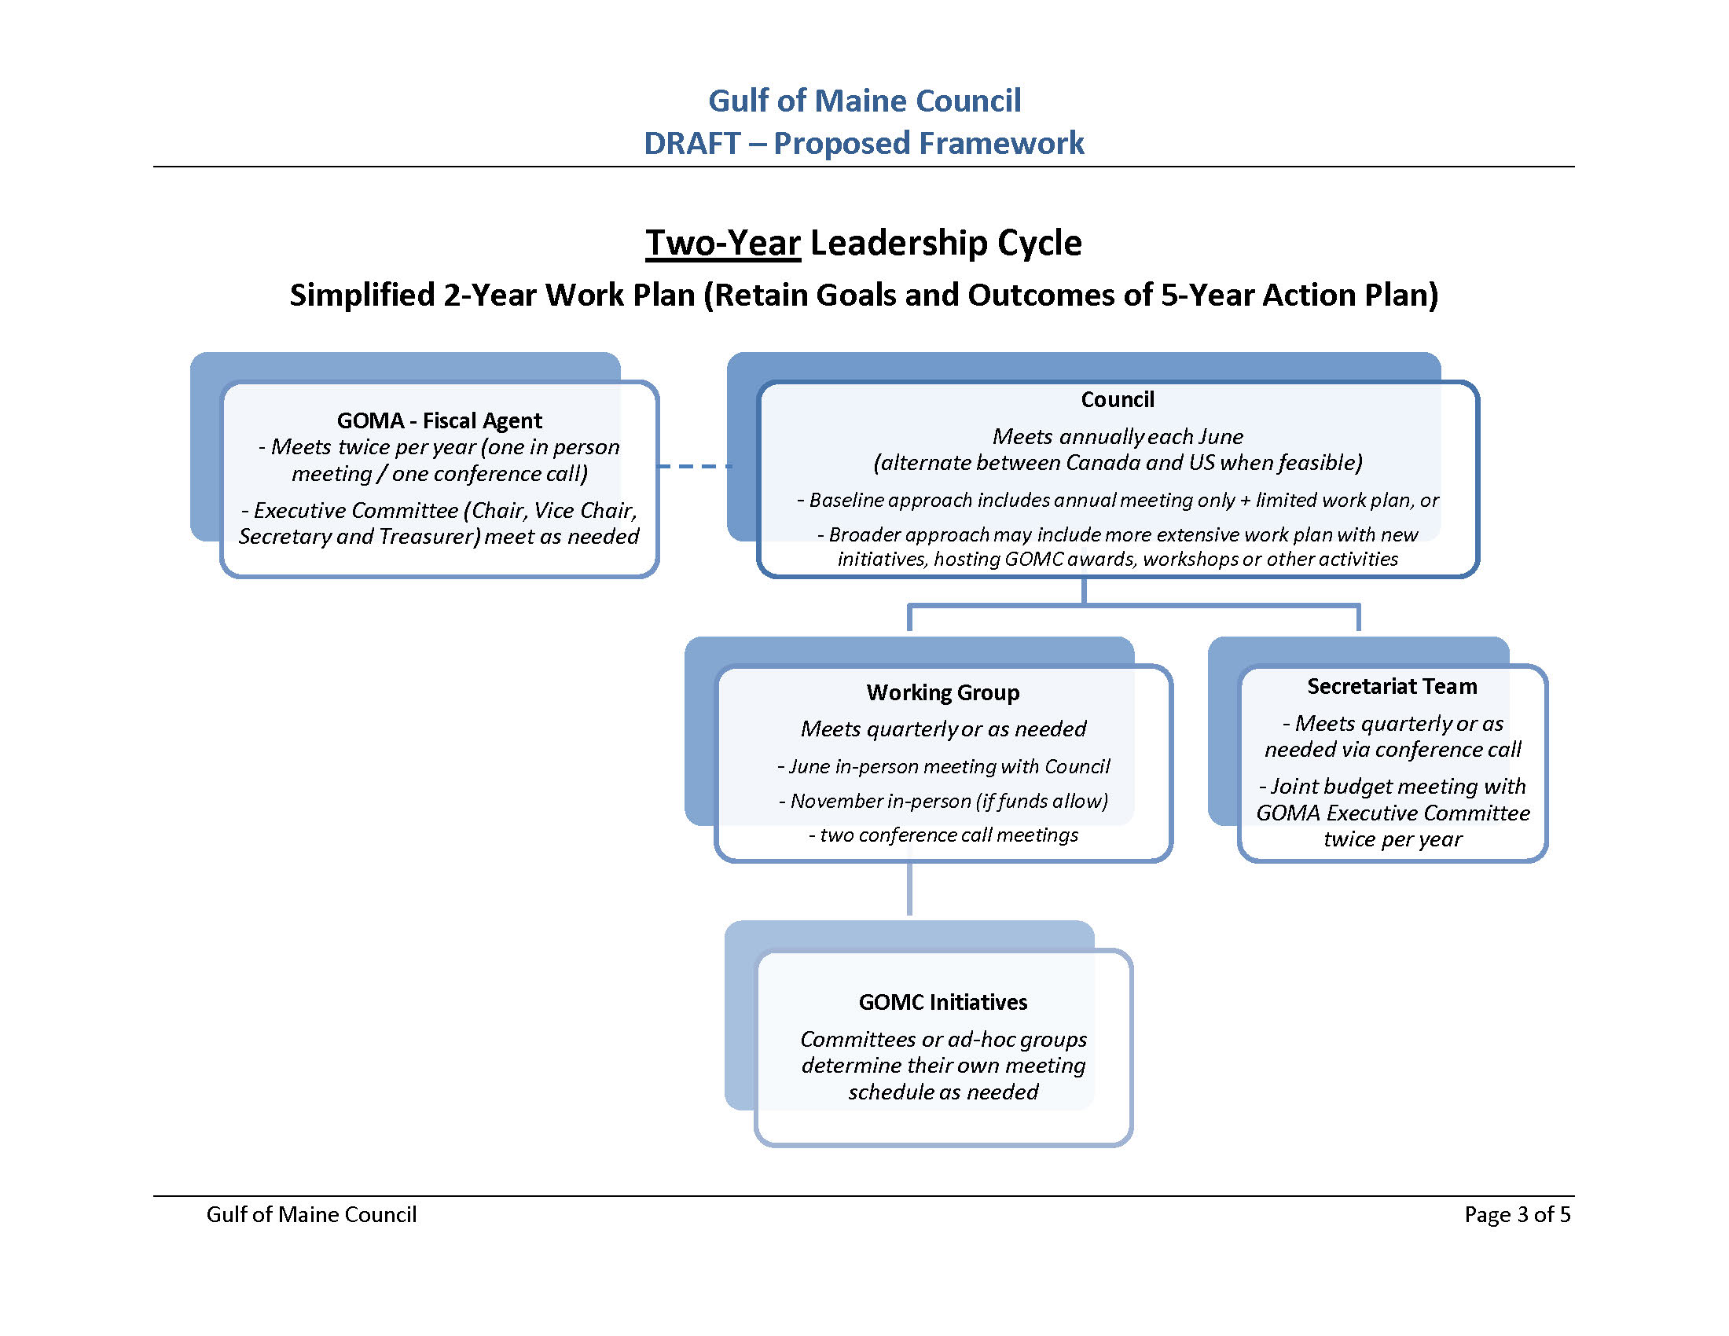

Slide 8
Key Highlights – 2 Year Cycle for Leadership and Work Plans (1 of 2)
Leadership period extended from 1 to 2 years
Aligns leadership cycle with work plans
Enhances productivity by reducing # of transitions
Works Plans focus on realistic tasks that can be accomplished within the leadership period
Flexibility to revisit GOMC priorities at outset of each leadership period

Slide 9
Key Highlights – 2 Year Cycle for Leadership and Work Plans (2 of 2)
Flexibility to adapt GOMC ‘level of effort’ for leadership period according to resources and needs:
  Baseline approach: limited GOMC effort during leadership cycle includes at least joint annual meeting for networking purposes
  Broader approach: may include GOMC initiatives, awards ceremony, workshops etc.

Slide 10
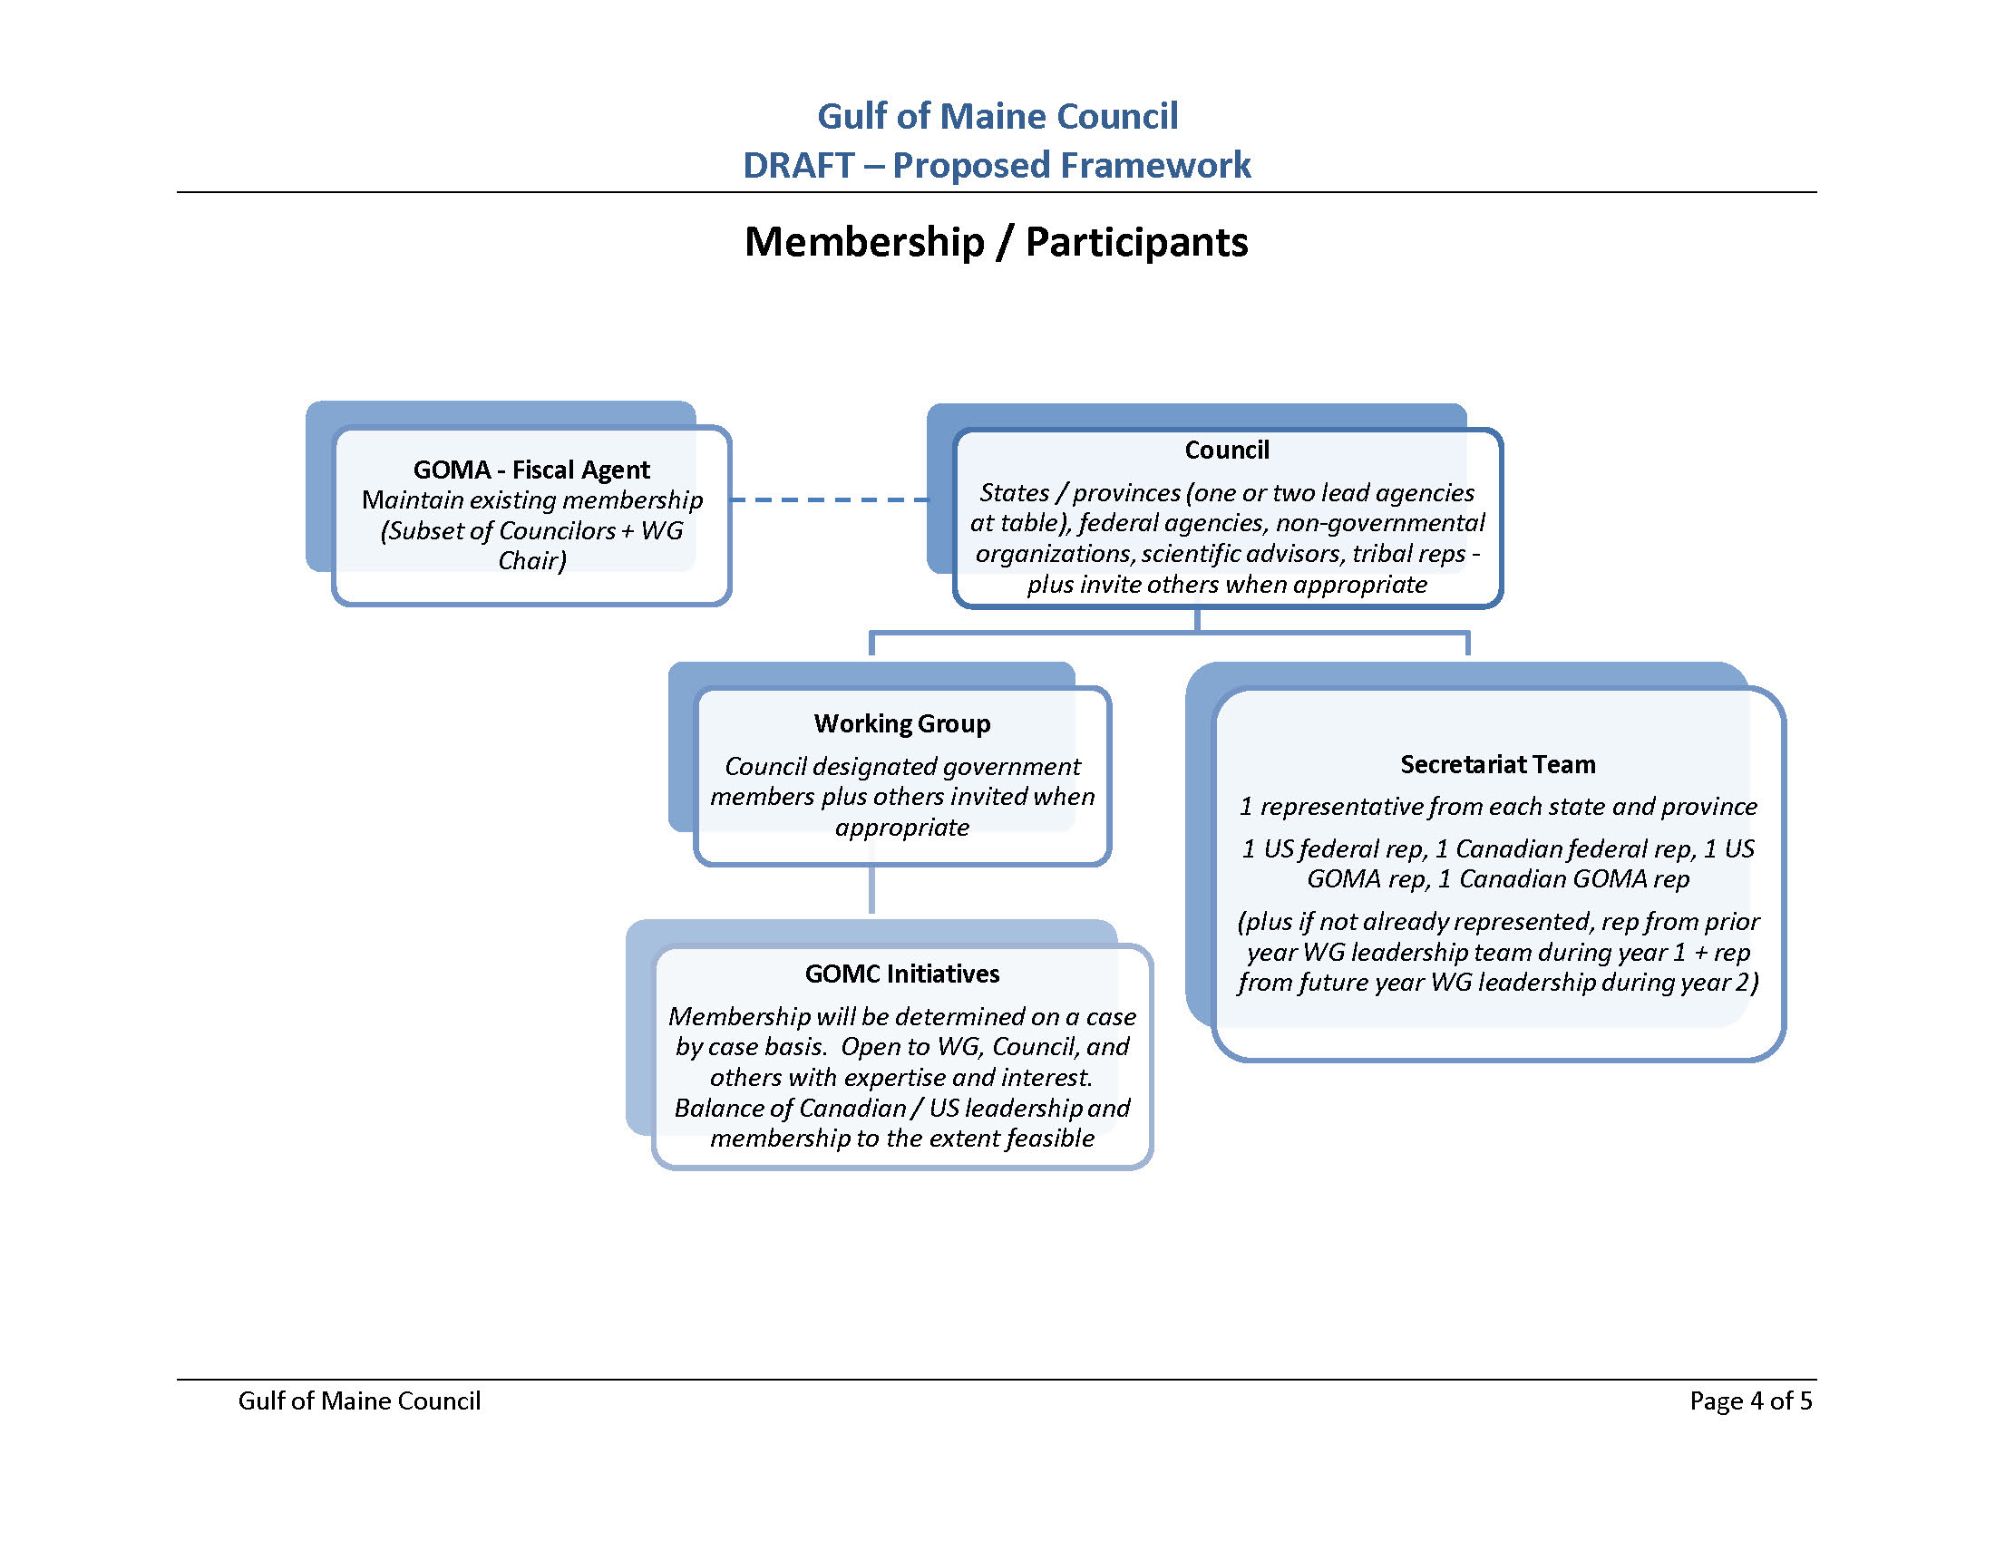

Slide 11
Key Highlights - Membership
Lots of added flexibility here
Jurisdictions may choose to have 1 or 2 agencies on Council
One rep may serve on both Council and Working Group
Guests will be invited when expertise is needed

Slide 12
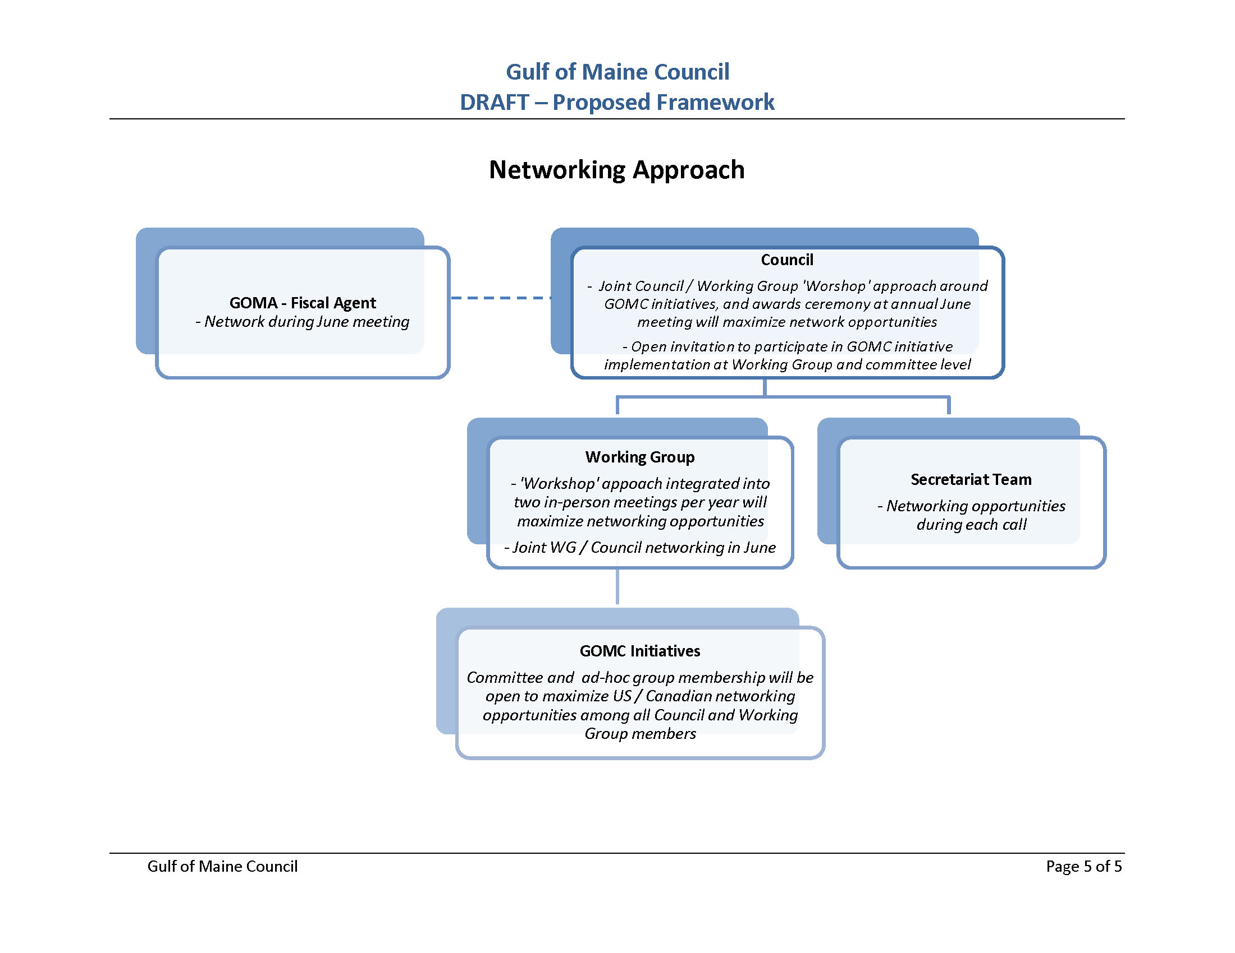

Slide 13
Key Highlights - Networking
Organize meetings to promote exchange of ideas, knowledge, strategies
Joint Council / WG collaborative sessions
Option of utilizing portion of Council meeting for workshop or other networking event

Slide 14
Discussion / Feedback / Q&A
Council and WG provide feedback, discuss outstanding issues, and ask questions
Include in discussion:
  Review proposed definition of ‘consensus’, and
  Discuss tribal appointments to the Council

Slide 15
Proposed Definition of Consensus
"Consensus: General agreement, characterized by the absence of sustained opposition to substantial issues by any important part of the concerned interests and by a process that involves seeking to take into account the views of all parties concerned and to reconcile any conflicting arguments. Consensus need not imply unanimity."1
1. ISO/IEC Guide 2:2004, Standardization and Related Activities -- General Vocabulary

Slide 16
Next Steps
Councilors are asked to support the proposed GOMC Framework and associated Terms of Reference for -
  Council
  Working Group
  Secretariat Team
Following meeting Council Coordinator will prepare GOMC TOR document for reference

