Slide 1
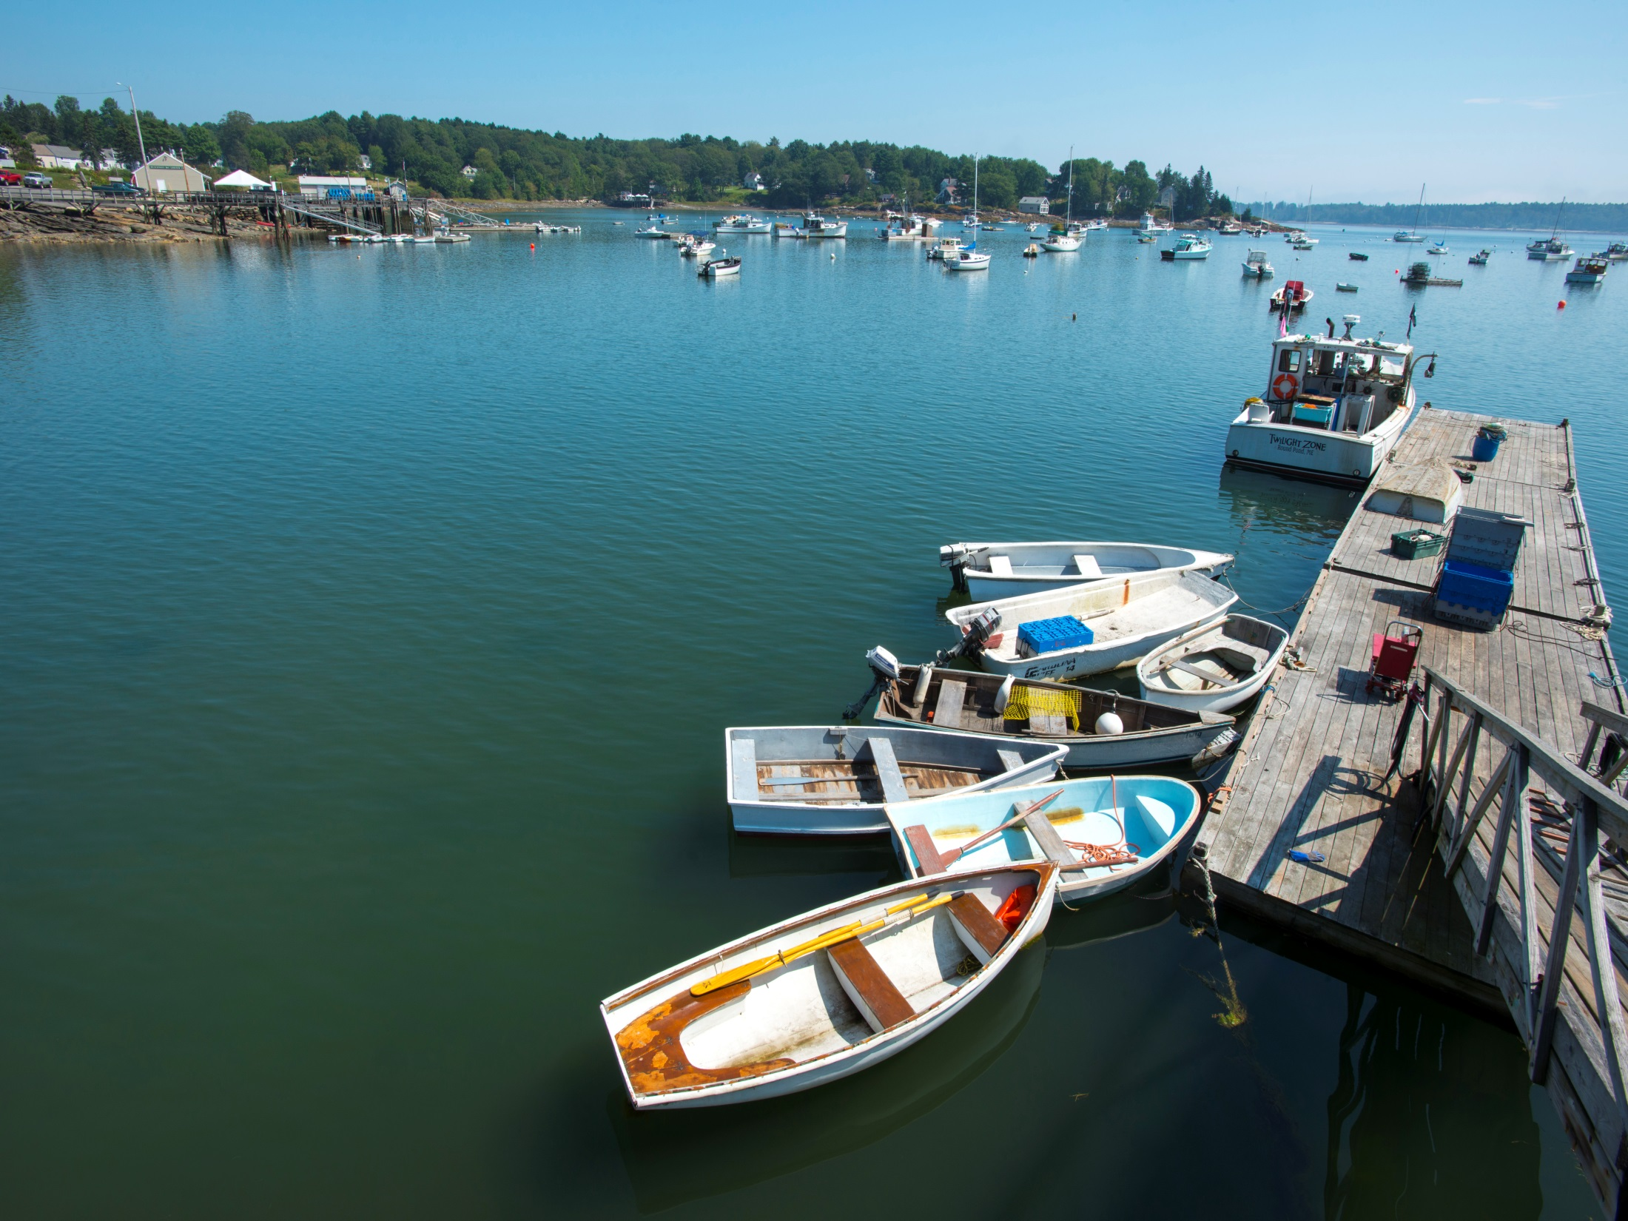












The Northeast Coastal Acidification Network:
Understanding the science of ocean and coastal acidification
NECAN Steering Committee
Ru Morrison* (IOOS/NERACOOS)
Cassie Stymiest (NERACOOS)
Todd Capson (Independent Consultant)
Dwight Gledhill (NOAA OAP)
Bill Mook (Mook Sea Farm)
Joe Salisbury (UNH)
Elizabeth Turner (NOAA/NOS/NCCOS)
Esperanza Stancioff (UMaine Cooperative Extension / ME Sea Grant)
Mel Cote (EPA)
Helmuth Thomas (Dalhousie University)
Juliana Barrett (CT Sea Grant)
Photo: University of Maine
Notes:
Formed in Sept 2013, 11 steering committee members from academia, industry, nonprofit and federal agency

Slide 2
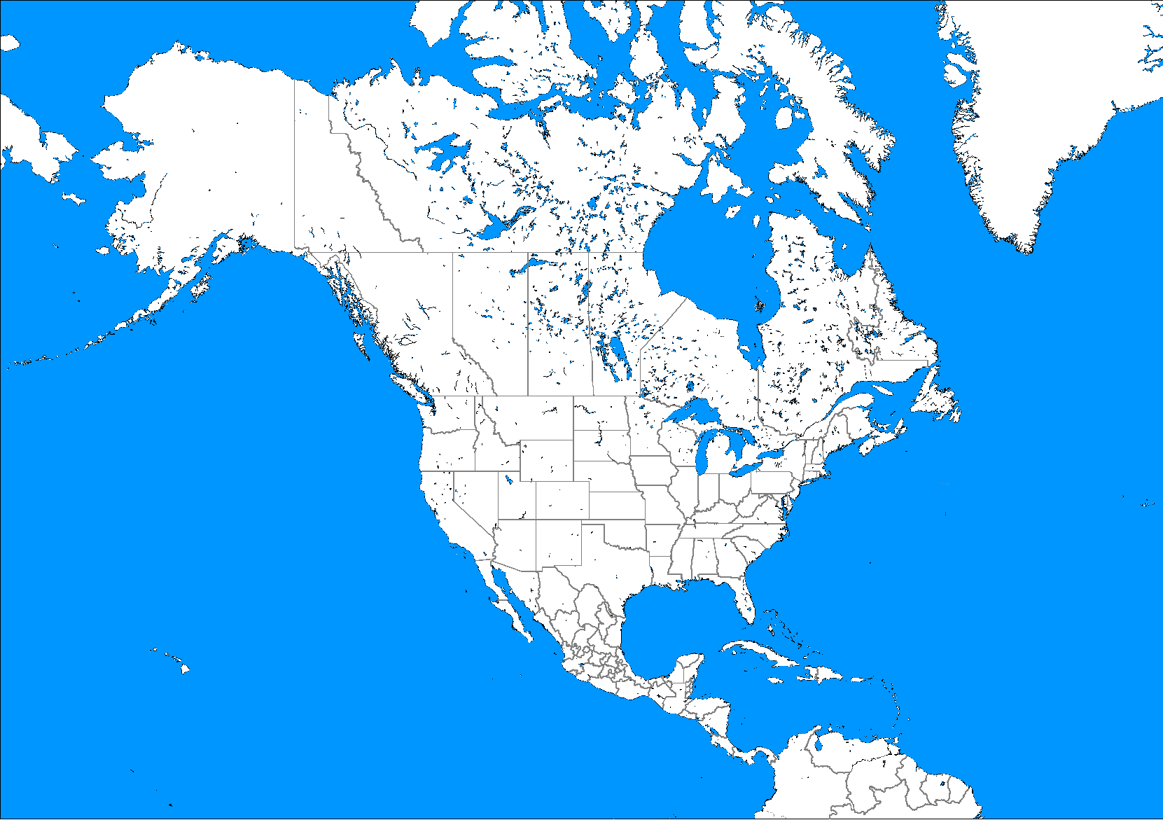
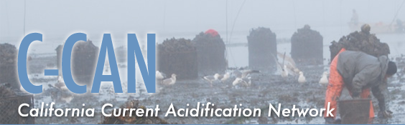
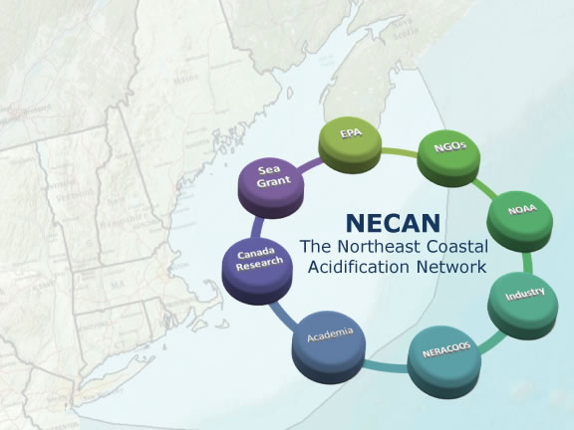
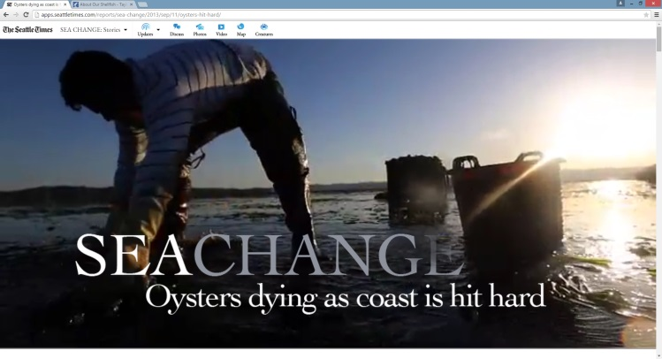
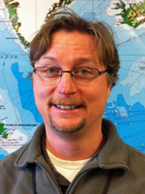
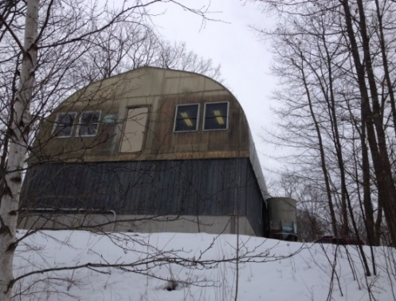

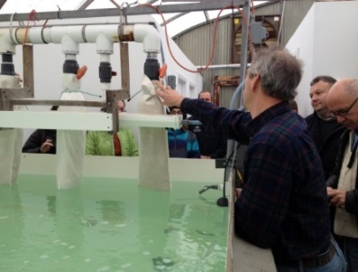
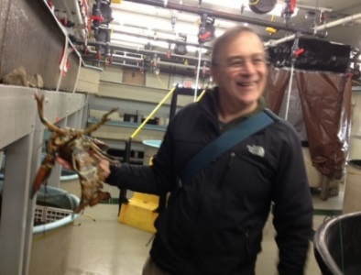

Mook Seafarm, ME
Mook Seafarm, ME
UNH, Coastal Marine Lab

Slide 3
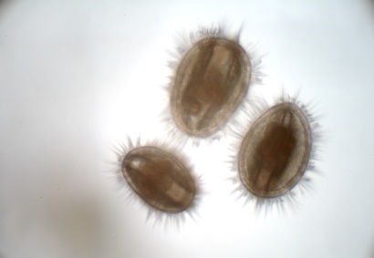
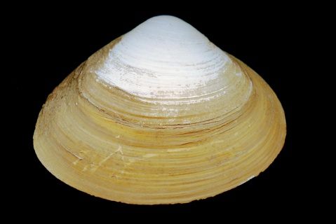
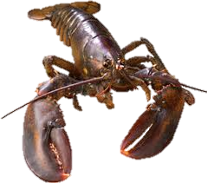
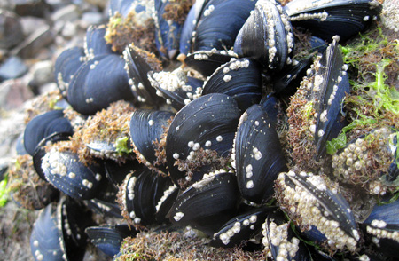
NECAN’s role:
Review and assess the most recent scientific, technical and socio-economic information relevant to the economically important marine organisms potentially impacted by ocean and coastal acidification;
Communicate state of knowledge and critical knowledge gaps identified by stakeholders to relevant state and federal agencies;
Help to coordinate and set regional priorities for monitoring and research designed to further our understanding of coastal acidification;
Respond to user and stakeholder needs.

Slide 4





Our Process
Synthesis
Stakeholder Input
Implementation Plan
Translation
Webinars
Review and assess
Communicate
Respond
Set priorities
Webinars
State of the Science Workshop
Summary Article
Stakeholder Engagement Workshops
Implementation
Plan

Slide 5
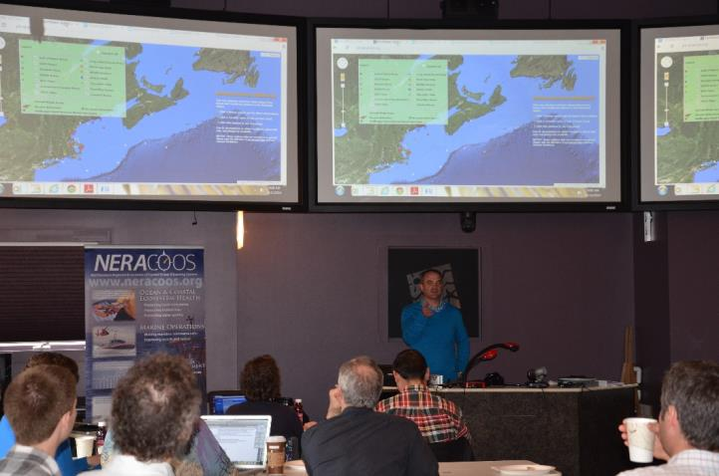
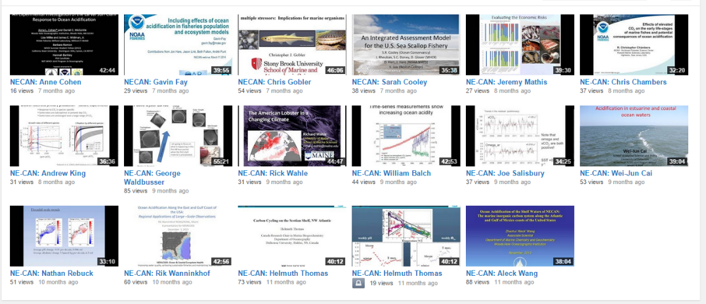
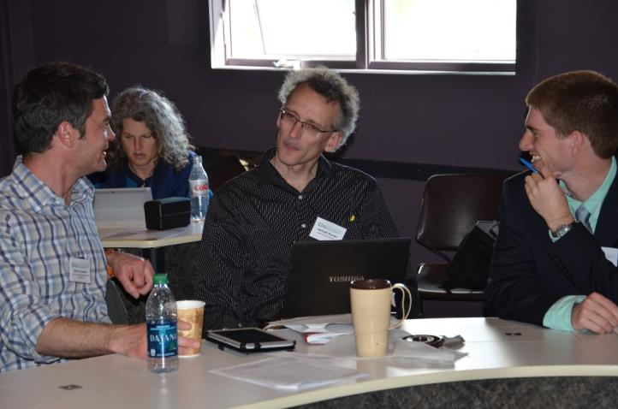
Synthesis
Stakeholder Input
Implementation Plan
Translation
Webinars
Review and assess
Communicate
Respond
Set priorities
16 research presentations by webinar
1 state of the science workshop
m.s. for special issue of Oceanography
The Northeast is unique
At risk shell forming species are hugely important to the region’s marine economy, including: lobsters, mussels, clams, oysters, scallops
Larvae are most vulnerable to acidification
Species response can vary: we know something (but not enough) about bivalves, and we are largely ignorant of OA impacts on lobsters

Slide 6
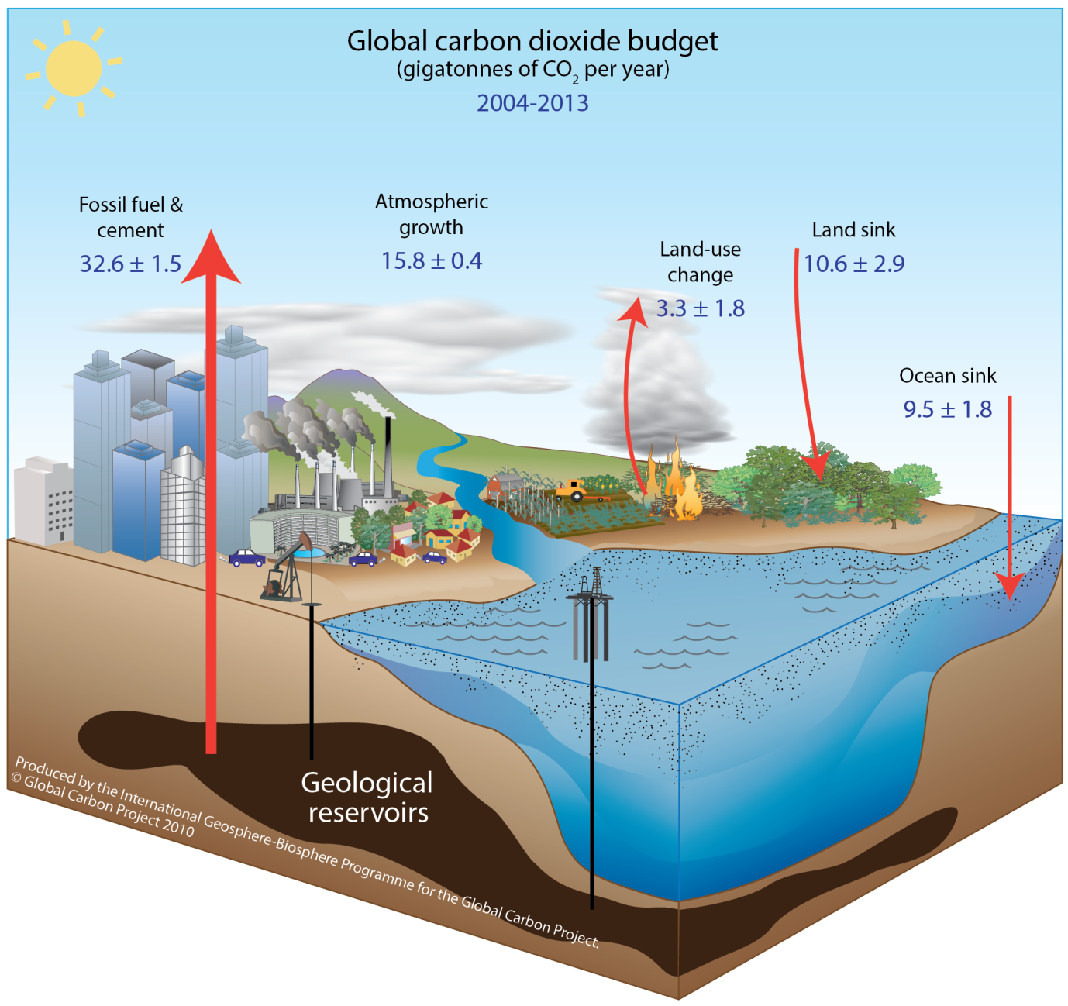
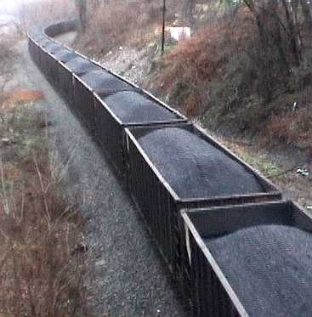
47%
10 BILLION TONS OF CARBON each year
(CO2 emissions from burning of fossil fuels and land use change)
27% land
26% ocean
10 billion tons= 121 million Railroad hopper cars of Coal
= ~31 million Railroad hopper cars of Coal
LeQuere et al. Nature Geosciences 2009; Global Carbon Project 2011

Slide 7
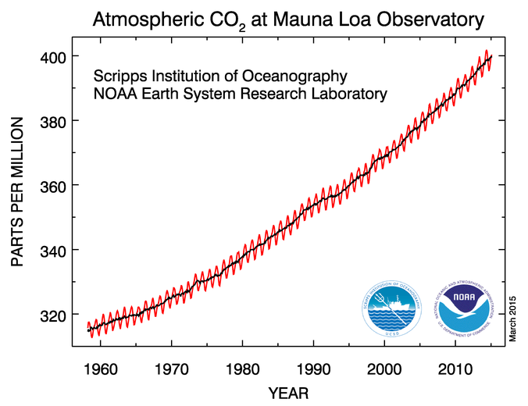

Slide 8
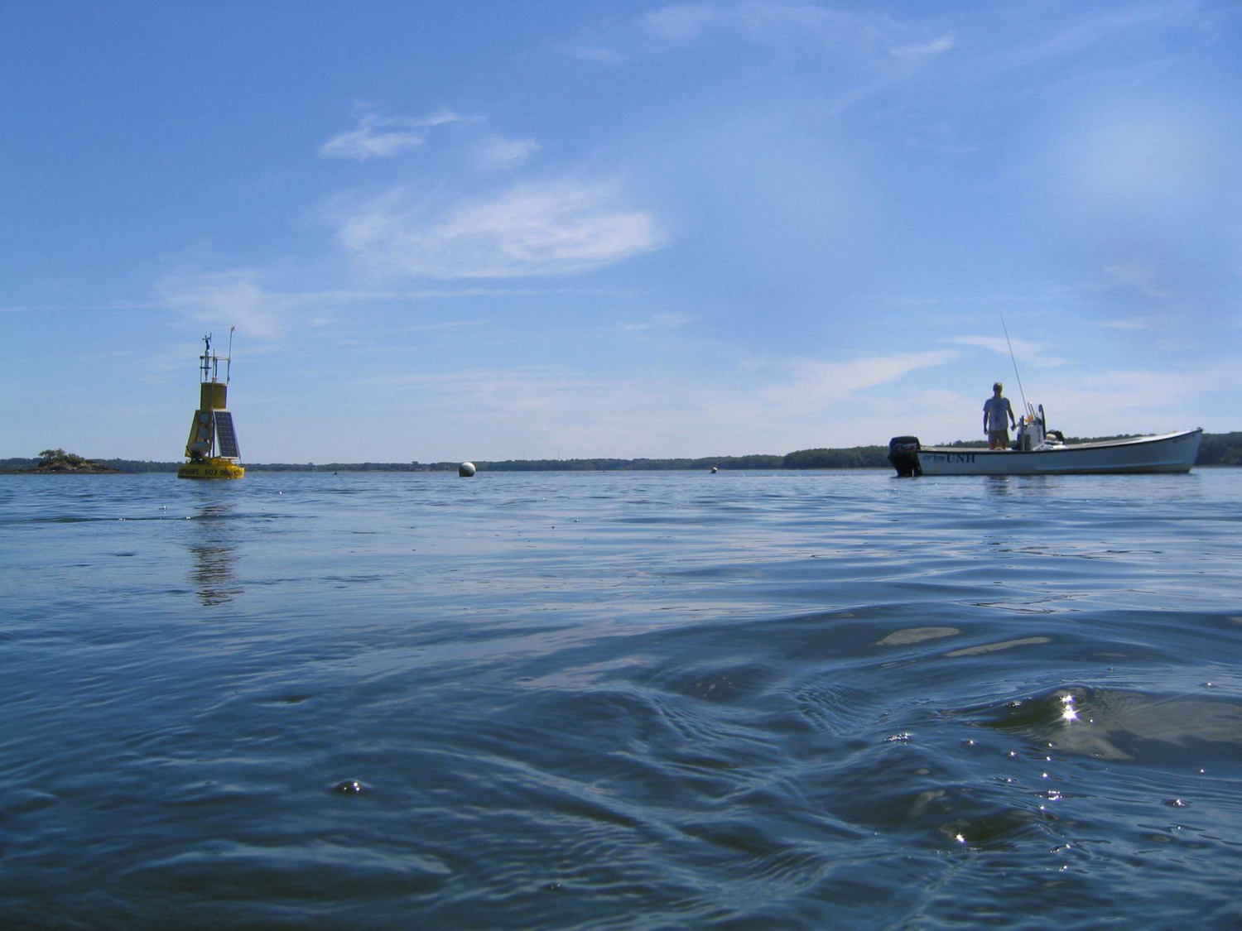
What happens when CO2 goes into the ocean?
CO2
dissolves
Carbonic Acid
CO2
H2O
H2CO3
dissociates
Hydrogen Ion
Bicarbonate Ion
H⁺
HCO3⁻
dissociates
Hydrogen Ion
Carbonate Ion
H⁺
CO3²⁻

Slide 9
The Carbonate Ion Problem
CO2
The Carbonate Ion (CO₃²⁻) is needed for shell formation
dissolves
Carbonic Acid
Calcium Carbonate
CO2
H2O
CaCO₃
H2CO3
dissociates
forms
Hydrogen Ion
Bicarbonate Ion
H⁺
HCO3⁻
Calcium Ion
Ca²⁺
dissociates
Hydrogen Ion
Carbonate Ion
H⁺
Carbonate Ion
CO3²⁻
CO3²⁻
Notes:
(SST=25 C, SSS=35): It takes 27,729 CO2 molecules invading into the ocean water to create 1 H+ ion. In this process 17,813 CO3 ions are consumed, 44,040 HCO3 are produced and 1500 (undissociated) CO2 molecule are added.

Slide 10
The Carbonate Ion Problem
CO2
CO2
CO2
dissolves
Carbonic Acid
Calcium Carbonate
CO2
H2O
CaCO₃
H2CO3
Less shell formation
dissociates
forms
Acic
Bicarbonate Ion
More shell formation
H⁺
HCO3⁻
But… these reactions depend on initial chemical conditions and changes in:
Temperature
Salinity
Pressure
Calcium Ion
Ca²⁺
dissociates
Less available CO₃²⁻
H⁺
Carbonate Ion
CO3²⁻
CO3²⁻
More available CO₃²⁻

Slide 11
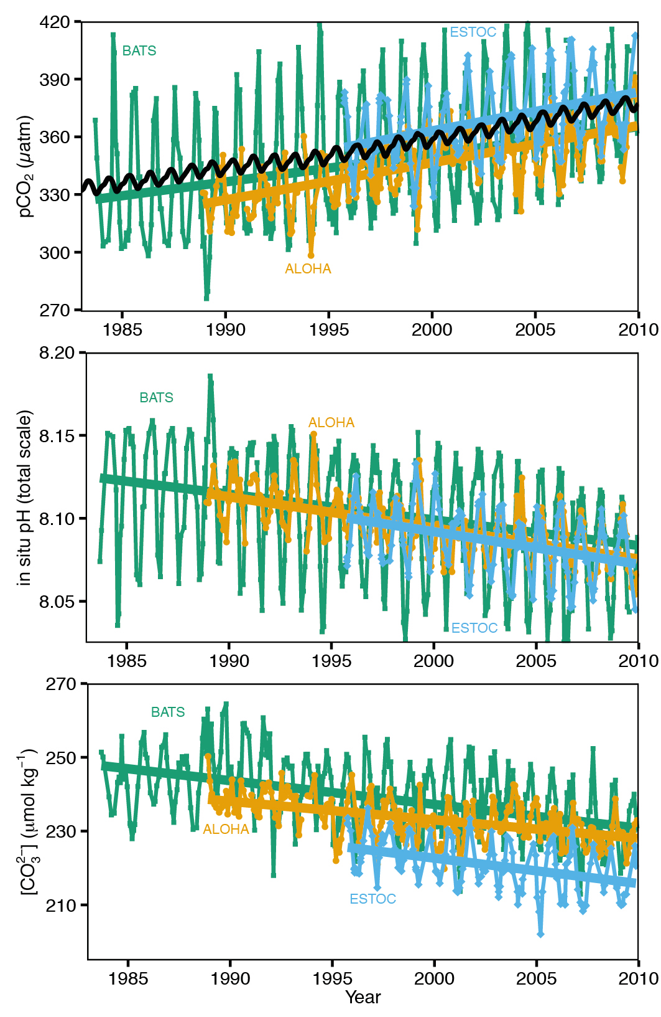
Changing Seawater Chemistry
carbon dioxide
pH
IPCC 2014
WG1, Chapter 3
Doney et al. Ann. Rev. Mar. Sci. 2009
Dore et al. PNAS 2009
Slide from Scott Doney 2015
carbonate ion

Slide 12
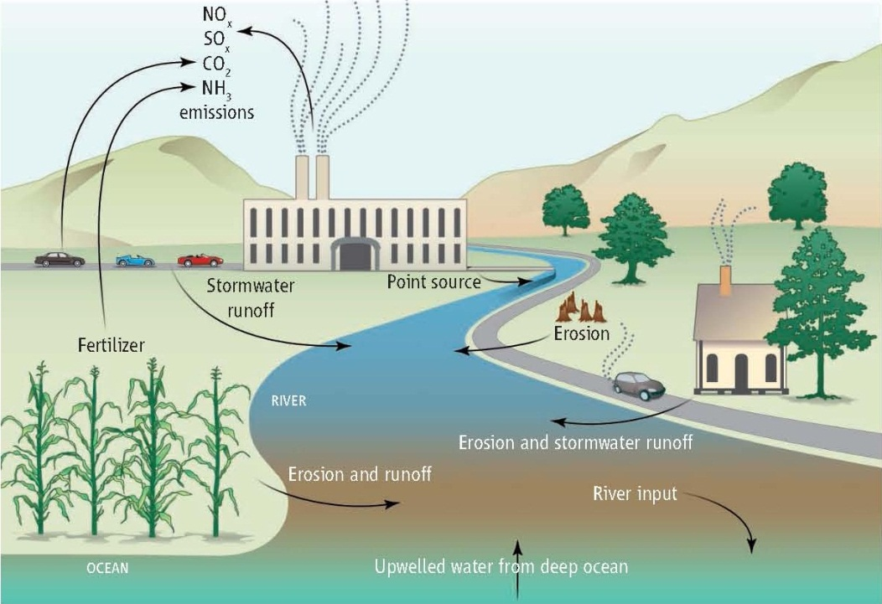
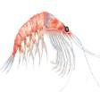
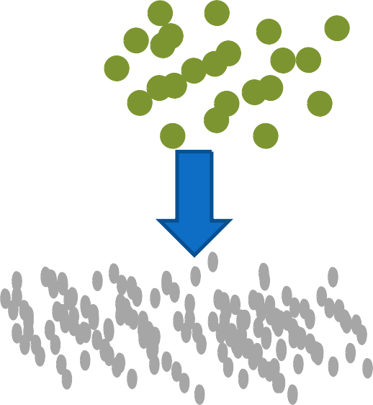
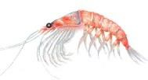

Other Local Sources of Coastal Acidification
Nutrients
Phytoplankton bloom
Phytoplankton die
WA BRP
From Kelly et al. 2011
Bacteria consume oxygen, respire carbon dioxide
Doney et al. PNAS 2007; Doney Science 2010; Kelly et al. Science 2011

Slide 13
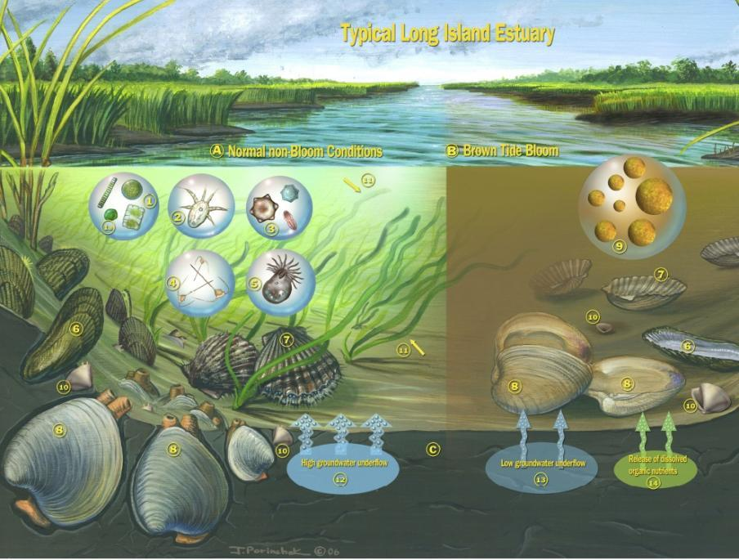
Shallow coastal ecosystems: multiple stressors
Pristine conditions
Anthropogenically impacted
Estuaries already experience:
  Acidification
  Thermally stressful conditions
  Hypoxia
  Suboptimal food, harmful algae
Notes:
Everything I have shown you so far have been the results of experiments performed under ideal temperature and ideal food sources…
Here is a cartoon of a typical LI Estuary where these bivalves would be present. Besides CO2, we know that there are other stressors that effect these dynamic ecosystems.
The first being: the occurance of Harmful Algal Blooms. This cartoon is displaying the water column on the left under normal non-bloom conditions, and also the same environment under a brown tide bloom
The second stressor is temperature. Due to the shallow nature of estuaries, they are the first to be affected by increases in temperatures

Slide 14
What’s so unique about us?
Freshwater input sources
Currents into the GOM supply poorly buffered waters
Temperature fluctuations
Spring bloom dynamics
Mixing dynamics
Nutrient loading

Slide 15
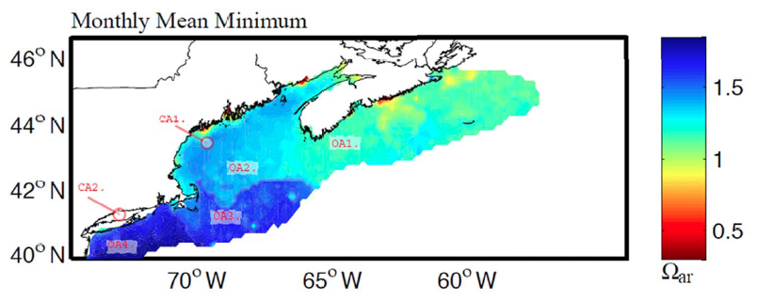
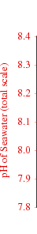
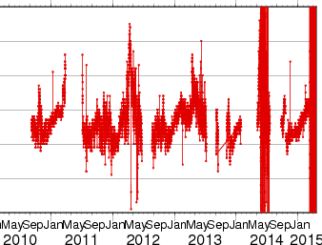
Regional Spatial Patterns & Seasonal Variability
Gledhill et al. Oceanography
2015 (in press)
Calcium Carbonate Saturation State
Surface pH
http://www.pmel.noaa.gov/co2/story/GOM

Slide 16
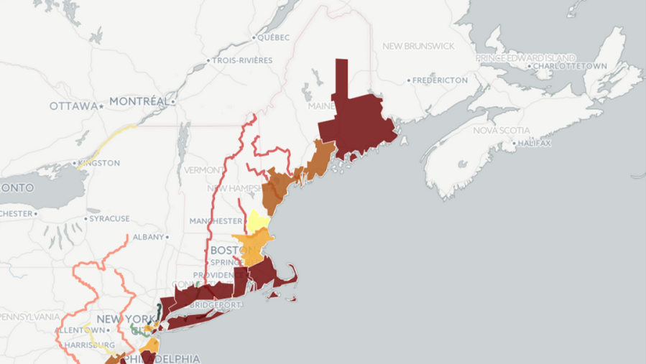
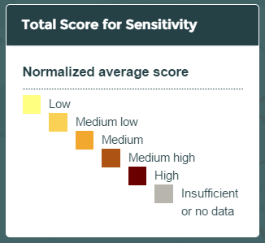
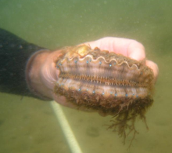
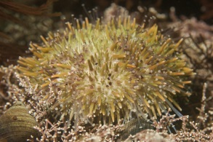
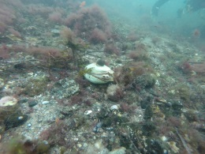
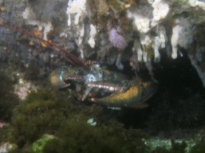
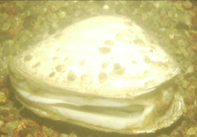
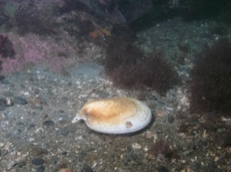
Areas of Concern

Slide 17
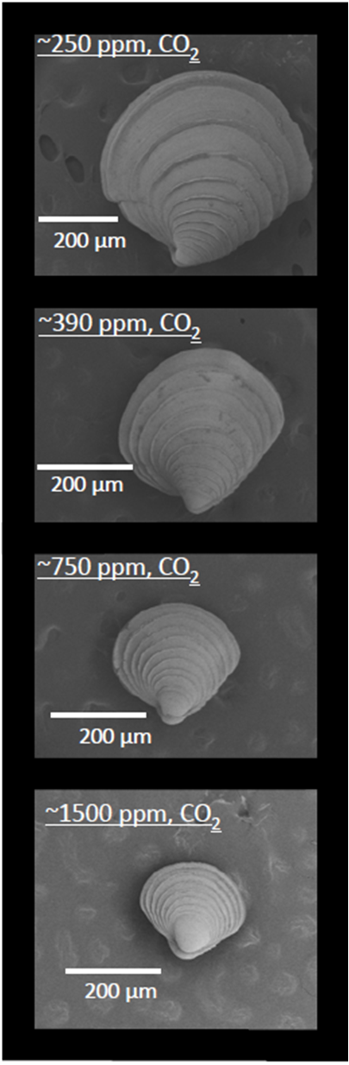
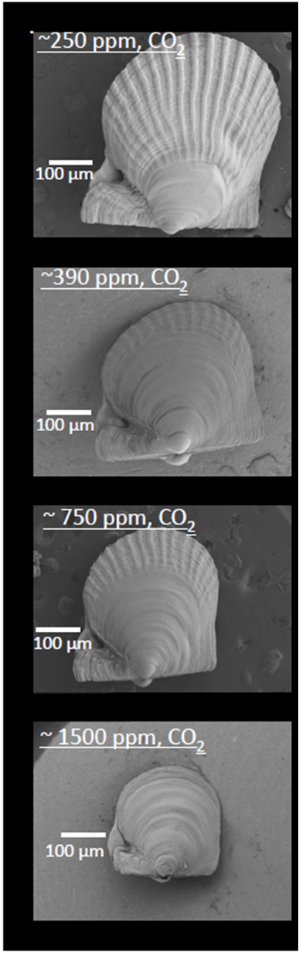
Impacts of OCA on Marine Life
Hard clam
Bay scallops
Low CO₂
Reduced shell & skeleton formation (calcification)
Growth
Habitat loss
Less available prey & smaller fisheries
Behavior
High CO₂
Talmadge and Gobler PNAS 2010

Slide 18

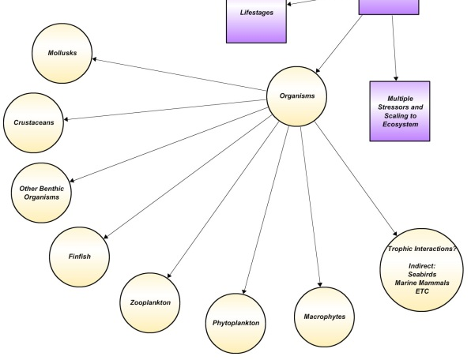

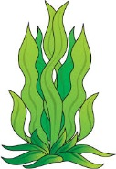
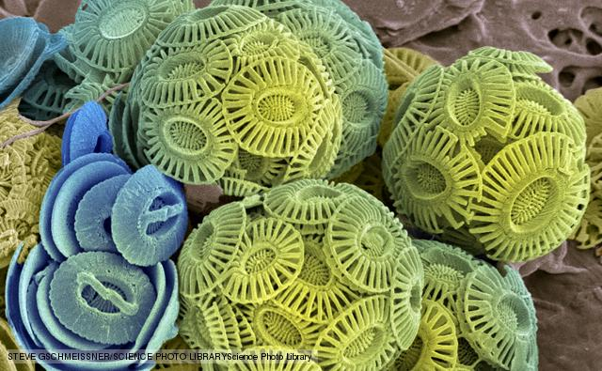
Some win, some lose
Notes:
Reis (2011) not all calcifying organisms show a decrease in rate of calcification in response to lower pH. You have to read this graph backwards. Lower omega aragonite corresponds to lower pH so the pH increases here from left to right.
You can see that as the pH decreases there is an decreased rate of calcification in organisms like oysters. But There is almost no change in some organisms like Periwinkles. Some organisms like conch seem to be able to maintain calcification until a certain threshold and then decrease. Some organisms like shrimp might actually increase calcification under lower pH.

Slide 19
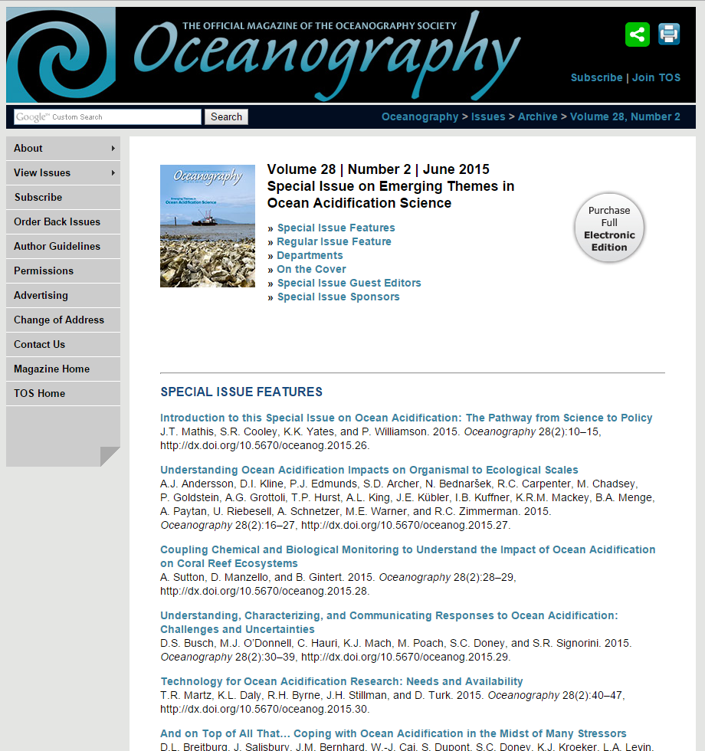
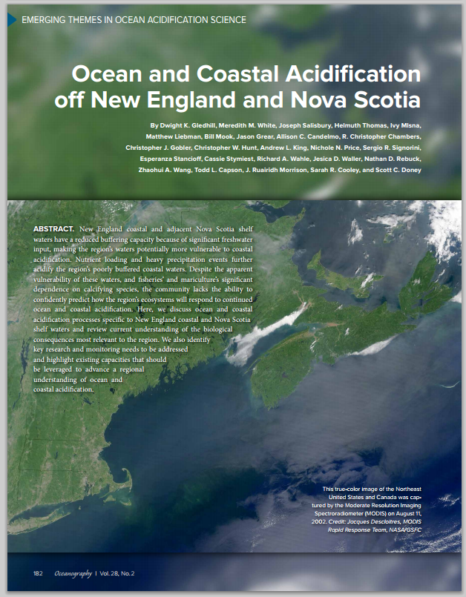
Want more science?

Slide 20
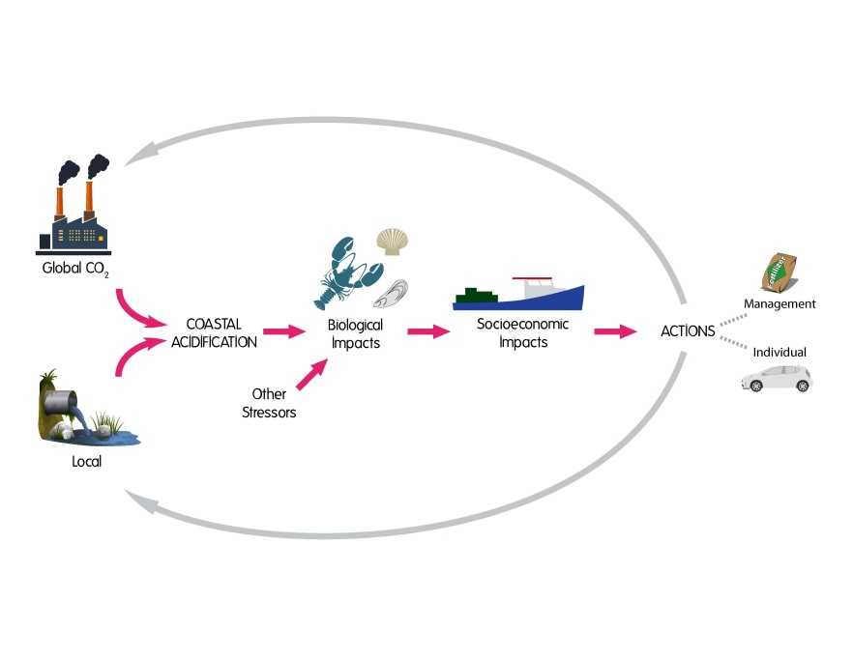
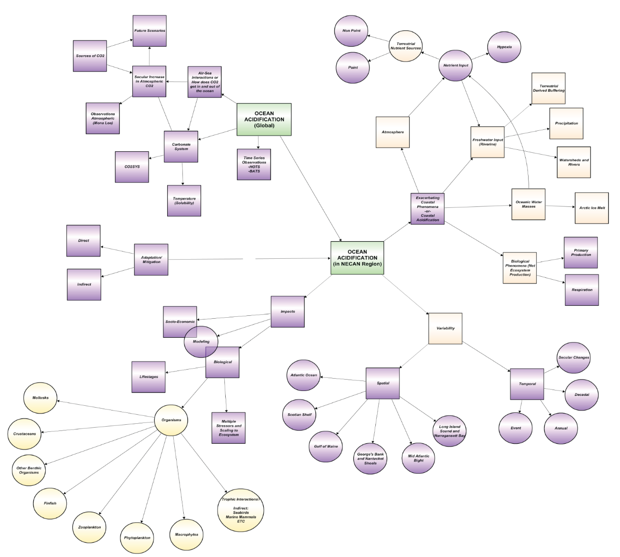
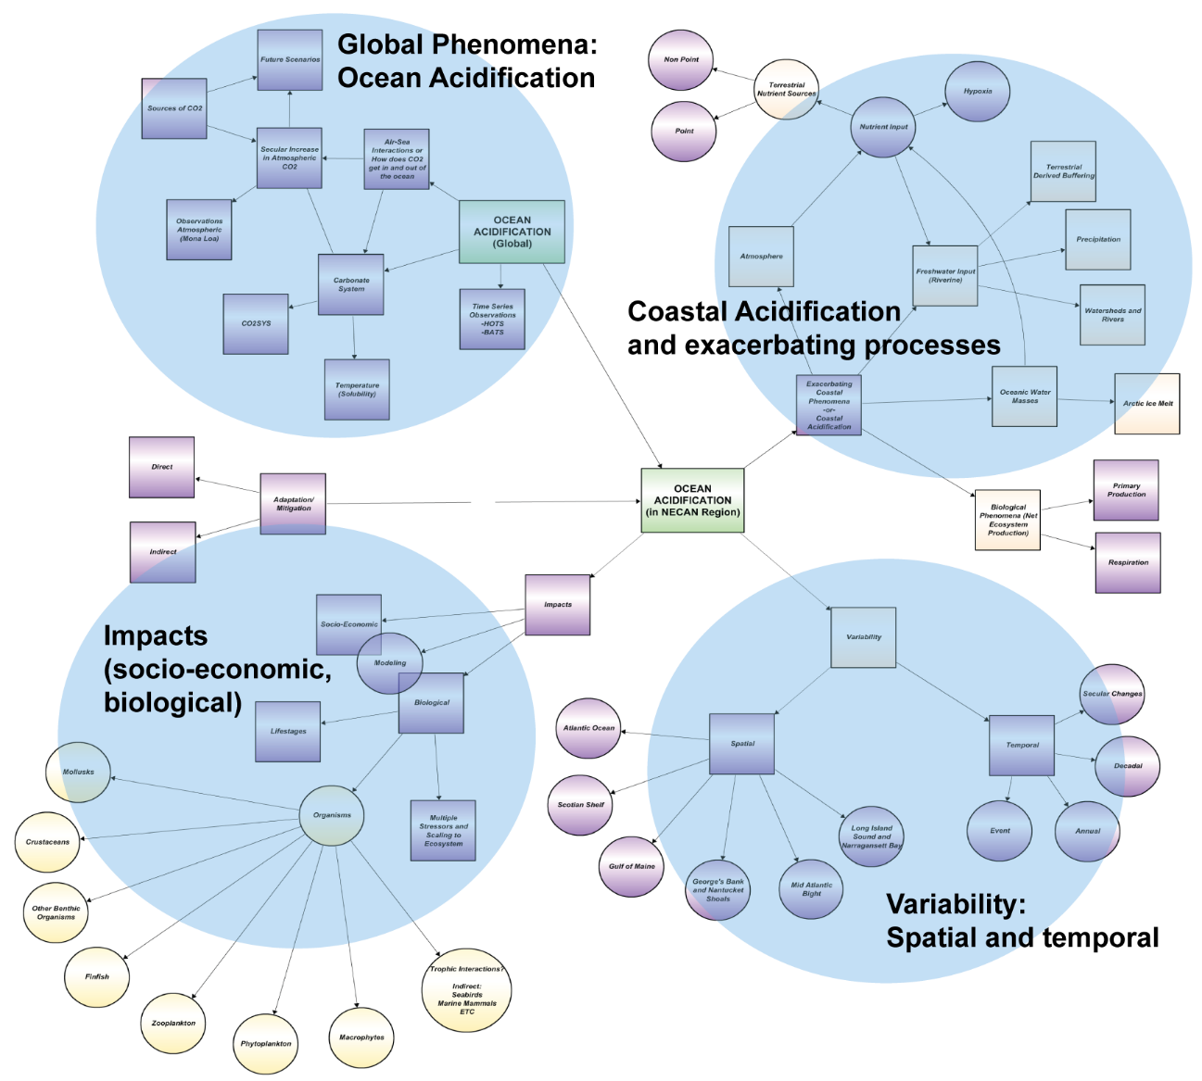
Synthesis
Stakeholder Input
Implementation Plan
Translation
Webinars
Review and assess
Communicate
Respond
Set priorities

Slide 21
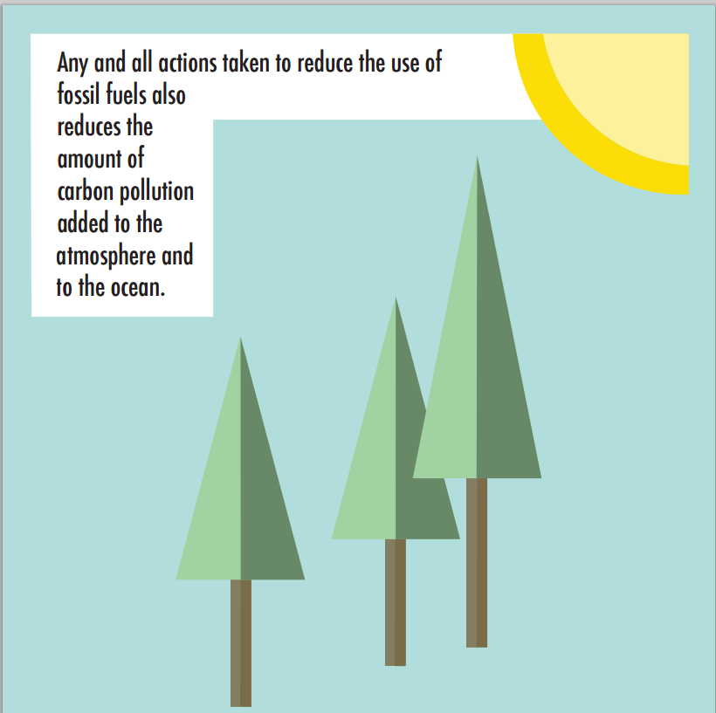
Climateinterpreter.org

Slide 22
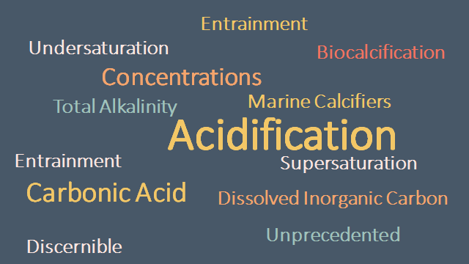
Synthesis
Stakeholder Input
Implementation Plan
Translation
Webinars
Review and assess
Communicate
Respond
Set priorities
When we burn fossil fuels like coal and gas, we release carbon dioxide into the air. The oceans absorb a lot of this carbon dioxide, which changes the ocean’s chemistry. This is called ocean acidification. One result of this change in chemistry is that carbonate- the thing that shellfish use to build their shells- becomes scarce. This means that there will be fewer shellfish in the food chain for other creatures to eat, which then affects the whole ecosystem.

Slide 23
Synthesis
Stakeholder Input
Implementation Plan
Translation
Webinars
Review and assess
Communicate
Respond
Set priorities
Completed:
Maine
South Shore Mass
Rhode Island
North Shore Mass
Planning:
Connecticut
Canada
New Hampshire
NY/NJ

Slide 24
Synthesis
Stakeholder Input
Implementation Plan
Translation
Webinars
Review and assess
Communicate
Respond
Set priorities
Purpose: to inform and learn from fishermen, aquaculturists, and coastal water quality groups regarding Ocean and Coastal Acidification.

Slide 25
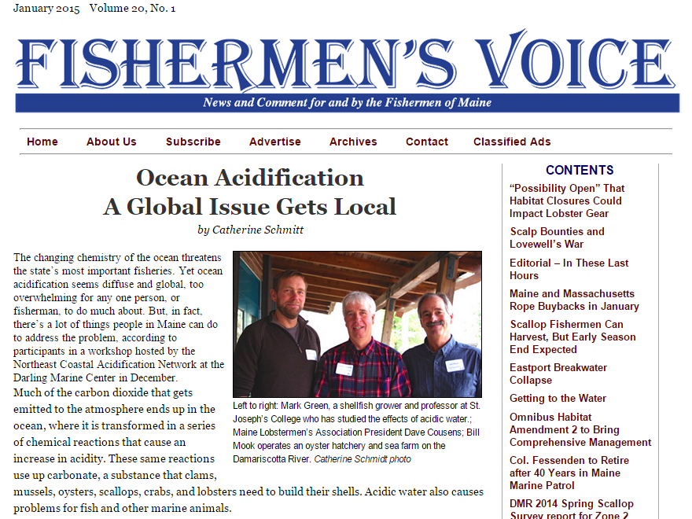
Synthesis
Stakeholder Input
Implementation Plan
Translation
Webinars
Review and assess
Communicate
Respond
Set priorities
Maine
Popular wording: “a lack of awareness” and “many unknowns”
The challenge of OCA is extremely complex – especially when adding storms and runoff to the conversation
Concern that research efforts are disjointed
Want practical solutions
Great potential for partnerships for long term monitoring among many different researching groups and bodies.

Slide 26

Synthesis
Stakeholder Input
Implementation Plan
Translation
Webinars
Review and assess
Communicate
Respond
Set priorities
South Shore Massachusetts
Popular wording: “do not fully understand” and “lack understanding of…”
Multiple stressors: the link between them all
Want more research on acidified mud
Concern for lack of mitigation solutions
Recognize the need for, and want to be part of collaborative research efforts
Need funding
“The goal should be to communicate with the public in a way that causes or inspires them to change behavior and spend money on solutions”

Slide 27

Synthesis
Stakeholder Input
Implementation Plan
Translation
Webinars
Review and assess
Communicate
Respond
Set priorities
Rhode Island
Need more research on the impacts of biota, eventual/potential ecosystem impacts, and acidified mud.
Questions raised about understanding coastal acidification and its role in the multiple stressors puzzle
Translation of the science (good science), through outreach and education efforts.
Future monitoring needs to be done in a targeted manner to cover gaps, and existing monitoring should be maintained; “Let’s not lose what we have”

Slide 28
Synthesis
Stakeholder Input
Implementation Plan
Translation
Webinars
Review and assess
Communicate
Respond
Set priorities
Summary so far
Need to translate the connections of OCA in the context of climate change and its role in a multiple stressor environment
Need to identify risks and make recommendations for each industry group
Need more monitoring and research
…which needs to be coordinated
Need to improve and expand monitoring so we are collecting high quality (long term) data

Slide 29

Inventory of Monitoring for OCA
Monitoring Program Name | Organization Name | State/Province | Monitoring Location | Notes on frequncy of monitoring | Link for more information | Contact Information | pH | pCO2 | DIC | TA | temperature | salinity | "nutrients" | nitrate | nitrite | phosphate | orthosilicic acid | DIN | silicate | POC | PIC | DOC | C14 primary productivity | C14 calcification | plankton | chl-a | DO | turbidity | TON | Pheophytin | DON | E. coli | TDN
Shelf-wide Plankton Surveys (Eco-Mon) | NOAA NEFSC | NS, NB, ME, NH, MA, RI, CT | over the continental shelf from Cape Hatteras, NC to Cape Sable, NS | Cruise runs 2-3 times per year. pCO2, pH, temp, sal, and chl-a are continuously monitored during cruises. All other parameters are discretely sampled. |  |  | Y | Y | Y | Y | Y | Y | Y | N | N | N | N | N | N | N | N | N | N | N | Y | Y
OOI Maintanance/Deployment Cruise | WHOI | MA | from WHOI out to the shelfbreak of the South New England Shelf | Cruise runs twice per year. Carbonate parameters are measured discretely at varying locations along the way. |  |  | Y | N | Y | Y | N | N | N | N | N | N | N | N | N | N | N | N | N | N | N | N
Martha's Vinyard Coastal Observatory | WHOI | MA | near South Beach in Edgartown, MA - OA monitoring probes are at the offshore subsurface (12-m depth) node approx. 1.5 km south of Edgartown Great Pond | Year round continual monitoring of pCO2, pH is discretely sampled monthly |  |  | Y | Y | N | N | N | N | N | N | N | N | N | N | N | N | N | N | N | N | N | N
Waquoit Bay System-Wide Monitoring Program | WHOI | MA | Waquoit Bay, MA | Nutrient data is sampled periodically, other parameters are measured every 15 mins |  |  | Y | N | N | N | Y | Y | spec. | Y | Y | Y | N | N | N | N | N | N | N | N | N | Y | Y | Y
Buzzards Bay Water Quality Monitoring Program | Buzzards Bay Coalition | MA | Buzzards Bay | Temp, sal, DO measured weekly, nutrient sampling 4 times per summer |  |  | N | N | N | N | Y | Y | N | N | N | Y | N | Y | N | N | N | Y | N | N | N | Y | Y | N | Y | Y | Y
Bathing Beach Water Quality Monitoring Program | MA Dept of Health and Environment | MA | 15 Cape-wide beaches | weekly sampling | http://www.barnstablecountyhealth.org/bathing-beach-water-quality |  | N | N | N | N | N | N | N | N | N | N | N | N | N | N | N | N | N | N | N | N | N | N | N | N | N | Y
National Coastal Assessment | multiple federal agencies | U.S. | multiple locations | assessment occurs about every 5 years, using many data sources collected at varying frequencies | http://water.epa.gov/type/oceb/assessmonitor/ncca.cfm |  | Y | N | N | N | Y | Y | spec. | Y | Y | Y | N | N | N | N | N | N | N | N | N | Y | Y | N | N | N | N | N
Environmental Monitoring Program | MWRA | MA | 50 locations around the coast and islands | monthly sampling | http://www.mwra.state.ma.us/harbor/html/bh_wq.htm |  | Y | N | N | N | Y | Y | spec. | N | N | N | N | Y | N | Y | N | N | N | N | N | Y | Y | N | N | Y | N | Y
Cape Cod Bay Monitoring Program | Center for Coastal Studies | MA | Over 40 stations located along the shoreline | bi-weekly sampling April-October | http://coastalstudies.org/programs/cape-cod-bay-monitoring-program/ |  | N | N | N | N | Y | Y | Y | N | N | N | N | N | N | N | N | N | N | N | N | Y | Y | N | N | N | N | N
Environmental Monitors on Lobster Traps | NOAA NEFSC | Gulf of Maine and Southern New England Shelf | almost 100 stations throughout study area | continuous monitoring | http://www.emolt.org/ |  | N | N | N | N | Y | Y | N | N | N | N | N | N | N | N | N | N | N | N | N | N | N | N | N | N | N | N
Plum Island Ecosystems Long Term Ecological Research | The Long Term Ecological Research Network | MA | Plum Island |  | http://pie-lter.ecosystems.mbl.edu/content/analytical-methods |  | N | N | Y | Y | N | N | spec. | Y | Y | Y | N | Y | N | N | N | Y | N | N | N | Y | Y | N | N | Y | Y | N | Y
Bay Watchers | Waquoit Bay National Estuarine Research Reserve | MA | Waquoit Bay (9 sites) |  | http://www.waquoitbayreserve.org/get-involved/volunteer-opportunities/ |  | N | N | N | N | Y | Y | spec. | Y | N | Y | N | N | Y | N | N | N | N | N | N | Y | N | N | N | N | N | N | Y
Water Quality in Buzzards Bay | Coastal America Foundation | MA | Buzzards Bay (5 sites with dataloggers) |  | http://www.coastalamericafoundation.org/waterqualitydata.html |  | N | N | N | N | Y | Y | N | N | N | N | N | N | N | N | N | N | N | N | N | N | Y | N | N | N | N | N | N
Salem Sound Water Quality Monitoring Project | Salem Sound Coastwatch | MA | Salem Sound (6 sites) | monthly sampling |  | Barbara Warren, barbara.warren@salemsound.org | Y | N | N | N | Y | Y | N | N | N | N | N | N | N | N | N | N | N | N | N | N | Y | N | N | N | N | N | N

Slide 30

  At least 2:
  pH
  pCO2
  DIC
  TA
Gledhill et al 2015, in press
Notes:
Figure 7: This figure is a representation of our current capacity for ocean acidification research and monitoring in the NECAN region. Represented on this map are laboratories researching ocean acidification, along with its effects on biology, buoys which are monitoring carbonate chemistry parameters, as well as vessel cruise tracks and the associated sampling waypoints. It should be noted that the cruise tracks are only representative of a possible route – the actual path a vessel will follow during a monitoring cruise varies each time. During these cruises, pCO2 in the water is continuously measured via a flow through system while discrete measurements are taken at the waypoints. One exception to this is the OOI maintenance cruise from WHOI to the Pioneer Array, during which the vessel is stopped at random locations for discrete sampling – no continual monitoring is done (and so, this cruise track is marked by dots instead of dashes). Frequency of sampling, through out the region, ranges from per second to per four years. Frequency of cruises is measured by how many times per year the cruise runs. Some monitoring locations are sampled at multiple frequencies (e.g., the UNH/NERACOOS buoy in Great Bay which is continuously monitoring pCO2 in the water but TA, DIC and pH are discretely sampled biweekly), in this case, the location is marked with a dual colored symbol.

Slide 31



Observations in the Northeast

Slide 32



Shore Stations
Mook Sea Farm & Casco Bay
The JBB
(Joe’s Black Box)
Measures:
Temperature
Salinity
Dissolved O₂
pCO₂
Calculates:
pH
Omega_{a&c}

Slide 33

Synthesis
Stakeholder Input
Implementation Plan
Translation
Webinars
Review and assess
Communicate
Respond
Set priorities
State of the science
Stakeholder needs
Research and monitoring requirements
Implementation Plan

Slide 34

Synthesis
Stakeholder Input
Implementation Plan
Translation
Webinars
Review and assess
Communicate
Respond
Set priorities

Slide 35


Where can I go for more info? www.neracoos.org/necan
Coming summer 2015: Resource portal

Slide 36



Yes, NE-CAN!
NECAN will:
provide guidance and direction on research and observations
generate information products
organize workshops and outreach activities
provide resources for stakeholders
SUCCESS!
388 members
41-61% open rate on monthly updates
16 science based webinars
3 stakeholder workshops
Over 850 Youtube views
Over 4,000 Pageviews
A model for other regions – SOCAN
Legislation and action – ME Commission, other states following
NECAN is not:
An agency or institution that undertakes monitoring or research (although its members do)
A source of research funding (although it helps to prioritize regional research)
Thank you!
www.neracoos.org/necan
cassie@neracoos.org

