Slide 1

What is New with ESIP?
December 2015

Slide 2
ESIP 2.0 Progress
Steering Committee has been discussing the best way to move forward
Learned from socio-economic indicator effort at NH DES
Learned from Ecosystem Goods and Services effort at EPA

Slide 3
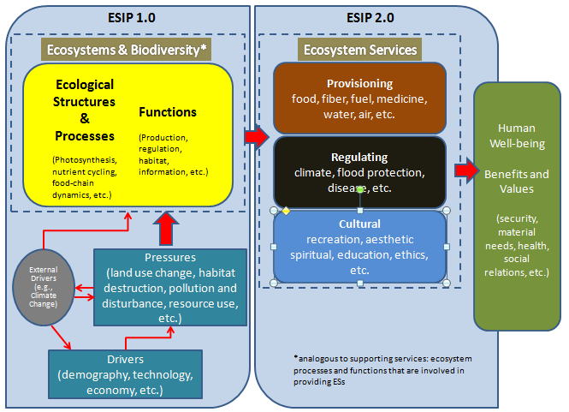
ESIP 2.0 Progress: Working Model

Slide 4
Web Traffic & Journals
Journals alone in 2014: 2516 2015: 3172
Notes:
ESIP is cross cutting and intersects with GOMC goals. We do this through our monthly journals, two webtools, and subcommittee projects (Fact Sheets).

Slide 5
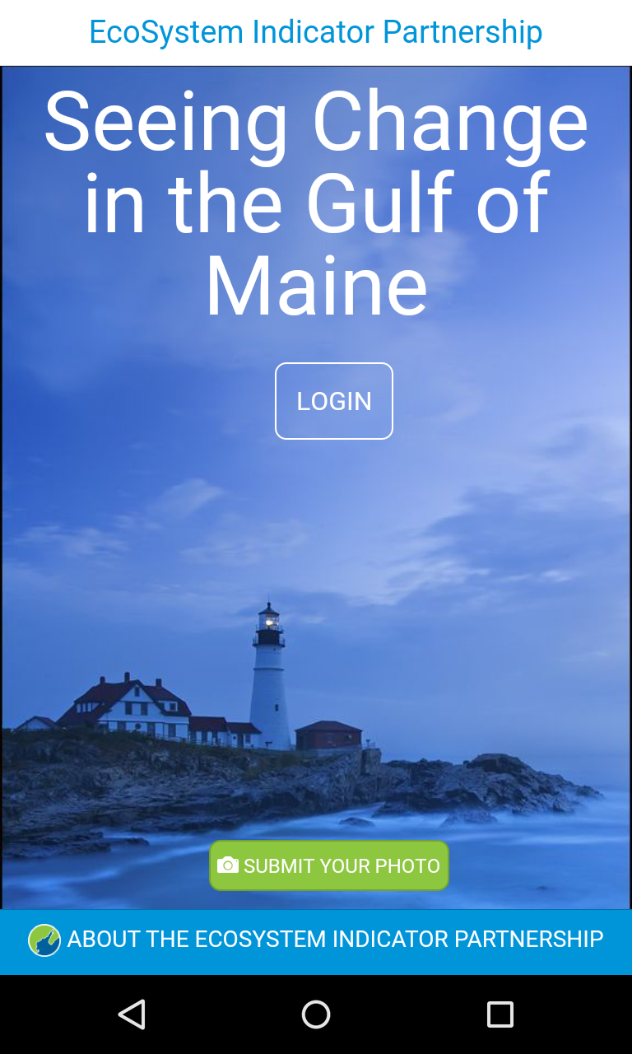
Smartphone app!
*Launching in January 2016!!

Slide 6
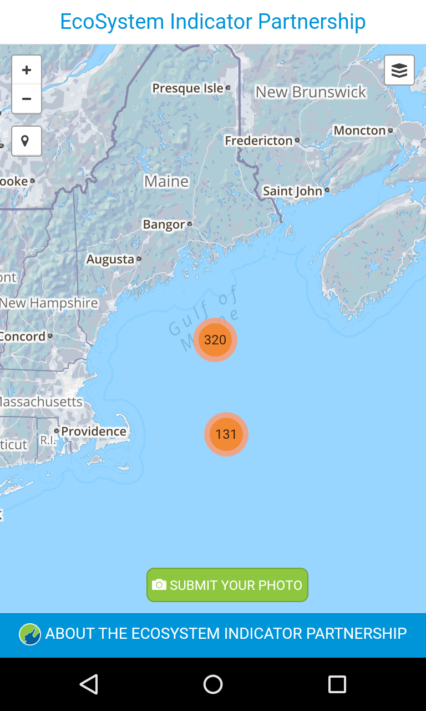
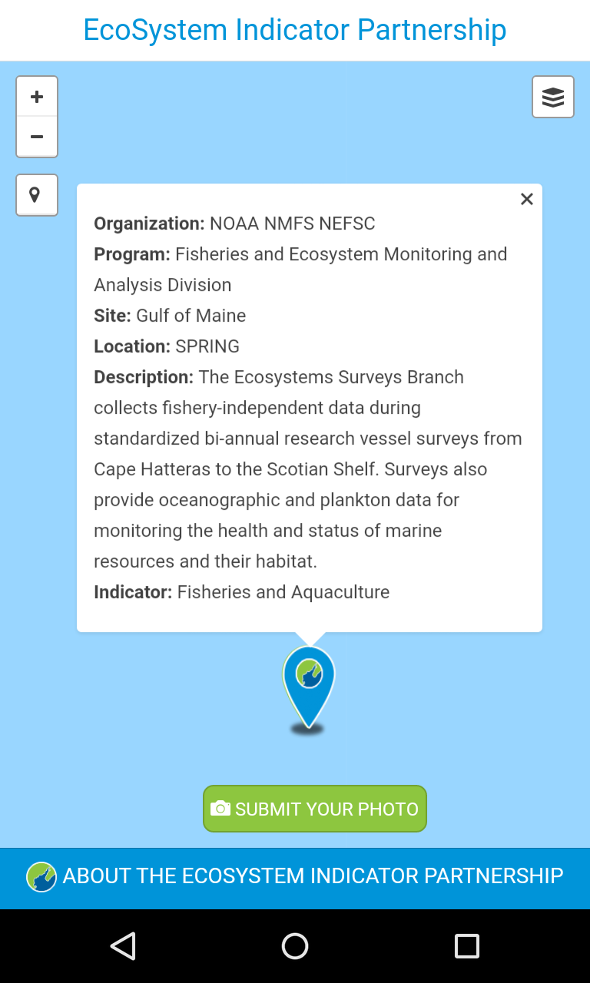

Slide 7
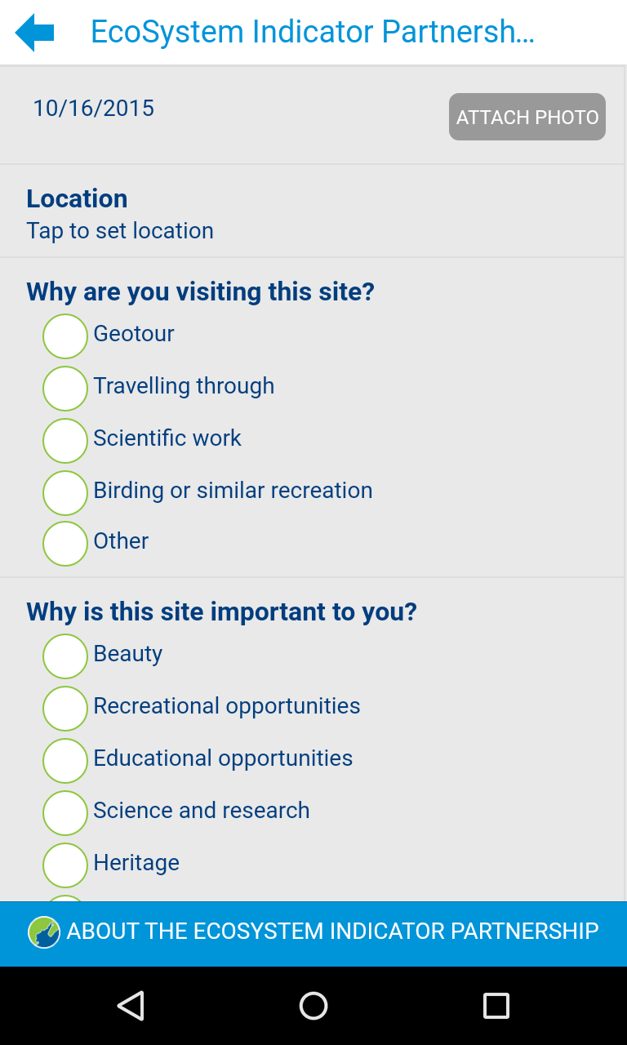
First photo sites located at:
Salem Maritime National Historic Site (MA)
Saugus Ironworks National Historic Site (MA)
Seacoast Science Center (NH)
Harborside Park (NH)
Wells NERR (ME)
Scarborough Marsh (ME)
Wolf’s Neck State Park (ME)
Schoodic Institute (ME)
Musquash (NB)
** Working on permission for a separate NB site and then several more in Phase 2
Brier Island (NS)
River Guardian Site (NS)

