Slide 1
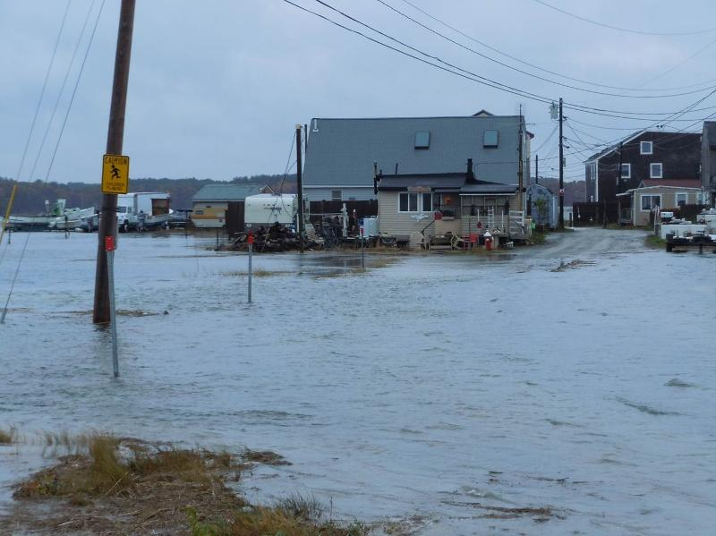
Draft Recommendations from the
NH Coastal Risks and Hazards Commission
Cross Beach Road, Seabrook
Gulf of Maine Council and Working Group
December 7, 2015
Sherry Godlewski
Department of Environmental Services
Coastal Adaptation Workgroup

Slide 2
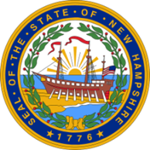




Goals
Science
Assessment
Implementation
Legislation
Best available peer reviewed-science about future coastal hazards
Identify vulnerabilities within our economy, our built environment, our natural resources, and our heritage
Implement strategies that will enable the state & coastal municipalities to effectively protect, sustain & adapt
Recommend timely considerations for legislation
SAIL – In honor of the State Seal. Features the frigate Raleigh, built in Portsmouth in 1776. Also features a granite boulder in the foreground that is “symbolic of the Granite State’s rugged terrain and the character of its citizenry.”

Slide 3
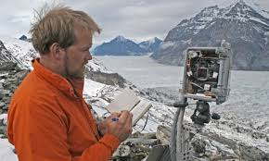
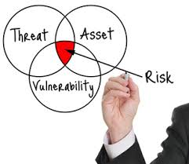
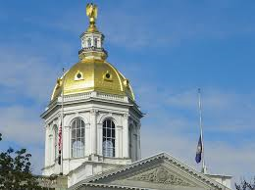
Summary of Goal Contents
Use science
  peer-reviewed research
  find gaps; support research
Assessment and Implementation
  Where are we vulnerable and where do we need to learn more?
  What do we do to reduce our risk?
Legislative action
  Two bills have been introduced

Slide 4




Assessment & Implementation
Topic Areas
Our Economy – systematic productive exchange of goods & services that must be resilient to risks & hazards in order to sustain our high quality of life
Our Built Landscape – network of buildings & infrastructure owned by governments & private entities
Our Natural Resources – natural systems that provide services & support species & biodiversity
Our Heritage – cultural, historic & recreational resources

Slide 5

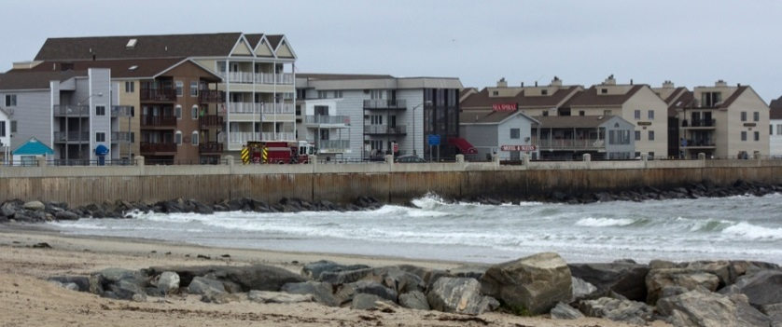
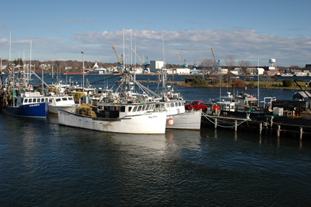
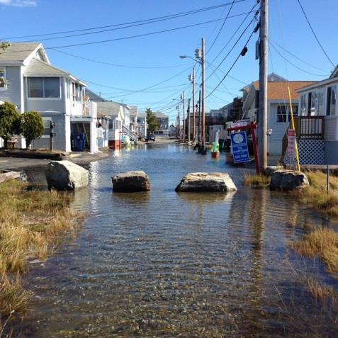
Our Economy
Identify vulnerability of economic assets
  tax base, workforce & jobs, property values, insurance, trade facilities, & public recreational facilities
Use incentives & market-based tools to fund infrastructure improvements, land conservation, & natural resource restoration
Inform property owners & potential property buyers about coastal hazards & vulnerabilities

Slide 6

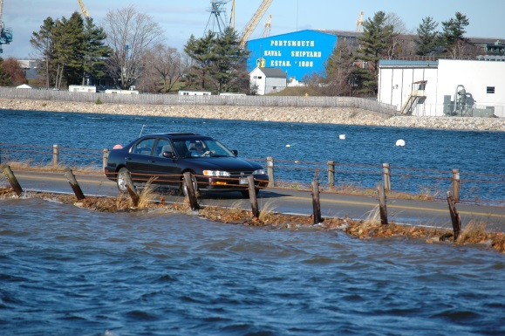
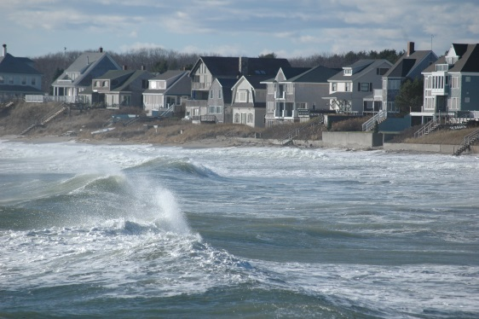
Our Built Landscape
Make infrastructure more resilient:
  Establish a minimum freeboard; be adaptive as things will change (update accordingly)
  New critical facilities be designed for 500 yr flood
  Plan forward for life of facility
  Explore funding sources to acquire at risk/repetitive loss properties
  Include vulnerability & risk tolerance in future road design & maintenance
Use floodplain management to prevent & minimize impacts
  Create flood hazard overlays
  Consider prohibiting development in areas destroyed by storms, repetitive loss structures
  Include vulnerability assessments to potentially amend building codes, erosion hazards & stormwater management
Develop a comprehensive, integrated Coastal Shoreline Management Plan

Slide 7

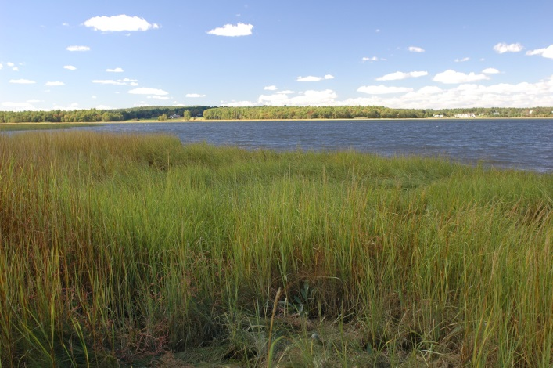
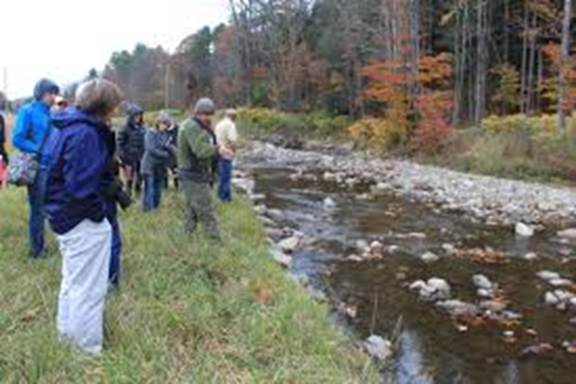
Our Natural Resources
Identify where habitats & biological populations would naturally shift
  Prioritize areas & species for protection or restoration
  Utilize marsh migration modeling to identify & implement priority marsh restoration opportunities
Protect land that provides ecosystem services that protect people and infrastructure
Establish buffer requirements/setbacks
Focus land protection efforts on areas that are vulnerable

Slide 8

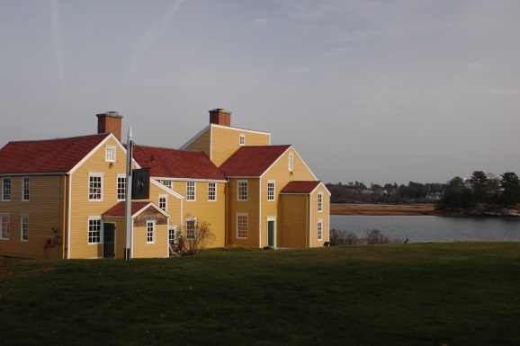
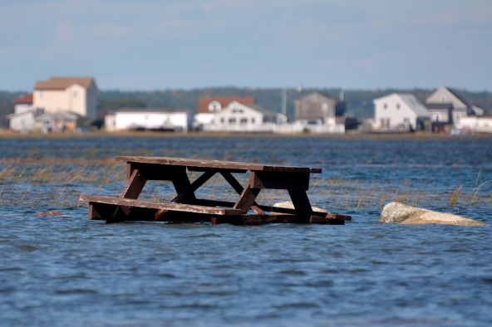
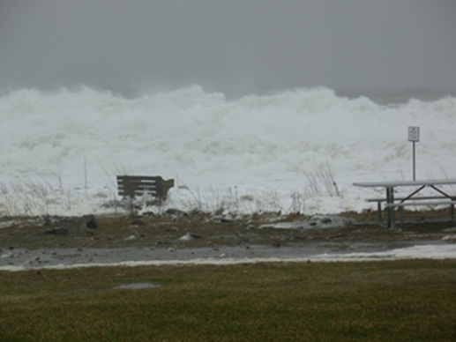
Our Heritage
Identify and survey cultural and historic resources and assess their vulnerability to coastal risks and hazards
Develop long-term plans for protecting & adapting cultural resources
Prepare and adapt recreational resources

Slide 9
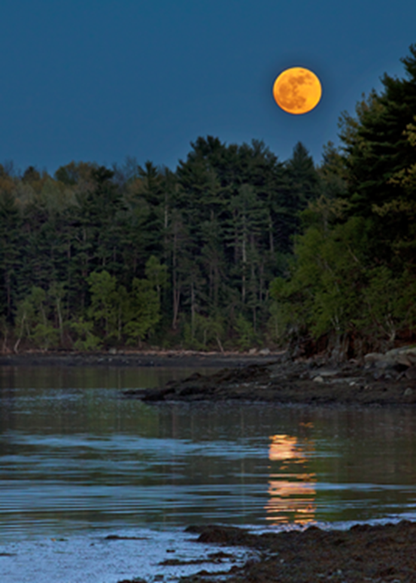
Summary
No requirements on municipalities
Enabling legislation
Incorporate into existing planning
Not every thing has to be done today
Getting started now will save us money
  $1.00 vs. $4.00
Refine as needed – on going
Discussing with municipal decision makers, legislative committees, state agencies and the public to get their feedback

