Slide 1



FROM TIDES TO STORMS: PREPARING FOR NEW HAMPSHIRE’S FUTURE COAST
Seabrook - Hampton Falls – Hampton - North Hampton – Rye - New Castle - Portsmouth
Assessing the Risk and Vulnerability of NH Coastal Communities to
Sea Level Rise and Storm Surge
Gulf of Maine Council and Working Group
December 7, 2015
Julie LaBranche
Senior Planner
This project is funded by New Hampshire Homeland Security and Emergency Management (HSEM) through a Pre-Disaster Mitigation Grant from the Federal Emergency Management Agency (FEMA).

Slide 2
FROM TIDES TO STORMS: PREPARING FOR NEW HAMPSHIRE’S FUTURE COAST
Goal: Assess and plan for projected future impacts to NH’s coastal resources and assets from sea level rise and storm surge
Local
Hazard Mitigation
Plans
State Agency
Plans
Regional
Master Plan
Natural Resource
Conservation
Vulnerability Assessment Results
Critical Facilities and Infrastructure
State and Local Roads
Natural Resources - Environment
Regional Planning Recommendations
Policy and Planning Recommendations
Regulatory Strategies
Non-Regulatory Approaches

Slide 3
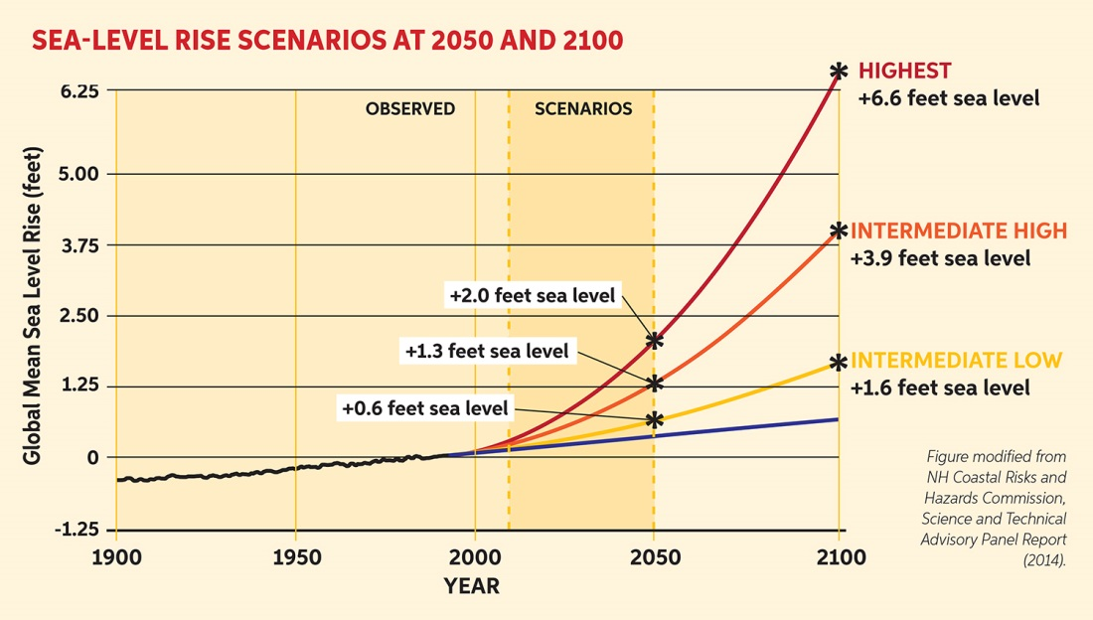
FROM TIDES TO STORMS: PREPARING FOR NEW HAMPSHIRE’S FUTURE COAST
Sources: 1) Wake CP, E Burakowski, E Kelsey, K Hayhoe, A Stoner, C Watson, E Douglas (2011) Climate Change in the Piscataqua/Great Bay Region: Past, Present, and Future. 2) Wake CP, Kirshen P, Huber M, Knuuti K, and Stampone M (2014) Sea-level Rise, Storm Surges, and Extreme Precipitation in Coastal New Hampshire: Analysis of Past and Projected Future Trends.
Sea Level Rise Scenarios for Mapping and Analysis
+6.3 feet sea level
+4.0 feet sea level
+1.7 feet sea level

Slide 4
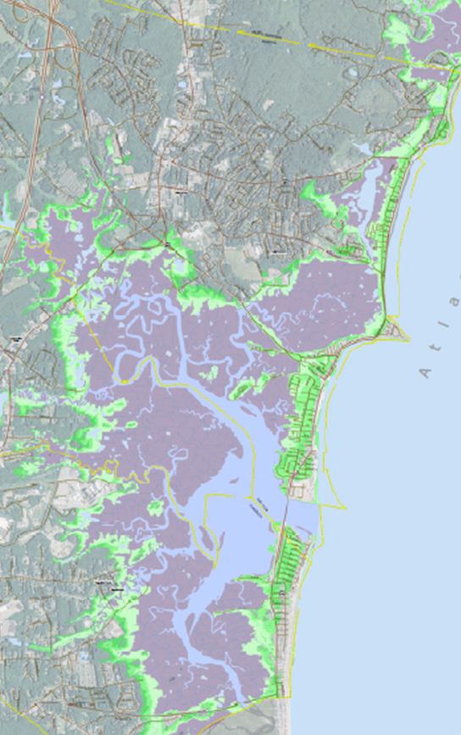
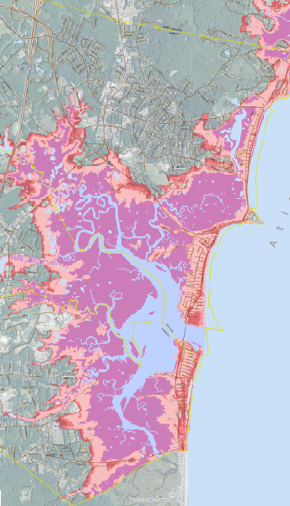
FROM TIDES TO STORMS: PREPARING FOR NEW HAMPSHIRE’S FUTURE COAST
+6.3 feet sea-level rise
+6.3 feet sea-level rise
+ storm surge

Slide 5
FROM TIDES TO STORMS: PREPARING FOR NEW HAMPSHIRE’S FUTURE COAST
Overview of Assessment Findings
3 sea-level rise scenarios lie within/equal to extent of the current 100-year floodplain
Designing for resiliency in the current 100-year floodplain will protect against long term sea-level rise
Overall impacts increase dramatically at 4.0 feet of flooding
Roadways and culverts are most heavily impacted parts of the municipal “built landscape”
Land adjacent to freshwater and tidal wetlands will be critical flood storage and wetland/salt marsh migration areas
Adaptation strategies customized to address local vulnerability

Slide 6
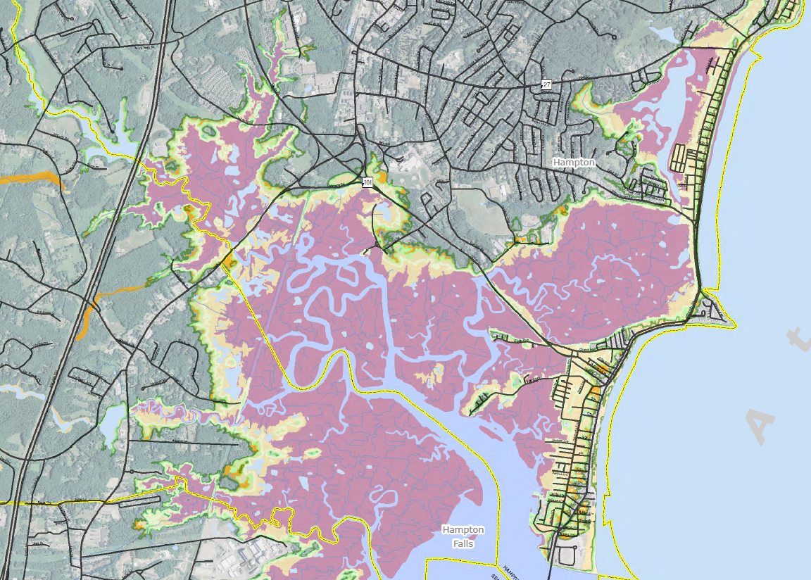
FROM TIDES TO STORMS: PREPARING FOR NEW HAMPSHIRE’S FUTURE COAST
100-year floodplain and +6.3 feet of sea-level rise
Notes:
The 3 SLR scenarios used in the assessment are contained roughly within the existing 100-year floodplain.
Creating more resilient systems and development within the existing 100+500-year floodplains will lessen the impacts from long term SLR.
Managing for SLR is different than managing for storm surge which is an infrequent event. SLR will create diffuse flooding across the landscape from the twice daily tide where managing storm flooding focuses typically on flood/storm proofing of structures.

Slide 7
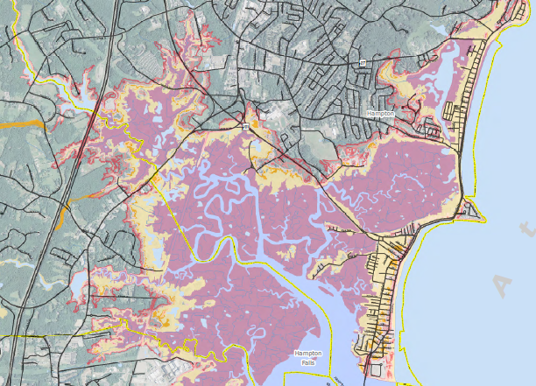
FROM TIDES TO STORMS: PREPARING FOR NEW HAMPSHIRE’S FUTURE COAST
100-year floodplain and +6.3 feet sea-level rise + storm surge
Notes:
However when we look at the effects of SLR on the 100+500-year floodplains – the result is expansion of the floodplain over time.
This has implications about how best to manage infrastructure and the developed landscape within areas outside the current 100-year floodplain that are susceptible to flooding.
For Example: Adopting strategies such as expanded coastal buffers and setbacks, and protecting areas for wetland and marsh migration can help maintain adequate flood storage to protect against sea level rise and storm flooding.

Slide 8
FROM TIDES TO STORMS: PREPARING FOR NEW HAMPSHIRE’S FUTURE COAST

Slide 9
FROM TIDES TO STORMS: PREPARING FOR NEW HAMPSHIRE’S FUTURE COAST

Slide 10
FROM TIDES TO STORMS: PREPARING FOR NEW HAMPSHIRE’S FUTURE COAST

Slide 11
FROM TIDES TO STORMS: PREPARING FOR NEW HAMPSHIRE’S FUTURE COAST

Slide 12
FROM TIDES TO STORMS: PREPARING FOR NEW HAMPSHIRE’S FUTURE COAST
Regional Considerations –
Critical Facilities and Infrastructure
Water/wastewater systems and drainage infrastructure particularly impacted by all flood scenarios
Infrastructure management plans to determine future costs
Plan future needs of regional and municipal drinking water supplies and waste water systems
Adjustments to state highways affect connecting local roads, driveways, access points
Flood impacts to Route 1A make east-west evacuation routes more critical

Slide 13
FROM TIDES TO STORMS: PREPARING FOR NEW HAMPSHIRE’S FUTURE COAST
Project Materials
Regional Assessment and Maps
Municipal Assessment and Maps
http://www.rpc-nh.org/Tides_to_Storms.htm
How can the project results be useful? (RPC, CRHC, others)
Inform recommendations in the CRHC Final Report
Assist with technical assistance and outreach to municipalities
Guide policy changes by state agencies

