Slide 1
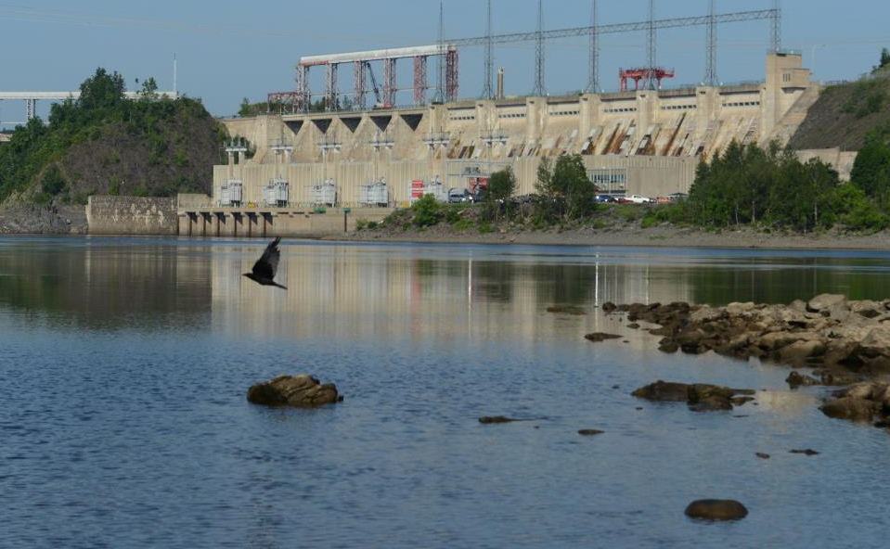
Mactaquac Project
Anthony Bielecki
June 8, 2016

Slide 2
Mactaquac Generating Station
operational since 1968
provides 20 per cent of peak energy needs in New Brunswick
annually produces electric energy for approximately 12 per cent of New Brunswick’s homes & businesses (2020 renewable requirement of 40%)
provides essential services to support a safe and reliable power grid (regulation, load following, reserves, black start, etc.)

Slide 3
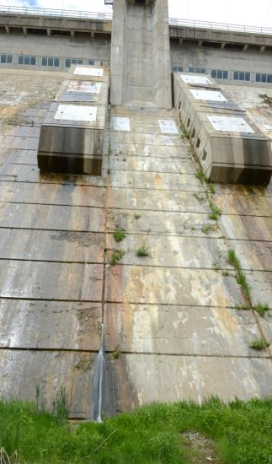
The AAR problem at Mactaquac
The AAR problem at Mactaquac
Alkali-Aggregate Reaction (AAR) causes expansion of the concrete
Hundreds of stations affected worldwide
Various techniques are used to address effects of expanding concrete
Mactaquac currently is expected to reach the end of its life by 2030

Slide 4
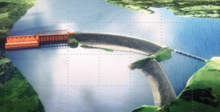
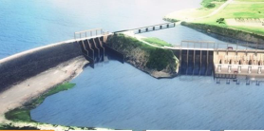
The future of Mactaquac could be …
Repower, with a new powerhouse, switchyard, fish passage facility and spillways.
Retain the Headpond, with new spillways and a new fish passage facility.
Restore the River, by removing all existing structures, including the earthen dam.
Life Achievement, extending operation of the existing concrete facilities beyond 2030.

Slide 5
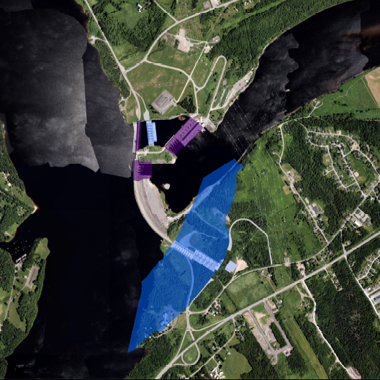
Repower footprint

Slide 6
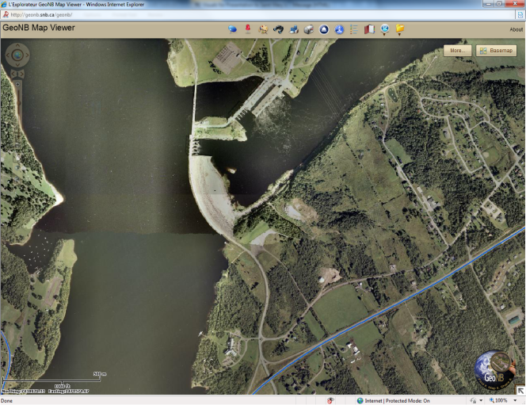
River restoration

Slide 7
River restoration
Residential Water Wells (~700 locations)
Regulated Water Intake Extensions (~10 locations)
Dust Control Measures (~11 locations)
Wastewater Outfall Extensions (~14 locations)
Culvert Replacement (~25 locations)
Surface Water Management (~133 locations)
Shoreline Protection (~11 locations)
Shaping and Grading Slopes (~22 locations)
Potential Land Exposed (~ 54 km2 (13,350 acres))

Slide 8
What is Life Achievement?
Continued operations beyond 2030, perhaps to original lifespan.
Detailed modelling suggests concrete’s structural integrity better than previously understood.
Consistent with ongoing tests of concrete samples from station.
Requires ongoing work and investment.
Require mechanical and electrical equipment in the station be replaced due to age and wear.

Slide 9
What next?
No decision has been made.
Refine analysis and business case of all options.
Business case is a work in progress as we gather estimates related to construction, environmental, social factors.
Each option is expensive. There is no low-cost option for Mactaquac.

Slide 10
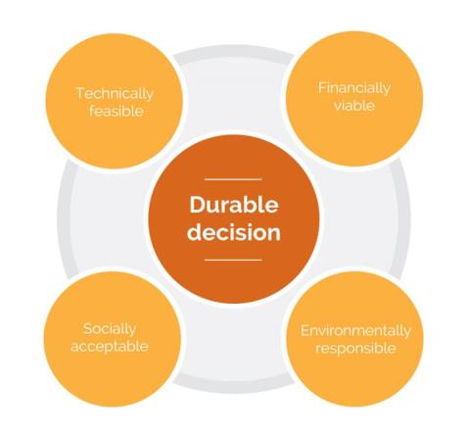
Durable decision
What we are doing to gather information for a durable decision:
Comparative Environmental Review
Social Impact Comparative Review
Engineering
Mactaquac Aquatic Ecosystem Study
First Nations Engagement
Public Engagement

Slide 11
Comparative Environmental Review
Atmospheric environment
Acoustic environment
Surface water
Groundwater
Aquatic environment
Vegetation and wetlands
Wildlife and wildlife habitat
Economy and employment
Human occupancy and resource use
Infrastructure and services
Transportation
Heritage resources
Current use of land and resources for traditional purposes by Aboriginal persons.

Slide 12
Social Impact Comparative Review
Social issues associated primarily with construction activities include:
nuisance effects (noise, vibration, dust, odour)
transportation effects (access, traffic, safety, road wear)
community services, infrastructure and housing
land acquisition
employment, expenditures and businesses

Slide 13
Social Impact Comparative Review
Social issues identified that relate primarily to the headpond drawdown include:
community identity
changes to recreational uses
view shed changes
property value impacts
reduced river access
exposure of lands
intakes and outfalls impacts
changes to water supplies/private wells
ice damage to downstream infrastructure
potential downstream flooding from ice jams

Slide 14
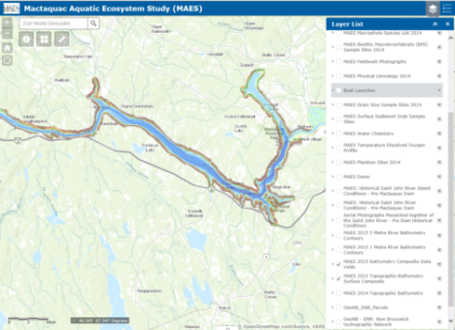
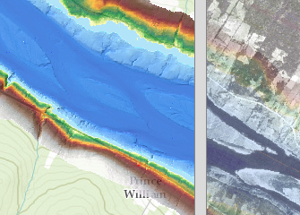
Mactaquac Aquatic Ecosystem Studies
Three themes in this work by the Canadian Rivers Institute
Whole River Ecosystem Studies
Fish Passage
Environmental Flows
See http://canadarivers-gis.maps.arcgis.com/home/index.html

Slide 15
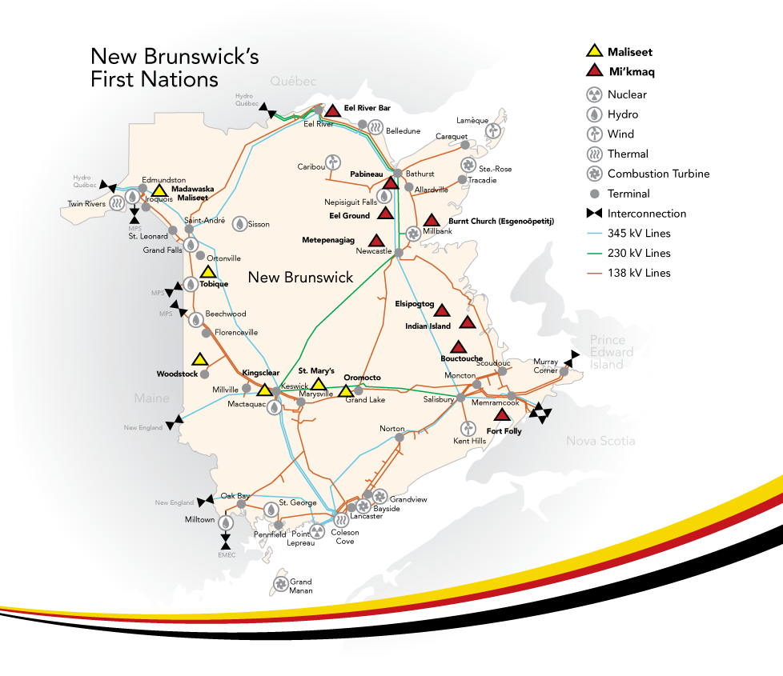
Overview of New Brunswick First Nations
Notes:
There are 15 First Nations communities in New Brunswick:
6 Maliseet (Wolastoqiyik) communities which are situated along the Saint John River and 9 Mi’kmaq communities which exist along the eastern and northern coasts.
According to Indian Register (August 31, 2012):
14,525 First Nations people live in New Brunswick;
9,052 (62%) live on-reserve;
5,473 (38%) off-reserve

Slide 16
First Nations engagement activities
Corporate Aboriginal Affairs department
First Nations engagement strategy with Dillon
First Nations expertise on environmental advisory committee
First Nations Liaison/Field Monitor
First Nations representation on Community Liaison Committee
NB Power funded activities
Consultation protocol
Traditional Knowledge/Traditional Land Use study
Technical analysis of comparative environmental review

Slide 17
Role of Public Engagement
Topics the public can influence
Topics the public cannot influence
Common values identified during engagement process will be reflected in option selection
How we engage with New Brunswickers (process and techniques)
New information uncovered during engagement process will be considered
Continued provision of safe, reliable electricity at low and stable rates
Compliant with environmental regulations
A decision must be made by 2016
Respectful of First Nation’s rights and interests

Slide 18
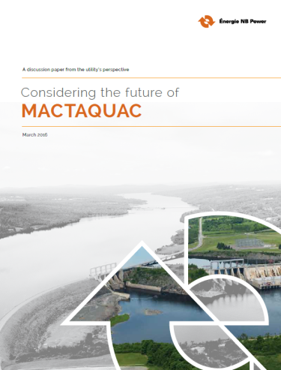
Discussion paper
Purpose: to help New Brunswickers understand the kinds of choices ahead and create a shared understanding of the potential risks and benefits of each
Key considerations
Energy Policy
Financial Considerations
Replacement Services
External Factors
Risk
NB Power must seek a best-cost solution that meets safety, reliability, environmental and financial goals.

Slide 19
Public engagement

Slide 20
Public engagement numbers
The following statistics provide an indication of the volume of engagement activity
NB Power open houses and stakeholder/public sessions: 12
Number of people who attended: 1250 approx
Mactaquac.ca updates (news releases, blog posts, reports): 20
Phone calls, emails, presentations and meetings: 282
‘Mactaquaction’ survey responses: 7,821
Facebook visits to Mactaquaction.ca: 27,223
Vimeo views of Mactaquaction videos: 15,180
After the May 31 closure of the public feedback period, a “what was said” document will be compiled and will provide a summary of the feedback received.

Slide 21
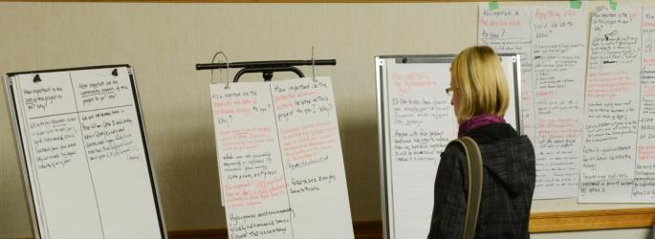
What New Brunswickers have been saying
Connection to landscape as it is now ‘we adapted, don’t make us change again’
Concern about property values, water views, recreational use of headpond, what lies beneath the headpond shorelines
Recognition of hydro as green energy, valued as a domestic supply
Desire for improved fish passage, species protection
Some support for dam removal ‘the river was beautiful before, and it can be again’
Questions about cost/benefit of rebuild ‘Can a new station pay for itself?’
We will want you to explain the rationale for your decision

Slide 22
Project timeline
Decision gate
2016
Decision gate
2019
End of service life 2030
Study Options:
Repower
Retain the headpond
River restoration
Due Diligence Studies
Acquire Approvals for Preferred Option
Detailed Design & Site Work for Preferred Option

Slide 23
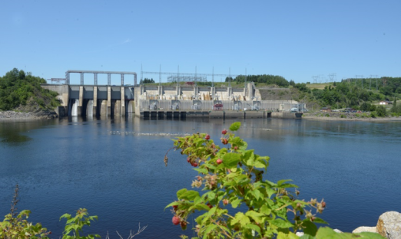
Questions?
If you or your group would like more information about this project, or would like to share your point of view, please contact us.
By email: mactaquac@nbpower.com
By phone: 1-866-754-7727
Online: www.mactaquac.ca

