Slide 1
Case Study: Managing the coastline for frequent
Managing extreme precipitation events -
Actions from New Brunswick
Presentation to the Gulf of Maine Council on the Marine Environment
Robert Capozi
New Brunswick Climate Change Secretariat
June 2017

Slide 2
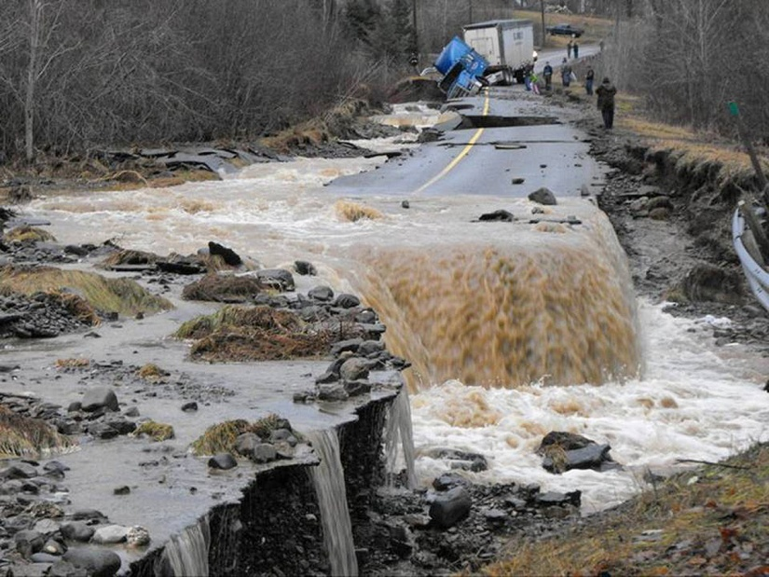
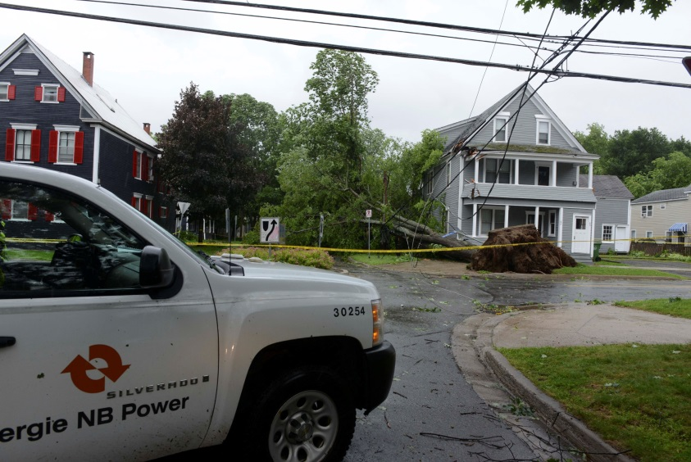
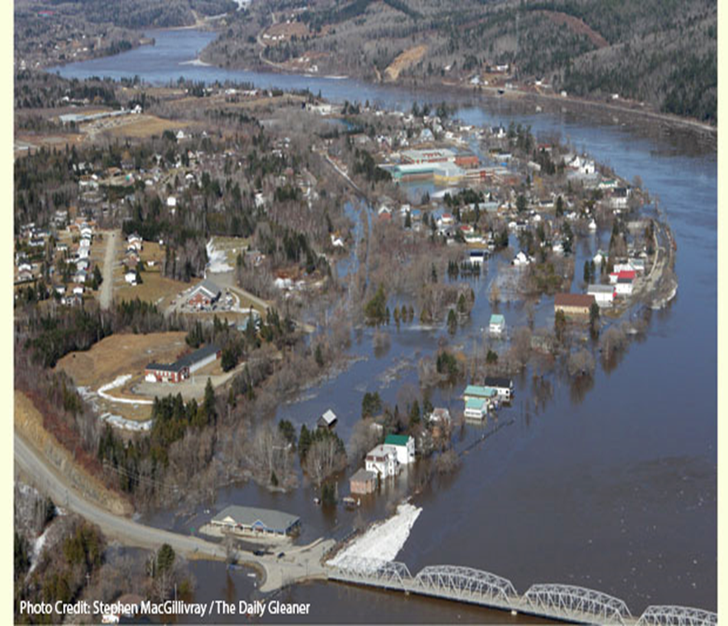
The NB Context
Recurring impacts of climate change – how do we respond?
Notes:
Increasing occurrence of extreme precipitation events ( 50 mm rain in </= 24 hr. period
Increased hurricane frequency and intensity

Slide 3

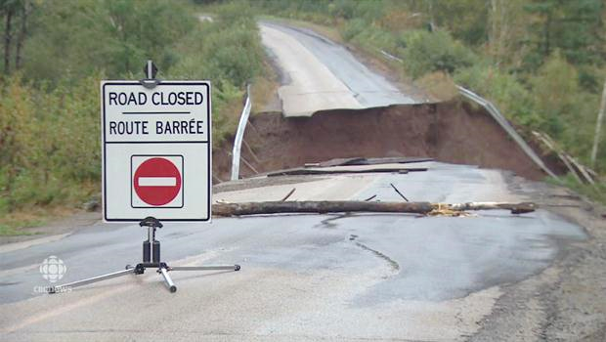
Adaptation
Building Resiliency in Communities, Infrastructure, and Natural Resources through –
Making adjustments in our decisions, activities and thinking re: planning, financing, design, and operations - in response to observed or projected climate change.
Using Risk / Vulnerability assessments to identify risks, develop adaptation strategies, and increase resilience.
Being proactive to avoid costly repairs and improve safety.

Slide 4
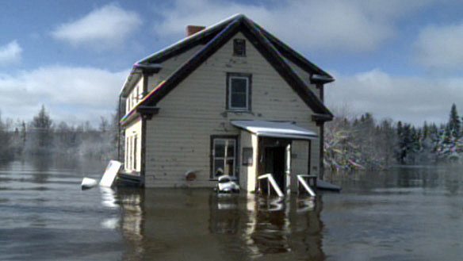
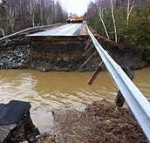
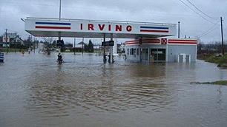
Precipitation – Potential Impacts
Extreme rainfall events can result in increased frequency and severity of flooding:
Increased flooding near watercourses and low-lying areas.
Increased flash-flooding causing erosion.
Increased damage to infrastructure and homes.
Increased risk of contamination to water sources.
4
Notes:
Extreme rainfall is defined by 50 millimetres or more of rain over a 24-hour period.
4

Slide 5
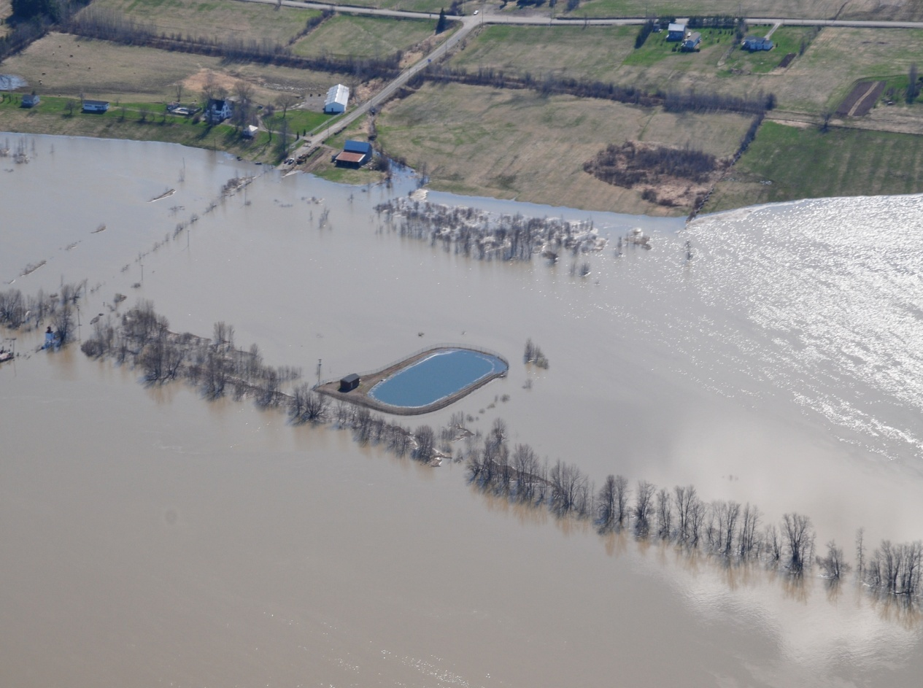
Location, Location, Location!
Notes:
From “CC Presentation for DELG – November 6, 2013”

Slide 6
Action Items from the NB Climate Change Action Plan
The Government of New Brunswick will Acquire up-to-date predictive CC information to support decision-making &planning. Ensure that the impacts of CC and extreme weather are considered in all infrastructure decisions and the lifecycle assessment of all infrastructure projects. Phase-in mandatory preparation and implementation of CC adaptation plans for local and municipal governments that apply for infrastructure funding. Acquire, and make available LiDAR data for mapping and land elevations to be used across all sectors, especially for flood risk mapping and coastal erosion. Collaborate with cities to ensure that CC vulnerability assessments and adaptation plans are completed by 2020. Promote and use natural infrastructure (forests, wetlands, floodplains) to buffer against CC impacts.

Slide 7
Climate Change Adaptation Tools / Resources Available
  Adaptation Planning Guide for Communities.
Community vulnerability assessments / adaptation plans.
Flood hazard mapping and Erosion Rates mapping – GEO NB
  Funding Support ($): NB ETF, NR CAN, ECC CAN
  Climate Change adjusted IDF curves.
  Province-wide Lidar to enhance storm water infrastructure design and placement
  Lidar enhanced Wet-Areas Mapping
  Naturalized storm water basins to capture runoff
  Incorporating ecosystem assets into land-use planning
  Promoting Asset Management to improve infrastructure resiliency
Notes:
New Brunswick has made significant progress increasing the climate resiliency of communities.
There is now widespread recognition of the issues and a willingness to act. Many communities are now aware and ready to start planning –this is a major shift in priorities and culture.
Decision Tree – online tool to help narrow the adaptation strategies that are appropriate to address an issue.
Guidance Documents – information on land use planning and engineering adaptation strategies.

Slide 8



Climate Change Adaptation Plan
Coastal erosion and flooding
City of Bathurst
Notes:
Who and what
Aster Group as lead to facilitate the development of a plan to address coastal flooding first
On-going process of increasing the community’s capacity to address challenges

Slide 9
Thank you / Merci

